Slide 1
SELECT A NUMBER
1
2
1
Sport/Hobbies 1
3
4
2
Sport/Hobbies 2
5
6
3
Sport/Hobbies 3
7
8
4
Sport/Hobbies 4
list
5
Sport/Hobbies 5
6
Sport/Hobbies 6
7
Sport/Hobbies 7
8
Sport/Hobbies 8

Slide 2
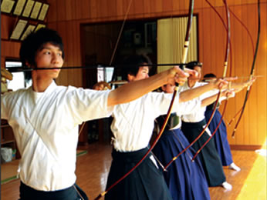
1
2
3
4
5
7
8
9
10
6
1
2
12
13
14
15
11
3
4
16
17
18
19
5
6
20
7
8
21
22
23
25
list
24
view
29
26
27
28
30
31
34
35
32
33
36
37
38
39
40
Kyudo

Slide 3
1
2
3
4
5
7
8
9
10
6
1
2
12
13
14
15
11
3
4
16
17
18
19
5
6
20
7
8
21
22
23
25
list
24
view
29
26
27
28
30
31
34
35
32
33
36
37
38
39
40
Ongaku

Slide 4
1
2
3
4
5
7
8
9
10
6
1
2
12
13
14
15
11
3
4
16
17
18
19
5
6
20
7
8
21
22
23
25
list
24
view
29
26
27
28
30
31
34
35
32
33
36
37
38
39
40
harishigoto

Slide 5
1
2
3
4
5
7
8
9
10
6
1
2
12
13
14
15
11
3
4
16
17
18
19
5
6
20
7
8
21
22
23
25
list
24
view
29
26
27
28
30
31
34
35
32
33
36
37
38
39
40
suiei

Slide 6
1
2
3
4
5
7
8
9
10
6
1
2
12
13
14
15
11
3
4
16
17
18
19
5
6
20
7
8
21
22
23
25
list
24
view
29
26
27
28
30
31
34
35
32
33
36
37
38
39
40
eiga

Slide 7
1
2
3
4
5
7
8
9
10
6
1
2
12
13
14
15
11
3
4
16
17
18
19
5
6
20
7
8
21
22
23
25
list
24
view
29
26
27
28
30
31
34
35
32
33
36
37
38
39
40
jyooba

Slide 8
1
2
3
4
5
7
8
9
10
6
1
2
12
13
14
15
11
3
4
16
17
18
19
5
6
20
7
8
21
22
23
25
list
24
view
29
26
27
28
30
31
34
35
32
33
36
37
38
39
40
basukettobōru

Slide 9
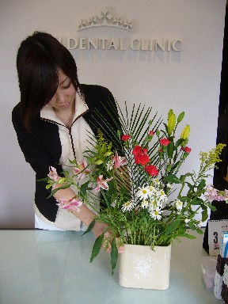
1
2
3
4
5
7
8
9
10
6
1
2
12
13
14
15
11
3
4
16
17
18
19
5
6
20
7
8
21
22
23
25
list
24
view
29
26
27
28
30
31
34
35
32
33
36
37
38
39
40
ikebana

