Slide 1
Prepositions

Slide 2
となり TONARI

Slide 3
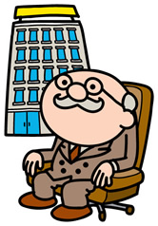
まえ MAE

Slide 4
なか NAKA

Slide 5
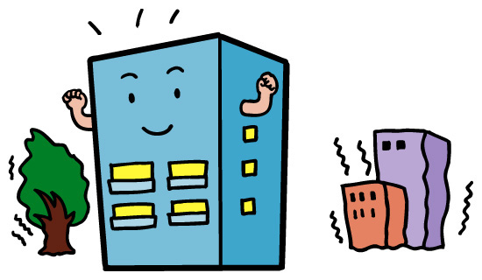
うしろ USHIRO

Slide 6
むかい MUKAI

Slide 7
ちかく CHIKAKU

Slide 8
この KONO その SONO あの ANO どの DONO?

Slide 9
ひだり HIDARI

Slide 10
みぎ MIGI

Slide 11
まっすぐ MASSUGU

Slide 12
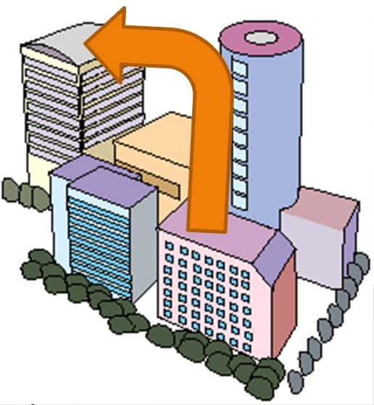
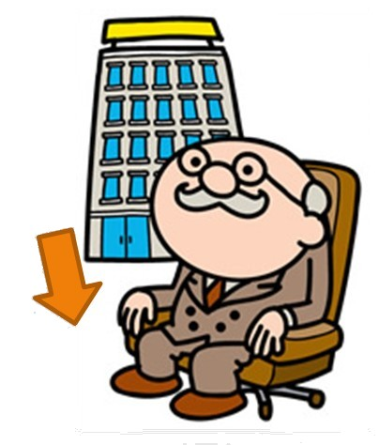
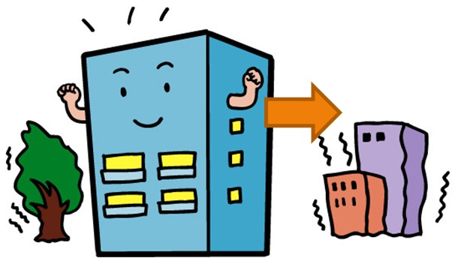

Slide 13
Where is the…?
GRAMMAR STRUCTURE
Sumimasen, PLACE wa doko desu ka?
(PLACE wa) DIRECTION desu.
EXAMPLE:
Sumimasen, eki wa doko desu ka?
Eki wa massugu desu.

Slide 14
It’s next to the…
GRAMMAR STRUCTURE
MAIN PLACE wa doko desu ka?
(MAIN PLACE wa) PLACE no PREPOSITION desu.
EXAMPLE:
Yūbinkyoku wa doko desu ka?
Yūbinkyoku wa eki no mae desu.

