Slide 1
Annual events
In Japan

Slide 2
一月睦月（むつき） January 正月(New Year’s Day)に親類一同があつまる(assemble) 月

Slide 3
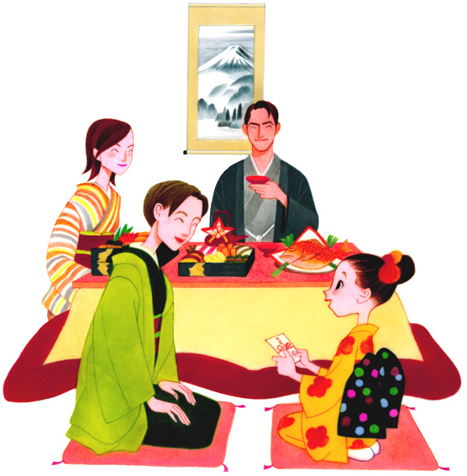

Slide 4
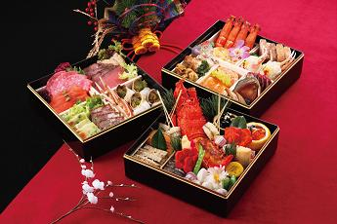

Slide 5
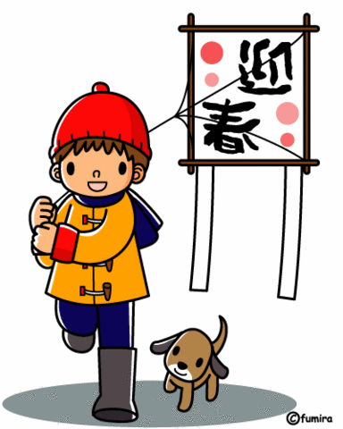

Slide 6
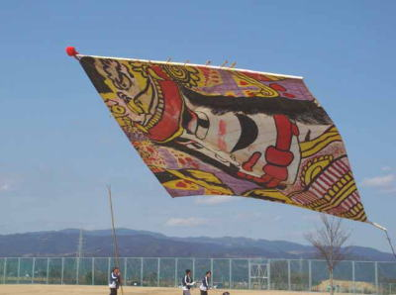

Slide 7
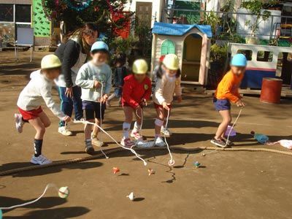

Slide 8
二月如月(きさらぎ) February 寒さ(cold)が残っていて重ね着(put on more clothes)する月

Slide 9
三月弥生 March 草木(plant)が生い茂る(grow)月

Slide 10
三月三日March ３rd Hina-matsuri (the Doll festival) (The annual event for girls)

Slide 11
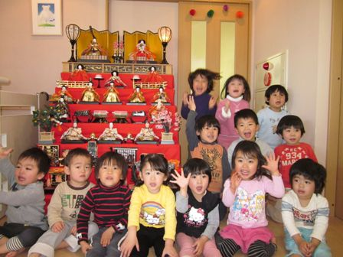

Slide 12
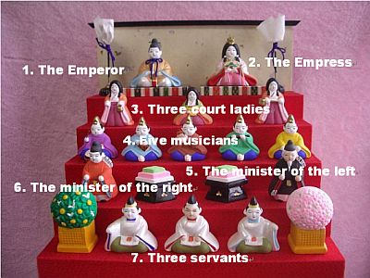

Slide 13
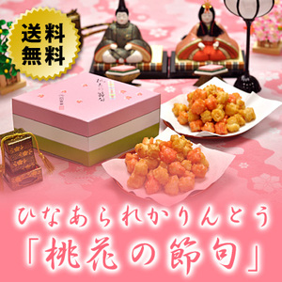

Slide 14
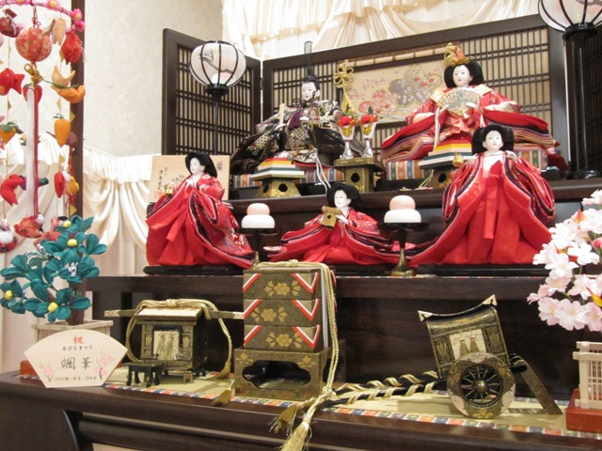

Slide 15
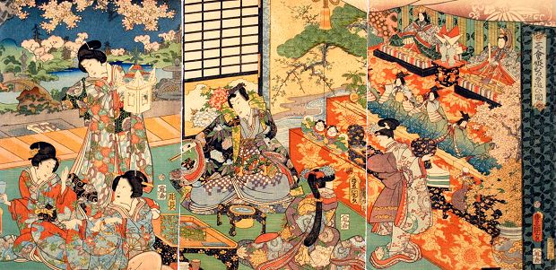

Slide 16
四月卯月 April 卯の花(Deutzia)の月

Slide 17
四月八日April 8th Hana-matsuri (Flower festival)

Slide 18
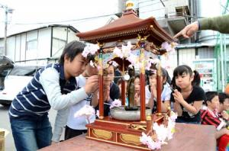

Slide 19
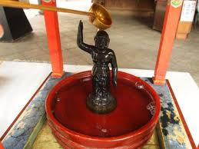

Slide 20
Hanami {桜Sakura (Cherry blossom) viewing}

Slide 21
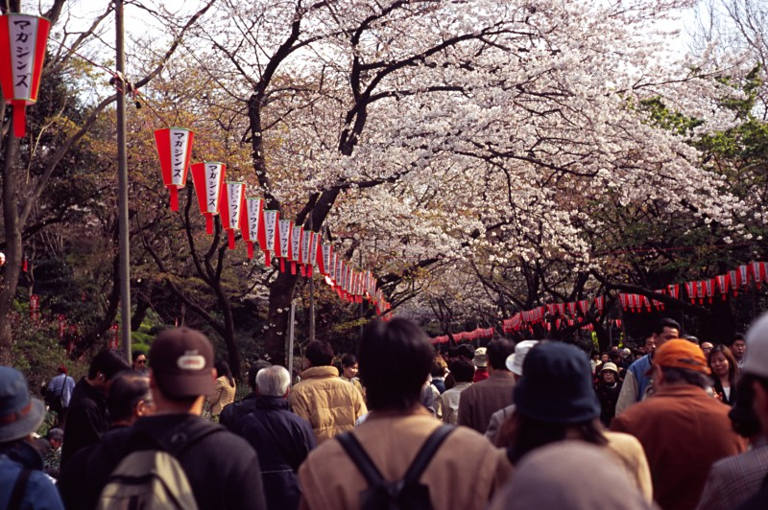

Slide 22
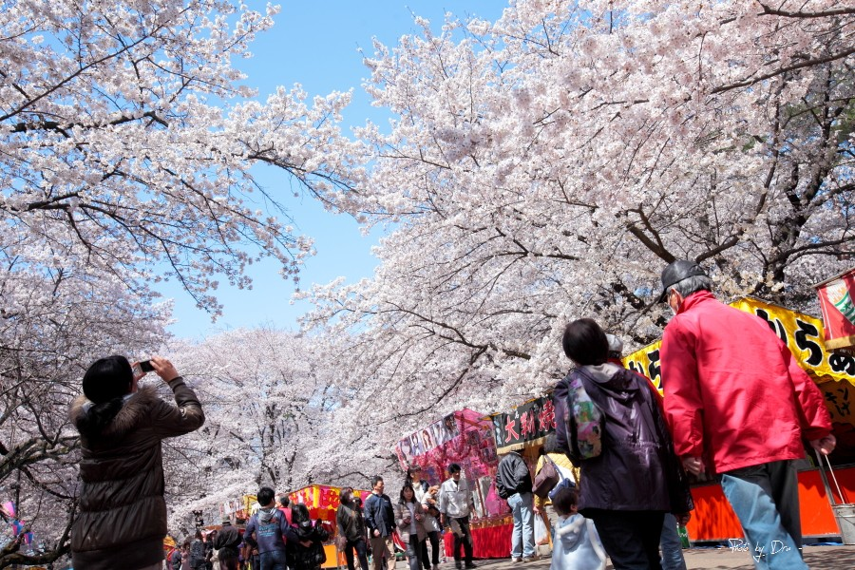

Slide 23
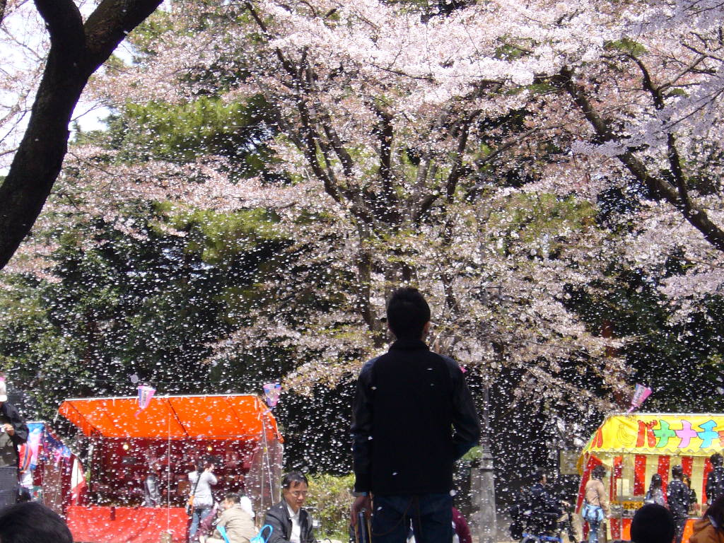
Ryookan (良寛) Zen-Buddhist monk (1758–1831) 散(ち)る桜 残（のこ）る桜も 散る桜
Some cherry blossoms are falling,
and the remaining blossoms are going to fall, too…

Slide 24
五月皐月(さつき) May 早苗（sprouts of rice）を植える(do plant)月

Slide 25
五月五日May 5th Kodomo no hi (the Children’s day) Tango no sekku (The annual event for boys)

Slide 26
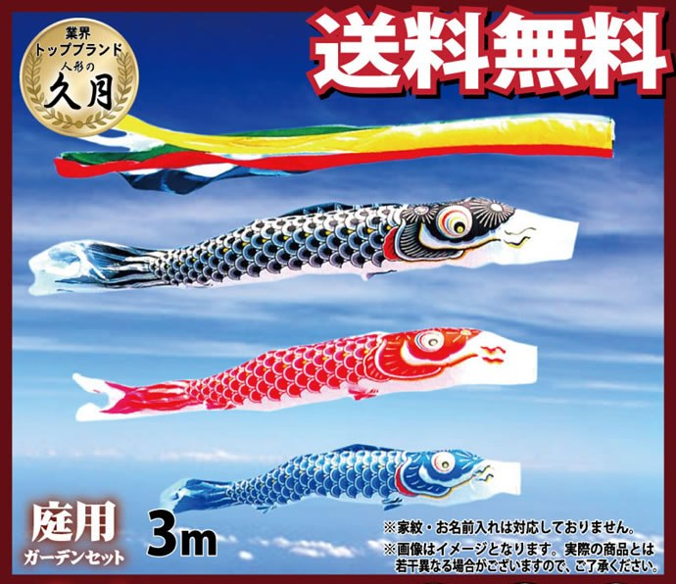

Slide 27
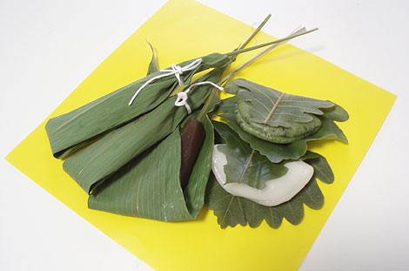

Slide 28
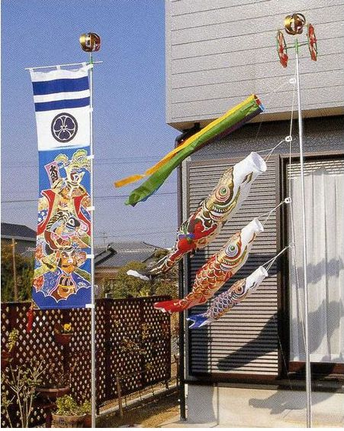

Slide 29
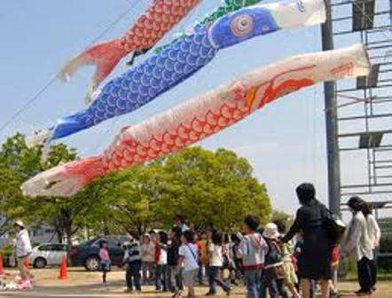

Slide 30
六月水無月(みなつき) June 水(water)の月、田(rice paddy)に水を引く月

Slide 31
七月文月 July (ふづき) 稲の穂(ears of rice)が実る(ripen)月

Slide 32
八月葉月(はづき)August 木々の葉落ち(fallen leaves)月

Slide 33
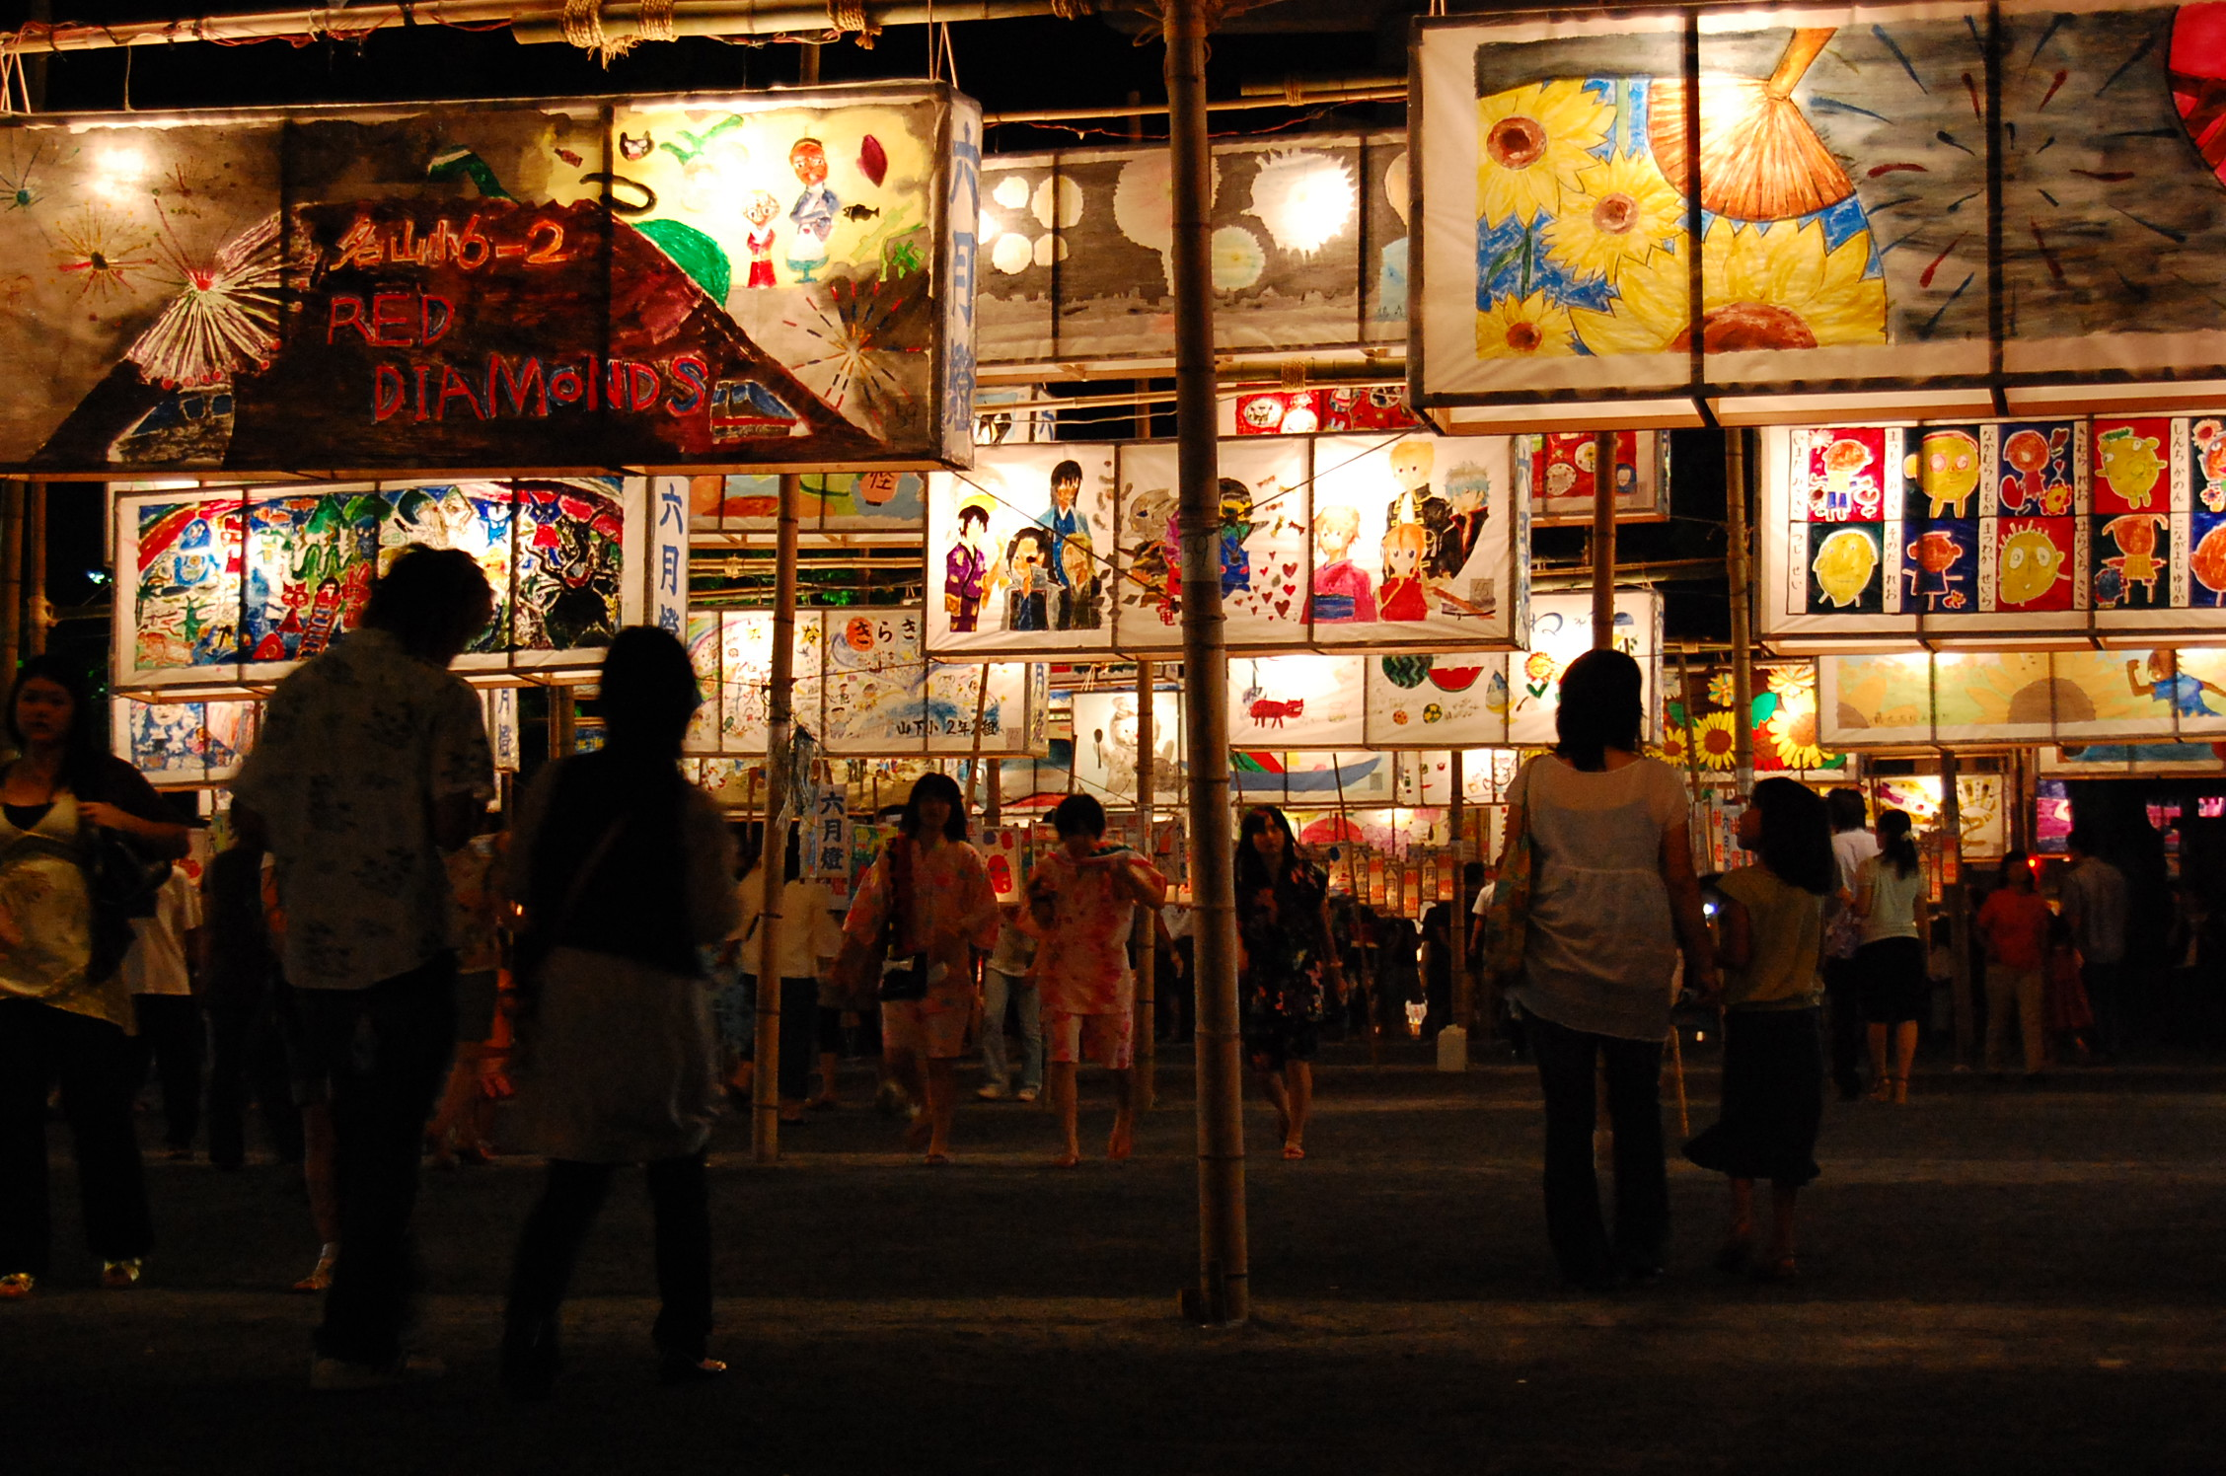

Slide 34
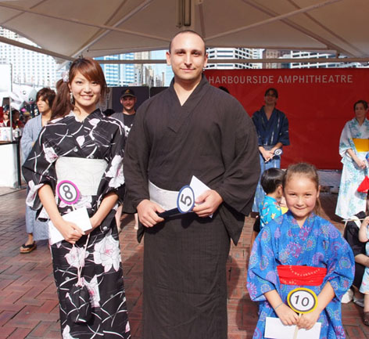

Slide 35
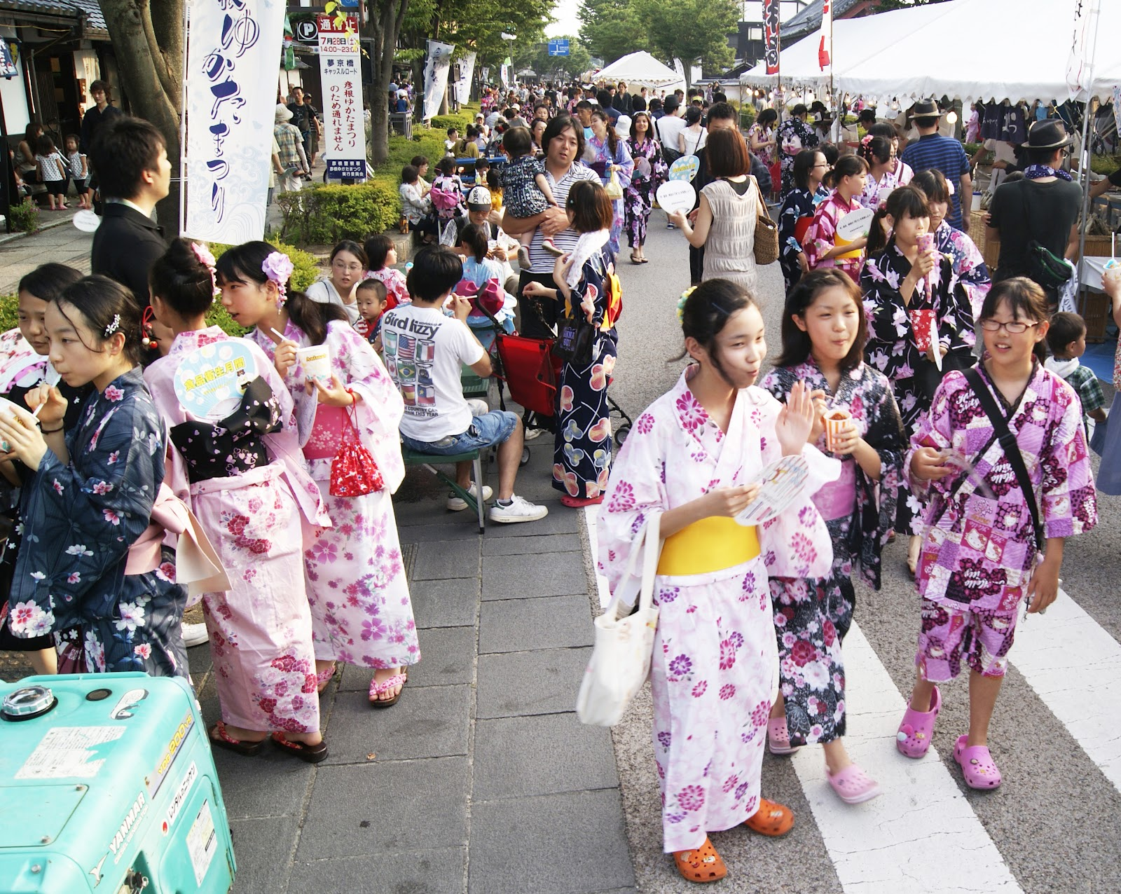

Slide 36
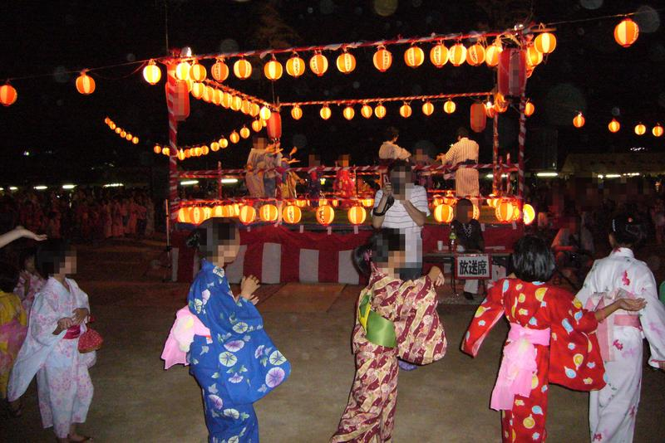

Slide 37
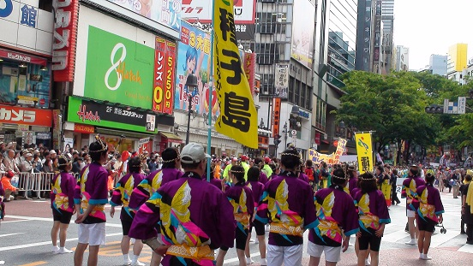

Slide 38
九月長月(ながづき) September 夜(night-time)が長い(long)月

Slide 39
十月神無月(かんなづき) October 神々(gods)が出雲大社に集まり(assemble)、 留守(are away)になる月

Slide 40
十一月霜月(しもつき) November 霜しも(frost)の降る月

Slide 41
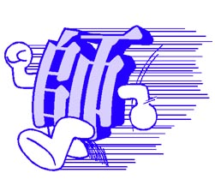
十二月師走(しわす) December 師teacher/mentor/the Reverendが走る(run)月

