Slide 1
Japanese ‘USELESS’ inventions
ちんどうぐ

Slide 2
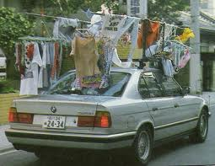
Portable clothesline

Slide 3
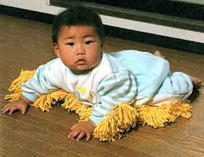
Baby mop

Slide 4
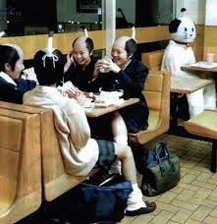
Samurai girls

Slide 5
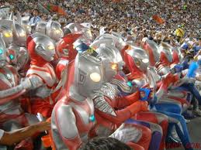
Robots at baseball game

Slide 6
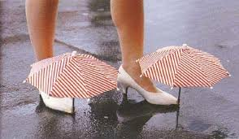
Umbrellas for your shoes

Slide 7
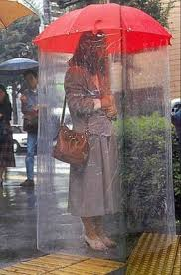
Body umbrella

Slide 8
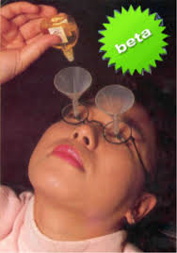
Eye drop glasses

Slide 9
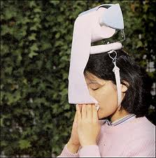
Hat fever hat

Slide 10
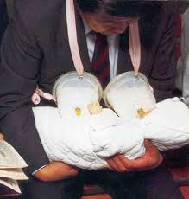
Daddies helper

Slide 11
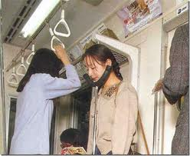
Sleep while standing

Slide 12
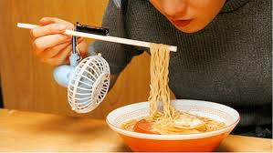
Noodle cooler

Slide 13
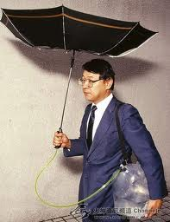
Portable rain saver

Slide 14
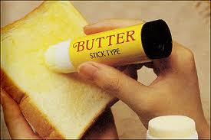
Butter stick

Slide 15
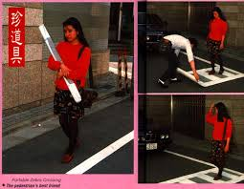
Portable zebra crossing

Slide 16
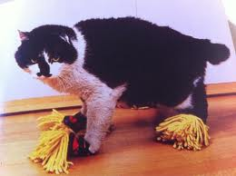
Dusting slippers for your cat

Slide 17
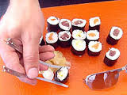
Chopstick glasses

Slide 18
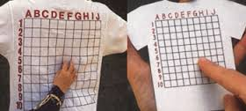
Scratch my back

Slide 19
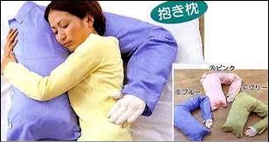
Hugging pillow

Slide 20
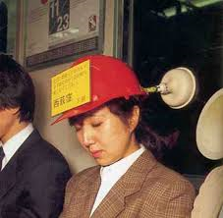
Commuter helmet

Slide 21
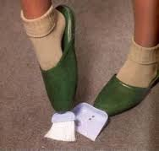
Cleaning slippers

Slide 22
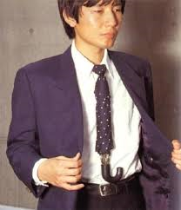
Tie umbrella

Slide 23
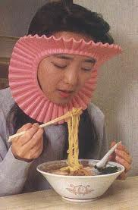
Noodle hair protector

Slide 24
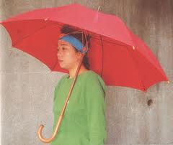
Umbrella headband

Slide 25
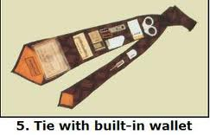
Convenience tie

Slide 26
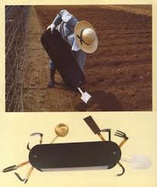
Giant pocket knife

Slide 27
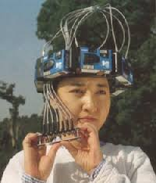
360 degrees portable camera

Slide 28
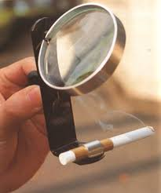
Solar powered cigarette lighter

Slide 29
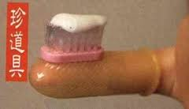
Finger mounted toothbrush

Slide 30
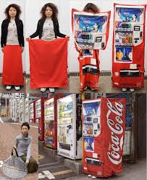
Vending machine disguise

Slide 31
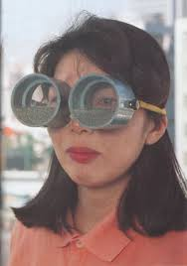
Vertigo relieving glasses

Slide 32
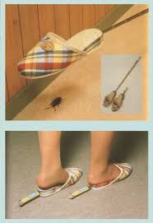
Cockroach swatting slippers

Slide 33
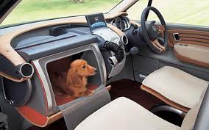
Capsule for your dog

Slide 34
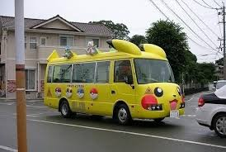
Piccachu bus

Slide 35
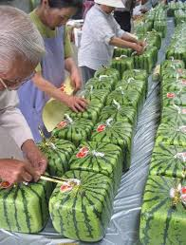
Square watermelon

Slide 36
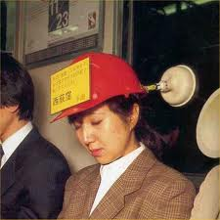
Commuter’s helmet

Slide 37
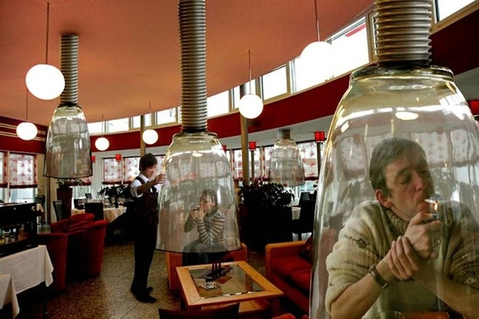
Smoking booth

Slide 38
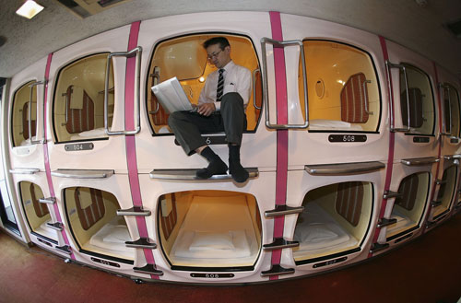
Capsule hotel

Slide 39
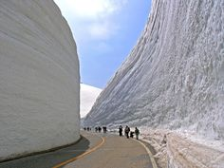
Snow cliffs

Slide 40
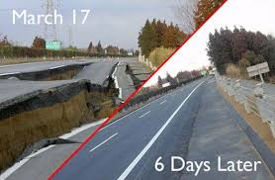
It only takes 6 days to fix road

Slide 41
Special compartment for your dog

Slide 42
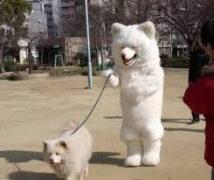
Who’s walking who ?

Slide 43
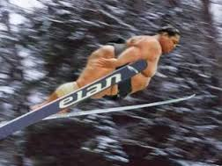
It’s a bird, it’s a plane , It’s a … ?

Slide 44
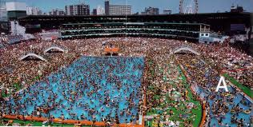
Water park

Slide 45
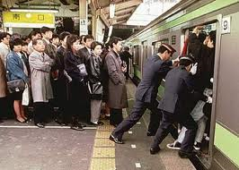
I want to get off !

