Slide 1
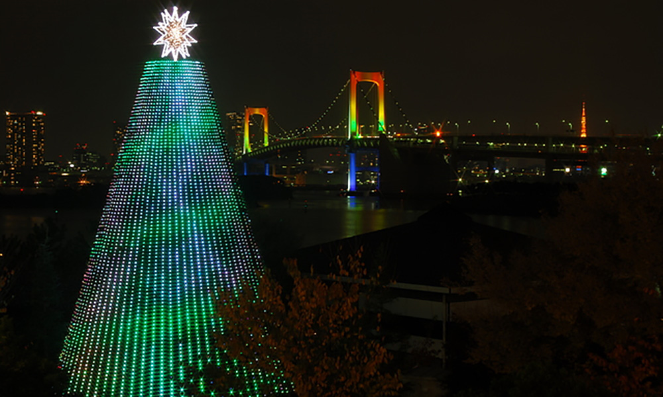
日本の クリスマス
Christmas in Japan

Slide 2
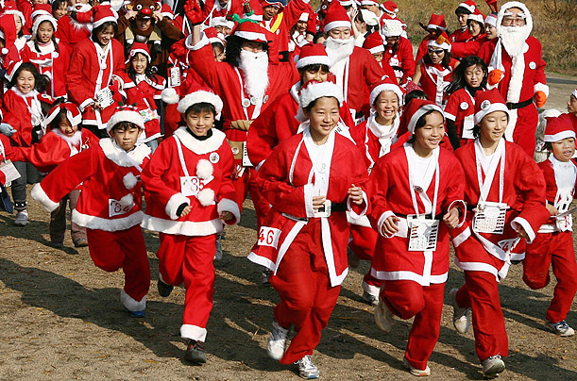
In Japan, クリスマス is known as more of a time to spread happiness rather than a religious celebration.
The main religion in Japan is Shinto or Buddhism, not Christian.

Slide 3
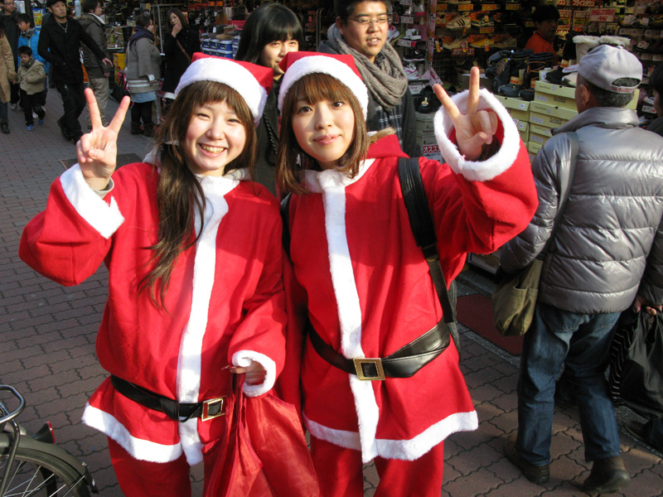
クリスマス おめでとう！

Slide 4
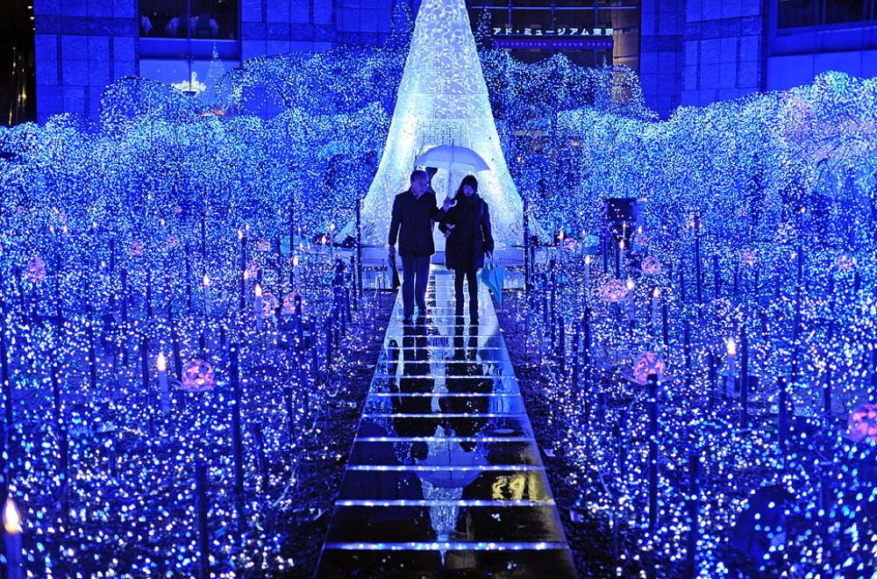
クリスマスイブ is often celebrated more than Christmas Day. クリスマスイブ is thought of as a romantic day, in which couples spend together and exchange presents. In many ways it resembles Valentine's Day celebrations.

Slide 5
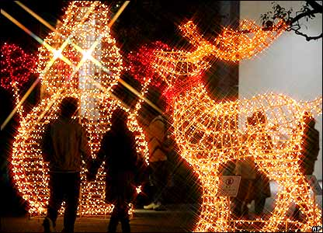
Young couples like to go for walks to look at theクリスマスライト and have a romantic meal in a restaurant. Booking a table on Christmas Eve can be very difficult as it's so popular!

Slide 6
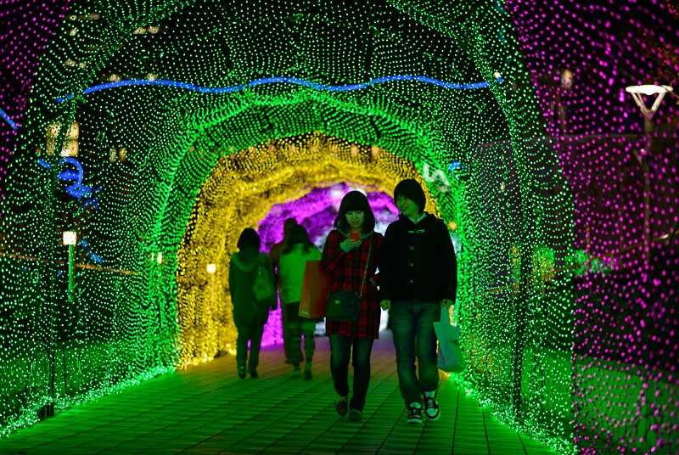

Slide 7
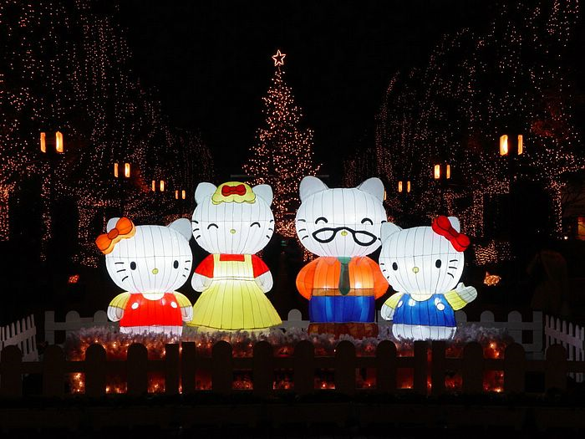

Slide 8
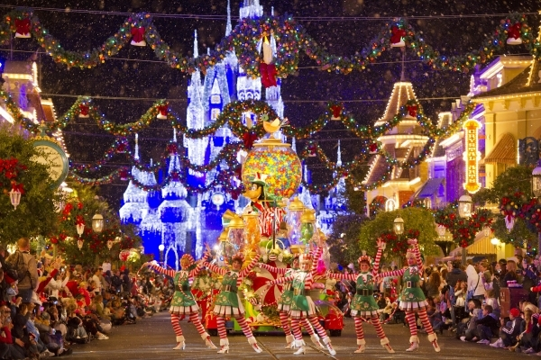
とうきょう ディズニーランドの クリスマス

Slide 9
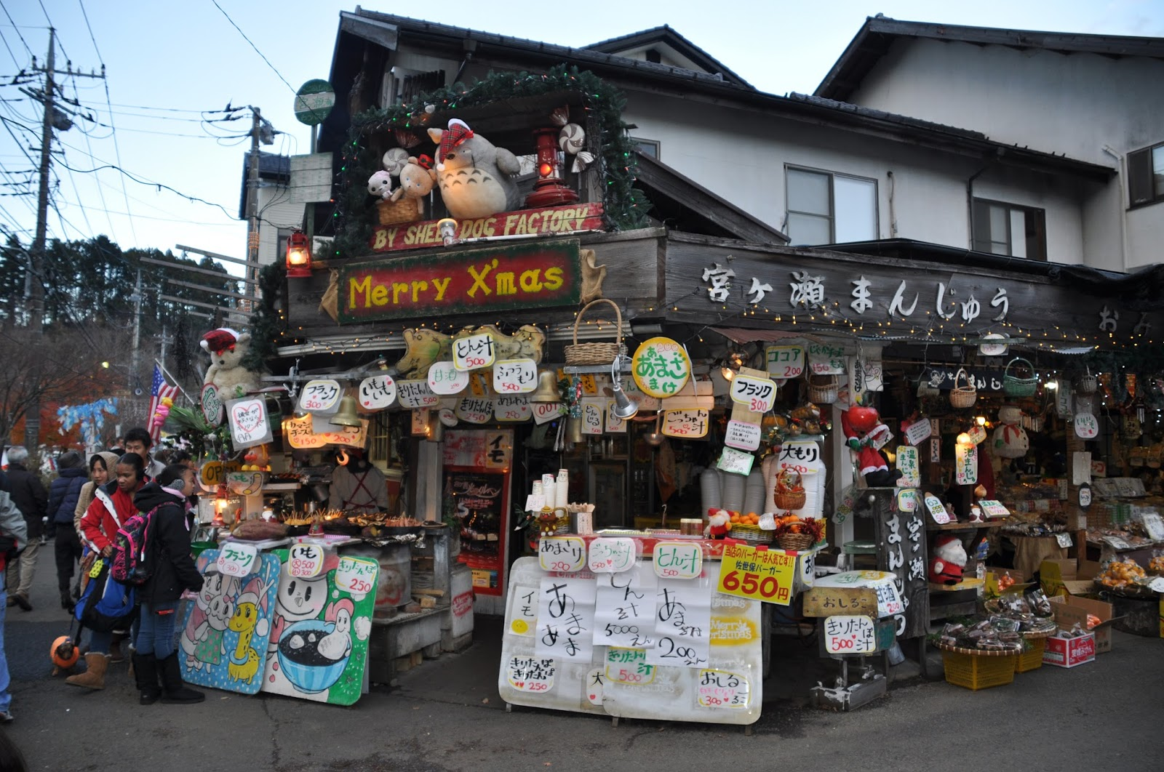
Christmas is not a national holiday in Japan, so schools and businesses are normally open on December 25th.

Slide 10
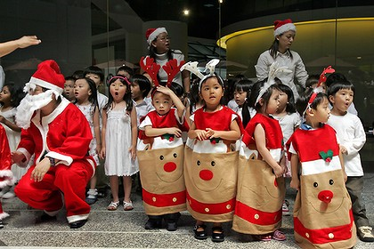
メリークリスマス！
クリスマスパーティー are often held for children, with games, singing and dancing.

Slide 11
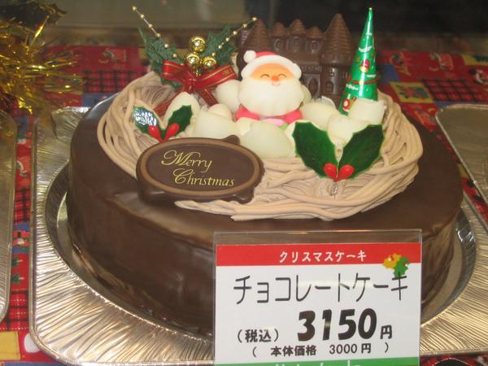
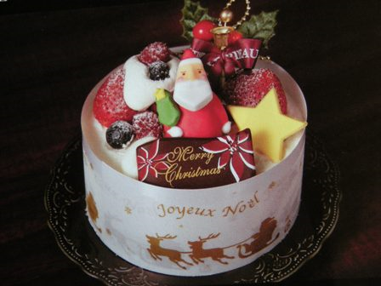
Families celebrate Christmas Eve by eating a クリスマスケーキ. This cake is often bought by the father of the family on his way home from work. クリスマスケーキ is a sponge cake decorated with strawberries and whipped cream decorated with trees, flowers and a figure of サンタさん.

Slide 12
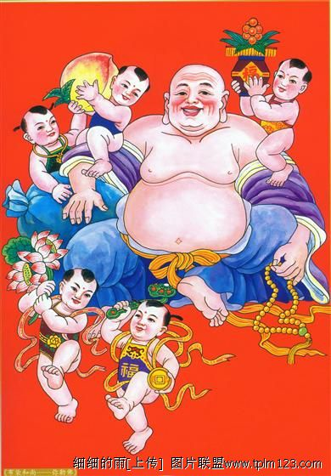
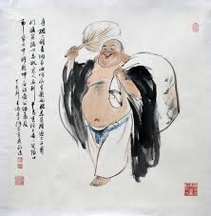
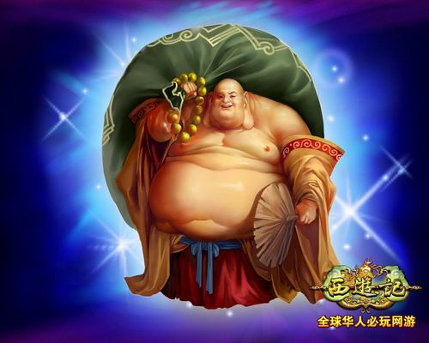
In Japan Santa is known as サンタさん or サンタクロース. Sometimes the term gift bringer ほていおしょう is used. However this is the Japanese god of good fortune from Buddhism and not really related to Christmas.

Slide 13
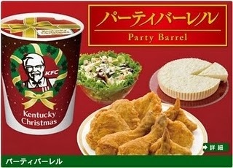
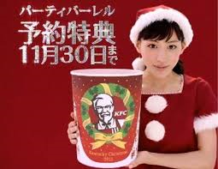
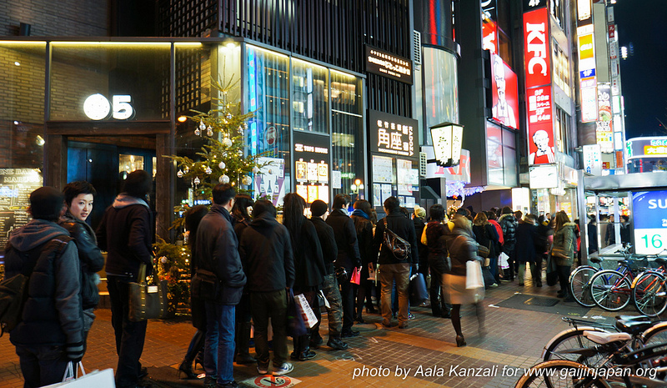
Thanks to the successful
クリスマスには ケンタッキー marketing campaign in 1974, Japan can’t get enough of KFC on Christmas day. People line up for hours or pre-order to avoid crowds.

Slide 14
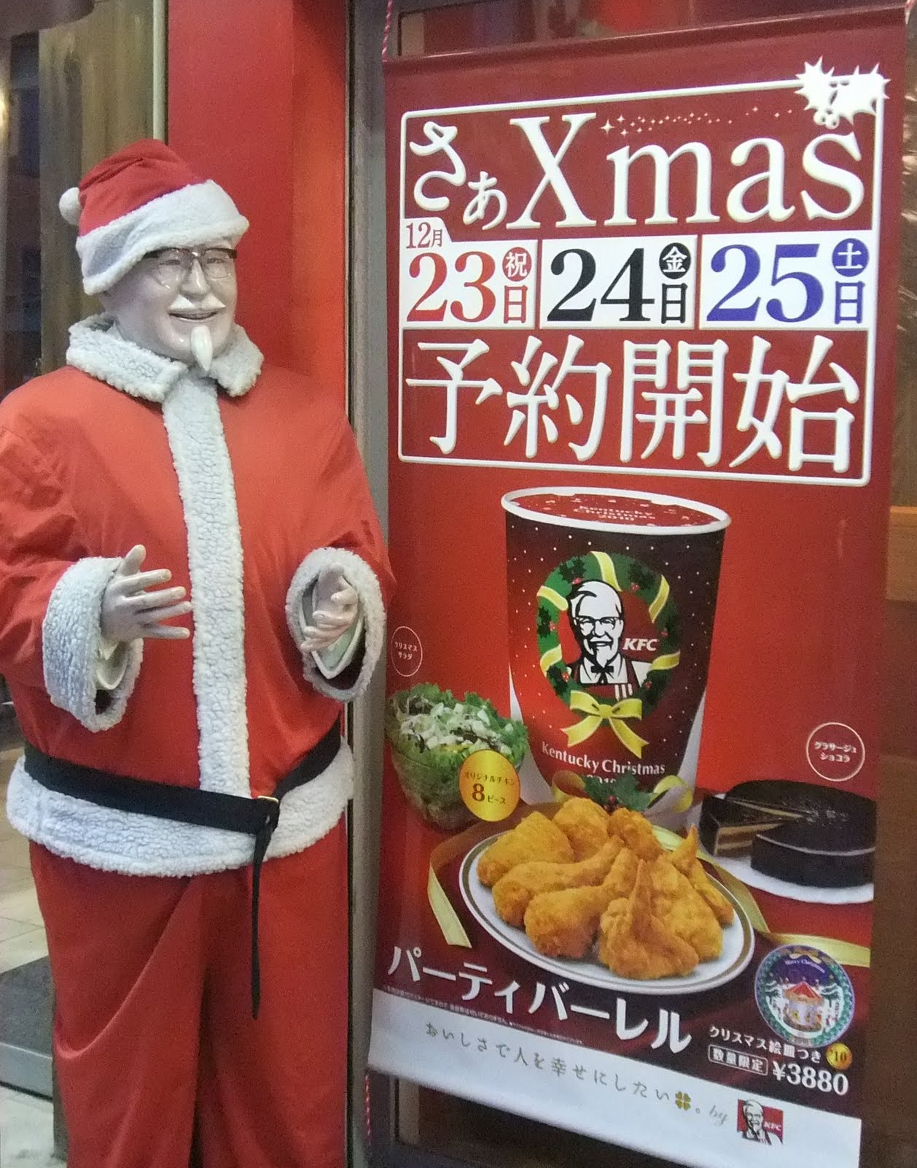
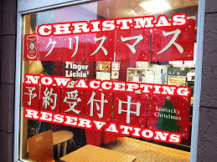
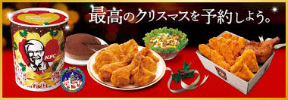
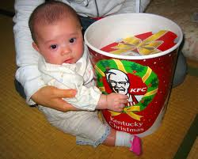

Slide 15
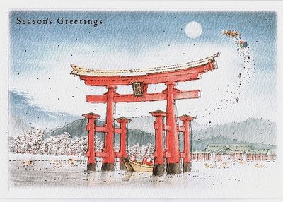
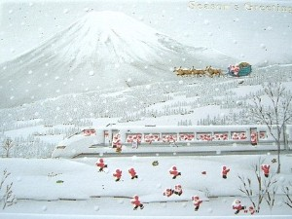
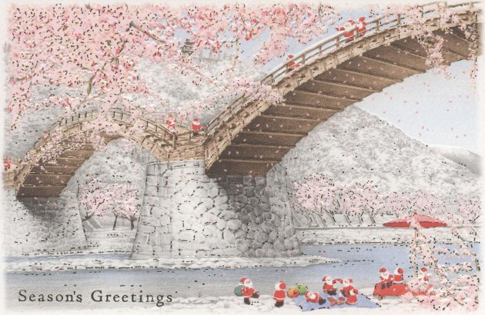
クリスマス クイズ
Christmas Quiz

Slide 16
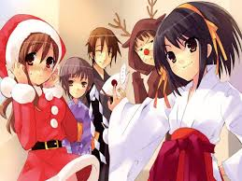
クリスマス クイズ：ほんとう うそう
Christmas Quiz: True False
Christmas in Japan is a religious festival.
Christmas eve in Japan is a romantic day.
25th of December is a public holiday.
Japanese Christmas cake is a fruit cake.
Santa in Japan is called ‘Santa-san’.
Most people eat KFC for Christmas dinner.

Slide 17
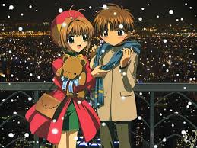
ANSWERS
Christmas in Japan is a religious festival.
うそう - FALSE
2. Christmas eve in Japan is a romantic day.
ほんとう - TRUE
25th of December is a public holiday.
うそう - FALSE
Japanese Christmas cake is a fruit cake.
うそう - FALSE
Santa in Japan is called ‘Santa-san’.
ほんとう - TRUE
6. Most people eat KFC for Christmas dinner.
ほんとう - TRUE

Slide 18
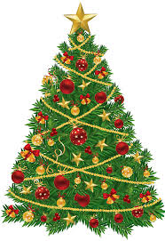
What are the similarities between Christmas celebrations in Australia and Japan?
What are the differences?

Slide 19
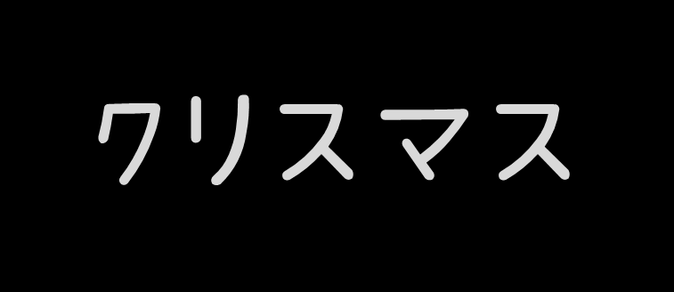
Let’s write Christmas in Japanese!

Slide 20
Let’s write Merry Christmas in Japanese!

Slide 21
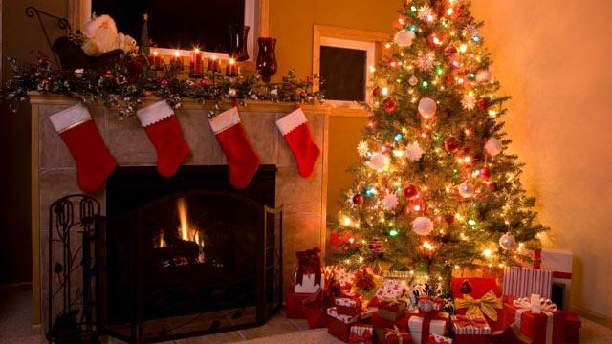
Let’s learn some クリスマス words in Japanese!
Listen here: http://www.japanesepod101.com/japanese-vocabulary-lists/christmas-day

Slide 22
クリスマスツリー
KURISUMASU TSURII

Slide 23
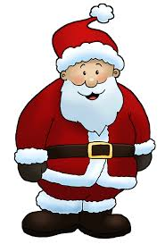
サンタクロース
SANTA KUROOSU

Slide 24
リース
RIISU

Slide 25
プレゼント
PUREZENTO

Slide 26
そうしょく
SOUSHOKU

Slide 27
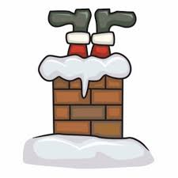
えんとつ
ENTOTSU

Slide 28
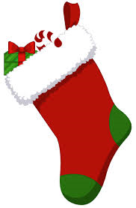
くつした
KUTSUSHITA

Slide 29
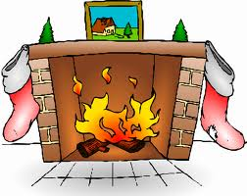
だんろ
DANRO

Slide 30
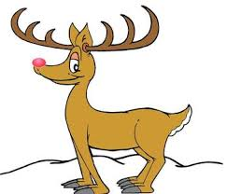
トナカイ
TONAKAI

Slide 31
おぼえますか？

Slide 32
Match the words with the appropriate picture:
LEVEL 1
santakuroozu
riisu
kurisumasutsurii
purezento
tonakai
soushoku
entotsu
kutsushita
danro

Slide 33
Match the words with the appropriate picture:
LEVEL 2
サンタクロース
リース
クリスマスツリー
プレゼント
となかい
そうしょく
えんとつ
くつした
だんろ

Slide 34
えを かいて ください。 Draw a picture.
LEVEL 1
santakuroozu
kurisumasutsurii
purezento
soushoku
tonakai
riisu
kutsushita
entotsu

Slide 35
えを かいて ください。
LEVEL 2
サンタクロース
クリスマスツリー
プレゼント
そうしょく
となかい
リース
くつした
えんとつ

Slide 36
What is in this picture? Label the picture with Japanese words.
THING が あります。

Slide 37
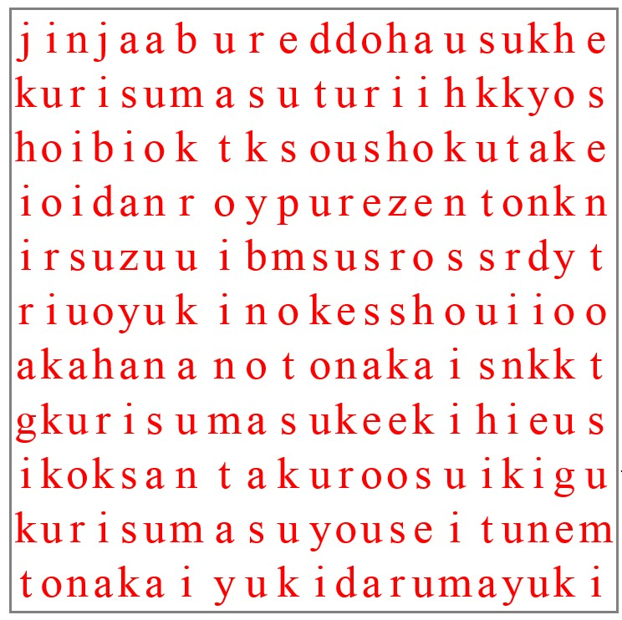
LEVEL 1
Translate these words into Japanese and then find them in the puzzle:
Christmas
Christmas tree
Santa Clause
wreath
present
decorations
stocking
chimney
fireplace
reindeer

Slide 38
ANSWERS
ANSWER
Christmas kurisumasu
Christmas tree kurisumasutsurii
Santa Clause santakuroosu
wreath riisu
present purezento
decorations soushoku
stocking kutsushita
chimney entotsu
fireplace danro
reindeer tonakai

Slide 39
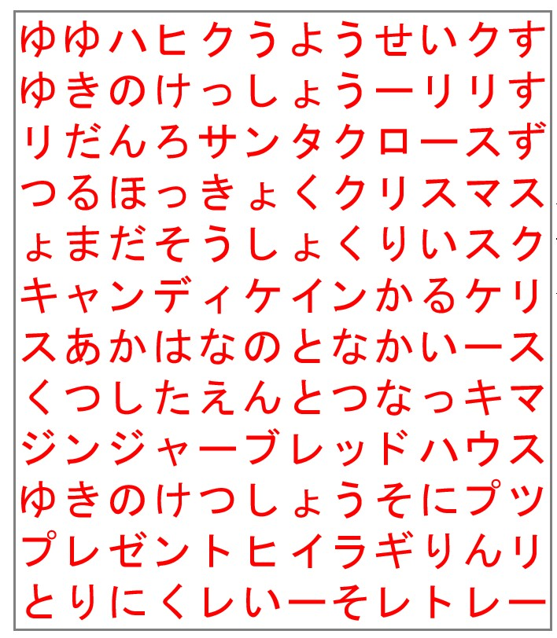
LEVEL 2
Translate these words into Japanese and then find them in the puzzle:
Christmas
Christmas tree
Santa Clause
wreath
present
decorations
stocking
chimney
fireplace
reindeer

Slide 40
LEVEL 2
ANSWER
Christmas クリスマス
Christmas tree クリスマスツリー
Santa Clause サンタクロース
wreath リース
present プレゼント
decorations そうしょく
stocking くつした
chimney えんとつ
fireplace だんろ
reindeer となかい

Slide 41
GAME 1
Play noughts and crosses. Students must say the Japanese for each item before placing a nought or cross on the board.
まる
ばつ

Slide 42
GAME 2
Play noughts and crosses. Students must say the Japanese for each item before placing a nought or cross on the board.
まる
ばつ

Slide 43
Let’s write a letter to Santa!
LEVEL 2
Santa-san e、
Konnichi wa. Watashi no namae wa Sarii desu. Watashi wa 13sai desu.
Burisuben ni sunde imasu.
Kurisumasu ni aipoddo o kudasai.
Yoroshiku onegaishimasu.
Sarii yori.
12 gatsu 20 nichi

Slide 44
サンタさんに てがみを かきましょう！
LEVEL 2
サンタさんへ、
こんにちは。 わたしの なまえは
サリーです。 わたしは 十三さい です。 ブリスベンに すんで います。
クリスマスに アイパッドを ください。
よろしく おねがいします。
サリーより。
十一月二十日

Slide 45
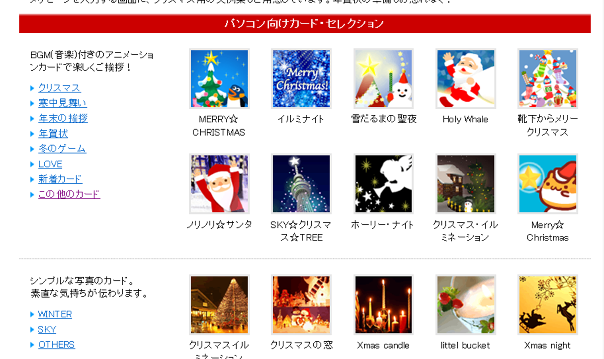
Create a digital Christmas card:
http://greeting.rakuten.co.jp/event/xmas/
1. Select a card

Slide 46
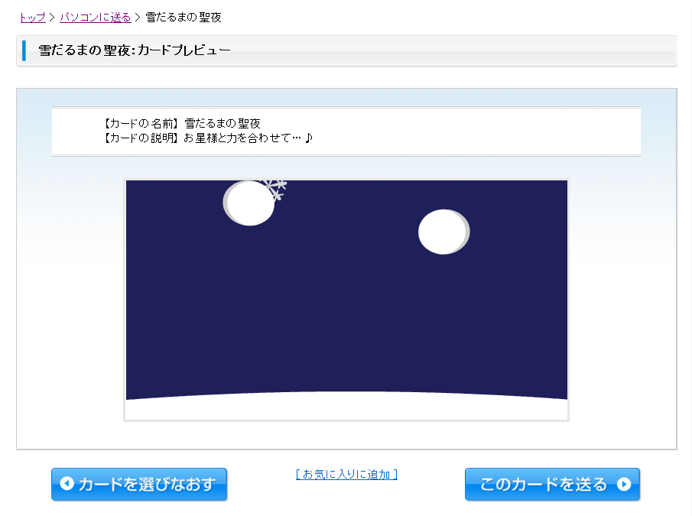
2. View the card
If you don’t like the card click here…
If you like the card click here…

Slide 47
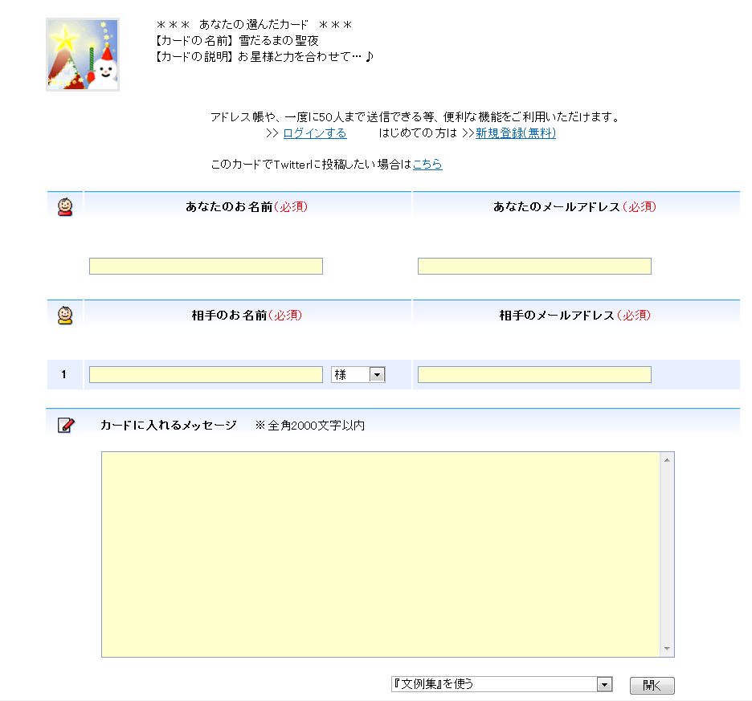
3. Fill in the card details:
Your name
Your email
Recipient’s name
Recipient’s email
Your message

Slide 48
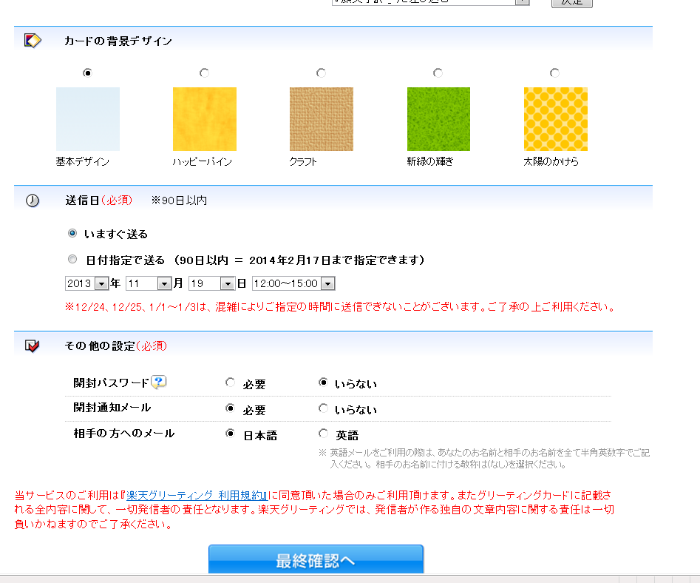

Slide 49
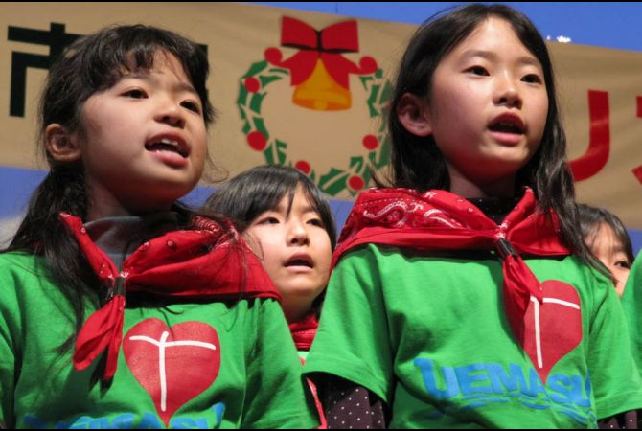
Let’s learn some クリスマスキャロル in Japanese!

Slide 50
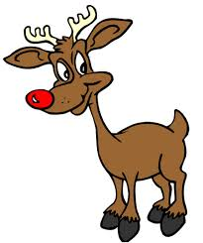
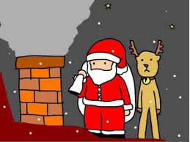
Awatenbou no Santa Claus あわてんぼうのサンタク https://www.youtube.com/watch?v=tGfpMTaIX6A
Akahananotonakai 赤鼻のトナカイ
https://www.youtube.com/watch?v=36l9ngO2gLA
Jingle Bells
https://www.youtube.com/watch?v=GgwKJ2xDo18
Silent night
https://www.youtube.com/watch?v=7ctyO4rRgsM

Slide 51
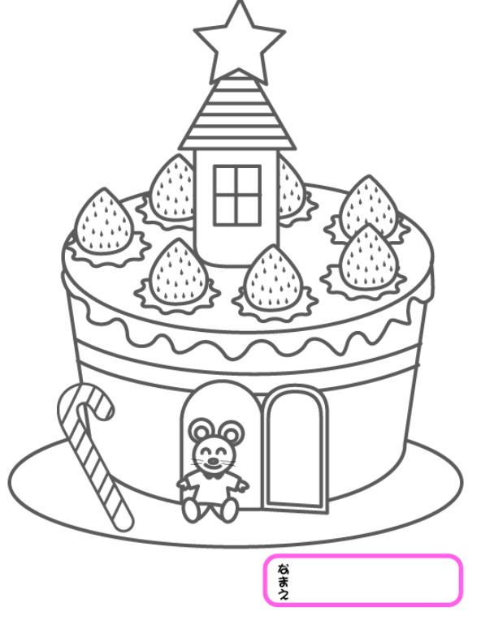
http://www.sakunet.ne.jp/~hayaka1/nurie.html

Slide 52
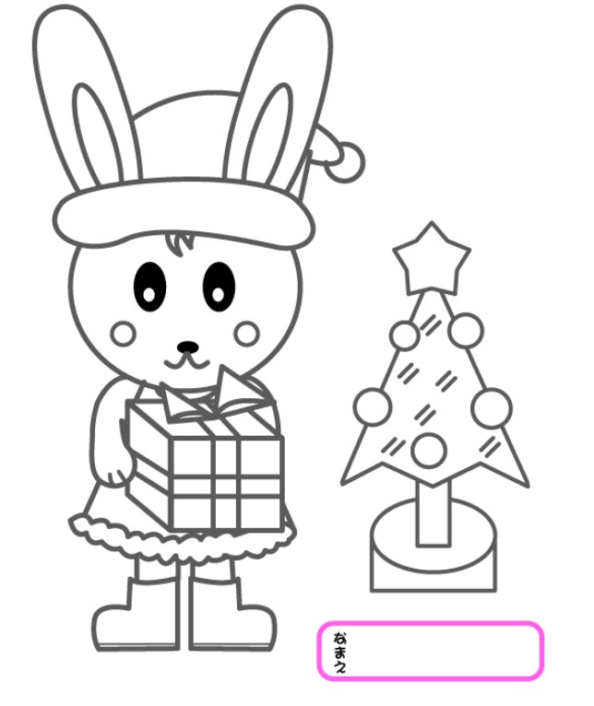
http://www.sakunet.ne.jp/~hayaka1/nurie.html

Slide 53
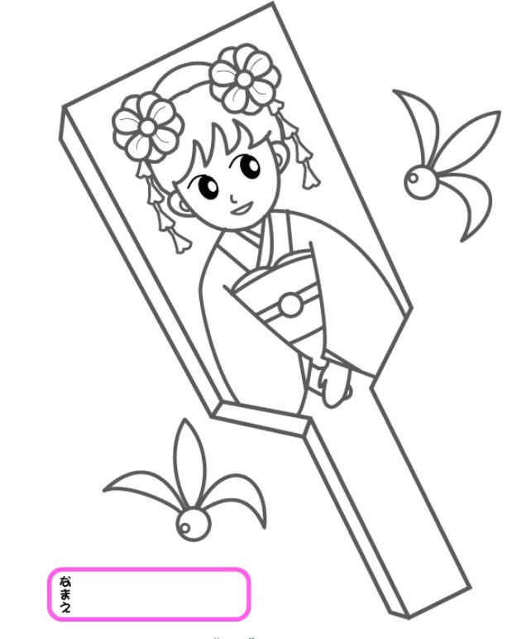
http://www.sakunet.ne.jp/~hayaka1/nurie.html

Slide 54
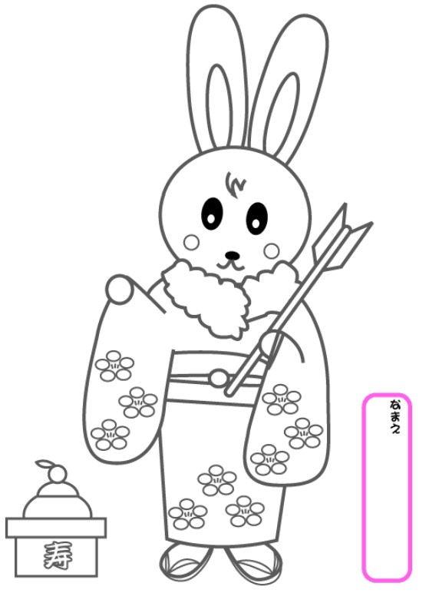
http://www.sakunet.ne.jp/~hayaka1/nurie.html

Slide 55
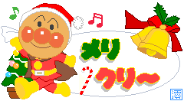
メリ クリ～！
MERI KURI~!

Slide 56
メリー クリスマス！
MERII KURISUMASU!

Slide 57
よい おやすみ を！
YOI OYASUMI O!

Slide 58
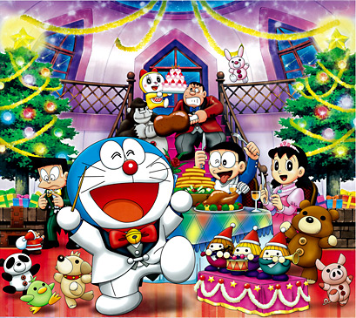
たのしい クリスマスを おすごし ください！
TANOSHII KURISUMASU
O OSUGOSHI KUDASAI!

