Slide 1
Describing a celebrity
Adjectives

Slide 2
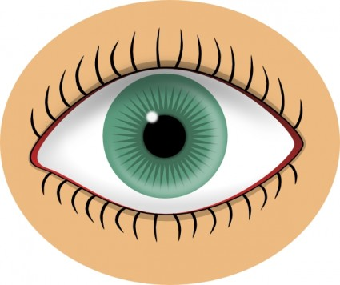
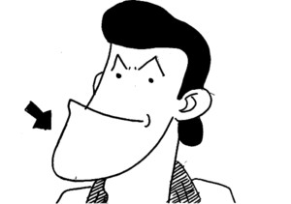
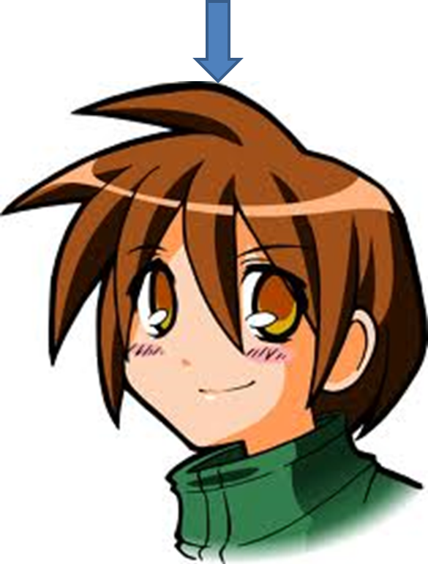
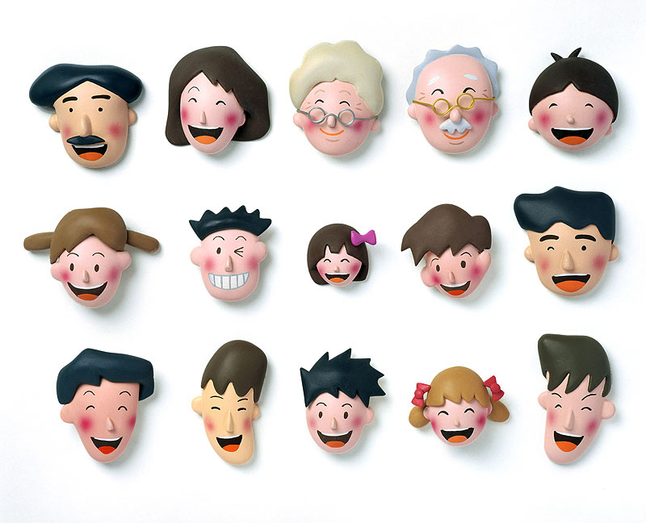
Can you remember the names of these parts of the face?

Slide 3
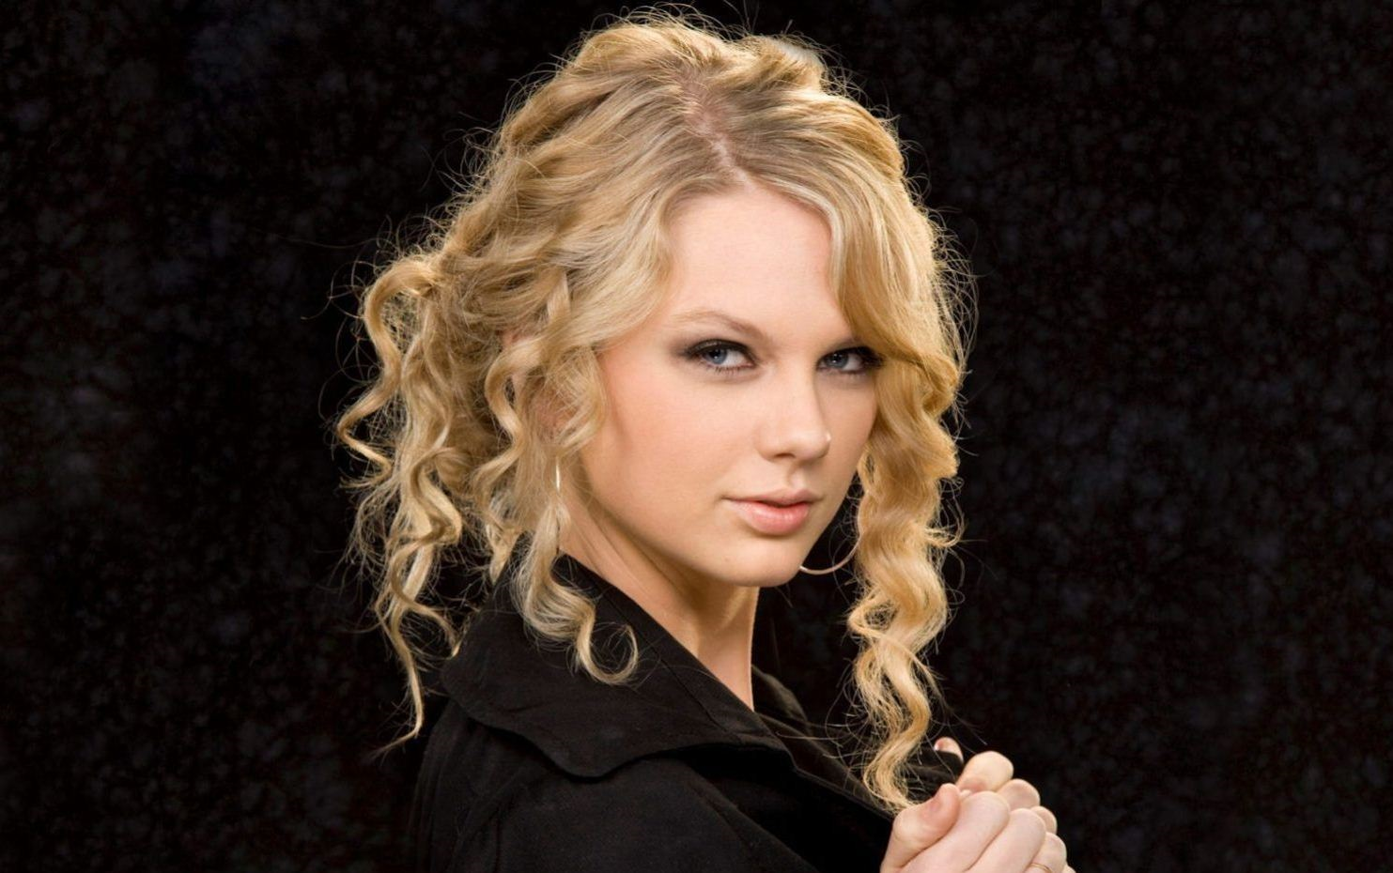
kinpatsu きんぱつ

Slide 4
kuroi くろい

Slide 5
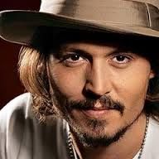
chairoi ちゃいろい

Slide 6
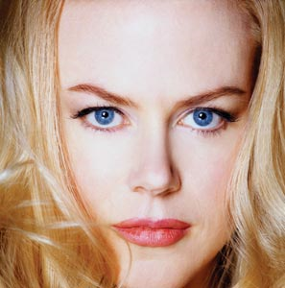
aoi あおい

Slide 7
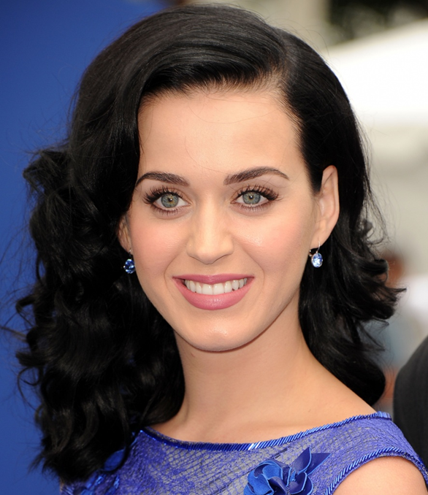
midori みどり

Slide 8
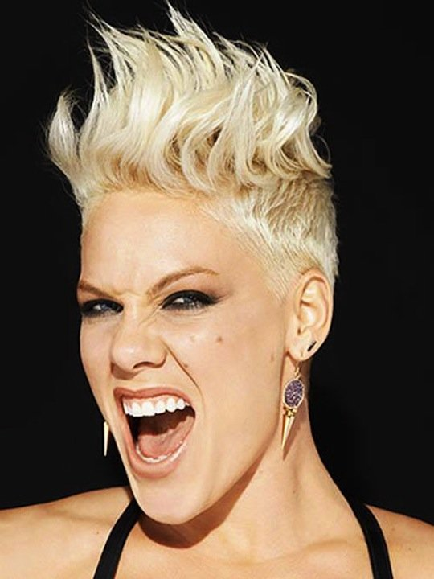
mijikai みじかい

Slide 9
nagai ながい

Slide 10
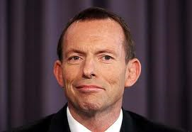
ookii おおきい

Slide 11
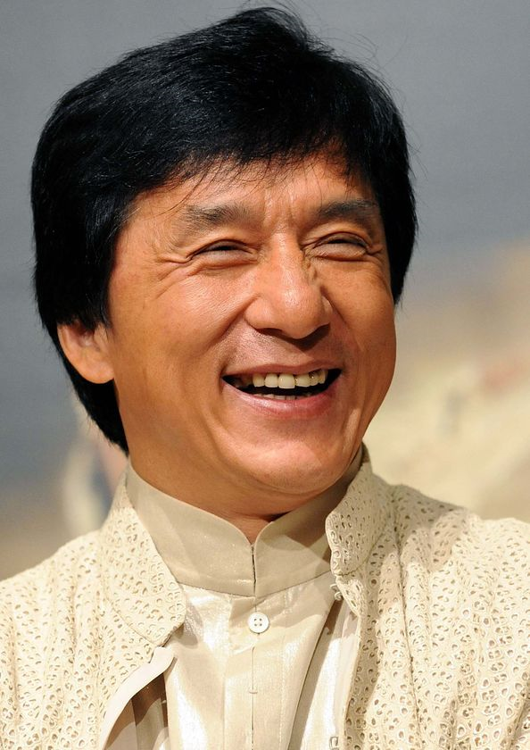
chiisai ちいさい

Slide 12
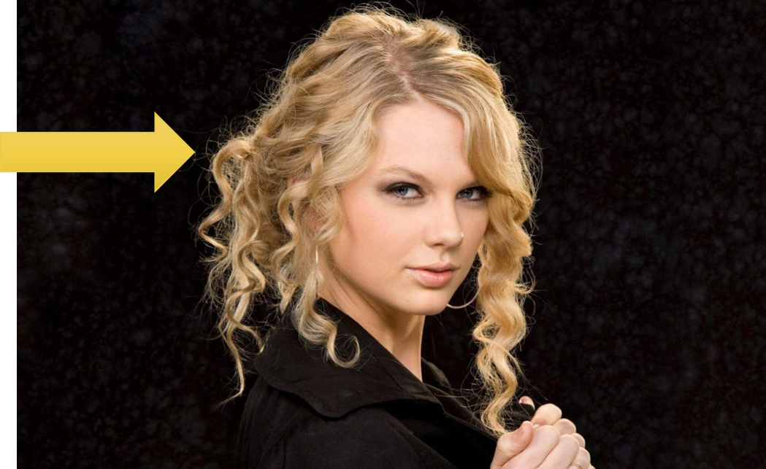
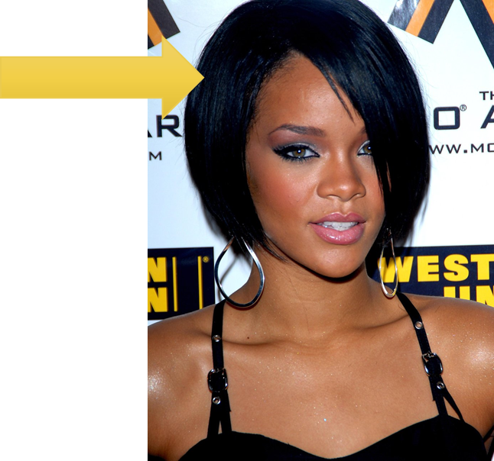
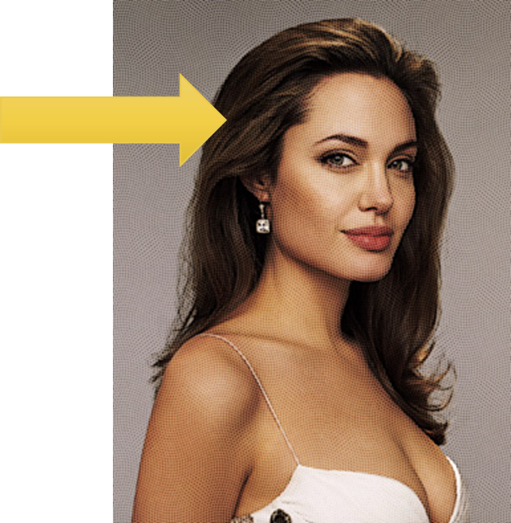
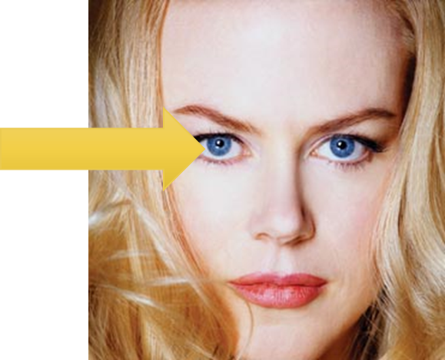
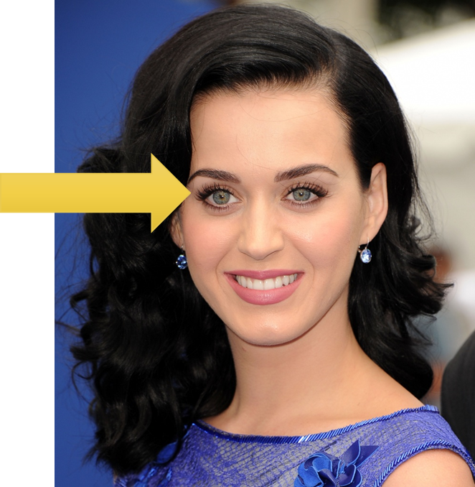
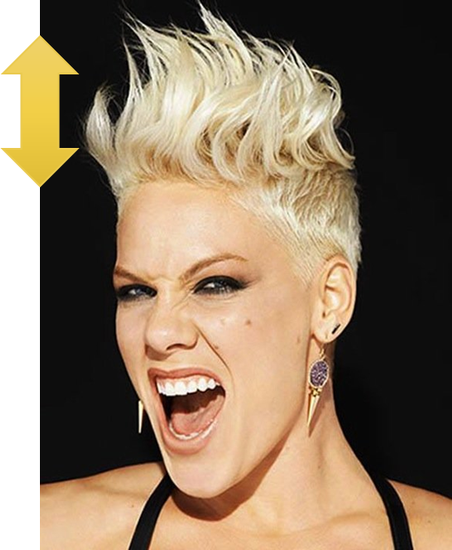
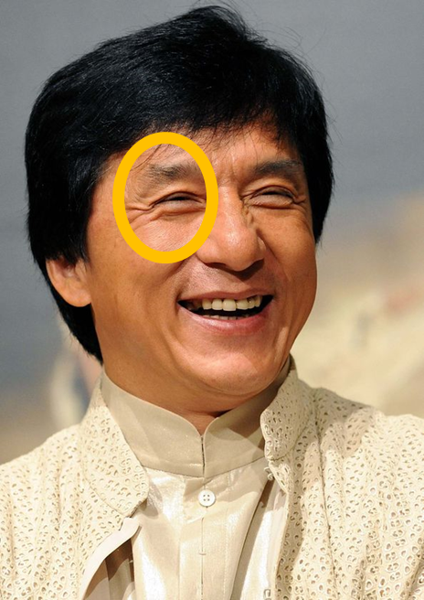
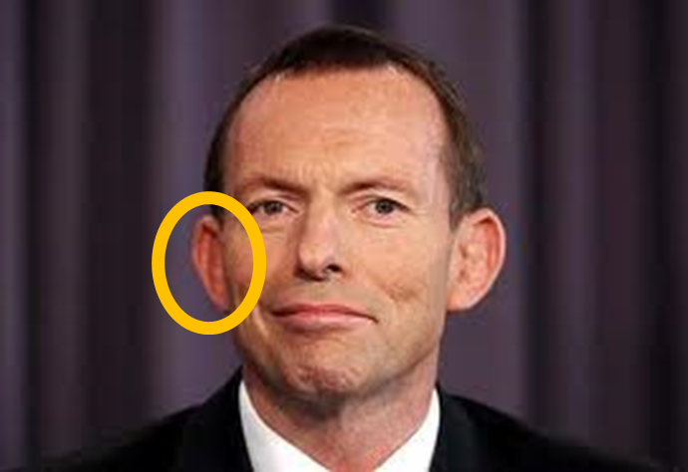

Slide 13
Ａｄｊｅｃｔｉｖｅｓ
ENGLISH | ROMAJI | JAPANESE
blonde | kinpatsu | きんぱつ
black | kuroi | くろい
brown | chairoi | ちゃいろい
blue | aoi | あおい
green | midori | みどり
short | mijikai | みじかい
long | nagai | ながい
big | ookii | おおきい
small | chiisai | ちいさい

Slide 14
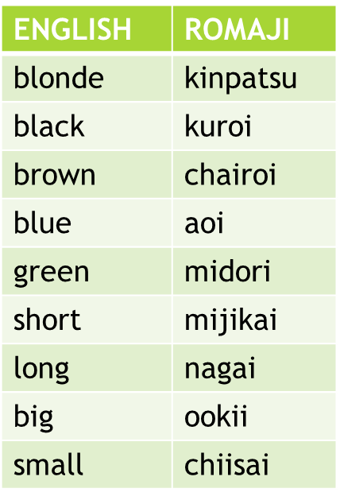
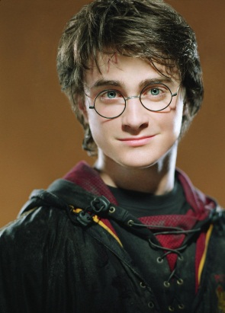
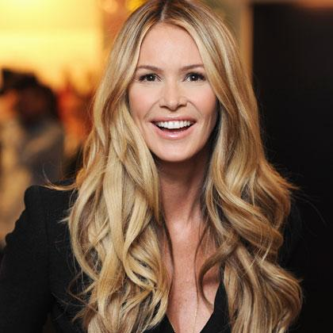
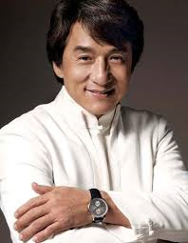
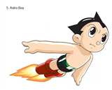
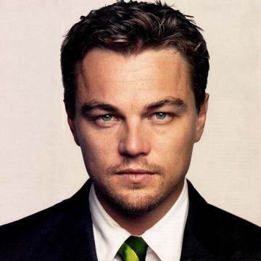
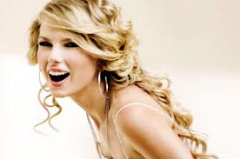
Can you describe these people’s hair?
A | Kaminoke wa? What is their hair like?
B | Kaminoke wa DESCRIPTION desu. His/her hair is DESCRIPTION. PERSON-san no kaminoke wa DESCRIPTION desu. PERSON’s hair is DESCRIPTION.
Harii Pottaa
Eru Makufaason
Jaki Chan
Riana
Tetsuwan Atomu
Rionarudo Dikapurio
Pinku
Teiraa Suifuto

Slide 15
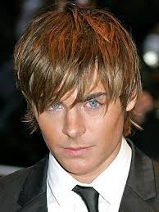
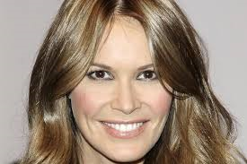
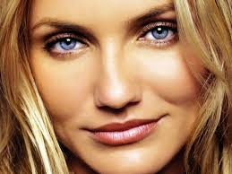
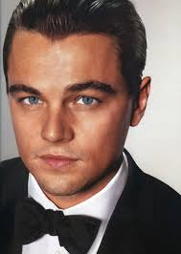
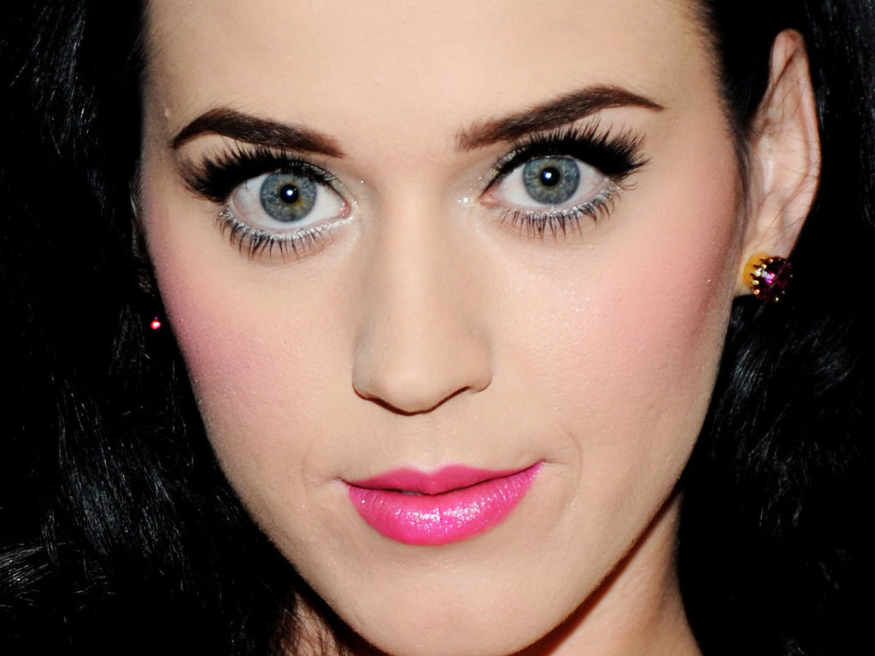
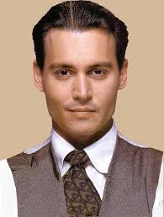
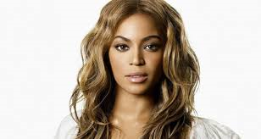
Can you describe these people’s eyes?
A | Me wa? What are their eyes like?
B | Me wa DESCRIPTION desu. His/her eyes are DESCRIPTION. PERSON-san no me wa DESCRIPTION desu. PERSON’s eyes are DESCRIPTION.
Eru Makufaason
Kyameron Deiasu
Anjeriina Jorii
Zakku Efuron
Biyonse
Rionarudo Dikapurio
Keitei Perii
Jonii Deppu

Slide 16
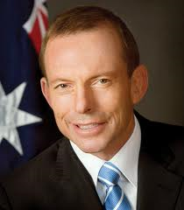
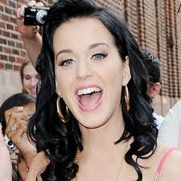
Can you describe these people’s mouths?
A | Kuchi wa? What is their mouth like?
B | Kuchi wa DESCRIPTION desu. His/her mouth is DESCRIPTION. PERSON-san no kuchi wa DESCRIPTION desu. PERSON’s mouth is DESCRIPTION.
Eru Makufaason
Kyameron Deiasu
Anjeriina Jorii
Tonii Abotto
Tetsuwan Atomu
Rionarudo Dikapurio
Keitei Perii
Jonii Deppu

Slide 17
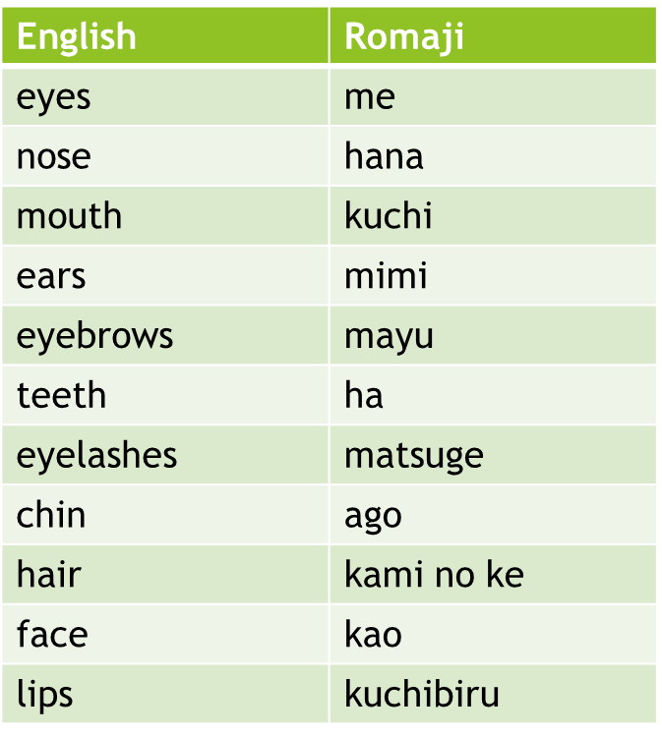
Select 2 celebrities. Write sentences describing them.
BODY PART wa DESCRIPTION desu. His/her BODY PART is DESCRIPTION. PERSON-san no BODY PART wa DESCRIPTION desu. PERSON’s BODY PART is DESCRIPTION.
SAMPLE Level 1
Eru Makufaason-san no kaminioke wa nagai desu. Me wa chairoi desu.
Kuchi wa ookii desu.
SAMPLE Level 2
Kochira wa Rionarudo Dikapurio desu. Rionarudo-san no kaminoke wa mijikai desu. Me wa aoi desu. Hana wa chiisai desu. Mimi mo chiisai desu.

Slide 18
Select 2 celebrities. Write sentences describing them.
BODY PART wa DESCRIPTION desu. His/her BODY PART is DESCRIPTION. PERSON-san no BODY PART wa DESCRIPTION desu. PERSON’s BODY PART is DESCRIPTION.

