Slide 1
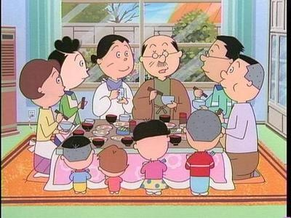
ご家族 Family family

Slide 2
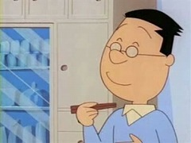
Family Tree Of SazaE-San
Grandfather
Grandmother
Father
Mother
Older Brother
Older Sister
Me

Slide 3
わたし wa ta shi watshi
Me

Slide 4
Honorific word
o ----- san

Slide 5
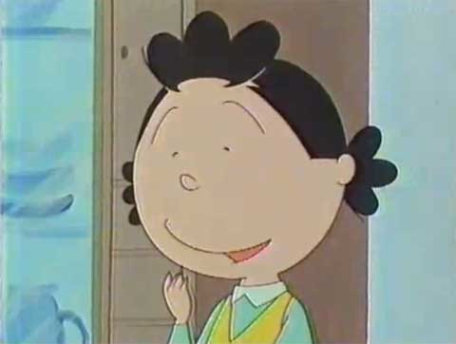
おかあさん okaasan
Mother
o ka a san

Slide 6
おかあさんokaasan
o car san

Slide 7
おとうさん O to o san
O
otoosan
Father

Slide 8
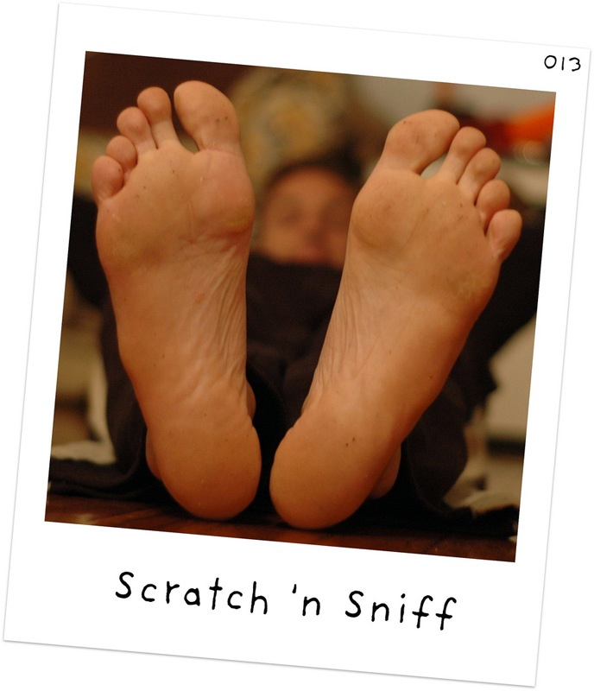
おとうさん otoosan
o toe san

Slide 9
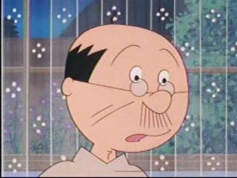
おじいさん o ji i sa n
oO ojiisan
Grandfather

Slide 10
おじいさん ojiisan
o “G” san
G

Slide 11
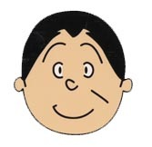
おばあさん o ba a sa n obaasan
Grandmother

Slide 12
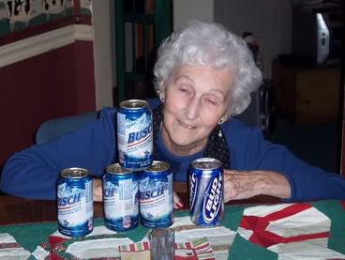
おばあさん obaasan
o bar san

Slide 13
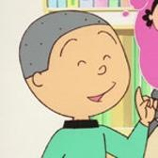
おにいさん o ni i sa n
Older Brother

Slide 14
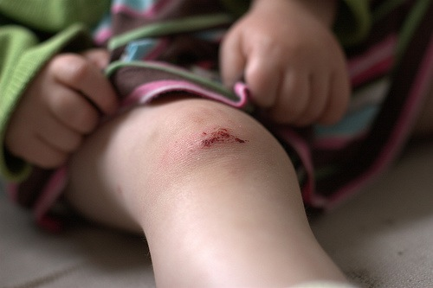
おにいさん oniisan
o knee san

Slide 15
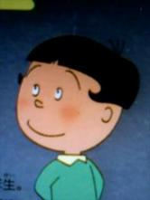
おねえさん o ne e sa n
Older Sister

Slide 16
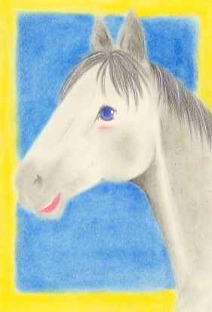
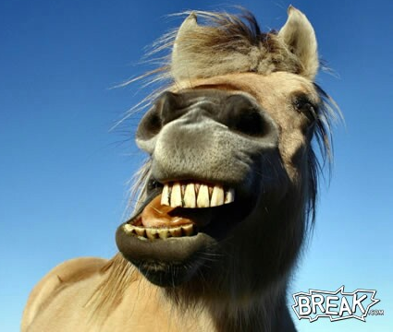
おねえさん oneesan
o neigh san

Slide 17
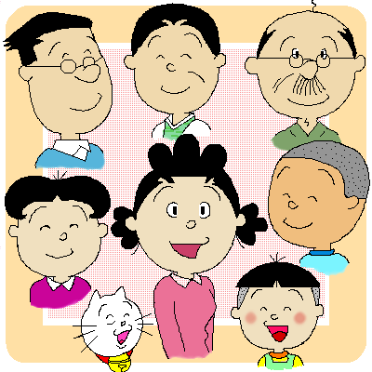
Mother = o-kaa-san Father = o-too-san G.father = o-jii-san G.mother = o-baa-san Brother = o-nii-san Sister = o-nee-san

Slide 18
Younger Brother = おとうと otooto Younger Sister = いもうと imooto Your Siblings = ごきょうだい gokyoodai

Slide 19
Let’s practice

Slide 20
おかあさん okaasan
Mother
o ka a san

Slide 21
おとうさん O to o san
O
otoosan
Father

Slide 22
おじいさん o ji i sa n
oO ojiisan
Grandfather

Slide 23
おばあさん o ba a sa n obaasan
Grandmother

Slide 24
おにいさん o ni i sa n
Older Brother

Slide 25
おねえさん o ne e sa n
Older Sister

Slide 26
O to o to
Younger brother

Slide 27
I mo o to
Younger sister

Slide 28
Kyo o da i
Brothers and sisters

Slide 29
Ha ha
Mother

Slide 30
chi chi
Father

Slide 31
A ni
Older Brother

Slide 32
Ane
Older Sister
Older Sister

Slide 33
Ka zo ku wa
nan nin de su ka?
Ka zo ku wa ______ nin desu
kyo u da i wa _______ nin desu

Slide 34
Ka zo ku wa nan nin de su ka?
Kyo o da i wa nan nin de suka?
Kyo

Slide 35
Ka zo ku wa 10 nin de su.
kyo o dai wa 4 nin de su.

