Slide 1
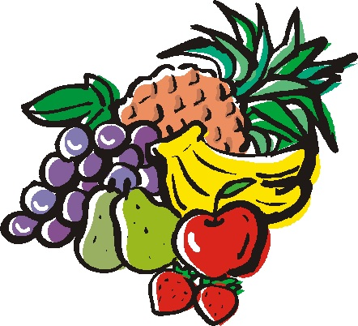
Kudamomo
くだもの
Michelle Berryman

Slide 2
painappuru
パイナップル

Slide 3
banana
バナナ

Slide 4

budou
ぶどう

Slide 5
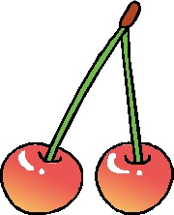
sakuranbo
さくらんぼ

Slide 6


suika
すいか

Slide 7
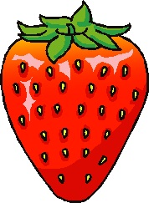
ichigo
いちご

Slide 8
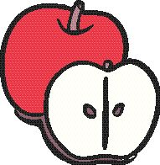
ringo
りんご

Slide 9
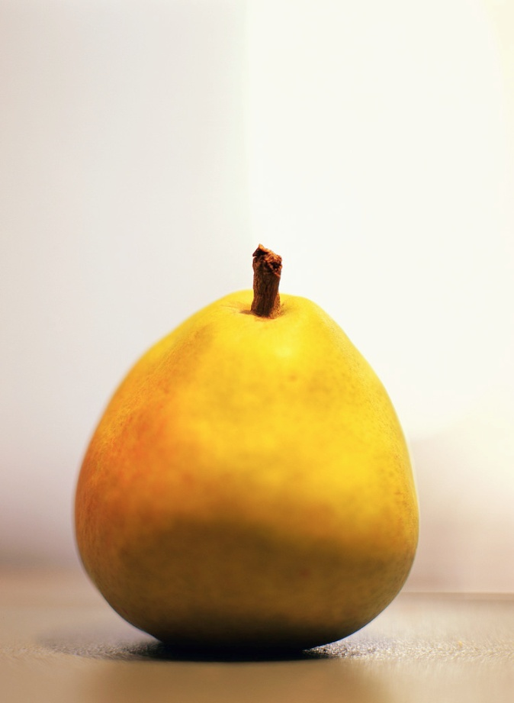
nashi
なし

Slide 10

orenji
オレンジ

Slide 11
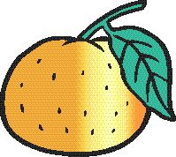
mikan
みかん

Slide 12
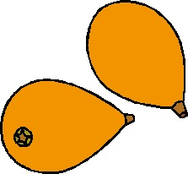
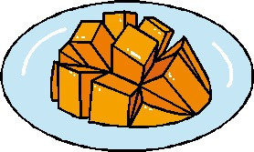
mango
マンゴ

Slide 13

remon
レモン

Slide 14
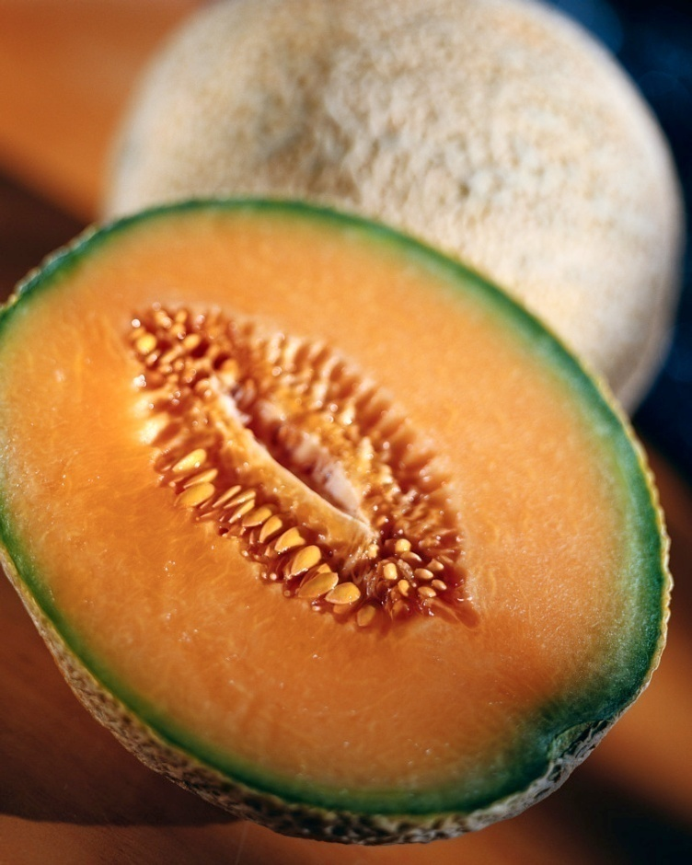
meron
メロン

Slide 15
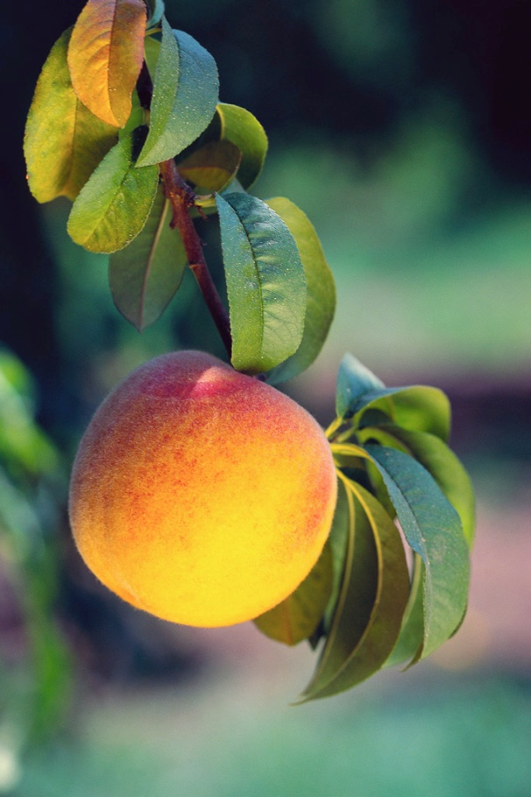

anzu
あんず

Slide 16

kaki
かき

Slide 17
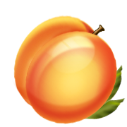
momo
もも

Slide 18
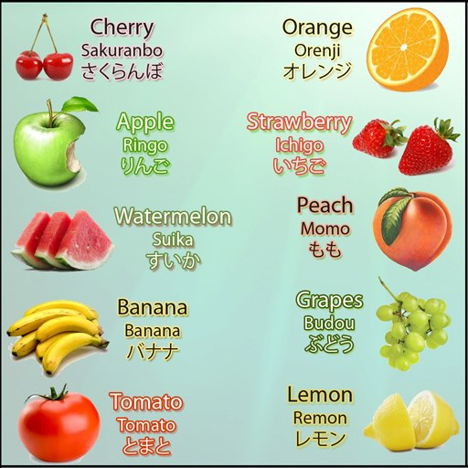
Furutsu

Slide 19

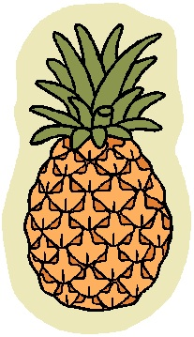


What Fruit do you eat?
Tabemasu, tabemasu,
Nani o tabemasu ka
Tabemasu, tabemasu
o tabemasu
To eat, to eat,
What do you eat?
To eat, to eat
Strawberries I eat
Insert the fruit you eat

Slide 20
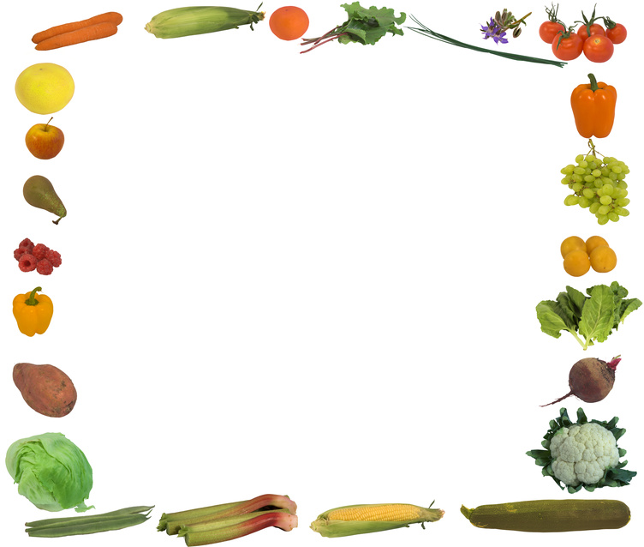
Write 2 sentences about fruits you eat...
For example, budou o tabemasu
Write 2 sentences about fruits you don’t eat.....
For example, sakuranbo o tabemasen
Tabemasen = don’t eat

Slide 21

To eat or not to eat?
Suika o tabemasu
demo
Remon o tabemasen
Demo = BUT
I eat watermelon but I don’t eat lemon!
Make your own sentence using ‘DEMO’

Slide 22




Do you eat……?
Ringo o tabemasu ka
Hai, Ringo o tabemasu
Meron o tabemasu ka
iie, meron o tabemasen
Use the picture clues below to ask a partner what fruit they eat

Slide 23
Delicious or Awful?
oishii
おいしい
mazui
まずい
Mango ga oishii desu DEMO orenji ga mazui desu

Slide 24
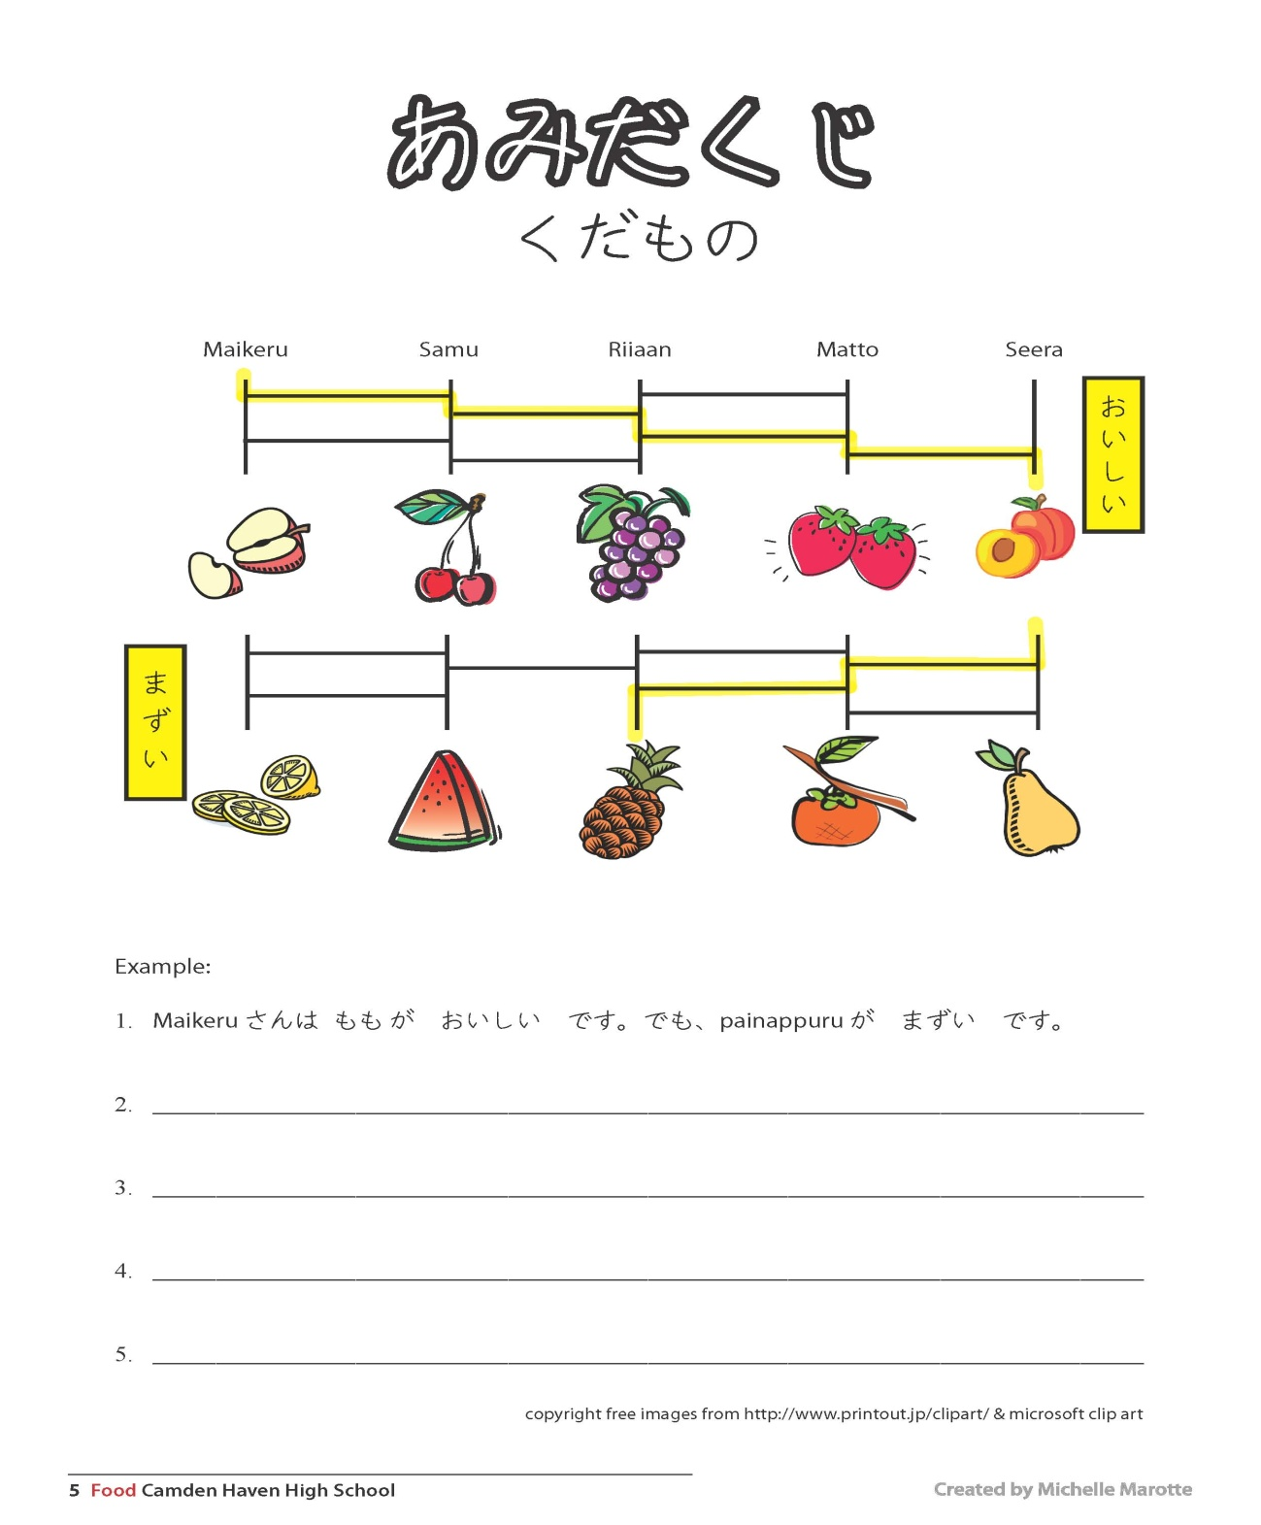

Slide 25
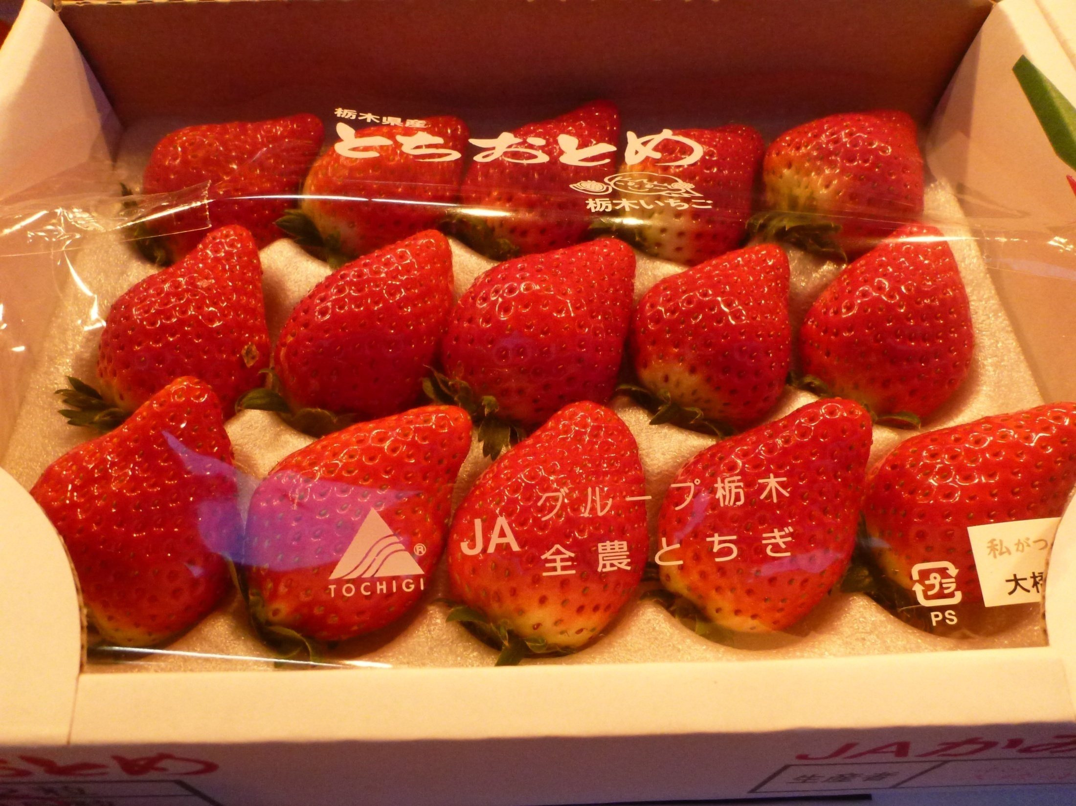
Fruit Stand

Slide 26
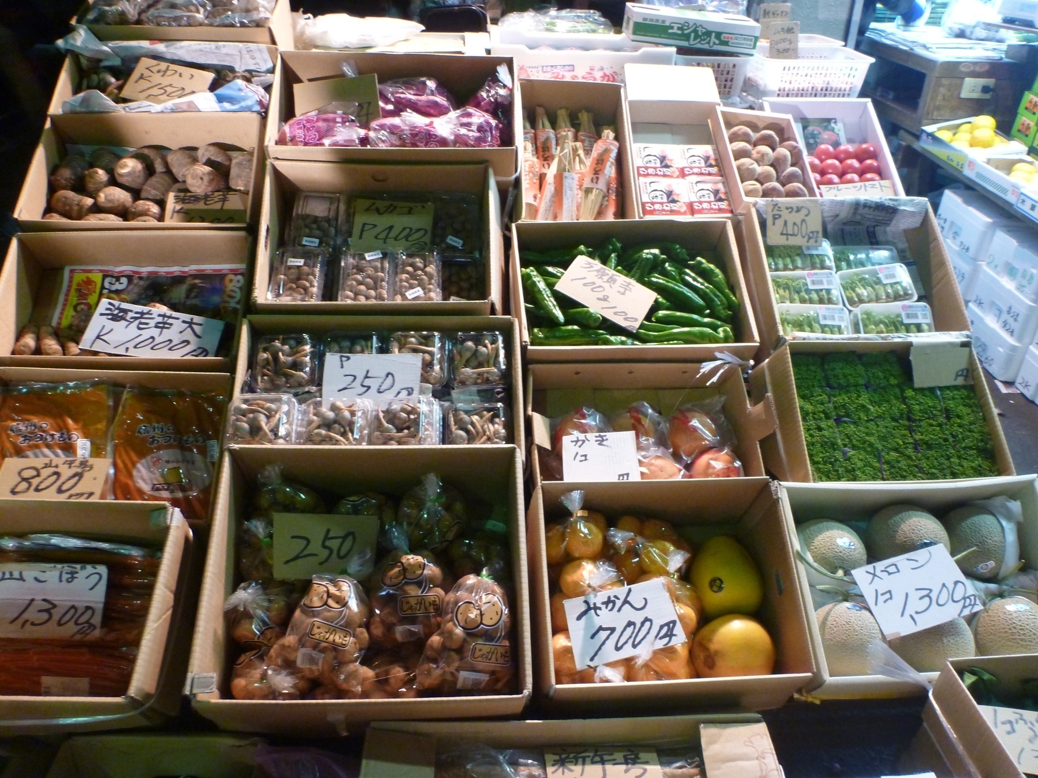

Slide 27
Copyright free images from http://www.printout.jp/clipart/ and Microsoft Clipart Gallery
Thanks to Michelle Marotte (CHHS) for the Amidakuji worksheet and Naomi Miles (CHHS) for the photos
Michelle Berryman - 2012

