Slide 1
Greetings/ Expressions

Slide 2
1.How do you greet your mother in the morning?

Slide 3
Ohayō
Kon-nichiwa
Arigatō

Slide 4
Ohayō
Kon-nichiwa
Arigatō

Slide 5
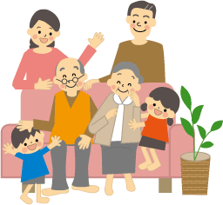
2.How do you greet your host family before going to bed on the first day of the home-stay?

Slide 6
Ohayō
Oyasumi nasai
Itadaki masu

Slide 7
Ohayō
Oyasumi nasai
Itadaki masu

Slide 8
3.How do you greet your new neighbor at 8pm?

Slide 9
Sumimasen
Konbanwa
Kon-nichiwa

Slide 10
Sumimasen
Konbanwa
Kon-nichiwa

Slide 11
4.How do you apologize when you accidentally stepped on someone’s foot?

Slide 12
Arigatō
Gomen-nasai
Gochisōsama

Slide 13
Arigatō
Gomen-nasai
Gochisōsama

Slide 14
Owari (The end)

