Slide 1
私はだれですか。
Instructions:-
Divide the class into two teams.
Have one team member sit at the front of the class facing away from data projector screen.
The student’s team then give a description in Japanese of the person projected. The student at the front must guess who it is.
Once they have successfully guessed who the person is they can swap with another team member.
Students keep rotating until the time limit set is up (e.g. 5 minutes per team). The other team then has a go to see how many they can get right.
The winning team is the team that has successfully guessed the most people. Teams are disqualified if they use English or sign language and a point is then given to the other team.
Once students get the hang of this game the time limit can be shortened. Also, have students make their own ‘Guess Who’ powerpoint to use for this game. Great way to consolidate Japanese language for body parts and descriptions of people.

Slide 4
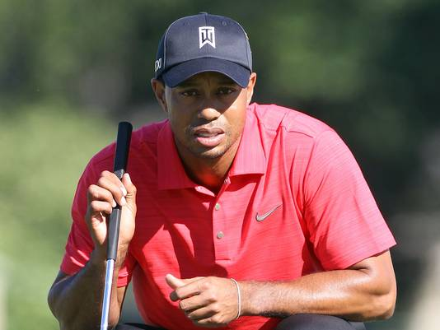

Slide 6
Jessica Watson

Slide 7
adelle

Slide 9
