Slide 1
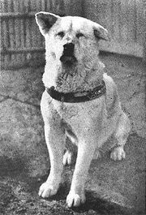
HACHIKO
はちこ
A true story

Slide 2
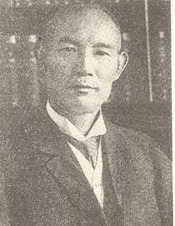
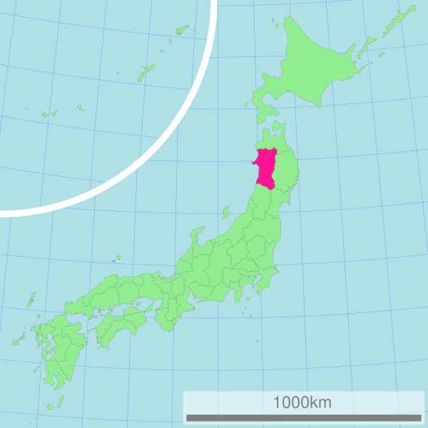
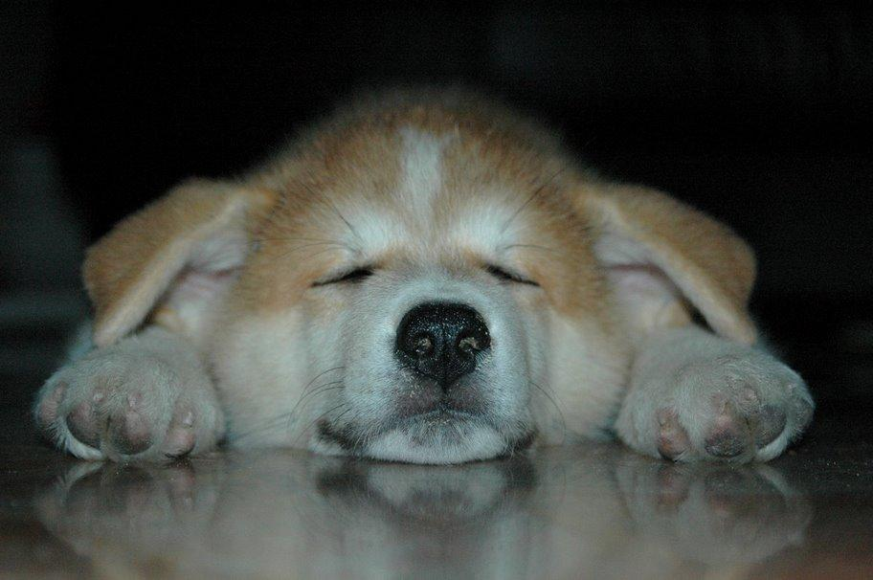
はちこ
Hachiko was born in Akita in 1923 and was first brought to Tokyo in 1924. He and his owner, Mr. Ueno, a university professor, were great friends right from the start.
AKITA
prefecture
A typical AKITA breed puppy
TOKYO

Slide 3
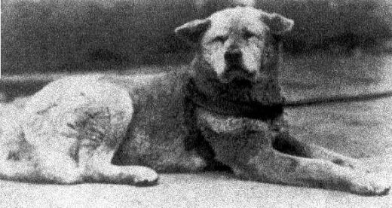
はちこ
Each day "Hachi" would accompany the professor to the train station at Shibuya in Tokyo, as he went to work. Upon returning, the professor would find the dog patiently waiting, tail wagging.
This happy routine continued until one fateful day in 1925, when the professor was taken ill on the job and unfortunately died before he could return home.

Slide 4
はちこ
Despite the fact that Hachiko was less than two years old at the time, the bond between dog and owner was very strong.
Hachiko was given away to new owners but the loyal dog always ran off in search of the professor.
Hachiko must have known something was wrong, but nonetheless he returned to the station every day at 3 o'clock to meet the train.
Soon people began to notice the loyal dog's trips made in vain to meet the professor.

Slide 5
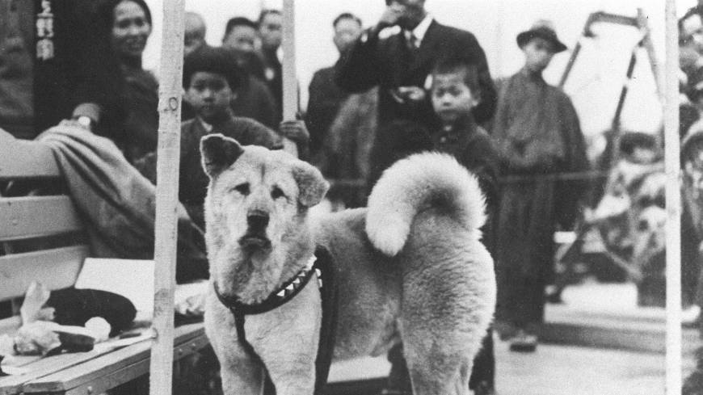

Slide 6
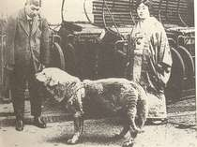
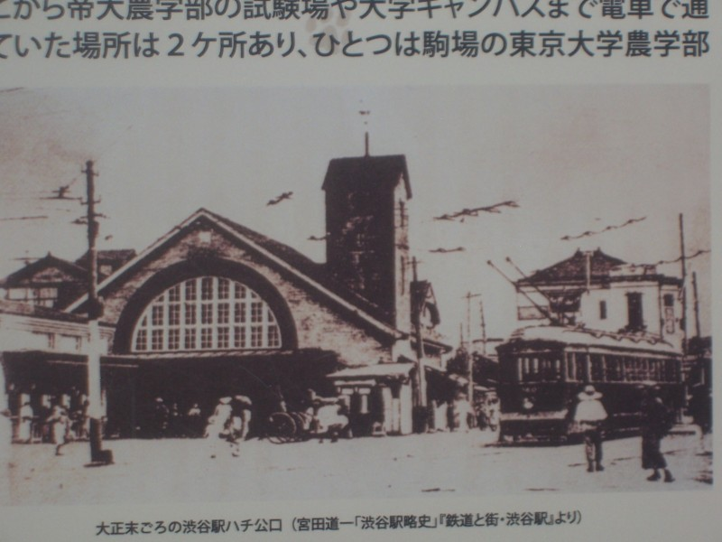
はちこ
Word of his unaltered routine spread across the nation.
People travelled to Shibuya simply to see Hachiko, feed him, and gently touch his head for luck.
The professor’s former gardener, the Shibuya stationmaster, and others began feeding Hachiko and giving him shelter.

Slide 7
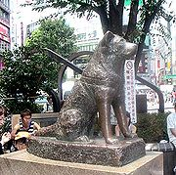
はちこ
Statue Erected
The people who passed the loyal dog, who sat waiting each day, were so touched by his story that they erected a statue in his honor in 1934.
A famous artist was commissioned to make the original bronzed sculpture, and Hachiko was present when the statue was dedicated!

Slide 8
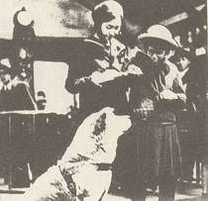
はちこ
With some school girls at the station
The months turned to years, and still Hachiko returned to Shibuya station daily at 3pm, even as arthritis and aging took their toll.
Finally, on March 8, 1935 - nearly ten years after last seeing Professor Ueno - the 12-year-old dog was found dead on the same spot outside the station where he had spent so many hours waiting .
Hachiko's death made the front pages of major Japanese newspapers. A day of mourning was declared.
The dog became a familiar sight to people at the station.

Slide 9
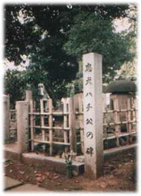
はちこ
Sadly Hachiko’s statue was melted down during the Second World War as metals were in short supply.
Grave in Aoyama cemetery, Tokyo
On March 8, 1935, Hachiko finally died, on the very same spot he last saw his friend alive.

Slide 10
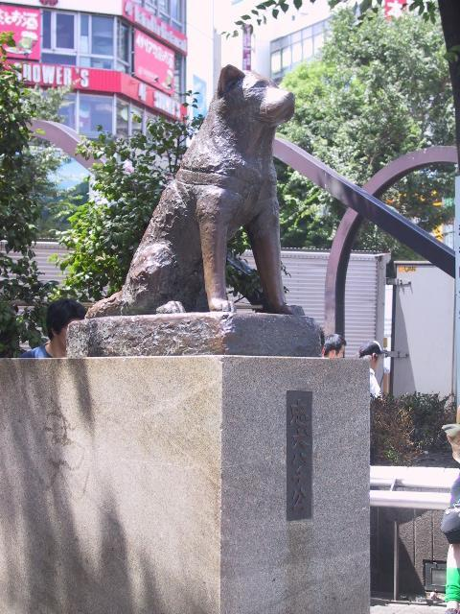
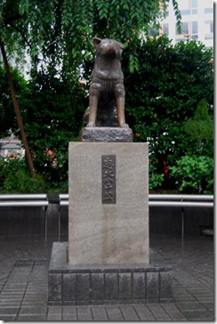
はちこ
After the war, Hachiko was not forgotten. In 1948 The Society For Recreating The Hachiko Statue commissioned the son of the original artist, who had since passed away, to make a second statue.
Chuken Hachiko
The faithful dog, Hachiko

Slide 11
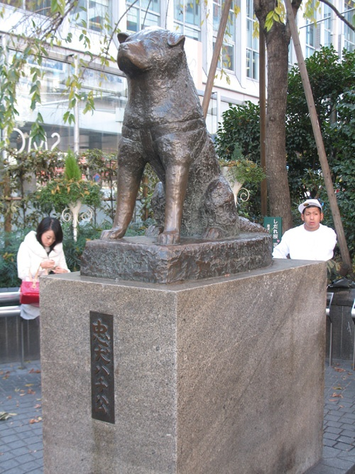
はちこ
Hachiko became a symbol of loyalty.
School teachers and parents would use him as a teaching model for dedication and loyalty.

Slide 12

はちこ
Hachiko Waits
Illustrated by Machiyo Kodaira
Henry Holt & Co.,

Slide 13
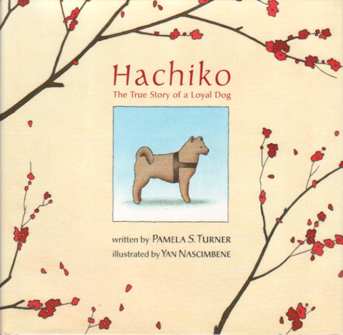
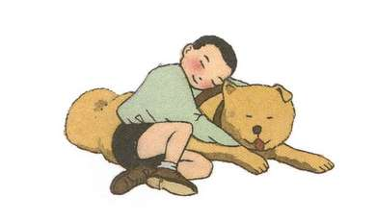
はちこ
The story is told through the eyes of a young boy who notices Hachiko at the station.
HACHIKO
The True Story of Loyal Dog
Pamela S. Turner

Slide 14

はちこ
Movie: Hachiko: A Dog's Story
Release Date: August, 2009
Runtime: 104 min
Language: English
Country: U.S.

Slide 15
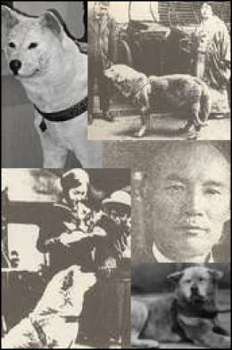
HACHIKO Video Clip

Slide 16
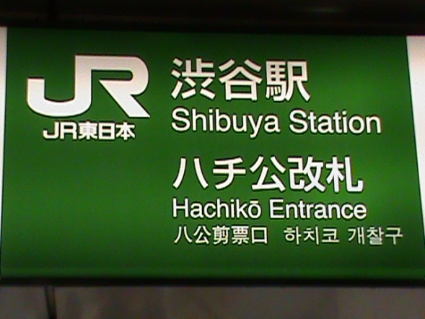
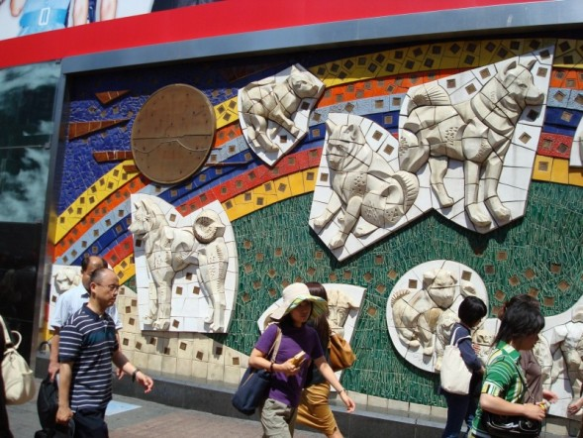
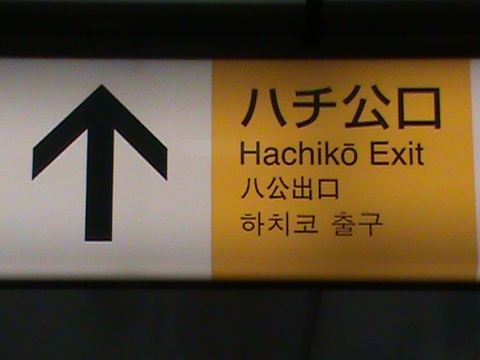
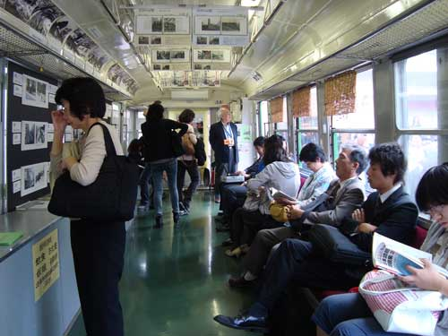
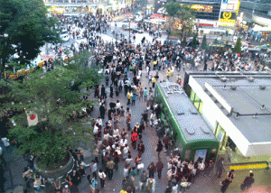
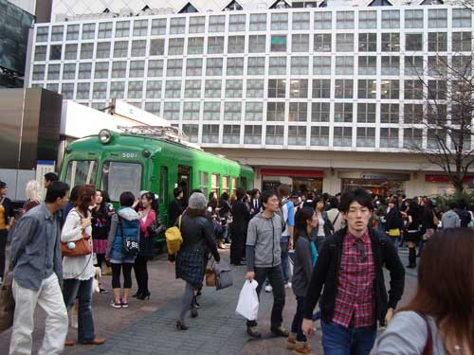
HACHIKO Today

