Slide 1
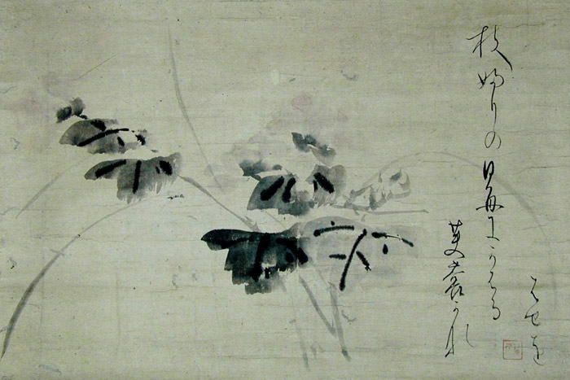
Haiku and the Seasons

Slide 2
Haiku
Haiku is a contemplative, unrhymed Japanese poem that attempts to capture the essence of a moment in which nature is linked to human life. And as one of the most important forms of traditional Japanese poetry, a well-written haiku creates tension between contrasting elements.

Slide 3
Haiku Form
Guidelines of traditional haiku writing in Japanese;
Syllable Count::
The poem consists of 17 syllables, a must in Japanese;
Kigo:
The poem should indicate through a kigo, a seasonal word, the season in which the haiku is set. Often the kigo is not obvious and may therefore be implied;
Division:
The poem contains a division between two contrasting parts, a certain imaginative distance should exist between the two sections, both of which must enrich the understanding of the other.

Slide 4
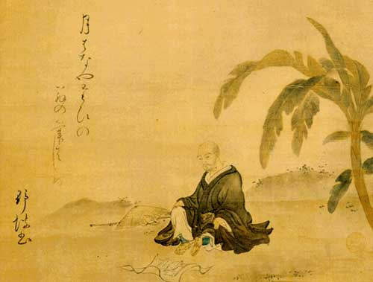
Matsuo Bashō (1644 -1694)

Slide 5
Showing no sign of an early death— a cicada’s voice
—Matsuo Basho
Under the tree in the soup, salad, and everywhere— cherry blossoms
—Matsuo Basho

Slide 6
A lightning flash— and piercing the darkness a heron’s shriek
—Matsuo Basho
A giant firefly flickers and then moves on
—Kobayashi Issa

Slide 7
A cherry petal flies back up to its branch— oh, a butterfly!
—Arakide Moritake (1473-1549)
A small frog rides a banana leaf trembling
—Kikaku (1600-1707)

Slide 8
An old pond; A frog jumps in- The sound of water.
—Matsuo Basho

Slide 9
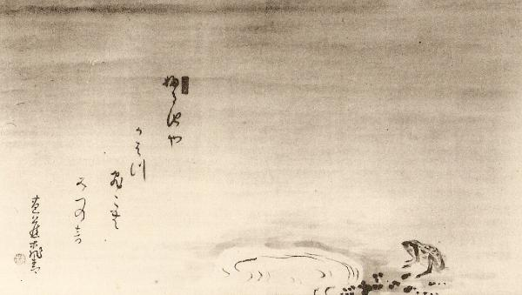

Slide 10
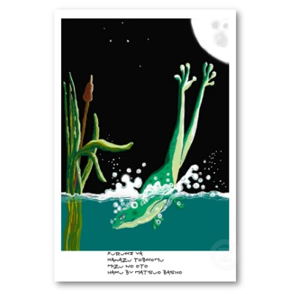

Slide 11
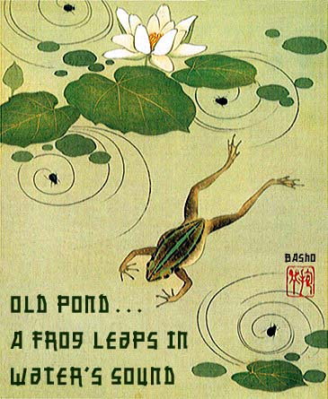

Slide 12
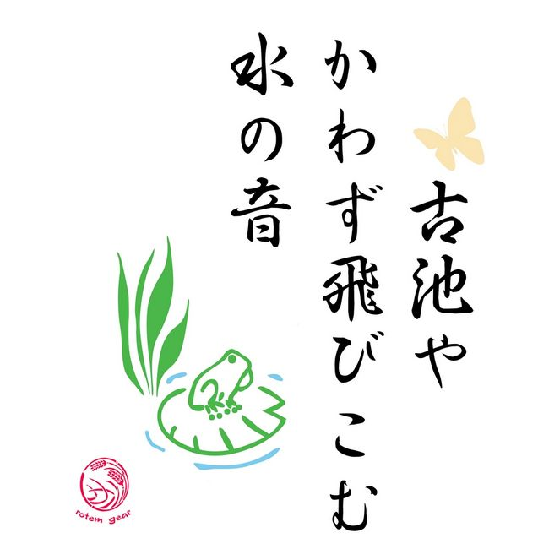

Slide 13
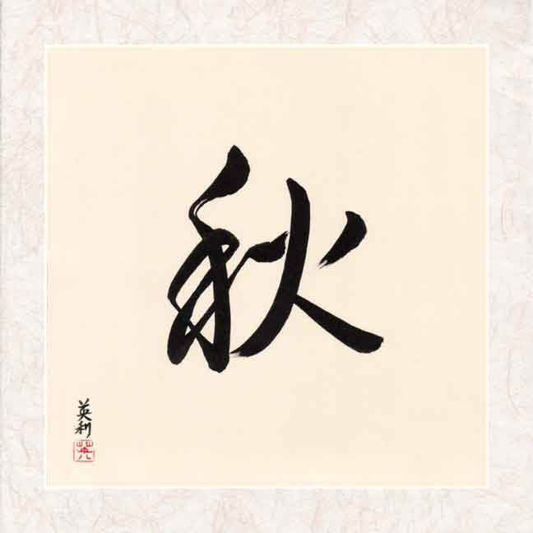
Autumn

Slide 14
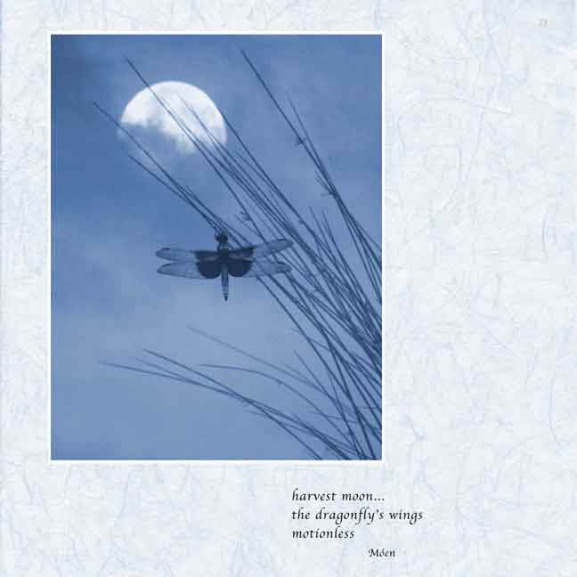

Slide 15
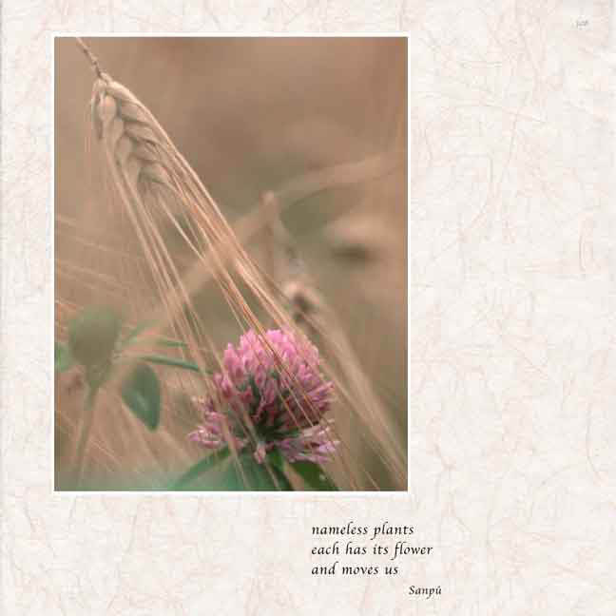

Slide 16
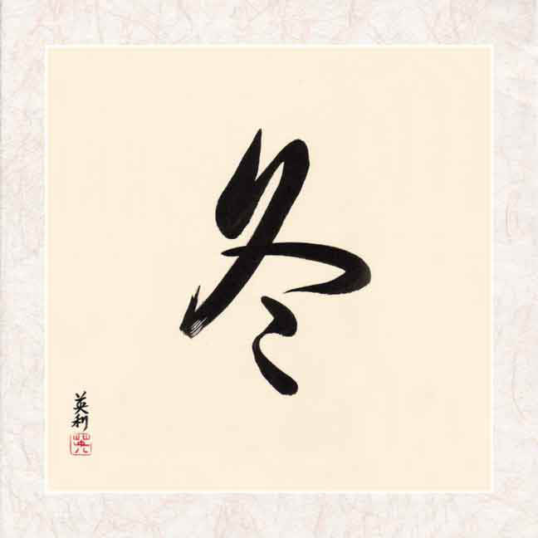
Winter

Slide 17
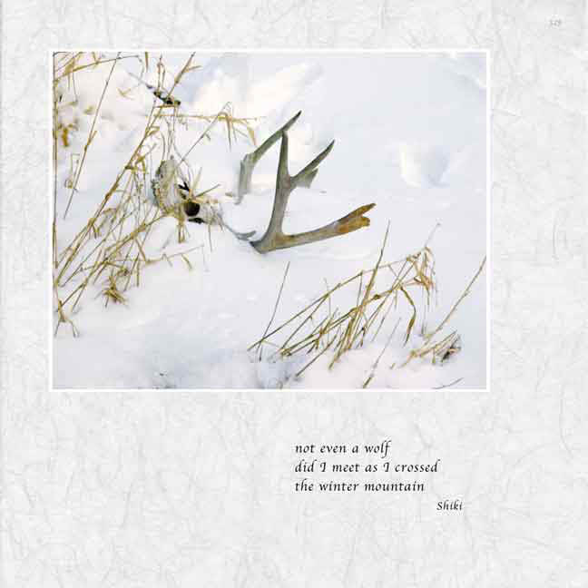

Slide 19
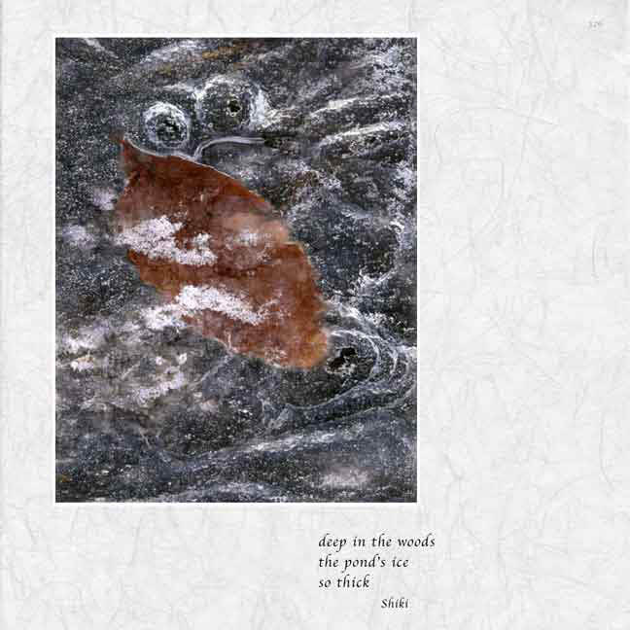

Slide 20
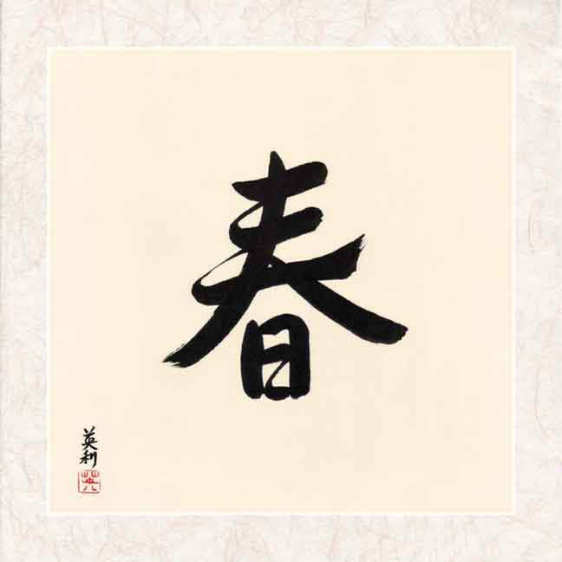
Spring

Slide 21
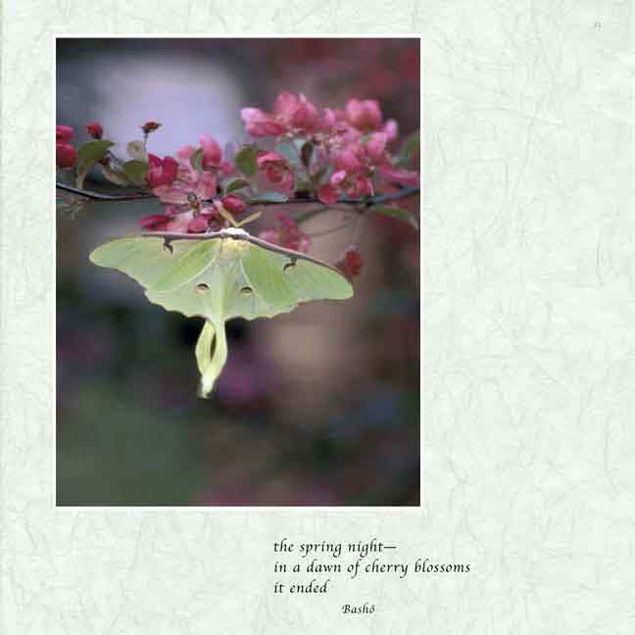

Slide 23
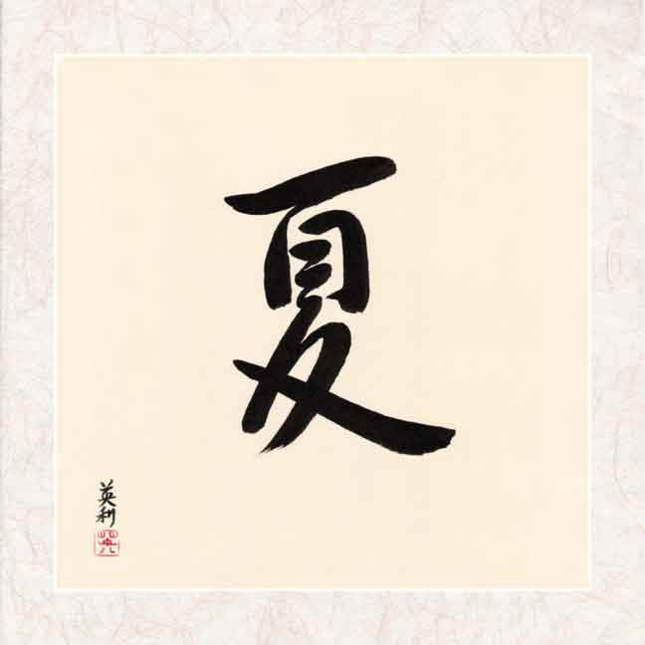
Summer

Slide 24
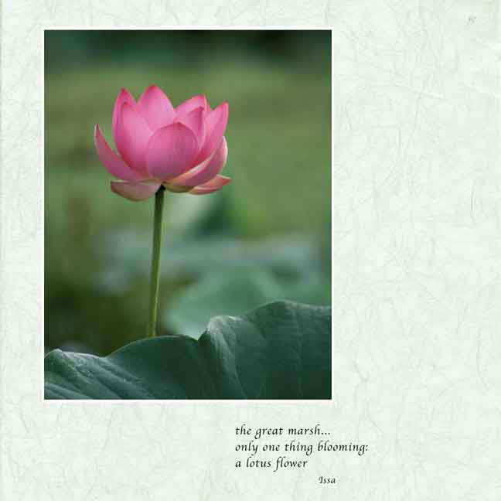

Slide 25
