Slide 1
Hiragana
by number of strokes
Images from: http://japaneselanguageculturefood.com/japanese-language-hiragana.htm

Slide 2
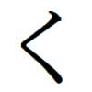
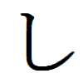
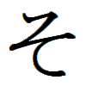
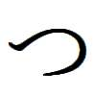
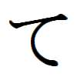
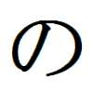
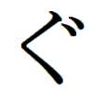
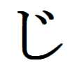
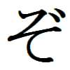
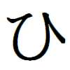
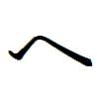
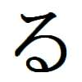
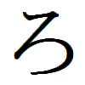
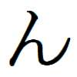
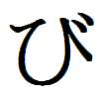
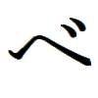
1 STROKE
ku
shi
so
tsu
te
no
gu
ji
zo
de
hi
e / he
ru
ro
n
bi
pi
be
pe

Slide 3
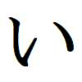
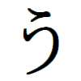
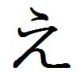
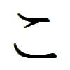
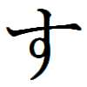
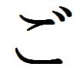
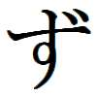
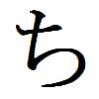
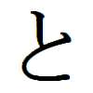
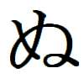
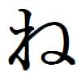
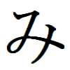
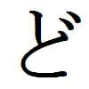
2 STROKES
i
u
e
ko
su
go
zu
chi
to
nu
ne
mi
do

Slide 4
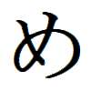
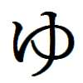
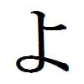
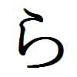
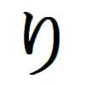
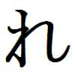
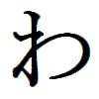
2 STROKES
me
yu
yo
ra
ri
re
wa

Slide 5
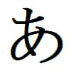
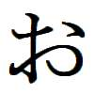
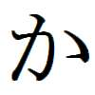
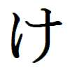
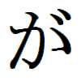
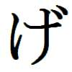
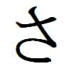
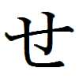
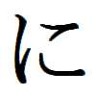
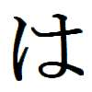
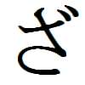
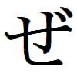
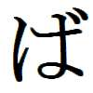
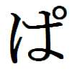
3 STROKES
a
o
ka
ke
ga
ge
sa
se
ni
ha / wa
za
ze
ba
pa

Slide 6
3 STROKES
ma
mu
mo
ya
wo/ o

Slide 7
4 STROKES
ki
ta
na
gi
da
fu
ho
bu
pu
bo
po

Slide 8
Writing practise
by number of strokes

Slide 9
One stroke

Slide 10
1 STROKE
ku
shi
so
tsu
te
no
gu
ji
zo
de
hi
e / he
ru
ro
n
bi
pi
be
pe

Slide 11
HIRAGANA ‘KU’
HIRAGANA ‘GU’

Slide 12
HIRAGANA ‘SHI’
HIRAGANA ‘JI’

Slide 13
HIRAGANA ‘TSU’

Slide 14
HIRAGANA ‘SO’
HIRAGANA ‘ZO’

Slide 15
HIRAGANA ‘TE’
HIRAGANA ‘DE’

Slide 16
HIRAGANA ‘NO’

Slide 17
HIRAGANA ‘HI’
HIRAGANA ‘BI’
HIRAGANA ‘PI’

Slide 18
HIRAGANA ‘HE or E’
HIRAGANA ‘BE’
HIRAGANA ‘PE’

Slide 19
HIRAGANA ‘RU’

Slide 20
HIRAGANA ‘RO’

Slide 21
HIRAGANA ‘RO’

Slide 22
TWO strokes

Slide 23
2 STROKES
i
u
e
ko
su
go
zu
chi
to
nu
ne
mi
do

Slide 24
2 STROKES
me
yu
yo
ra
ri
re
wa

Slide 25
HIRAGANA ‘I’

Slide 26
HIRAGANA ‘U’

Slide 27
HIRAGANA ‘E’

Slide 28
HIRAGANA ‘KO’
HIRAGANA ‘GO’

Slide 29
HIRAGANA ‘SU’
HIRAGANA ‘ZU’

Slide 30
HIRAGANA ‘CHI’

Slide 31
HIRAGANA ‘TO’
HIRAGANA ‘DO’

Slide 32
HIRAGANA ‘NU’

Slide 33
HIRAGANA ‘NE’

Slide 34
HIRAGANA ‘MI’

Slide 35
HIRAGANA ‘ME’

Slide 36
HIRAGANA ‘YU’

Slide 37
HIRAGANA ‘YO’

Slide 38
HIRAGANA ‘RA’

Slide 39
HIRAGANA ‘RI’
*Note: When hand writing don’t join the two lines with a loop.

Slide 40
HIRAGANA ‘RE’

Slide 41
HIRAGANA ‘WA’

Slide 42
THREE strokes

Slide 43
3 STROKES
a
o
ka
ke
ga
ge
sa
se
ni
ha / wa
za
ze
ba
pa

Slide 44
3 STROKES
ma
mu
mo
ya
wo/ o

Slide 45
HIRAGANA ‘A’

Slide 46
HIRAGANA ‘O’

Slide 47
HIRAGANA ‘KA’
HIRAGANA ‘GA’

Slide 48
HIRAGANA ‘KE’
HIRAGANA ‘GE’

Slide 49
HIRAGANA ‘SA’
HIRAGANA ‘ZA’
*Note: When hand writing don’t join the two lines with a loop.

Slide 50
HIRAGANA ‘SE’
HIRAGANA ‘ZE’

Slide 51
HIRAGANA ‘NI’

Slide 52
HIRAGANA ‘HA’ or ‘WA’
HIRAGANA ‘BA’
HIRAGANA ‘PA’

Slide 53
HIRAGANA ‘MA’

Slide 54
HIRAGANA ‘MU’

Slide 55
HIRAGANA ‘MO’

Slide 56
HIRAGANA ‘YA’

Slide 57
HIRAGANA ‘WO’ or ‘O’

Slide 58
FOUR strokes

Slide 59
4 STROKES
ki
ta
na
gi
da
fu
ho
bu
pu
bo
po

Slide 60
HIRAGANA ‘KI’
HIRAGANA ‘GI’
*Note: When hand writing don’t join the bottom line with a loop.

Slide 61
HIRAGANA ‘TA’
HIRAGANA ‘DA’

Slide 62
HIRAGANA ‘NA’

Slide 63
HIRAGANA ‘FU’
HIRAGANA ‘BU’
HIRAGANA ‘PU’

Slide 64
HIRAGANA ‘HO’
HIRAGANA ‘BU’
HIRAGANA ‘PU’

Slide 65
Can you remember the hiragana?

Slide 66
1 STROKE
so
ro
shi
hi
no
e / he
ru
n
tsu
te
ku
be
pi
pe
bi
ji
gu
zo
de

Slide 67
2 STROKES
chi
ko
to
e
mi
u
su
i
nu
ne
go
do
zu

Slide 68
2 STROKES
ra
yu
re
ri
yo
me
wa

Slide 69
3 STROKES
o
ka
ke
sa
se
ha / wa
a
ni
ga
ge
za
ze
ba
pa

Slide 70
4 STROKES
fu
ta
ki
ho
na
gi
bu
da
pu
bo
po

