Slide 1

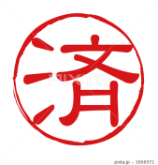


Inkan

Slide 2




?
?
Why Japanese began to use Inkan?
Before 1784…
No custom to use Inkan
悲
和
楽
People started signing things another way!

Slide 3


Question!
People who couldn’t write characters used to use a part of the body to make their mark on documents.
Which part of the body was it?
1.toe
2.thumb
3.lips

Slide 4
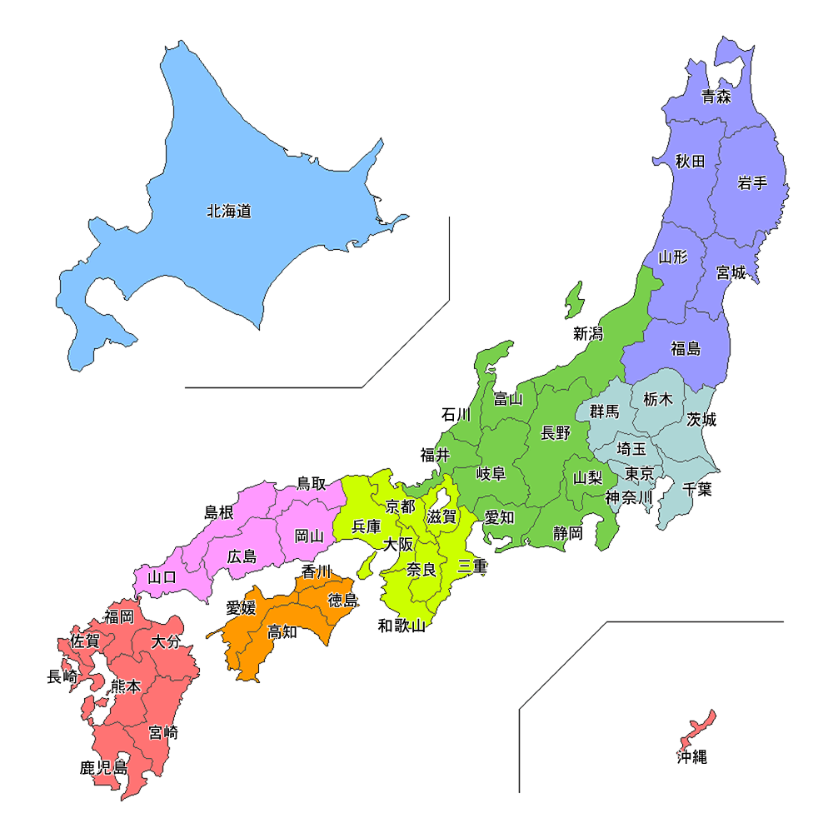
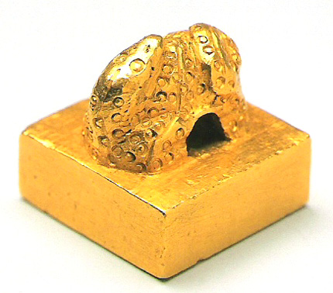
History of Inkan
1784
IN FUKUOKA
The oldest Japanese Inkan
漢倭奴国王
(Kanno wano nanokokuou)

Slide 5
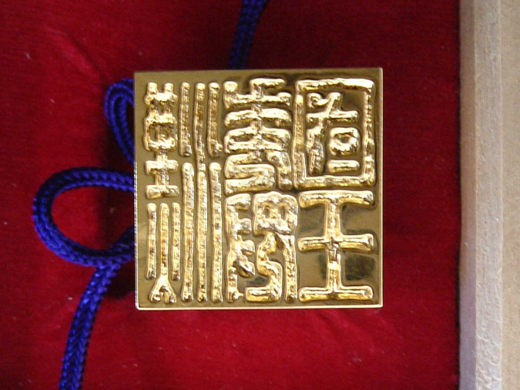

Gift from the Chinese emperor

Slide 6


漢倭奴国王
(Kanno wano nanonokokuou)
=
China
=
Japan
奴国王
Nanokokuou
=
The Japanese king

Slide 7
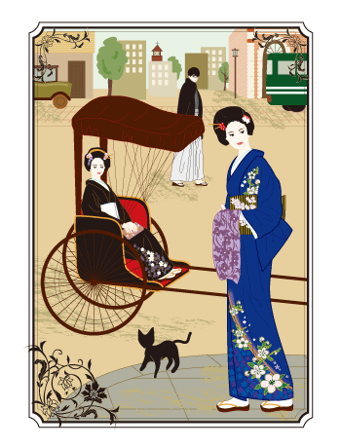
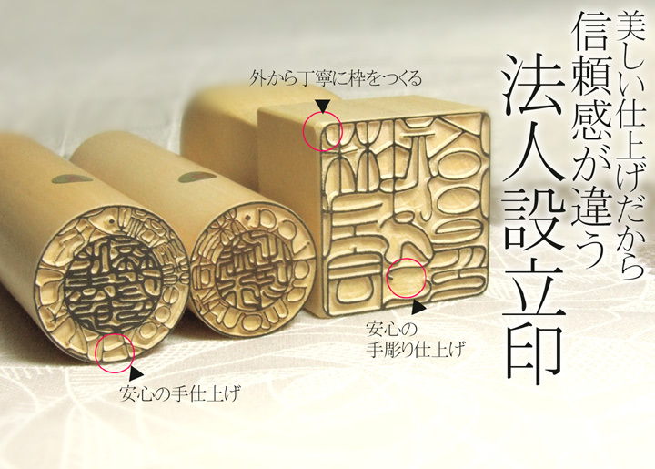
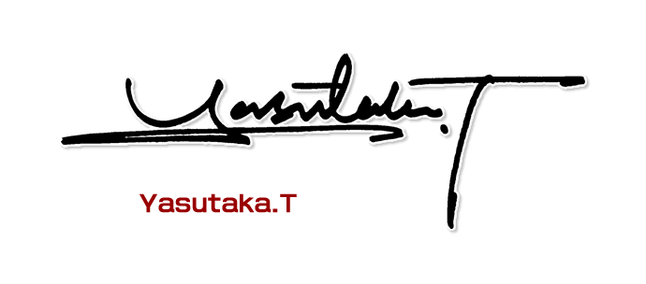
１４０ years ago
People started to use Inkan.
System of signatures after the American and European countries.
×

Slide 8

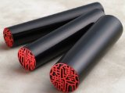
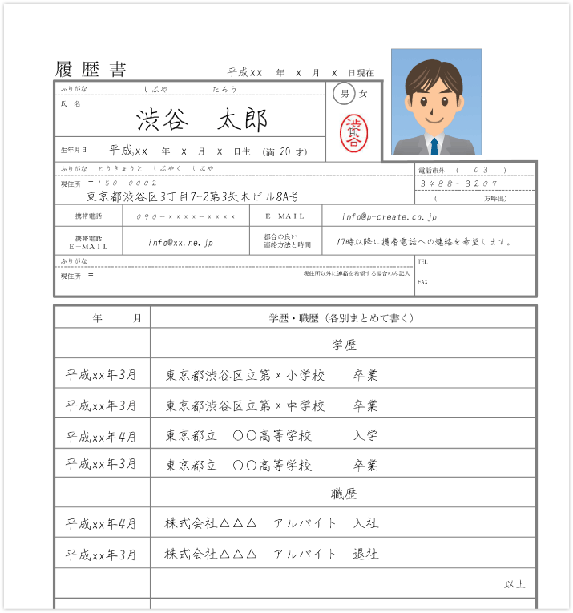


Jitsuin is used for resumes, marriage, real estate and so on.
Jitsuin
City Hall
We register Inkan at City Hall.

Slide 9



Mitomein-General use stamp
We use this frequently
Instead of signing for the parcel
For examples…
・School Documents
・Applications
・Attendance book

Slide 10
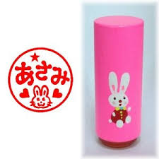
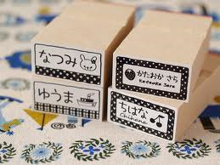
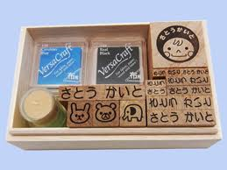
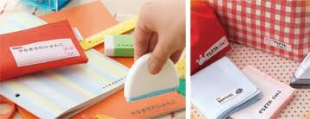
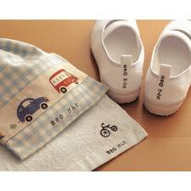
Onamaestanpu – Name stamp

Slide 11
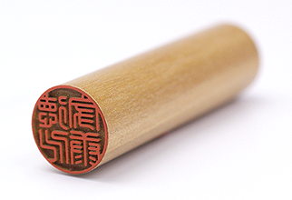
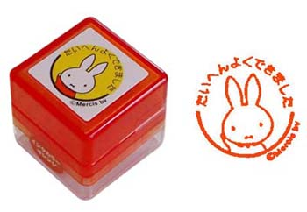
Difference between Inkan and Stamp
“Stamp”
In English
We have two stamps!
Inkan
But…
Stamp
Inkan

Slide 12
Inkan
Different meaning
Stamp
●For providing your identity
●Proves that documents are important
★For amusement

Slide 13
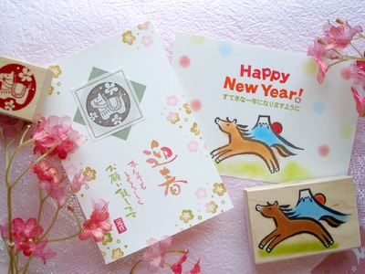
For example…
★To decorate the cards★

Slide 14
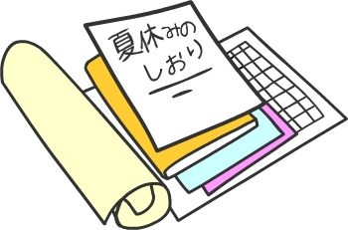

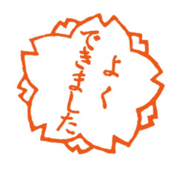
Other example…
Finished checking this homework!!
I have checked this.
Teacher
Great job!

Slide 15

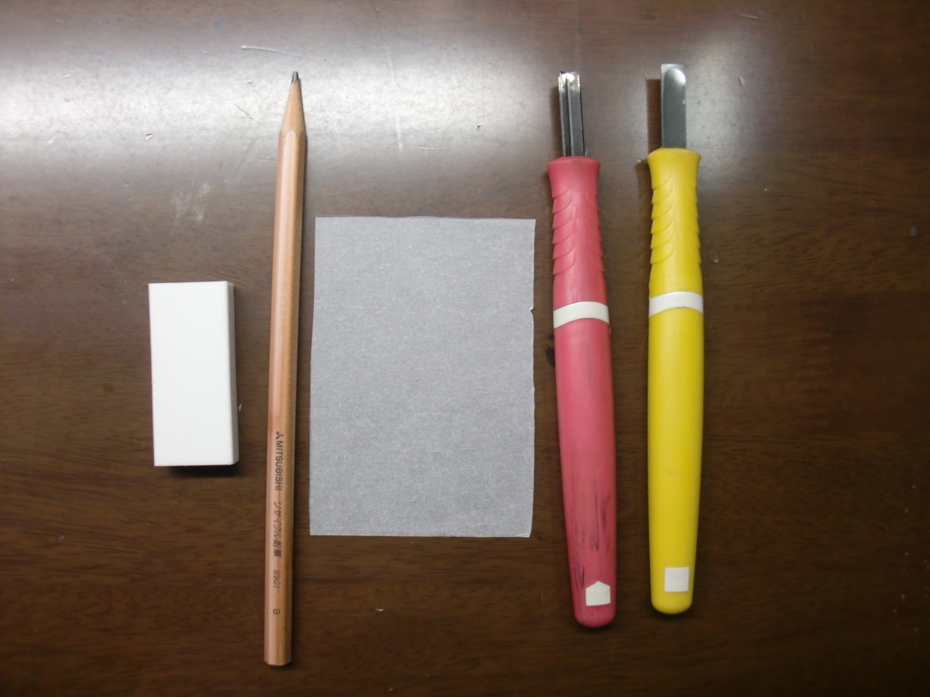

Let’s make a simple stamp!
Things to prepare
Tracing paper
Eraser
Pencil
Inkpad
Chisel

Slide 16
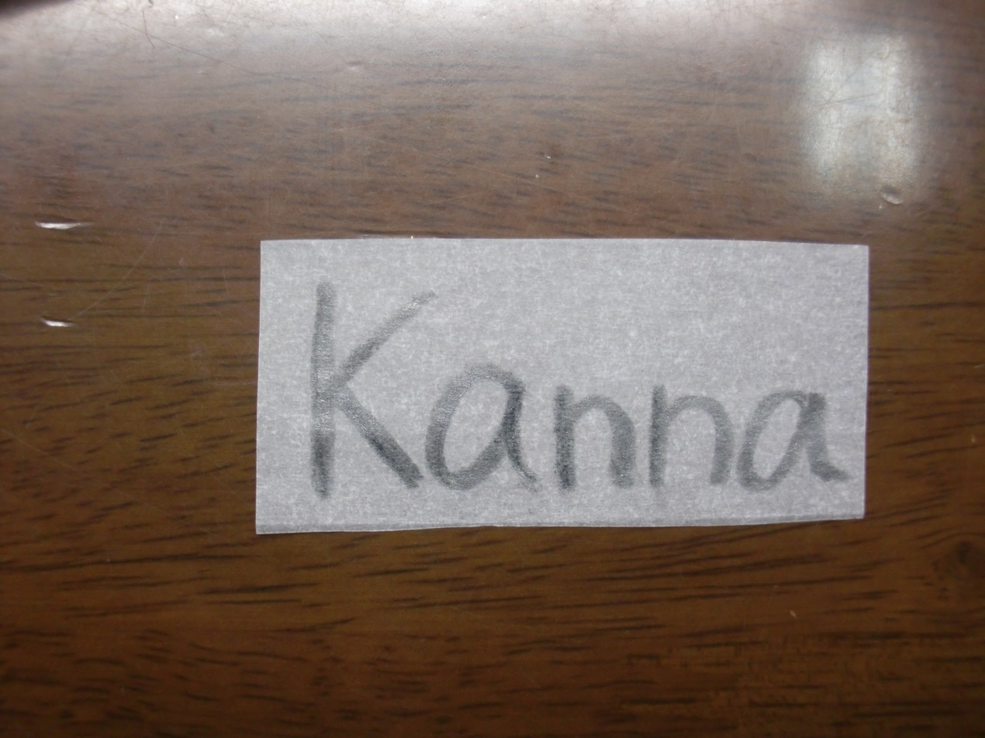
1. You draw a picture or the letter which you want to stamp, on tracing paper.

Slide 17
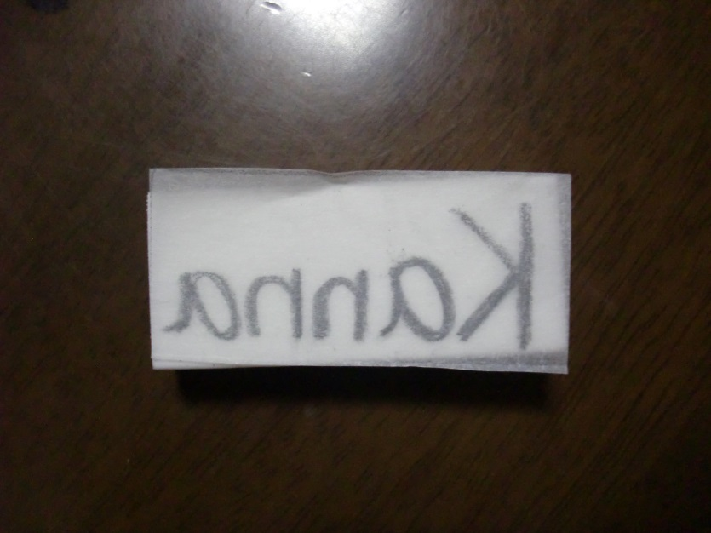
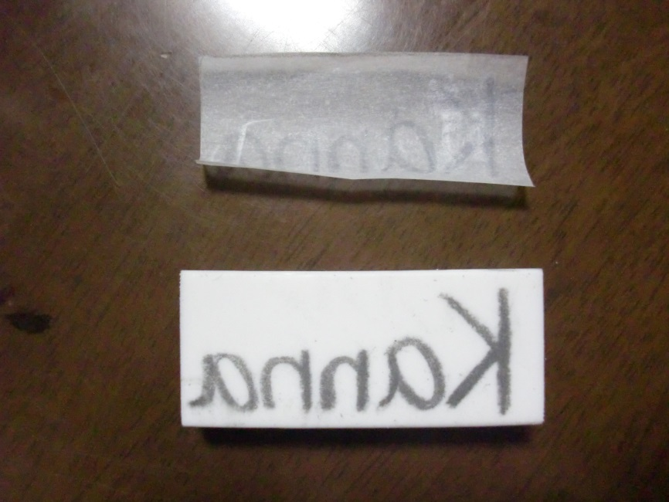
2. You put your tracing paper on which you drew the picture or letter on your eraser. And you scratch that part. Put it on upside down.

Slide 18
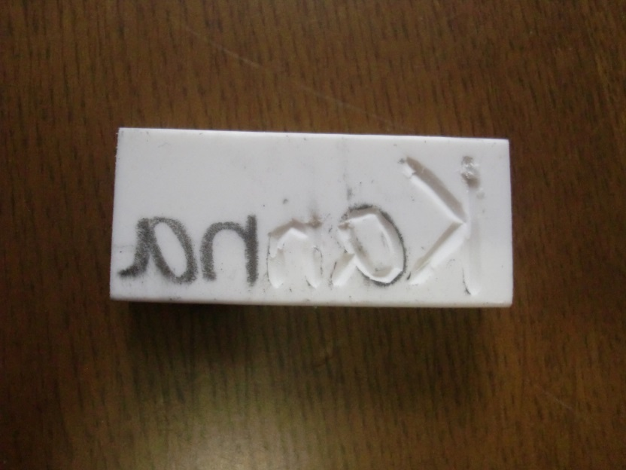
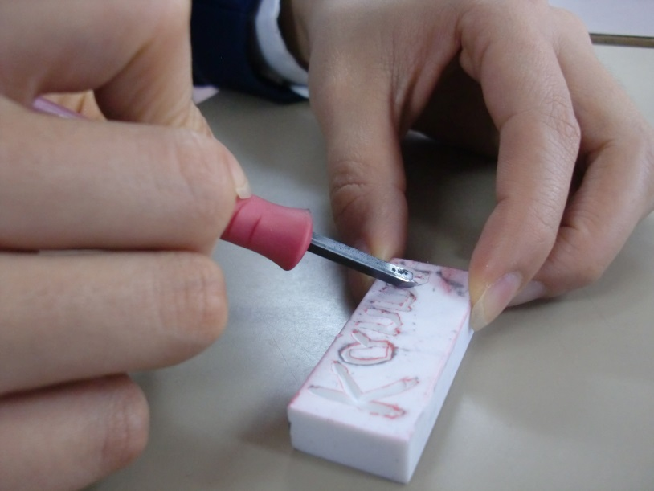

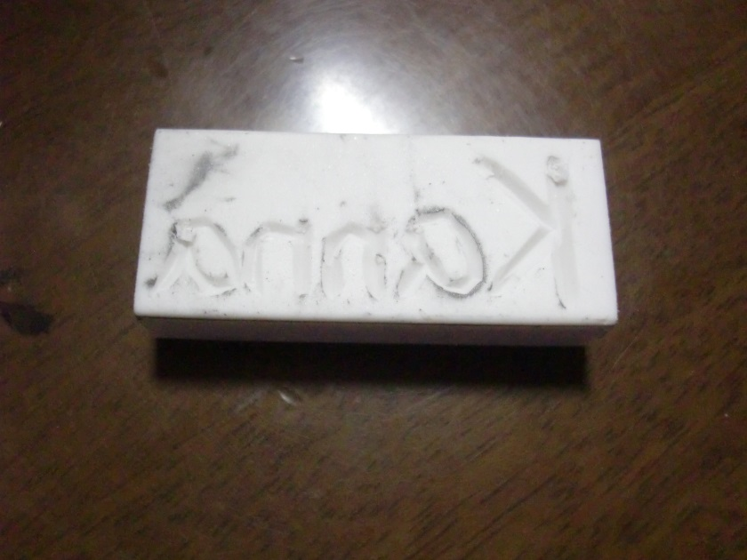

3. You cut the picture or letter.

Slide 19
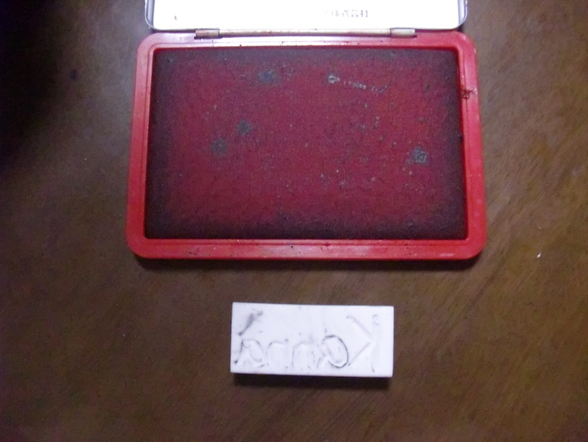
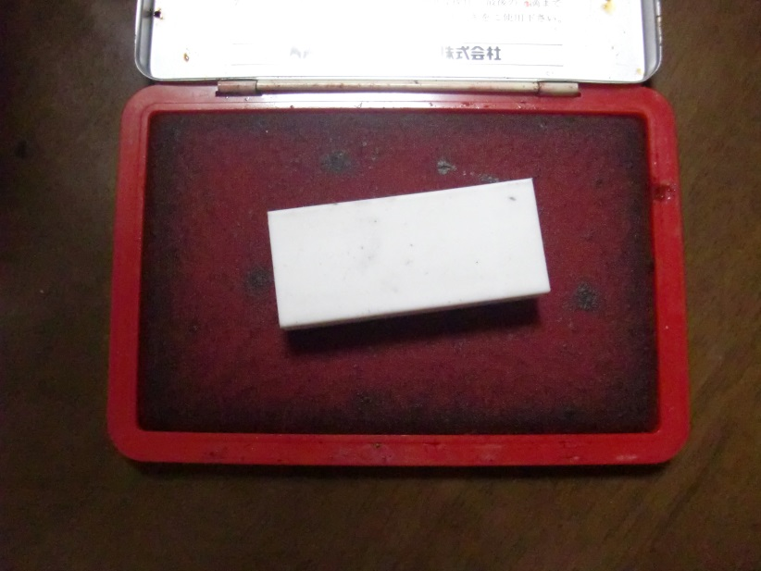


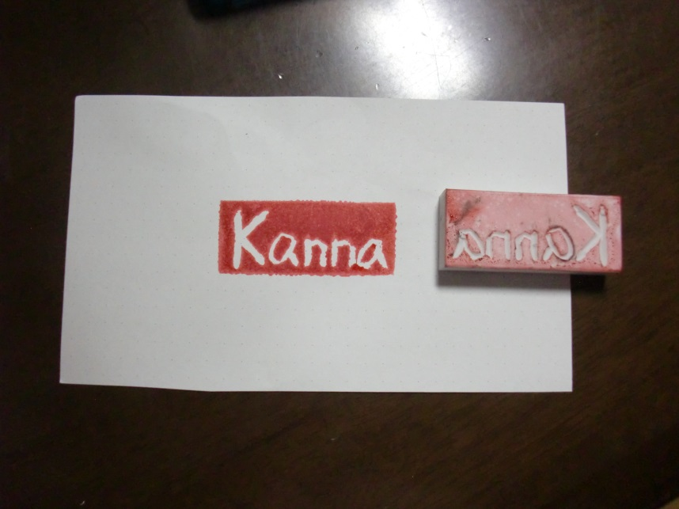
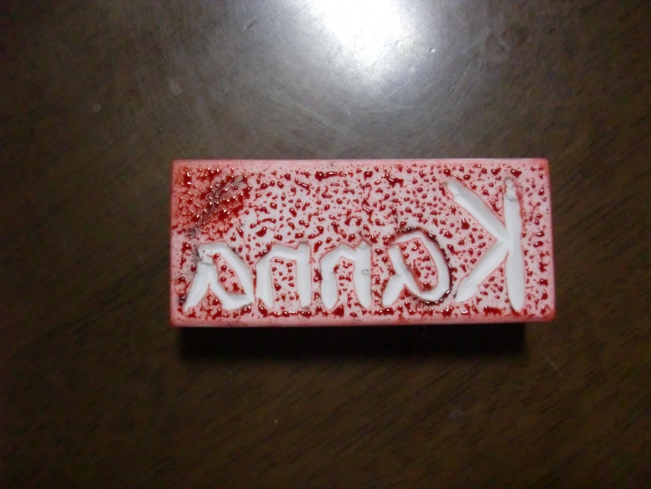
4. Put your stamp on your inkpad.

Slide 20
Let’s make our own stamps!
★
♪

