Slide 1
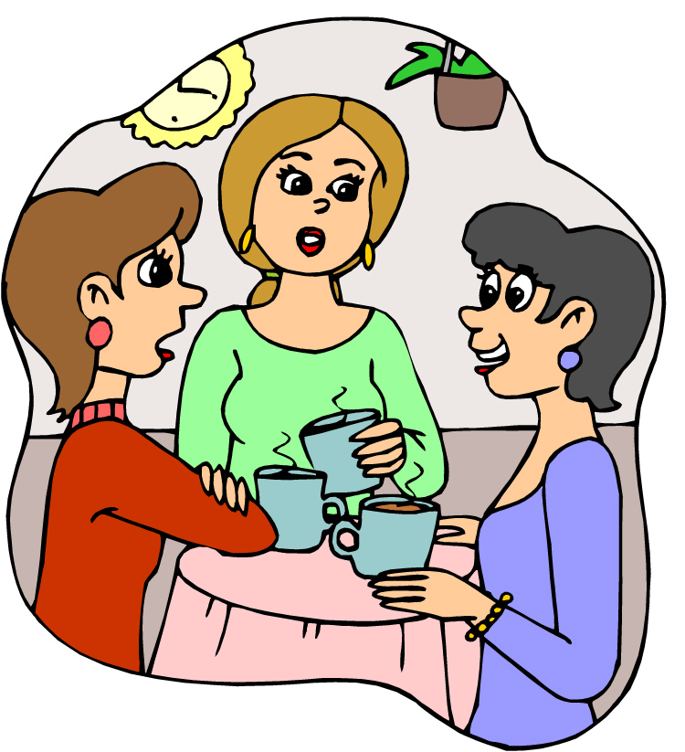
ごしょうかい します
Go-shōkai shimasu

Slide 2
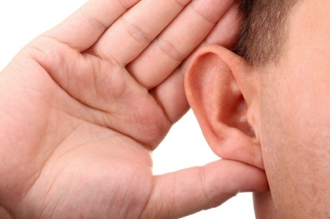
Listening!
Page 25 - #5 (no looking) みないで
Ogawa-san is chatting to Honda-san. Who does Ogawa san introduce Honda-san to?
Page 25 - #６

Slide 3
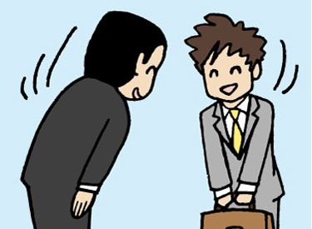
A: Go-shōkai shimasu. Kochira wa NAME-san desu.
B: NAME desu. Dōzo yoroshiku.
C: NAME desu. Dōzo yoroshiku.
Level 1
A: A, NAME-san, konnichiwa. Kyō wa WEATHER tenki desu ne.
B: Sō desu ne.
A: Go-shōkai shimasu. NAME-san, kochira wa NAME-san desu.
C: NAME desu. Dōzo yoroshiku.
B: NAME desu. Dōzo yoroshiku.
Level 2

Slide 4
ごしゅじん go-shujin
しゅじん shujin

Slide 5
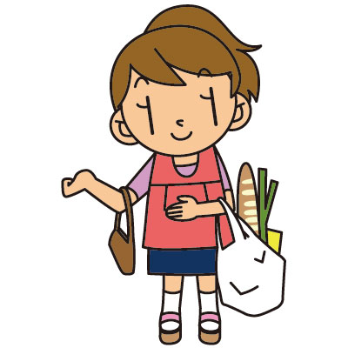
おくさん okusan
かない kanai

Slide 6
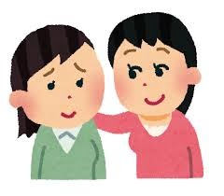
おともだち o-tomodachi
ともだち tomodachi

Slide 7
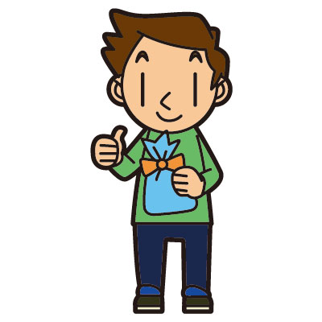
かれし kareshi

Slide 8
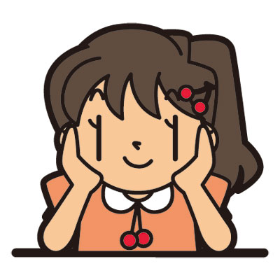
ガールフレンド gaarufrendo
かのじょ kanojo

Slide 9
husband
wife
friend
boyfriend
girlfriend
shujin
tomodachi
go-shujin
kanai
o-tomodachi
kareshi
garufrendo
okusan

Slide 10
Listening!
Page 26 - #2, #3

Slide 11
Kaiwa o shimashō!
Imagine you are in Japan and you are showing some pictures of your friends/family to your new Japanese friends.
A: Kochira wa PERSON desu.
B: O-namae wa?
A: NAME-san desu.
B: O-shigoto wa?
B: JOB desu.
A: COUNTRY-jin desu ka?
B: Hai sō desu.
Level 1
A: Kochira wa watashi no PERSON desu. NAME-san desu.
B: Aa, sō desu ka?O-shigoto wa nan desu ka?
A: JOB desu.
B: A, sō nan desu ka? COUNTRY-jin desu ka?
A: Iie, COUNTRY-jin desu. OR Hai sō desu.
Level 2

