Slide 1
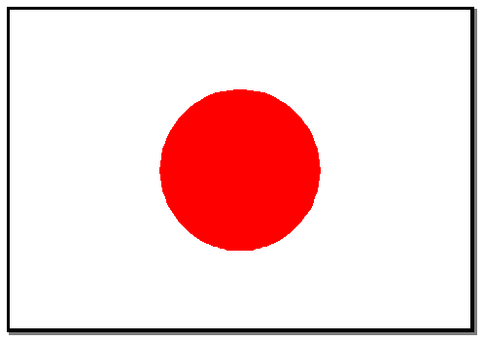
Japanese Language Booklet
Name: ____________

Slide 2
1. Japanese Greetings

Slide 3
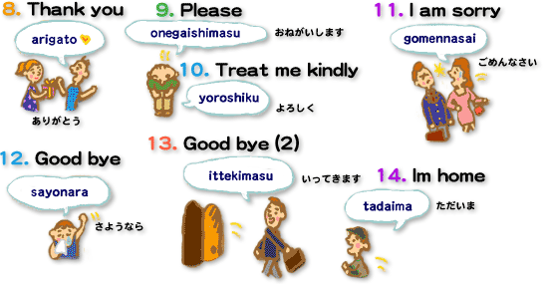
Some other useful sayings
English | Roomaji | Hiragana
How are you? | Ogenki desu ka. | おげんき ですか。
Yes, I am well | Hai, genki desu | はい、げんき です。
I’m okay | Maa maa desu. | まあまあ です。
Excuse me | Sumimasen | すみません
It’s okay | Daijoubu desu. | だいじょうぶ です。
Hello (on the phone) | Moshi moshi | もし もし
Dear ______ | _______ e | ＿＿＿ へ
From ______ | _______ yori | ＿＿＿＿より
You’re welcome | douitashimashite | どういたしまして

Slide 4
What would you say in the following situations?
Your friend gives you an apple.
You meet a friend in the afternoon.
You come back from school.
You meet your friend in the morning.
You say goodbye to a friend.
You meet your friend's parents for the first time.
You run into a friend in the evening.
You leave the house to go to school.
You head for bed.
You accidentally bump into a friend.
You answer the phone
You end a letter
Someone says thank you
With a partner write and rehearse a script to present in front of the class using the greetings and other words you have just learnt.

Slide 5
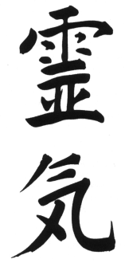
Japanese Scripts
There are 3 types of Japanese characters:
Hiragana
The basic Japanese alphabet. There are 46 symbols. There is only one way of pronouncing each Japanese character or combination of characters, unlike the English alphabet.
Katakana
This is another way of writing the Japanese sounds. Usually used with foreign words.
Kanji (Chinese characters)
These are Chinese characters and each character has its own specific meaning
Roomaji
This is the Japanese language written in English letters.
わたし
タクシ
Name the types of script used…
こんにちは
ミルク
日本語
にほんご
バス

Slide 6
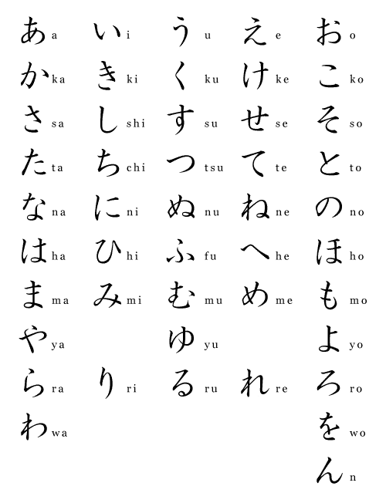
Hiragana Chart
How many Hiragana do you know?
Record your pretest result here and compare it with how you go at the end of the term.
Beginning of Term /46 End of Term /46

Slide 7
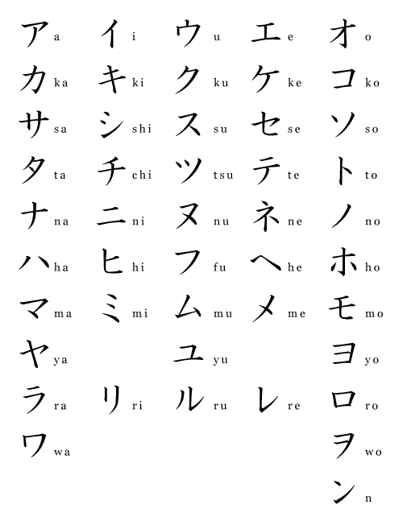
Katakana Chart
Highlight the katakana you already recognise.

Slide 8
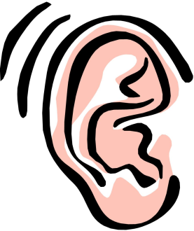
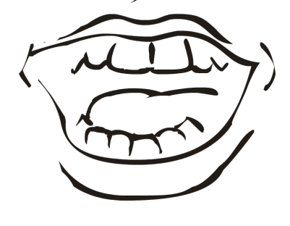
So how do you say it?
Even though writing in roomaji may look like English letters, the way that you pronounce the sounds may be different. But don’t worry! Once you have learnt how to pronounce the sounds they will always be the same so you can always say the words correctly.
Just remember...
a as in art
i as in we
u as in soon
e as in get
o as in hot

Slide 9
List 2 new things you have learnt from today’s lesson
Spend a few minutes adding any new words to your vocabulary book.
よくできました！

Slide 10
2. Meeting New Friends
はじめまして。
Hajimemashite.
How do you do?
わたしはルーシーです。
Watashi wa ruushii desu.
I am Lucy.
おなまえはなんですか？
Onamae wa nan desu ka?
What is your name?
はじめまして。
Hajimemashite.
How do you do?
わたしはトムです。
Watashi wa tomu desu.
I am Tom.
どうぞよろしく。
Douzo yoroshiku.
Pleased to meet you.

Slide 11
Substitute your name on the conversation below and practise with your friend.
はじめまして。
Hajimemashite.
How do you do?
わたしは＿＿＿＿＿です。
Watashi wa ＿＿＿＿＿ desu.
I am＿＿＿＿＿.
おなまえはなんですか？
Onamae wa nan desu ka?
What is your name?
Draw a picture of yourself and your friend next to the speech bubbles.
はじめまして。
Hajimemashite.
How do you do?
わたしは＿＿＿＿＿です。
Watashi wa ＿＿＿＿＿desu.
I am ＿＿＿＿.
どうぞよろしく。
Douzo yoroshiku.
Pleased to meet you.
どうぞよろしく。
Douzo yoroshiku.
Pleased to meet you.

Slide 12
Have a go at answering the following questions in Japanese. Below is some new vocabulary to help you.
おかあさん
Okaasan
Mother
ペット
petto
pet
ともだち
tomodachi
せんせい
sensei
なまえ
namae
name
わたし
Watashi
I, me
Tomodachi no namae wa nan desu ka?
Sensei no namae wa nan desu ka?
Okaasan no namae wa nan desu ka?
Namae wa nan desu ka?
Petto no namae wa nan desu ka?

Slide 13
Things you may have noticed from today’s lesson
What did you notice about the full stop on the end of the Japanese sentence?
Look again at the list of questions, what is there instead of a question mark?
If “namae” means “name”, why do we say “onamae” when asking a person’s name?
Spend a few minutes adding any new words to your vocabulary book.
よくできました！

Slide 14
3. What language do you understand?
Understanding what language someone speaks is the first step in being able to communicate. Australia is an English speaking country so we usually assume that others speak English. If you are in Japan you will assume that others speak Japanese. Many Japanese people also speak English. Today we will learn how to ask people what language they speak.

Slide 15
Have a go at this script with a friend
にほんご が わかりますか。
Nihongo ga wakarimasu ka.
Do you understand Japanese.
はい、 ちょっと わかります。
Hai, chotto wakarimasu.
Yes, I understand a little bit.
えいご が わかりますか。
Eigo ga wakarimasu ka.
Do you understand English?
いいえ、わかりません。
Iie, wakarimasen.
No, I don’t understand.
なにご が わかりますか。
Nanigo ga wakarimasu ka.
What language do you understand?
ちゅうごくご が わかります。
Chuugokugo ga wakarimasu.
I understand Chinese.

Slide 16
Countries and Languages
In Japanese “go” means language. To say the language that is spoken in that country add “go” to the end of the name of the country. (English is of course the exception). The following table will help you.
France | Furansu | Furansugo | フランスご
Germany | Doitsu | Doitsugo | ドイツご
Italy | Itaria | Itariago | イタリアご
China | Chuugoku | Chuugokugo | ちゅごくご
England | Eikoku | Eigo | えいご
What? | Nani | nanigo | なにご
Now you can say these sentences in Japanese! Have a go...
にほんご が わかります。
Nihongo ga wakarimasu.
I understand Japanese.
なにご が わかります。
Nanigo ga wakarimasuka.
What language do you understand?
えいご が わかりますか。
Eigo ga wakarimasuka.
Do you understand English?

Slide 17
Here are some other very useful phrases to know...
English | Roomaji | Hiragana
Please say it slowly | Mou yukuri hanashite kudasai | もう ゆくり はなして ください。
Please say it again | Mou ichidou itte kudasai | もう いちどう いって ください。
Please write it | Kaite kudasai | かいて くださぢ。
Spend a few minutes adding any new words to your vocabulary book.
よくできました！

Slide 18
4. Describing things
Adjectives ending in “i”, like “ii” (meaning “good”) and “muzukashii”, (meaning “difficult”) can come immediately before the noun they describe. If an adjective does not end in “i” then add “no” before the noun. Here is a table of common things found around the classroom. There are spaces for you to add some more.
Classroom objects
English | Roomaji | Hiragana/Katakana
ruler | jougi | じょうぎ
marker | maaka | マアカ
pencil | enpitsu | えんぴつ
pencil case | fudebako | ふでばこ
rubber | keshigomu | けしごむ
sharpener | enpitsu kezumi | えんぴつ けずみ
scissors | hasami | はさみ
glue | nori | のり
pen | pen | ペン

Slide 19
Here is a table of common adjectives you can use to describe these classroom items. There are spaces for you to add some more. Please add の in the space after the adjective if you need to add it before the noun.
Common Adjectives
English | Roomaji | no | Hiragana/Katakana | の
big | ookii |  | おおきい
small | chiisai |  | ちいさい
cool | kakkoii |  | かっこいい
cute | kawaii |  | かわいい
expensive | takai |  | たかい
cheap | yasui |  | やすい
long | nagai |  | ながい
short | mijikai |  | みじかい
green | midori |  | みどり
blue | aoi |  | あおい
red | akai |  | あかい
black | kuroi |  | くろい
pink | pinku |  | ピンク

Slide 20
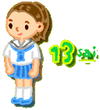
How old are you?
“Sai” refers to age. So if you know Japanese numbers you can say how old you are. Just add “sai” on to the end of the number. The only exceptions are the numbers that end with “chi”, for example “ich” and “hachi”. For these numbers just drop the “chi” and add “s” and “sai” to the end. Use the table below to help you.
Age
English | Roomaji | Hiragana
1 | issai | いっさい
2 | nisai | にさい
3 | sansai | さんさい
4 | yonsai | よんさい
5 | gosai | ごさい
6 | rokusai | ろくさい
7 | nanasai | ななさい
8 | hassai | はっさい
9 | kyuusai | きゅうさい
10 | jusai | じゅさい
11 | juuissai | じゅういっさい
12 | juunisai | じゅうにさい
13 | juusansai | じゅうさんさい
20 | nijussai | にじゅっさい

Slide 21
Have a go at finding some things from around the room and talking about them. Use the script to help you.
Dare no ____ _____ desu ka.
Who’s is this _____ _______ ?
Watashi no ____ ___ desu.
It’s my ______ ____
Douzo.
There you go.
Arigatou
Thank you.
Kore wa anata no ____ ___ desu ka.
Is this your ______ ______?
Hai watashi no ____ ___desu ka.
Yes this is my _____ ______.
Douzo.
There you go.
Arigatou
Thank you.

Slide 22
List 2 new things you have learnt from today’s lesson
Spend a few minutes adding any new words to your vocabulary book.
よくできました！

Slide 23
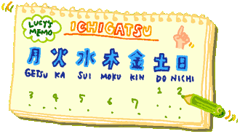
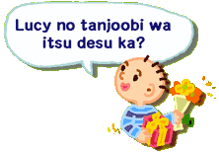
5. When is your birthday?

Slide 24
Saying a date in Japanese is much like saying it in English: You just put the day of the month after the month itself.
Months of the Year
English | Roomaji | Hiragana
January | ichigatsu | いちがつ
February | nigatsu | にがつ
March | sangatsu | さんがつ
April | shigatsu | しがつ
May | gogatsu | ごがつ
June | rokugatsu | ろくがつ
July | shichigatsu | しちがつ
August | hachigatsu | はちがつ
September | kugatsu | くがつ
October | juugatsu | じゅうがつ
November | juuichigatsu | じゅういちがつ
December | juunigatsu | じゅうにがつ

Slide 25
Saying the first 10 days of the month can be a little bit trickier than simply saying the numbers followed by “nichi” meaning “day”. The following table shows what to say for the 1st to the 10th.
Days of the month
English | Roomaji | Hiragana
1st | tsuitachi | ついたち
2nd | futsuka | ふつか
3rd | mikka | みっか
4th | yokka | よっか
5th | itsuka | いつか
6th | muika | むいか
7th | nanoka | なのか
8th | yokka | よっか
9th | kokonoka | ここのか
10th | tooka | とうか

Slide 26
Have a go at this script with a friend
Konnichiwa.
Hello.
Konnichiwa.
Hello.
Nan sai desu ka.
How old are you?
______sai desu .
I am _____ years old.
Soo desu ne. Tanjoobi wa itsu desu ka.
Is that so? When is your birthday?
_____ gatsu _______ desu.
____ month ____ day.
Tanjoobi wa itsu desu ka
When it your birthday?
____ gatsu ______ desu.
____month _____day.

Slide 27
Days of the week
English | Roomaji | Hiragana | Kanji
Monday | getsuyoubi | げつようび | 月ようび
Tuesday | kayoubi | かようび | 火ようび
Wednesday | suiyoubi | すいようび | 水ようび
Thursday | mokuyoubi | もくようび | 木ようび
Friday | kinyoubi | きにようび | 金ようび
Saturday | doyoubi | どようび | 土ようび
Sunday | nichiyoubi | にちようび | 日ようび

Slide 28
Have a go at answering the following questions in Japanese. Below is some new vocabulary to help you.
きょう
Kyoo
today
きのう
Kinoo
Yesterday
ともだち
tomodachi
friend
せんせい
sensei
teacher
あした
ashita
tomorrow
Tomodachi no tanjyoobi wa itsu desu ka.
Sensei no tanjoobi wa itsu desu ka.
Tanjyoobi wa itsu desu ka.
Kyoo wa itsu desu ka.
Kinoo wa itsu desu ka.

Slide 29
List 2 new things you have learnt from today’s lesson
Spend a few minutes adding any new words to your vocabulary book.
よくできました！

Slide 30
Happy Birthday to you!
おたんじょうび おめでと
otanjyoubi omedoto
Happy Birthday to you
おたんじょうび おめでと
otanjyoubi omedeto
Happy Birthday to you
おたんじょうび おめでと ＿＿＿さん
otanjyoubi omedeto (name) san
Happy Birthday dear _____
おたんじょうび おめでと
otanjyoubi omedeto!
Happy birthday to you!

Slide 32
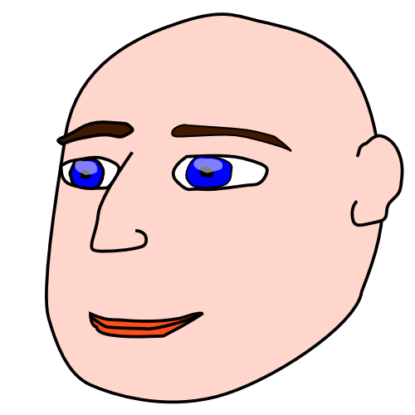
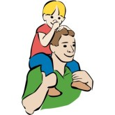
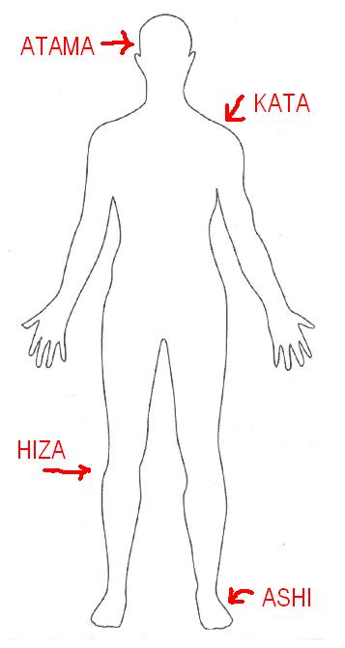
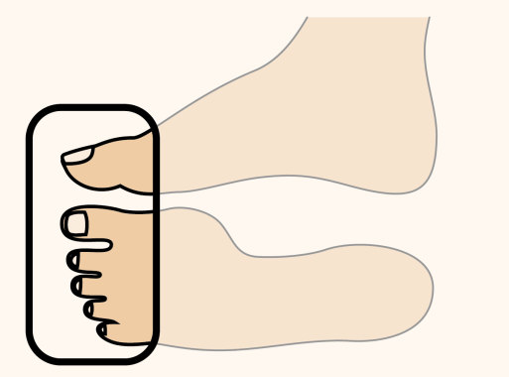
Heads Shoulders Knees and Toes
atama kata
head shoulder
hiza ashi hiza ashi
knee leg knee leg
atama kata
head shoulder
hiza ashi hiza ashi
knee leg knee leg
me to mimi to
eye and ear and
kuchi to hana.
mouth and nose
atama kata
head shoulder
hiza ashi
knee leg

