Slide 1
歌舞伎
KABUKI

Slide 2
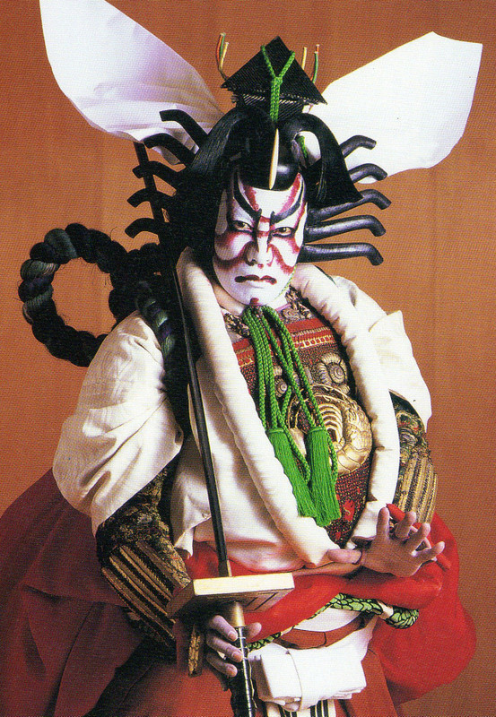
About KABUKI
Kabuki (歌舞伎) is the classical Japanese dance Drama. The individual kanji characters, from left to right, mean sing (歌), dance (舞), and skill (伎).
Some people refer Kabuki as “Japanese Opera’

Slide 3
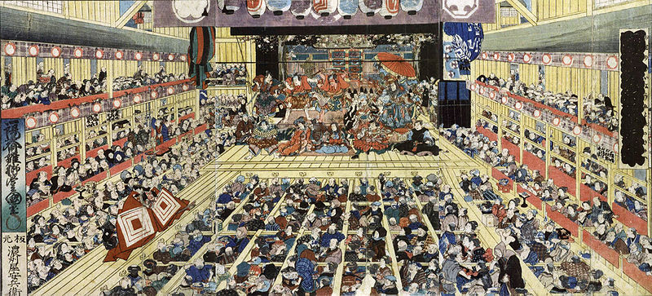
歴史 History
The history of kabuki began in 1603. Female performers played both men and women in comic plays about ordinary life. The Shogun switched to all male performers after 1629. Kabuki has been one of the most popular forms of entertainment in Japan since then.

Slide 4
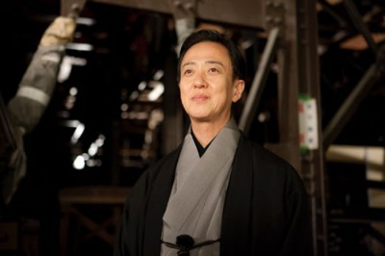
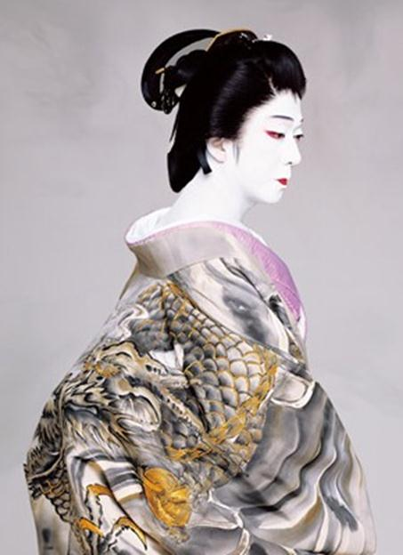
女形 onnagata
After the Shogunate banned females from performing in kabuki, the female roles were played by onnagata ("female impersonators"), who often have movements more feminine than those of real women. During performances they walk delicately with their knees pointed inward and stand sideways to take attention away from the broad masculine shoulders. During their training they are taught to walk like a woman by having their legs tied together at the knees

Slide 5
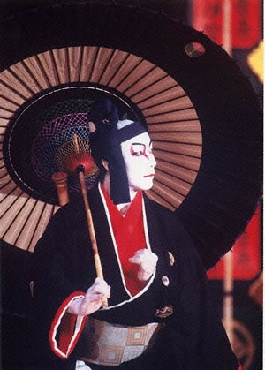
歌舞伎役者 – KABUKI ACTORS
Kabuki acting and traditions are often kept in the family and can span six or more generations. Famous kabuki actors rarely rehearse, as they have been exposed to the plays their entire life.
They know practically the entire 500-play repertoire of kabuki theatre by heart because of their training in classic dance, music, movement and acting from a young age.

Slide 6
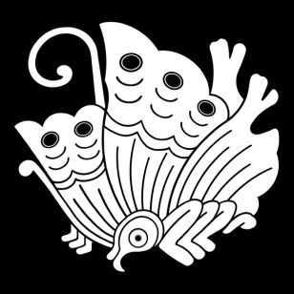
KABUKI Actor Families
Nakamura
Narita
Omodaka
Matsushima
Korai
Yamato
Yorozu
Harima

Slide 7
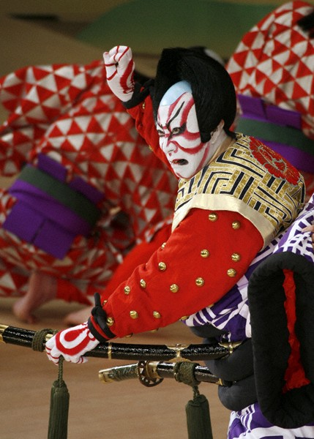
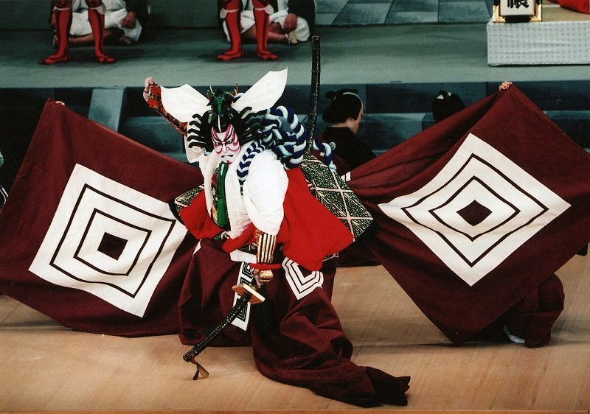
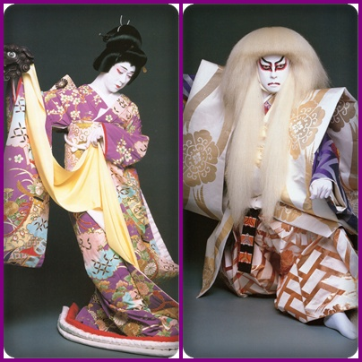
歌舞伎役者 KABUKI ACTORS
Most actors have been trained in family run schools, many of which get their names and styles from famous kabuki actors. Children regard their teacher-father as a master and use formal language when communicating to him even at home.

Slide 8
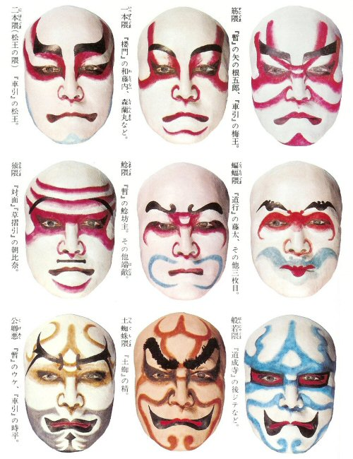
隈取 KUMADORI
Red - anger
Brown - selfishness
Blue - ghost / villain
White face & black eyes - Samurai

Slide 9
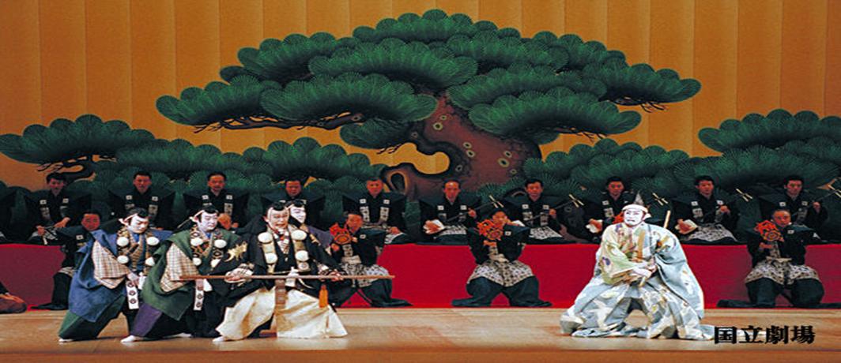
勧進帳 KANJINCHO
‘Kanjincho’ is one of the most popular kabuki plays. The story takes place during the Genpei war (1180-1185). Three brothers from the Minamoto clan help each other to conquer the powerful Heike clan, who killed their parents. However, after the war the eldest son, Yoritomo, feared and envied the youngest who was more talented and clever, and decided to kill him. The youngest, Yoshitsune, who didn’t want to fight with his older brother, tried to escape but was captured and killed.
This story takes place when Yoshitsune, a fugitive with his faithful bodyguard, the famous warrior monk, Benkei, try to pass through a gate surrounded by Yoritomo’s clan.

