Slide 1
Katakana

Slide 2
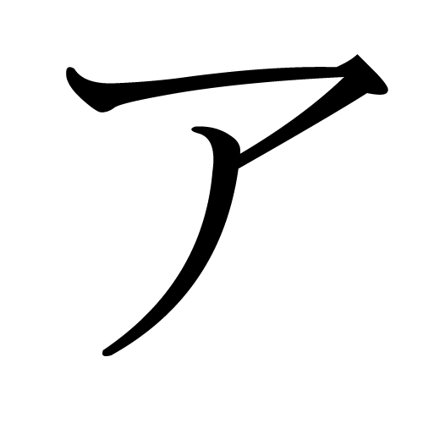
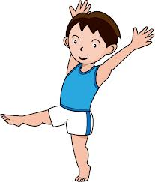
ア - A
A Stands for…. Ah cute boy

Slide 3
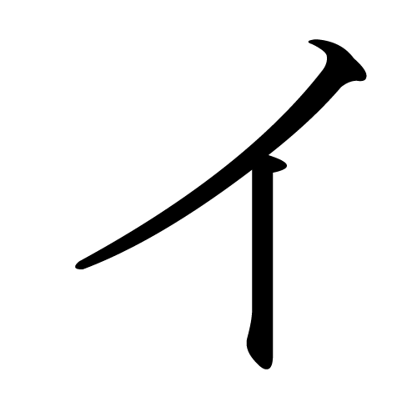
イ - i
i stands for…. Capital cursive i - I

Slide 4
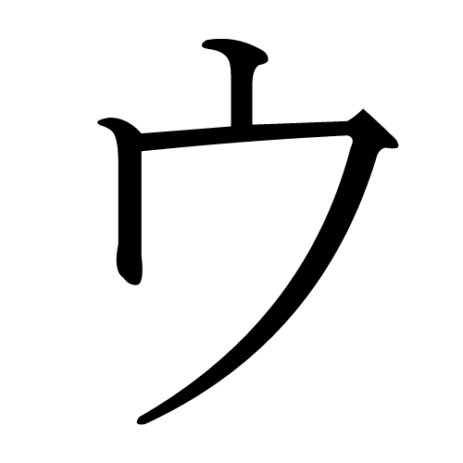
ウ- u
U stands for
Ur reaching your toes

Slide 5
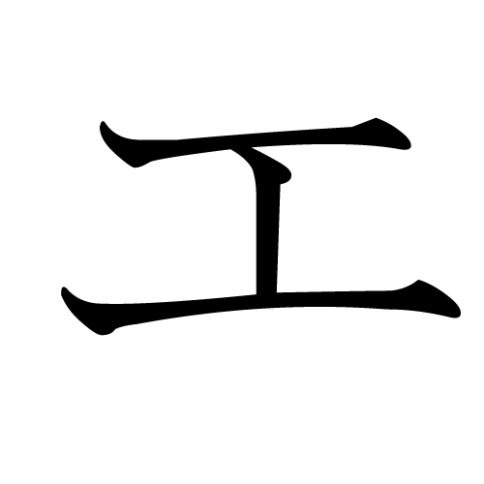
エ - e
Stands for….
Eh? Whats that? An H on its side!

Slide 6
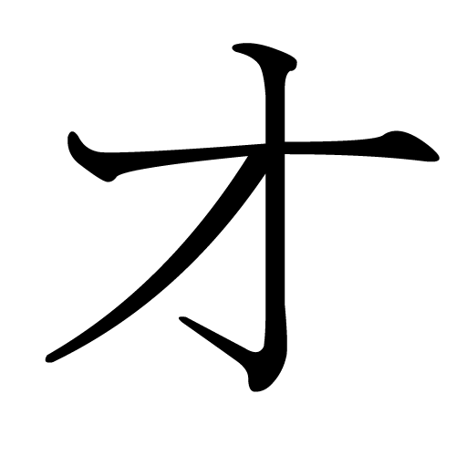
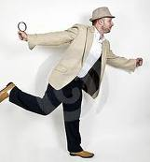
オ - O
Stands for…hopping on one leg

Slide 7
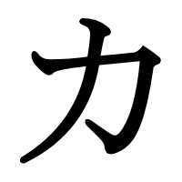
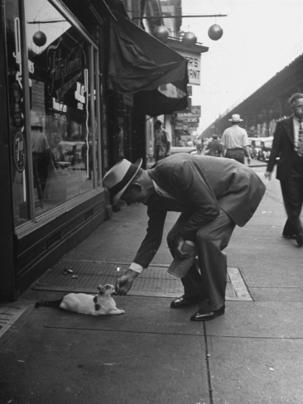
カ - ka
Stands for…. Kate’s Grandpa bending over…

Slide 8
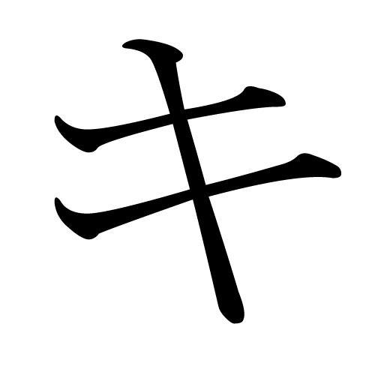
キ- ki
Stands for….
A Key

Slide 9
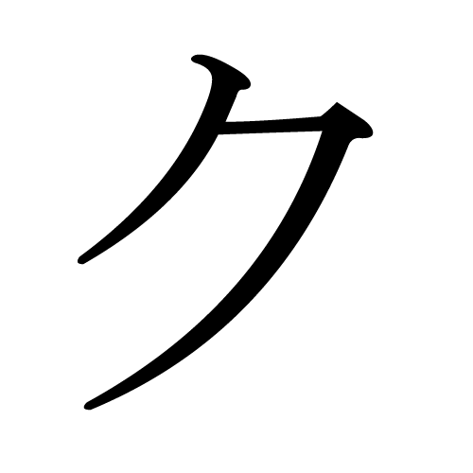
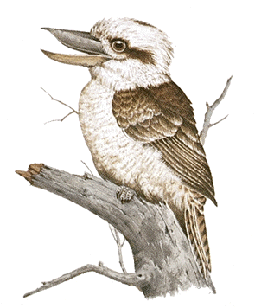
ク - ku
A Stands for….
A Kukaburra’s beak

Slide 10
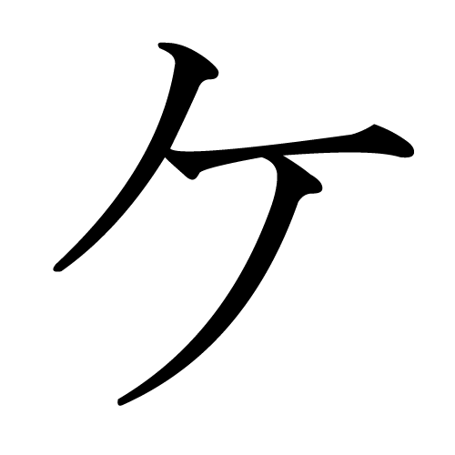
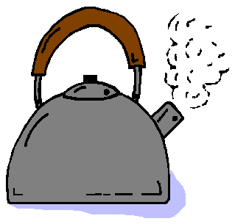
ケ - ke
A Stands for….
A Kettle

Slide 11
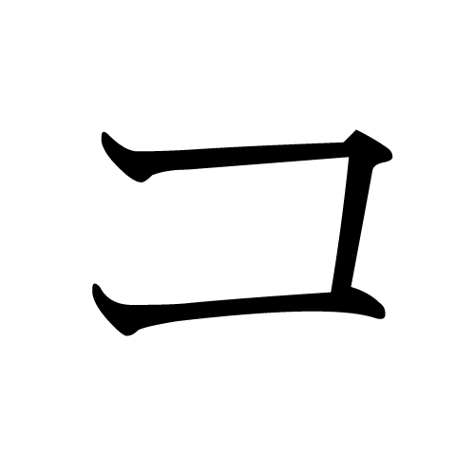
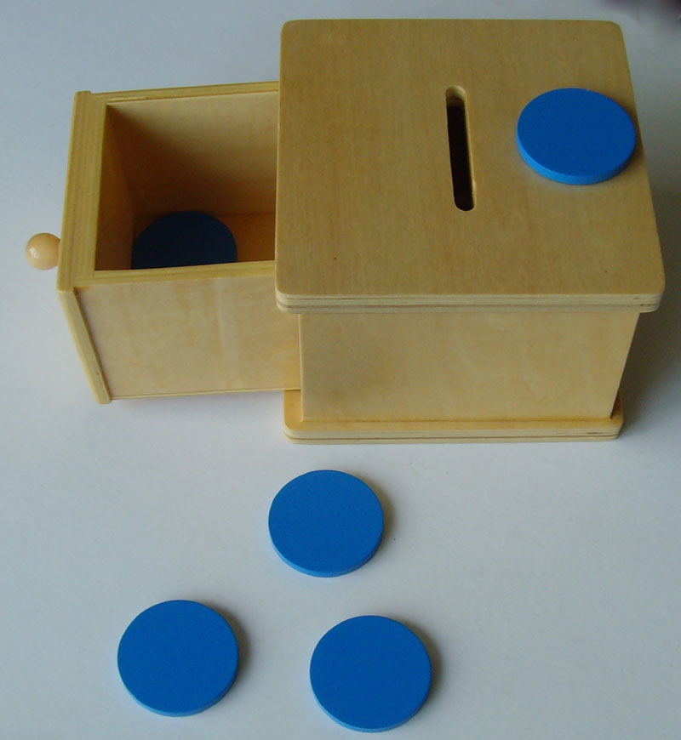
コ - ko
Stands for….
An open coin box

Slide 12
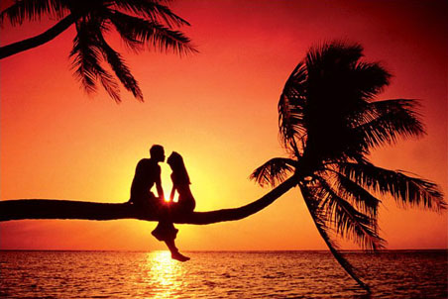
サ - sa
サ
Stands for….
Sitting watching a SUN set

Slide 13
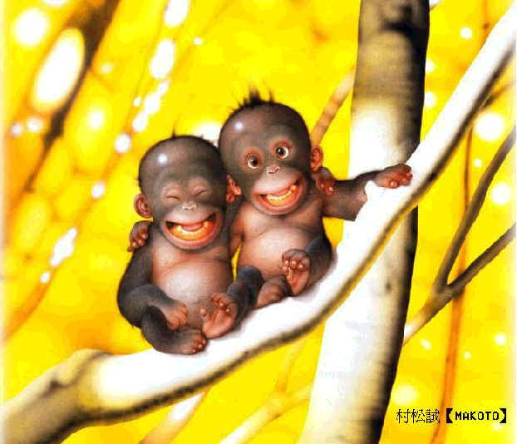
シ - shi
She is looking to the right and she has a nice smile…
シ

Slide 14
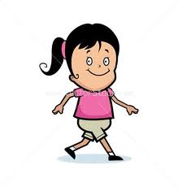
ス - su
Su stands for sue… who is walking…
ス

Slide 15
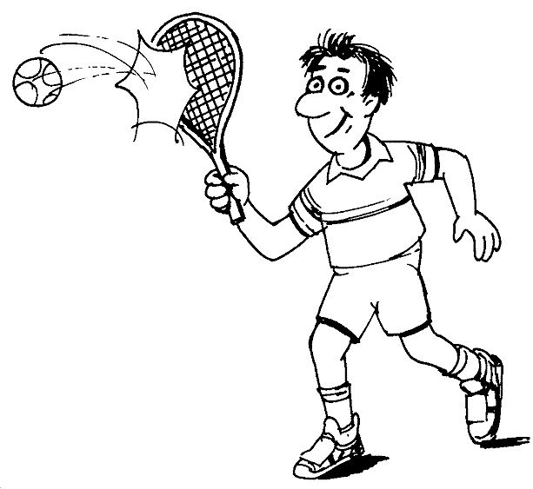
セ - se
セ
Se stands for sepoortuu (sport)

Slide 16
ソ- so
ソ
Stands for sowing

Slide 17
タ - ta
タ
Ta is like KU with an extra line

Slide 18
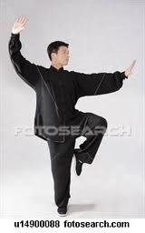
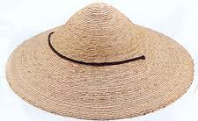
チ - chi
チ
Stands for….
A man doing tai CHI with a hat on

Slide 19
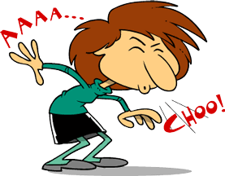
ツ - tsu
ツ
Stands for….
HAAATSUUUUU , blesss you…

Slide 20
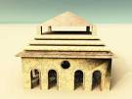
テ - te
テ
Stands for….
テ
The temple is about to fall down!!

Slide 21
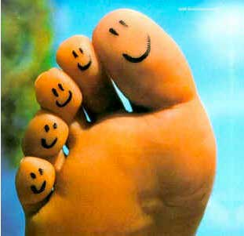
ト - to
ト
Stands for….
A toe being poked…

Slide 22
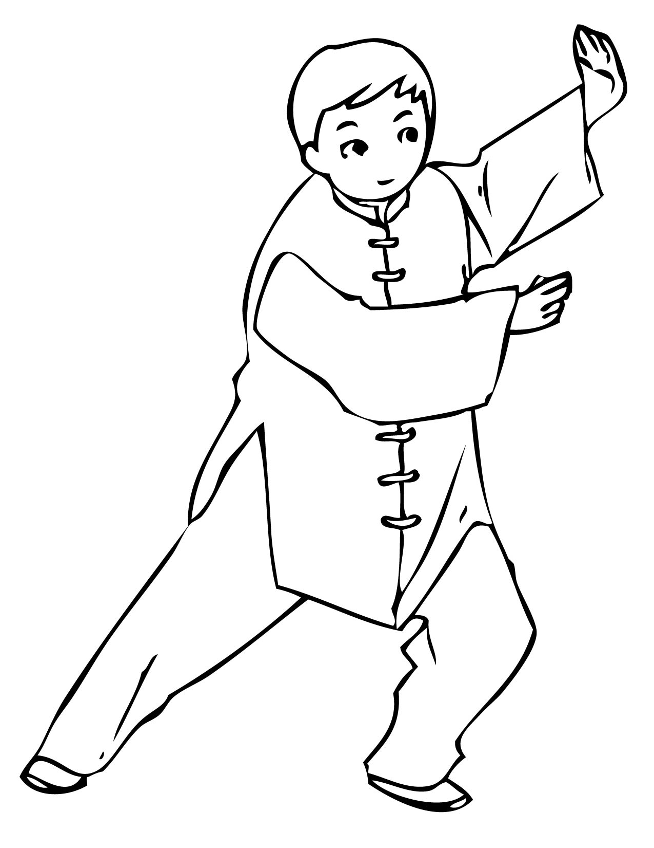
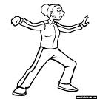
ナ - na
ナ
Na stands for….
My nan doing tai chi

Slide 23
ニ - ni
ニ
Ni stands for….
Wow, you ruled out those lines really Neatly!

Slide 24
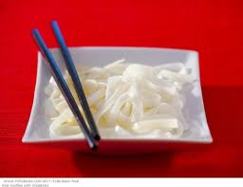
ヌ - nu
ヌ
Nu stands for….
Eating nudles

Slide 25
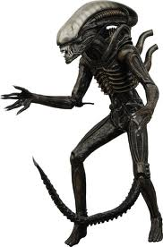
ネ - ne
ネ
Ne Stands for….
Alien on Neptune.

Slide 26
ノ - no
ノ
No Stands for….
Not hard, just a line.

Slide 27
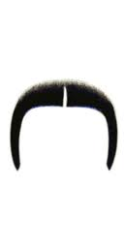
ハ - ha
ハ
Ha Stands for….
Ha, what a funny moustache!

Slide 28
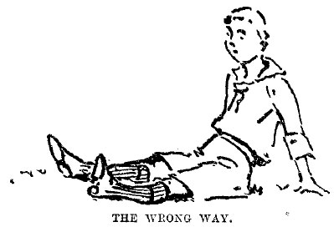
ヒ - hi
ヒ
Hi Stands for….
He is sitting down…

Slide 29
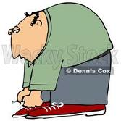
フ - hu
フ
Fu Stands for….
Hu’s that bending over?

Slide 30
ヘ - he
ヘ
He Stands for…
ヘ
Hehehe I’m cute! ^.^

Slide 31
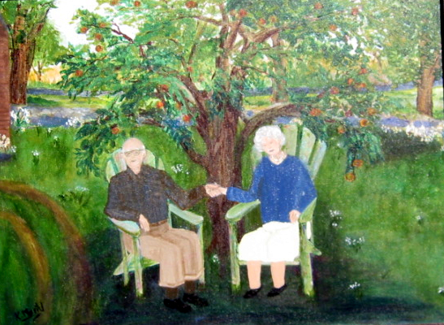
ホ - ho
ホ
Ho Stands for….
Its hot so they sit under the shade of
a tree

Slide 32
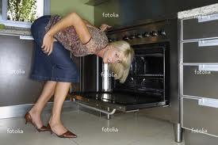
マ- ma
マ
Ma Stands for….
My mum is cooking

Slide 33
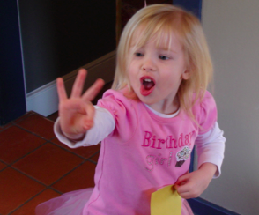
ミ - mi
ミ
Mi Stands for….
Look at me, I am 3!

Slide 34
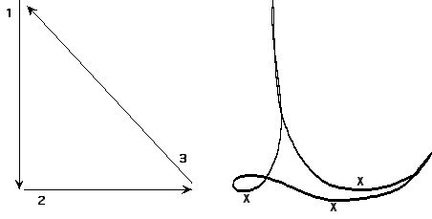
ム - mu
ム
A Stands for….
Conducting in Music

Slide 35
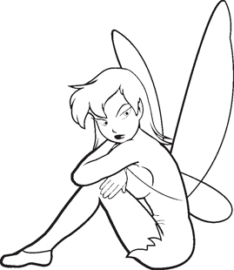
メ - me
メ
Look at me I’m sitting down…

Slide 36
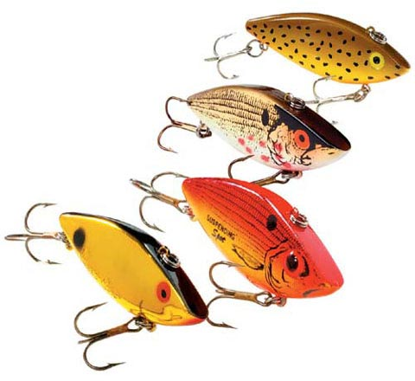
モ – mo
モ
Mo Stands for….
More fish to catch

Slide 37
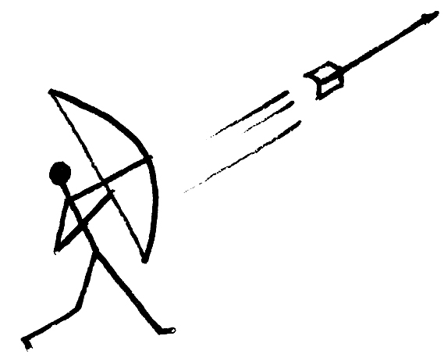
ヤ - ya
ヤ
Ya Stands for….
Yak! Wrong way!

Slide 38
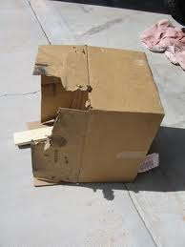
ユ - yu
ユ
Yu Stands for….
Yu broke the box

Slide 39
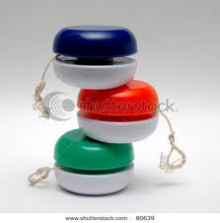
ヨ - yo
ヨ
Yo Stands for…
Three yoyos that are stacked up on top of each other.

Slide 40
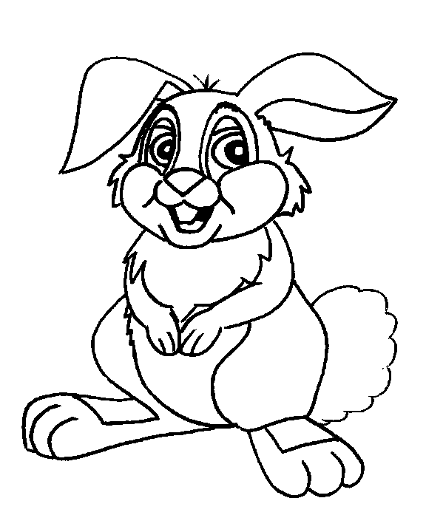
ラ - ra
ラ
Ra Stands for….
Rabbit ears

Slide 41
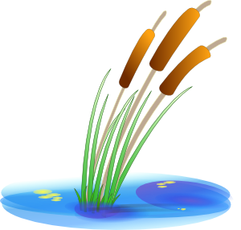
リ - ri
リ
Ri Stands for….
The Reeds

Slide 42
ル - ru
ル
Ru Stands for….
Ruby’s hair

Slide 43
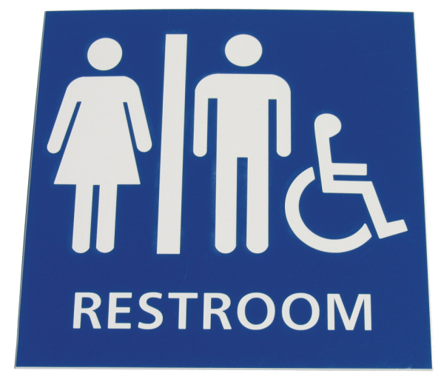
レ - re
レ
Re stands for:
Resting against the wall..

Slide 44
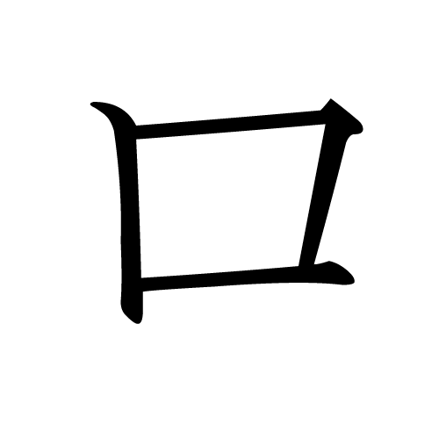
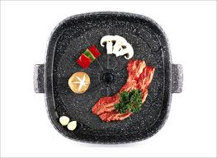
ロ - ro
Ro Stands for….
Square roast pan

Slide 45
ワ- wa
ワ
Wa Stands for….
Wa the sleeping baby says.

Slide 46
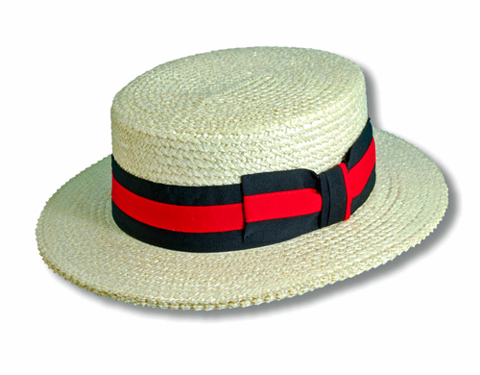
ヲ- wo
ヲ
He wore a hat…

Slide 47
ン- n
ン
N Stands for….
Not different to ‘so’
ソ

