Slide 1
これ、それ、あれ
Using Demonstrative Adjectives to indicate things

Slide 2
これ
Kore – This one (used for things within your reach – closer to you)
http://katanepc.exblog.jp/2590780/

Slide 3
それ
Sore – that one (used to describe things close to you, but out of your reach – closer to the listener)

Slide 4
あれ
Are – that one over there (used to describe things far away from both of you)

Slide 5
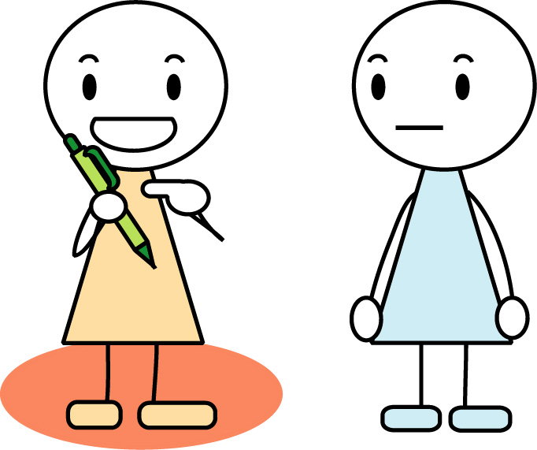
Asking about things near to the speaker
c
Q：これはなんですか？
Kore wa nan desu ka?
(What is this?)
これ = this one
は = particle marking subject
なん = question word = what
です = verb: it is/ to be
か = particle: question marker

Slide 6
Answering
A: それはペンです。
Sore wa pen desu
(That is a pen.)
それ = that one
ペン = pen

Slide 7
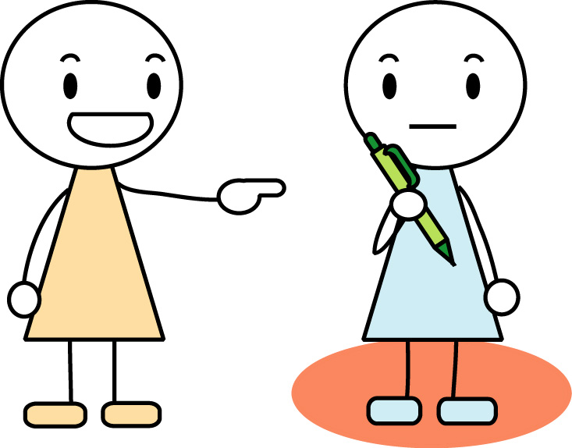
Asking about things near to the listener
Q: それはなんですか？
Sore wa nan desu ka?
(What is that?)

Slide 8
Answering
A: これはペンです。
Kore wa pen desu.
(This is a pen.)

Slide 9
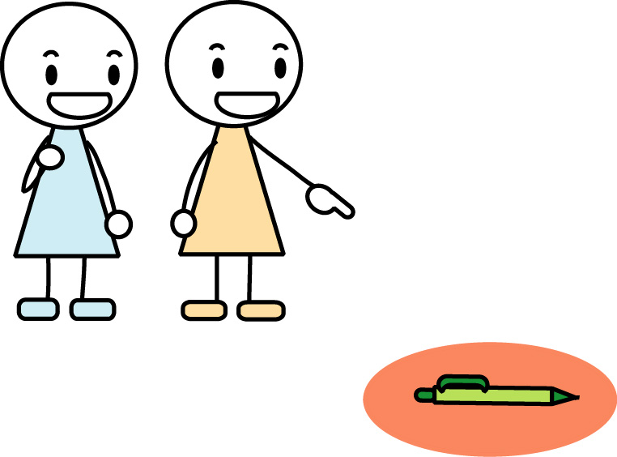
Asking about things distant from both speakers
Q: あれはなんですか？
Are wa nan desu ka?
(What is that over there?)

Slide 10
Answering
A: あれはペンです。
Are wa pen desu.
(That (over there) is a pen.)

Slide 11
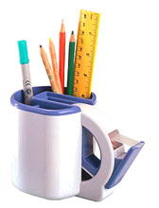
Question word
どれ (dore)
E.g. ぺんはどれですか？
Dore wa pen desu ka?
*Notice どれ comes in the middle
of the sentence instead of
at the beginning.

Slide 12
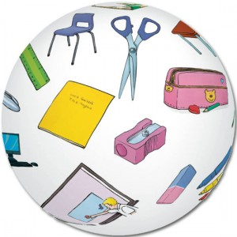
SKIT
Work in pair.
Make a skit with three – four dialogues using これ, それ、あれ to ask and indicate about classroom objects.

