Slide 1
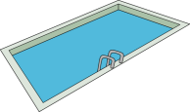
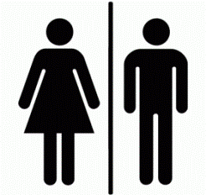
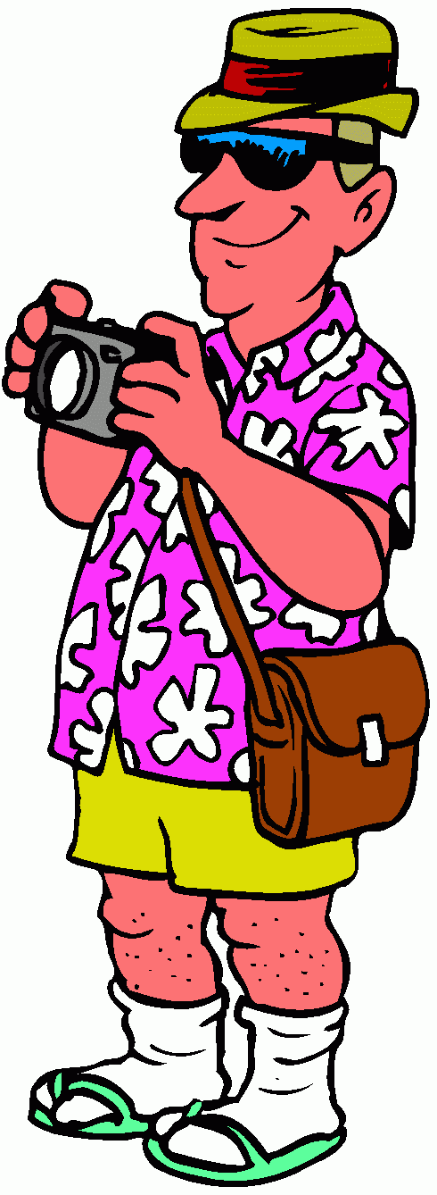
Pūru
Yakitori-ya
Makku
Izakaiya
Hoteru
Depāto
Kēki-ya
Eki
Kōen

Slide 2
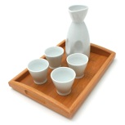
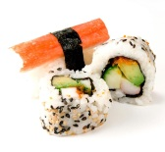
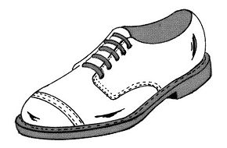
Izakaiya
Mitsukoshi
Depāto
Sakura
Hoteru
Sushi-ya
Sakura Eki
Karaoke bā
Starbucks
Makku
Hibiya
Hoteru
Daimaru
Depāto
Kutsu-ya
Hibiya Kōen
Hibiya Eki

