Slide 1
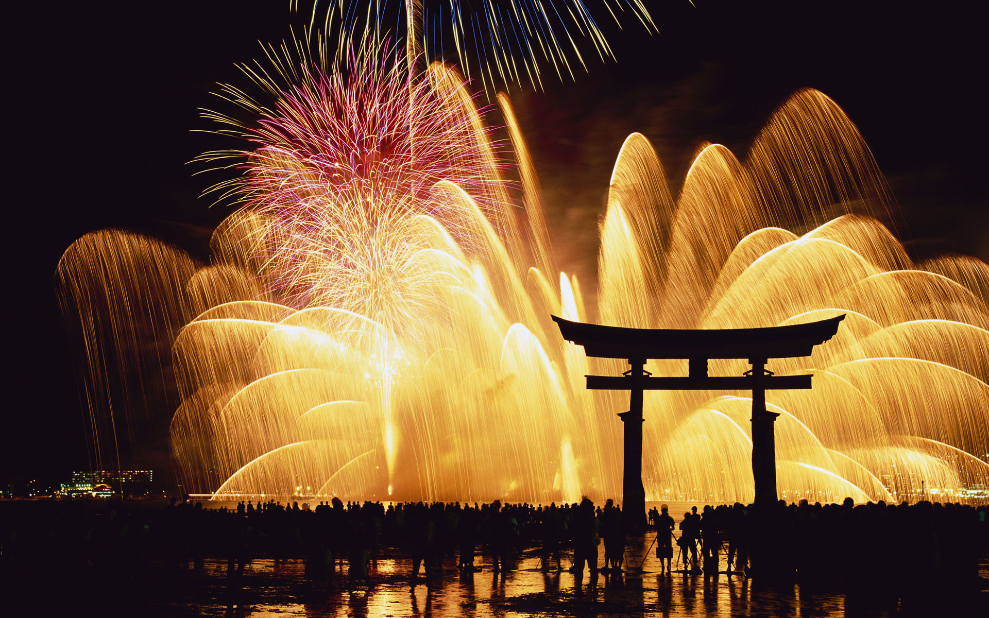
おしょうがつ
お正月
Japanese New Year

Slide 2
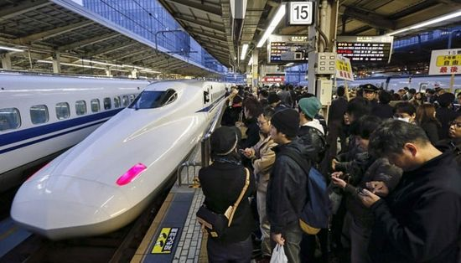
おしょうがつ is the most important holiday in Japan. Most businesses shut down from January 1 to January 3, and families typically gather to spend the days together.

Slide 3
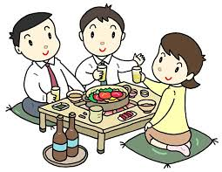
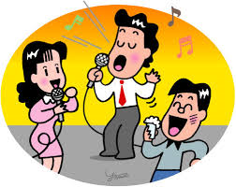
Japanese people believe a new year will provide a fresh start. So, all duties are supposed to be completed by the end of the year.
ぼうねんかい "year forgetting parties" are held with the purpose of leaving the old year's worries and troubles behind.

Slide 4
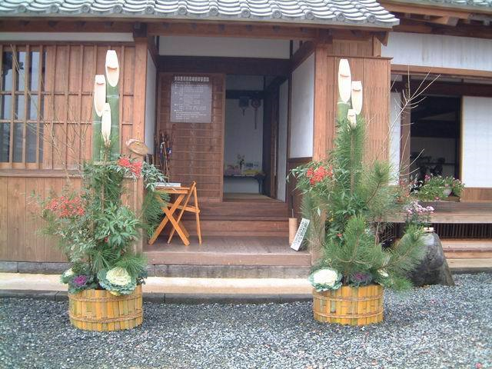
かどまつ (pine gates) are traditional decorations of おしょうがつ placed in pairs in front of homes to welcome ancestral spirts to the harvest.

Slide 5
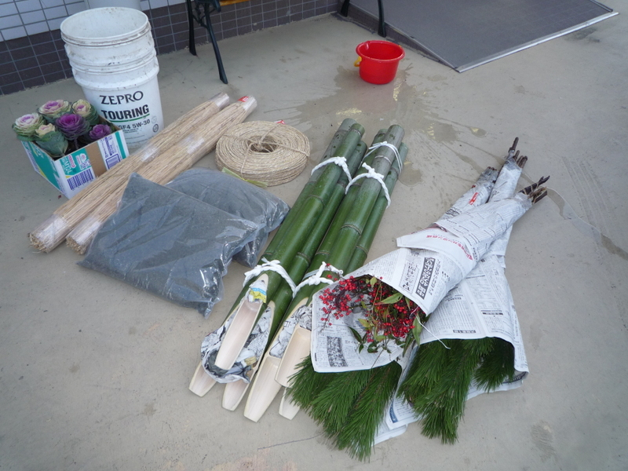
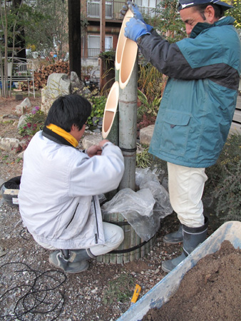
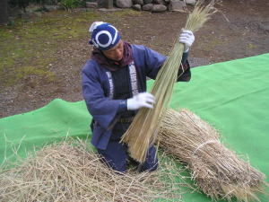
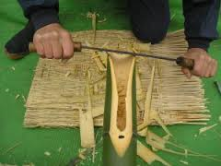
かどまつ are made of pine, bamboo and sometimes plum tree.

Slide 6
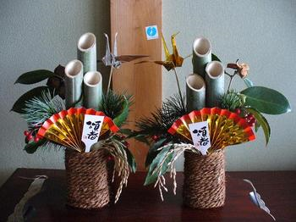
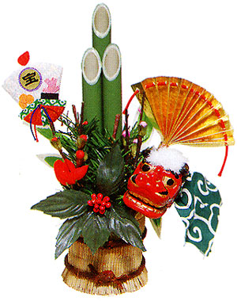
かどまつ are set out after クリスマス until 一月七日.

Slide 7
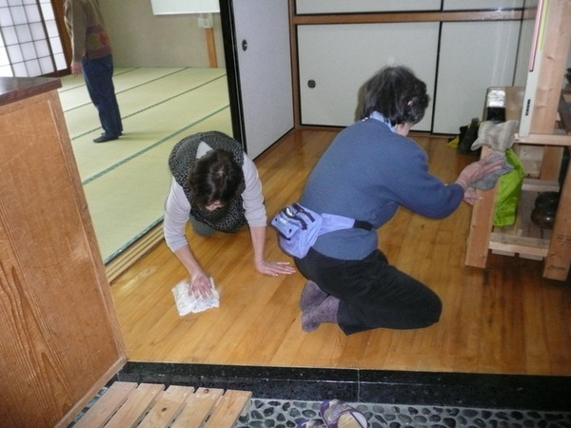
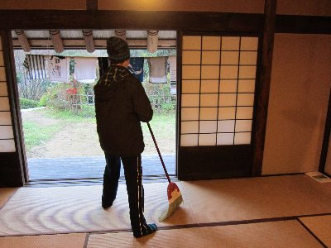
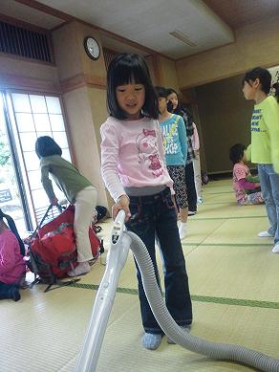
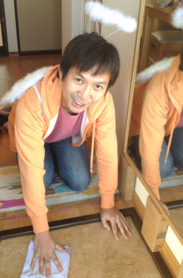
It is a custom to have a big clean おおそうじ before the New Year to remove clutter and dirt from the old year and to purify the home, school or office for the coming year.

Slide 8
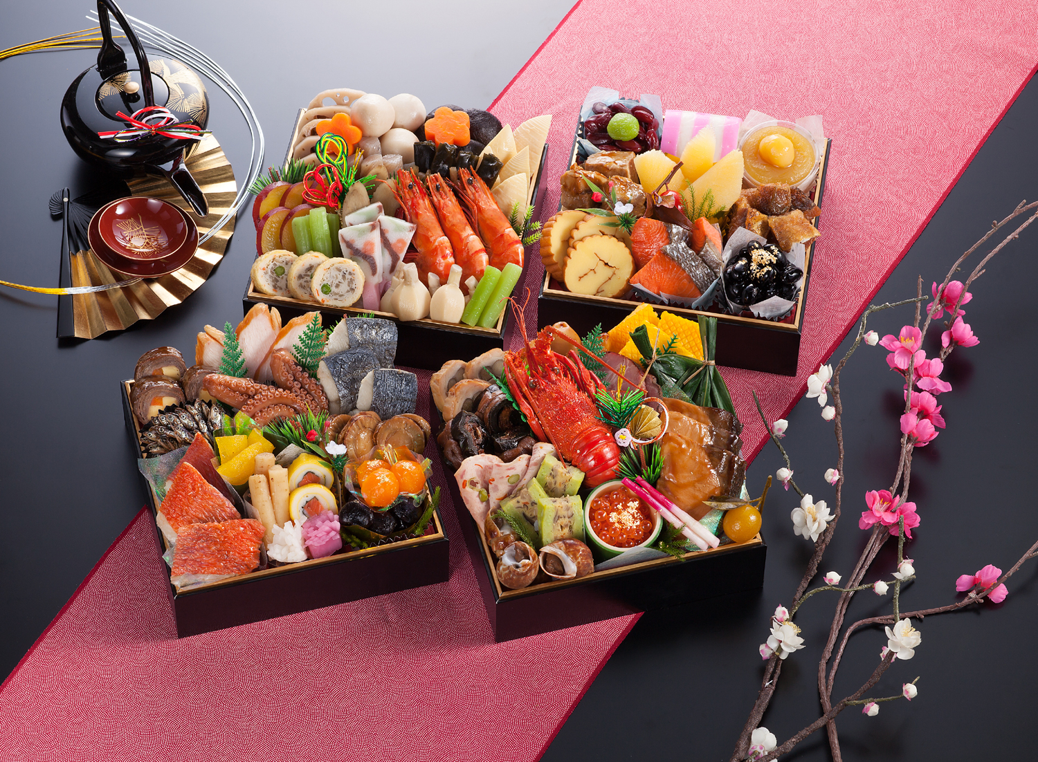
おせち りょうり are traditional Japanese New Year foods. おせち are easily recognizable by their special boxes called じゅうばこ, which look similar to おべんとう boxes.

Slide 9
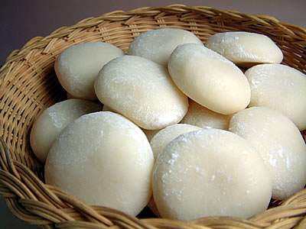
もち rice cakes are another traditional food おしょうがつ food. It is made before New Year’s Day and eaten during the beginning of January.

Slide 10
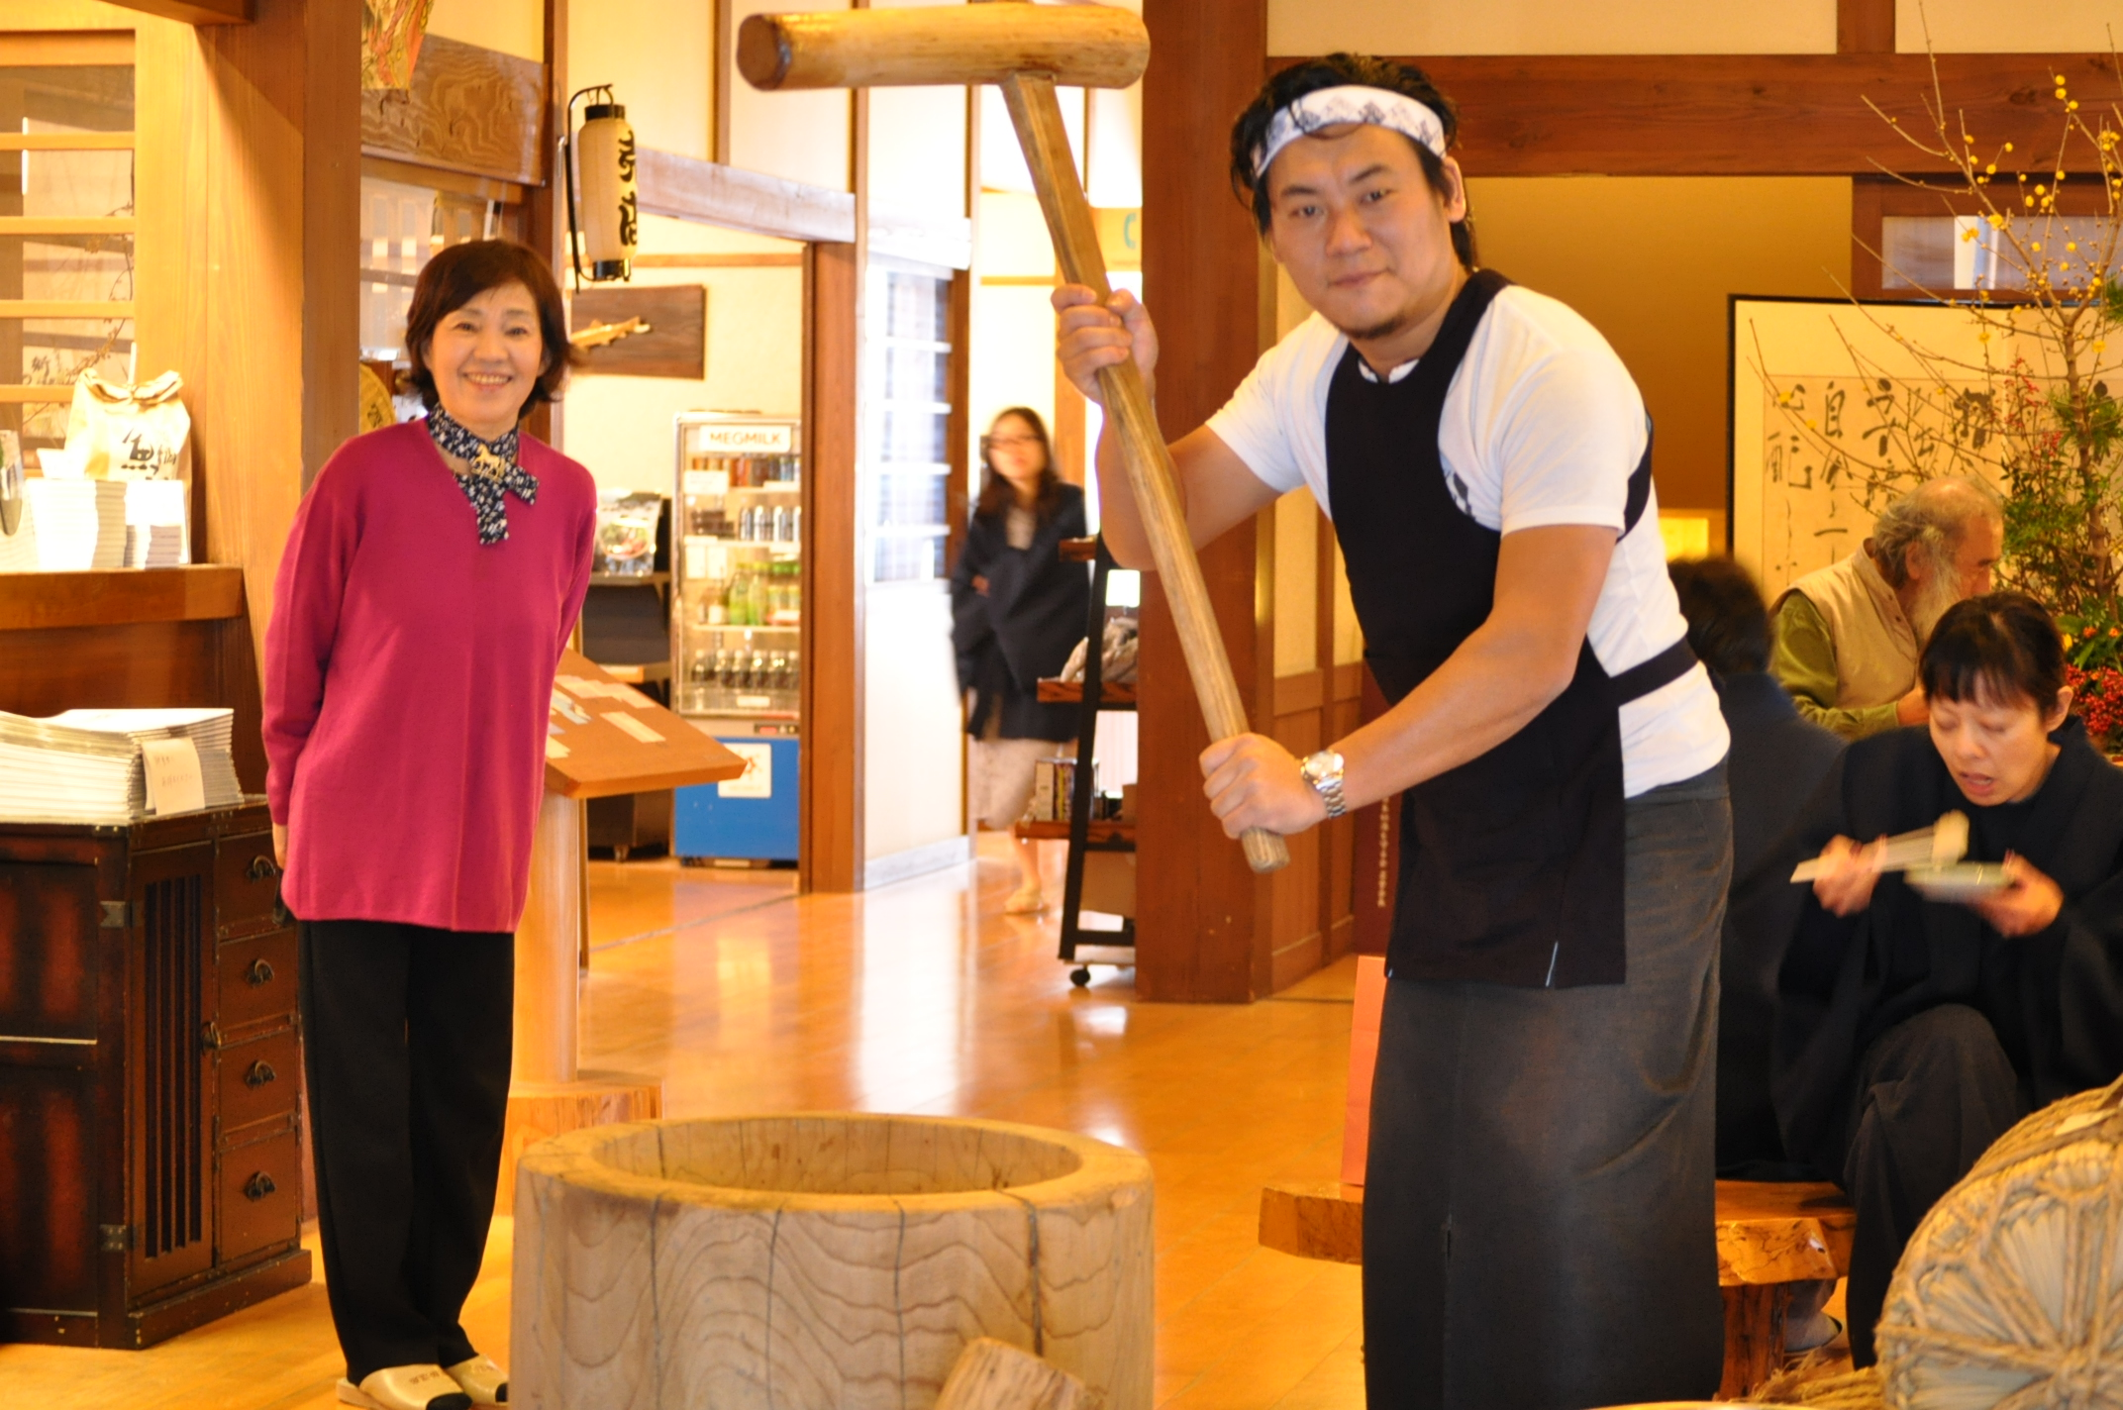
もち is made by putting boiled sticky rice into wooden bucket like containers and pound with a wooden mallet.

Slide 11
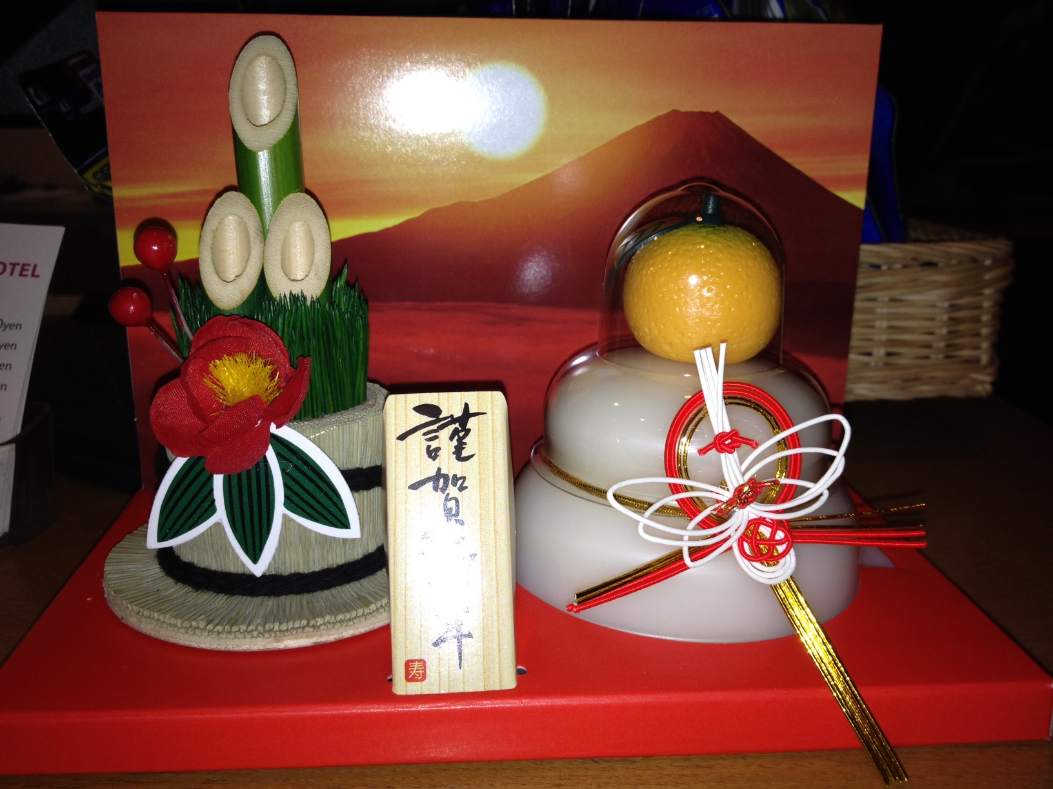
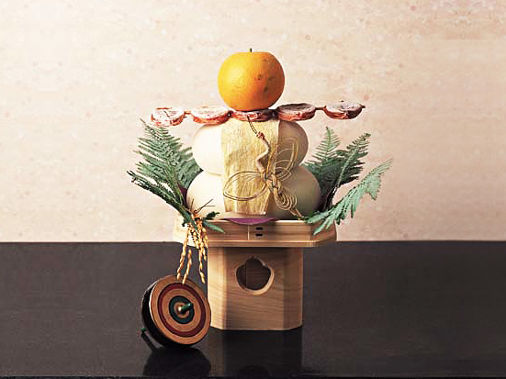
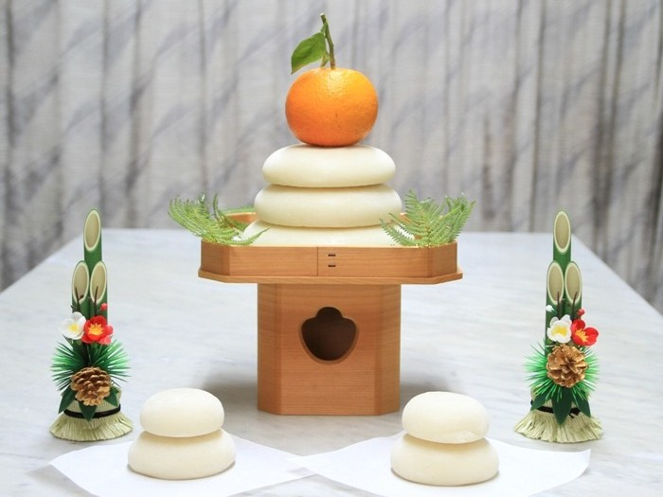
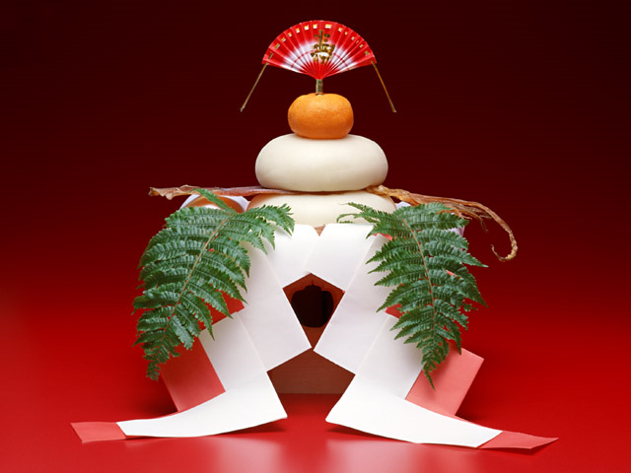
もち is made into a New Year‘s decoration called かがみもち formed from two round cakes of もち with a tangerine placed on top.

Slide 12
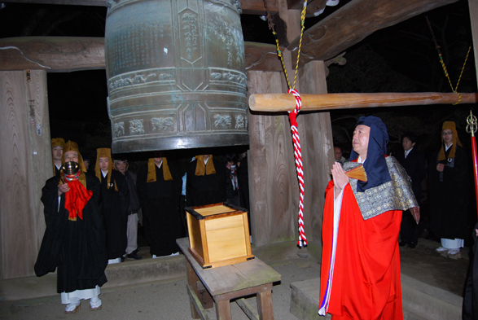
At midnight on １２月３１日 (also known as おおみそか), Buddhist temples all over Japan ring their bells 108 times. The bells are rung this many times as it symbolizes the 108 human sins in Buddhism. Japanese believe that the ringing of bells can rid their sins from the previous year.

Slide 13
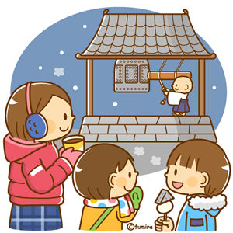
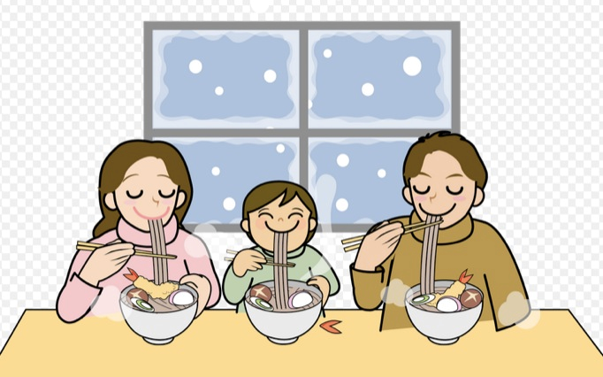
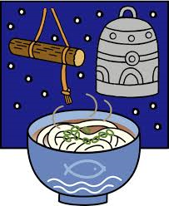
After the ringing of the bells, Japanese people celebrate and feast on noodles. These are called としこしそば and are long buckwheat noodles which symbolize the crossing over from one year to the next and are connected to enjoying a long life.

Slide 14
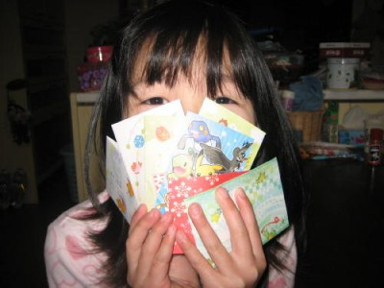
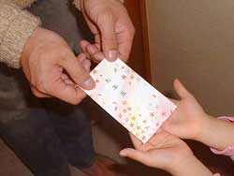
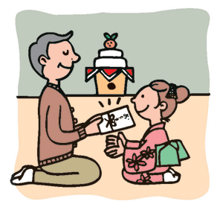
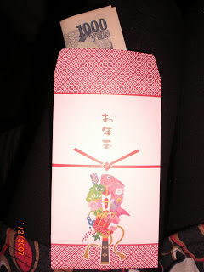
On New Year’s Day Japanese people have a custom of giving money to children. This is known as おとしだま.

Slide 15
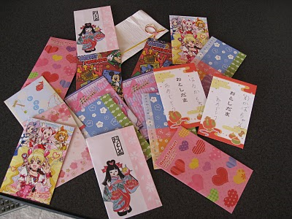
おとしだま is handed out in small decorated envelopes called ぽちぶくろ. The amount of money given depends on the age of the child. Teenagers often receive between ５０００円 and １００００円.

Slide 16
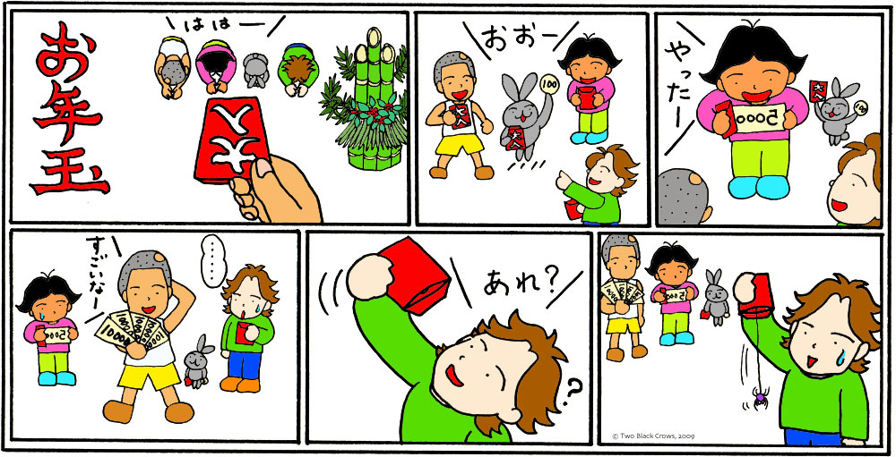

Slide 17
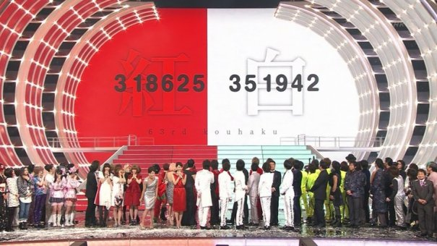
On New Year’s eve on NHK tv there is a highly popular singing contest called こうはく うたがっせん (the red and white song battle) The program divides the most popular music artists of the year into competing teams of red and white. あかぐみ are all female artists and しろぐみ are all male artists. A panel of celebrity judges, as well as the audience at home, vote for one team. The team with the most votes wins. In 2014 しろぐみ were the winners!
Video clip of the song contest:
https://www.youtube.com/watch?v=6gNBy3UUNpc

Slide 18
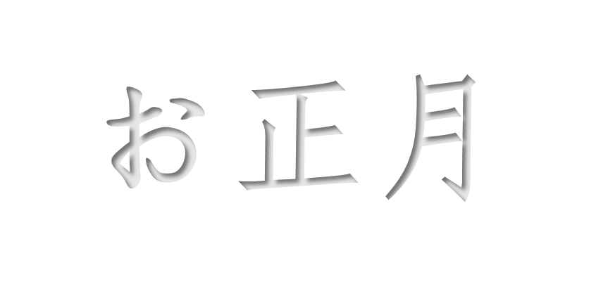

Slide 19
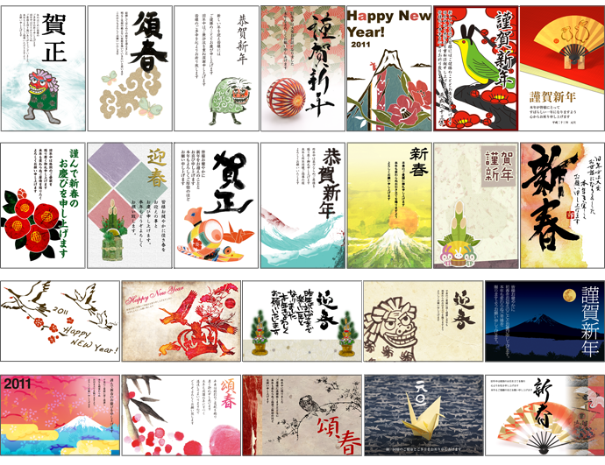
ねんがじょう are New year’s day post cards. Japanese people send ねんがじょう to all of their family and friends. The cards are sent so that they arrive on 1 January.

Slide 20
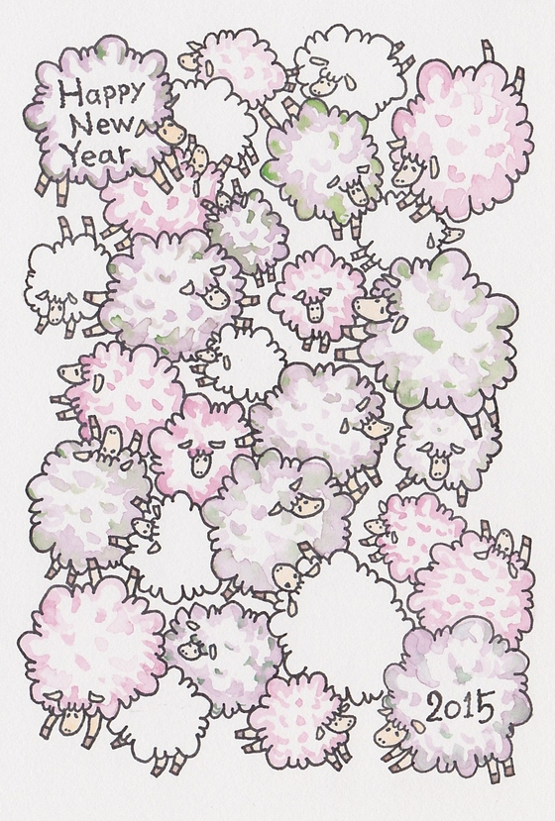
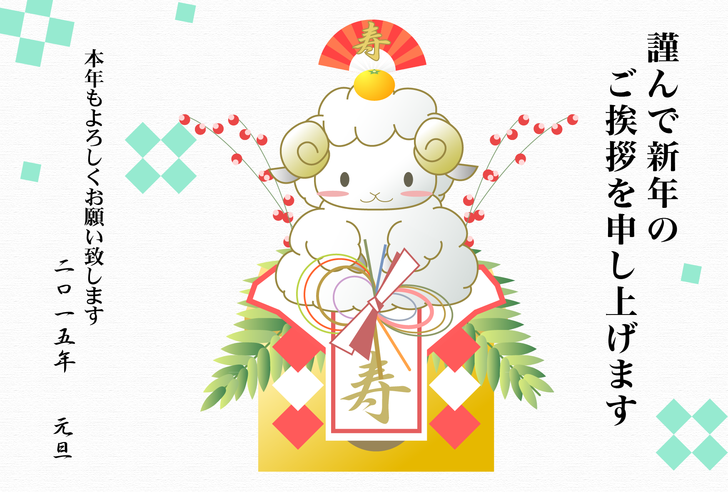
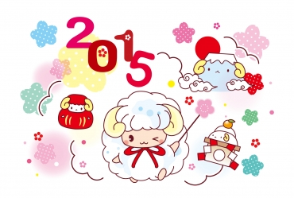
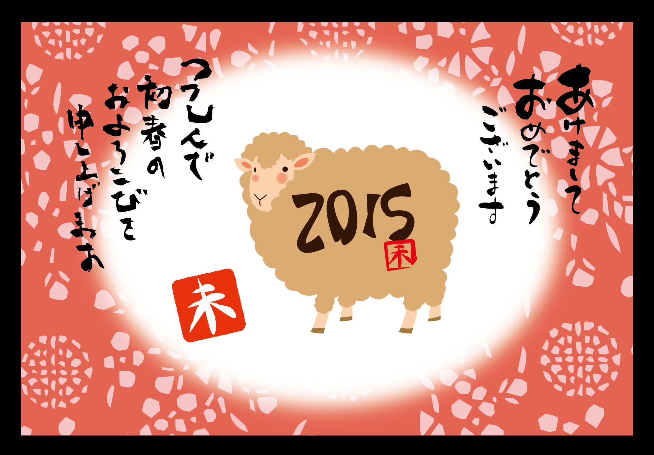
Most of the cards have the Chinese zodiac sign of the New year as their design. In 2015 it will be the year of the ひつじ.

Slide 23
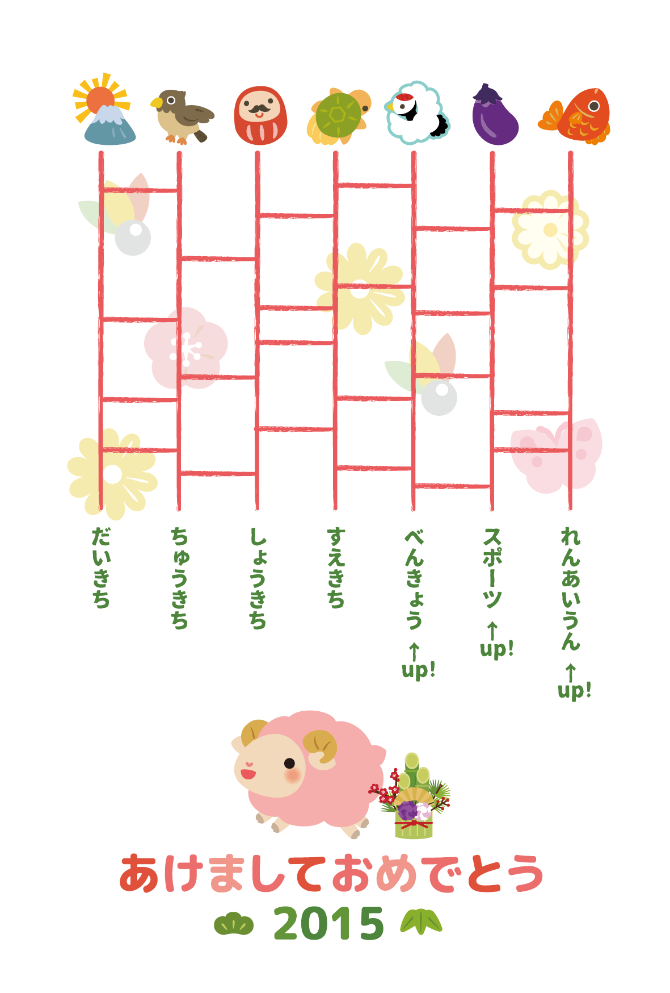
excellent
luck
medium
luck
a little
luck
good
luck
sports ↑
Study ↑
chances of
love ↑

Slide 24
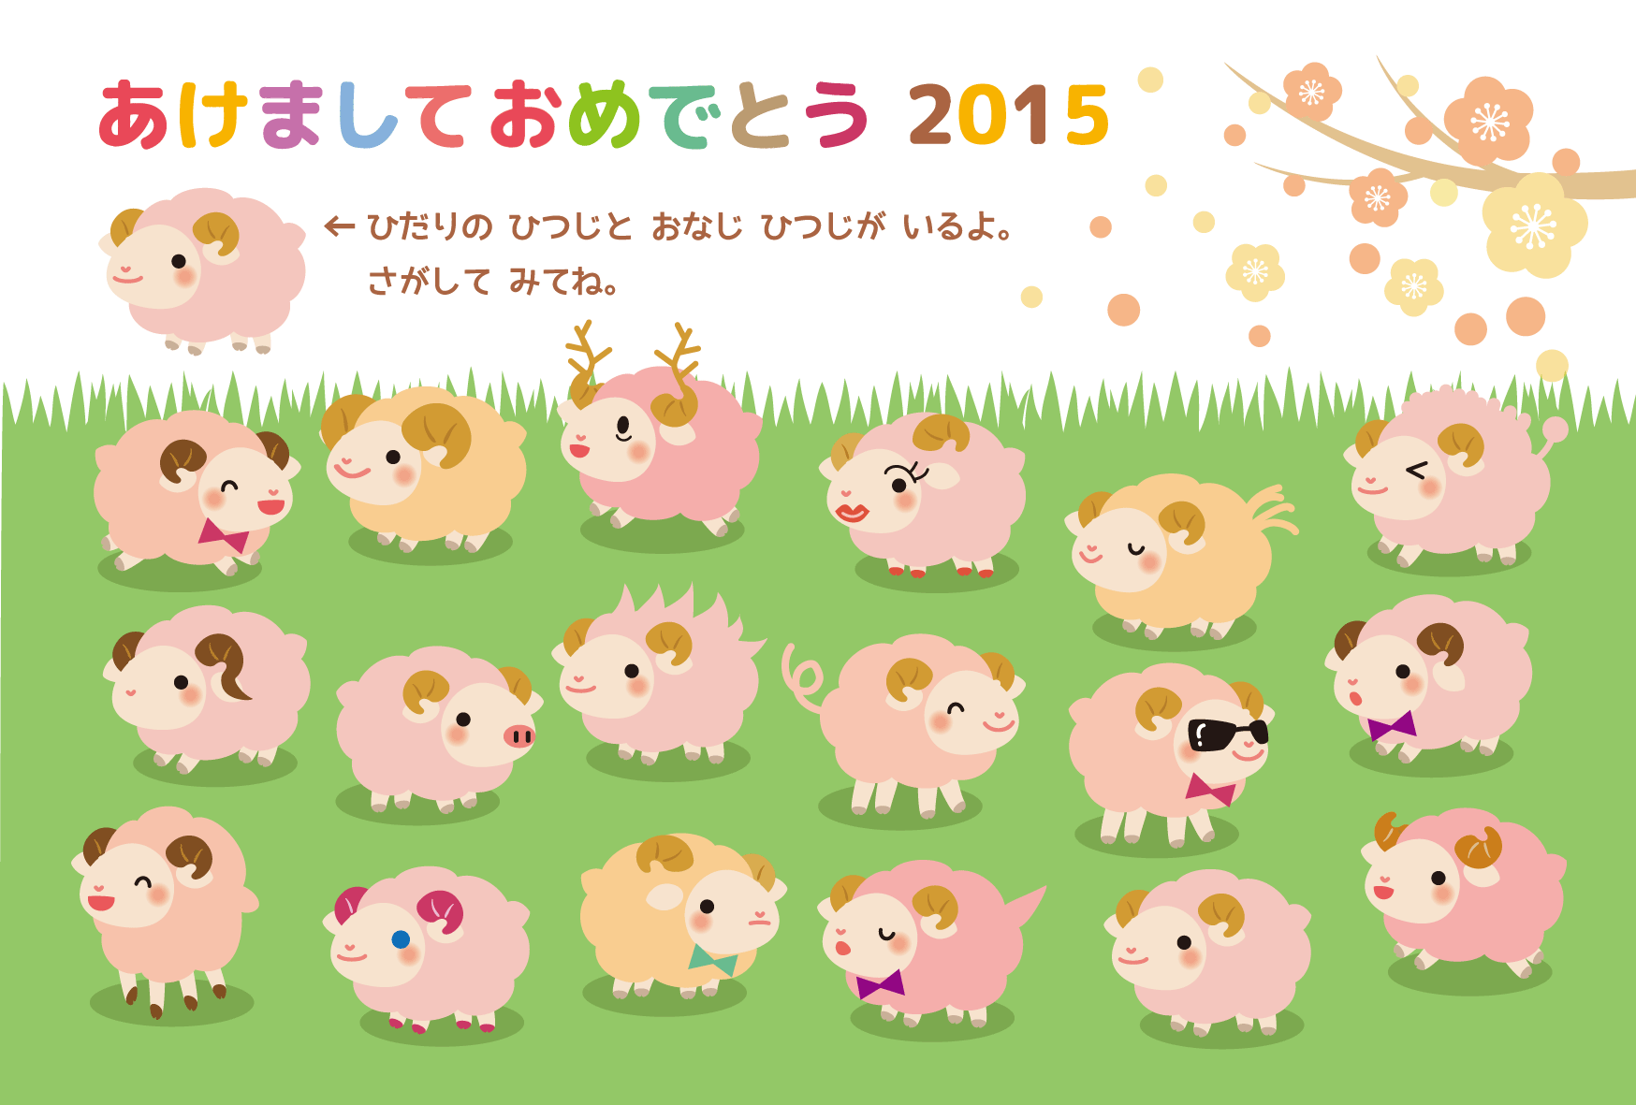

Slide 25
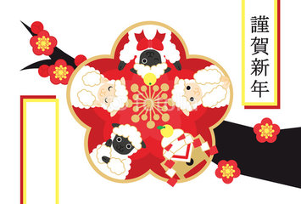
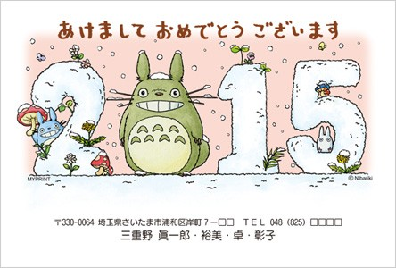
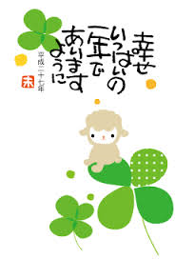
Some common greetings on ねんがじょう:
きんが しんねん
謹賀新年
Kinga shin nen
Happy New Year
あけまして おめでとう ございます。
明けましておめでとうございます。
Akemashite omedetogozaimasu
Happiness to you on the dawn of a New Year.
しあわせ いっぱいの いちねんで あいますように
幸せ いっぱいの 一年で あいますように
Shiawase ippai no ichinen de aimasu youni
I hope your New year is filled with happiness

Slide 26
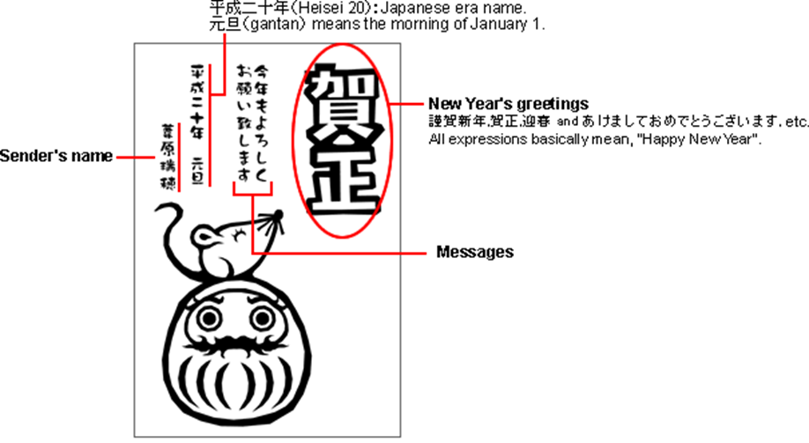
2014 = 平成26 (Heisei 26)
2015 = 平成27 (Heisei 27)

Slide 27
Create your own ねんがじょう:
Write in Japanese a New Year’s greeting.
Write the year – 2015.
Paste/draw a picture for this year’s zodiac ひつじ.
Or create a digital card here: http://greeting.rakuten.co.jp/event/nenga/

Slide 28
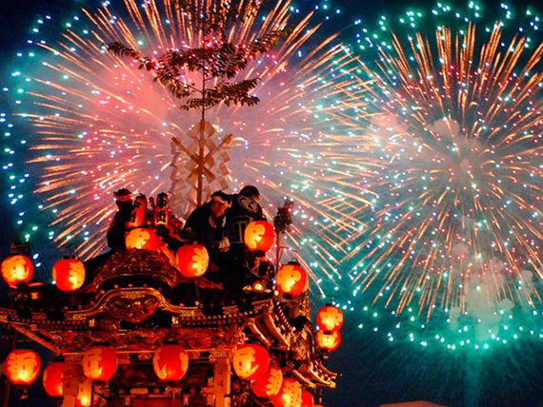
Let’s learn some Japanese New Year Vocabulary!

Slide 29
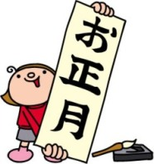
おしょうがつ
OSHOUGATSU

Slide 30
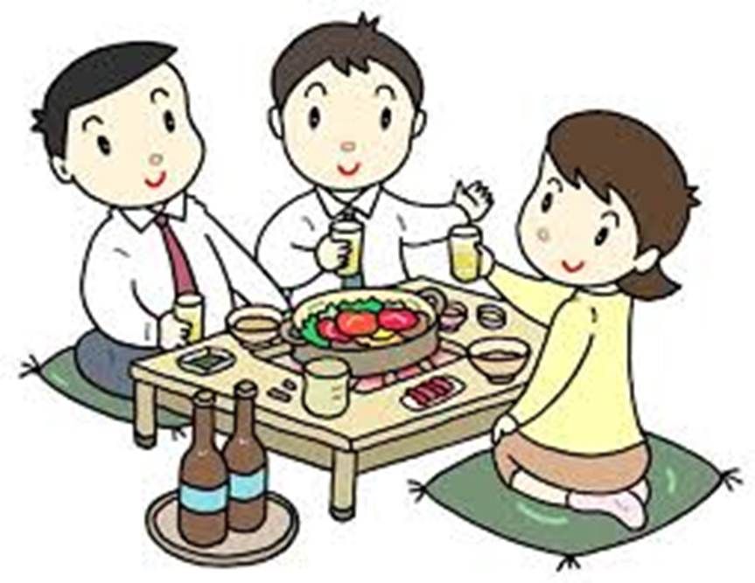
ぼうねんかい
BOUNENKAI

Slide 31
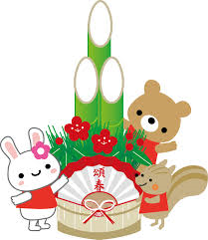
かどまつ
KADOMATSU

Slide 32
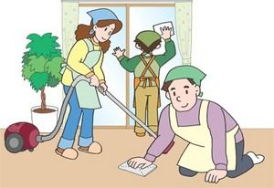
おおそうじ
OOSOUJI

Slide 33
おせち
OSECHI

Slide 34
もち
MOCHI

Slide 35
かがみもち
KAGAMIMOCHI

Slide 36
おとしだま
OTOSHIDAMA

Slide 37
ねんがじょう
NENGAJOU

Slide 38
Label the pictures with one of the words from the box:
ねんがじょう
おせち
おしょうがつ
おとしだま
ぼうねんかい
かどまつ
もち
かがみもち

Slide 39
えを かいて ください。 Draw a picture.
おせち
ぼうねんかい
かどまつ
おおそうじ
かがみもち
おとしだま
ねんがじょう
おしょうがつ

Slide 40
Play noughts and crosses. Students must say the Japanese for each item before placing a nought or cross on the board.
まる
ばつ

Slide 41
What are the similarities between New Year celebrations in Australia and Japan?
What are the differences?

Slide 42
よい おとしを！
YOI OTOSHI O!

