Slide 1
Housing in Japan
日本 の いえ （家）

Slide 2
In Japan, multiple-unit blocks are referred to as one of two types:
1) Apaato (アパート） (or Apartment) for rented unit buildings, which are usually only a few stories in height, without a central secure entrance
2) Mansion (マンション) usually purchased type expensive buildings (but recently some have been rented due to large vacancies) with multiple floors, elevators, and a communal secure gate, with centralized postboxes; they are usually more sturdily built than apaato, normally of reinforced concrete (RC) construction.

Slide 3
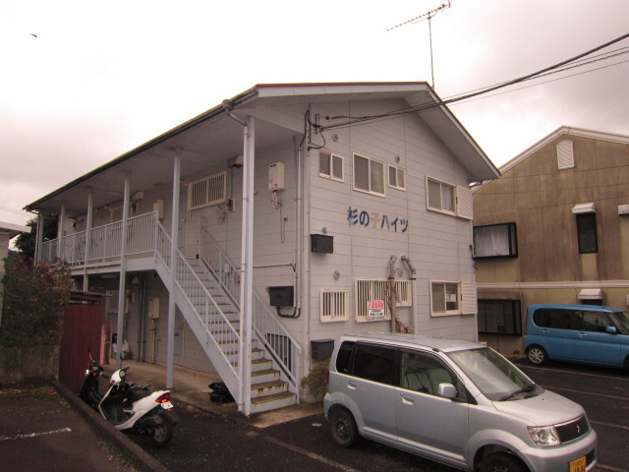
アパート Apaato – Unit/Flat

Slide 4
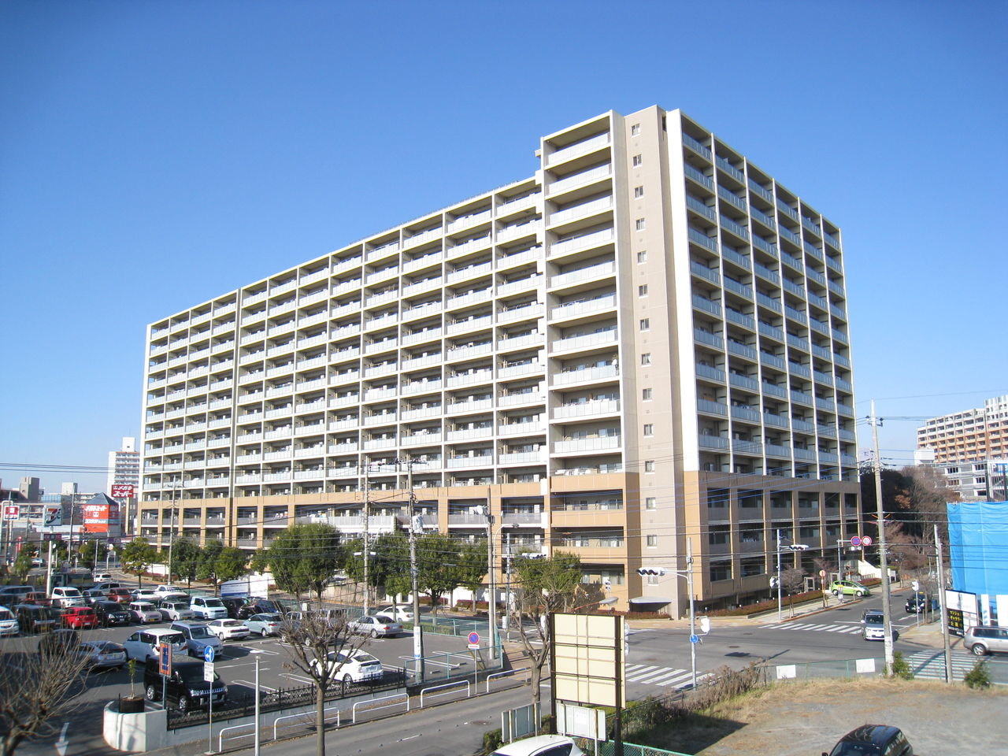
マンション Manshon - Apartment

Slide 5
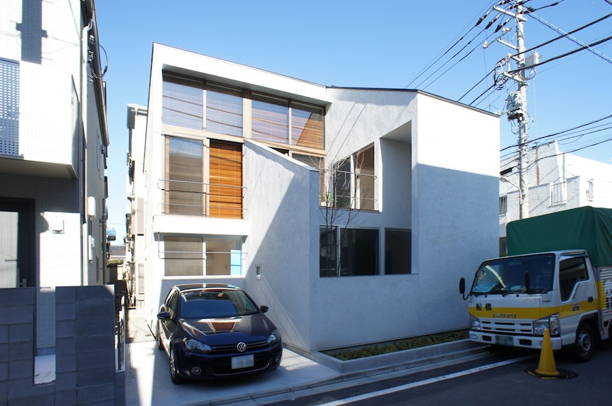
いえ（家） House

Slide 6
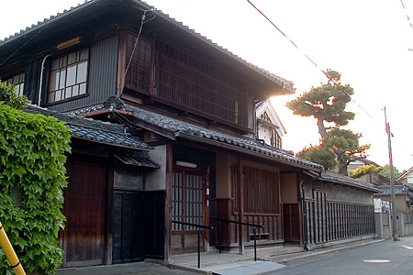
Traditional Home

Slide 7
Kanji for HOME/HOUSE

Slide 8
Guide to a Japanese home..

Slide 9
げんかん
One characteristic of a Japanese home is the genkan, or entryway. It includes a small area, at the same level as the outside, where arriving people remove their shoes.
As they take off their shoes, people step up onto a raised floor. They point the tips of their shoes to the outside.
The rest of the residence is at the raised level of this floor.
Adjacent to the lower floor is a shelf or cabinet called a getabako (geta box) in which people will place their shoes.
Slippers for indoor use are usually placed there.

Slide 10
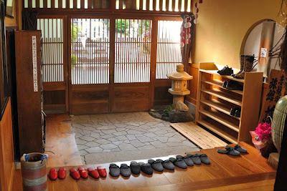
げんかん

Slide 11
トイレ
The toilet in Japanese housing is usually located away from the bathroom. However, very inexpensive one room apartments often use what's called a unit-bath where both the toilet and bath are in a single unit. Inexpensive Japanese hotels often use these unit-baths as well.
The toilet is usually in a small stall-like room, including just the toilet. When entering the bathroom, one traditionally replaces their house slippers with plastic "toilet" slippers, swapping back when exiting the bathroom.
Traditionally, Japanese toilets have had an image of "unclean" and as such were separated, but more modern day toilets tend to ward off the traditional "unclean" image.

Slide 12
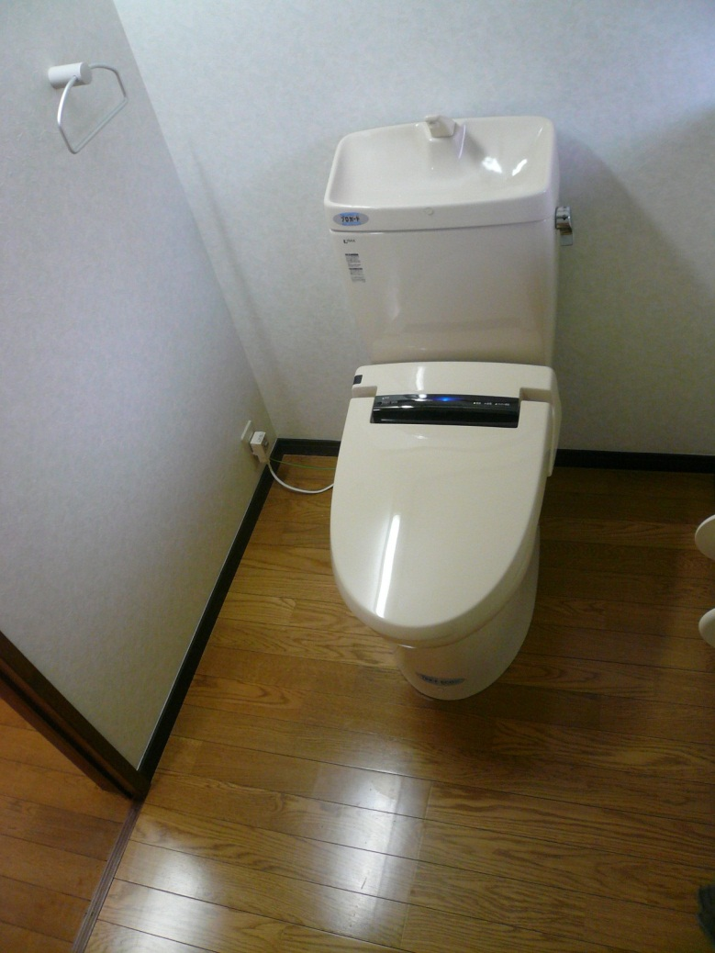
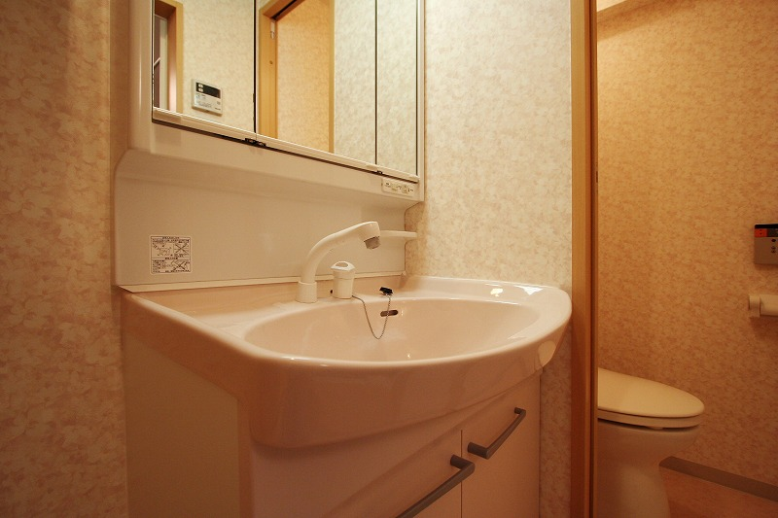
トイレ

Slide 13
だいどころ
The modern Japanese kitchen features appliances such as a stove, a narrow fish grill (broiler), and an electric refrigerator. The stovetop may be built-in or may be a self-contained unit on a counter-top, and it is usually gas-burning, although recently induction heating (IH) stovetops have become popular. Common units of all types of stoves include two to four burners.
Built-in ovens large enough to bake or roast are uncommon; in their place, work-top multifunction convection microwaves are used. Most kitchens have electric exhaust fans.
Furnishings commonly include microwave ovens, hot water boilers, and electric toaster ovens. Built-in dishwashers are rare, although some kitchens may have small dishwashers or dish dryers.

Slide 14
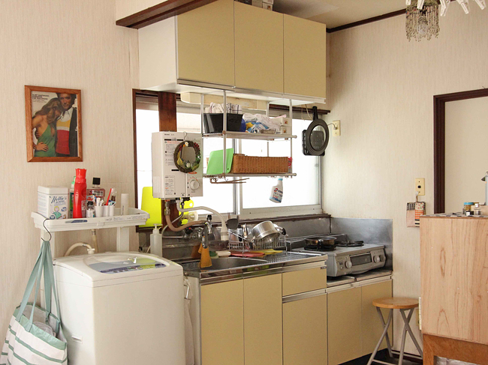
だいどころ

Slide 15
ふろば・せんめんじょ
Japanese housing typically has multiple rooms for what in Western housing is the bathroom. Separate rooms for the Japanese toilet, sink, and ofuro (bathing room) are common.
Small apartments, however, frequently contain a tiny single bathroom called a unit bath that contains all three fixtures. A small sink may also be built into the top of the toilet tank – there is a tap, with the top of the tank forming the sink, and the water draining into the tank – which runs during the flush cycle; this is particularly common in mid-20th century buildings.
The room with the sink, which is called a clothes changing room, usually includes a space for a clothes-washing machine. The room containing the bathtub is waterproof with a space for washing, and often for showering, adjacent to (rather than in) the tub. As a result, bathwater is neither soapy nor dirty, and can be reused.
Many washing machines in Japan come with an extension pipe to draw water from the tub for the wash.

Slide 16
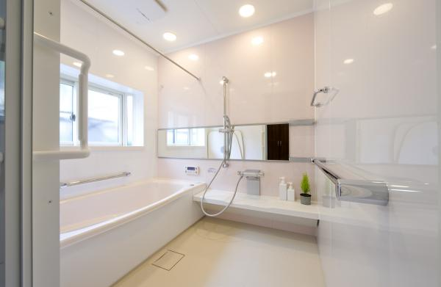
ふろば

Slide 17
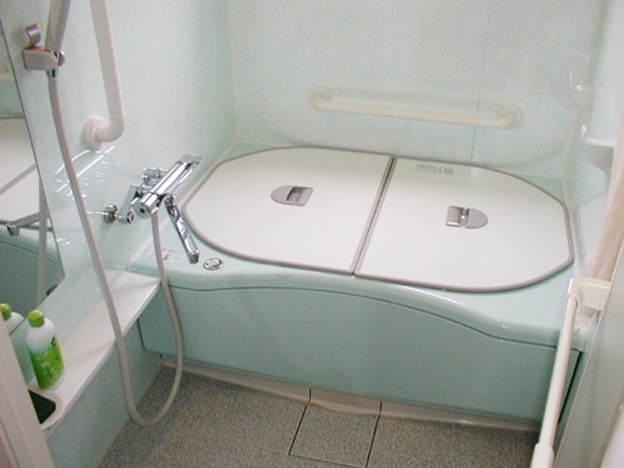
ふろば

Slide 18
わしつ
Many homes include at least one traditional Japanese styled room, or washitsu.
It features tatami flooring, shoji (paper sheet doors/windows) rather than draperies covering the window, fusuma (opaque sliding vertical partitions) separating it from the other rooms, an oshiire (closet) with two levels (for storing futon), and a wooden ceiling.
It might be unfurnished, and function as a family room during the day and a bedroom at night. Many washitsu have sliding glass doors opening onto a deck or balcony.
Other bedrooms, as well as living rooms, dining rooms, and kitchens, are in a Western style.

Slide 19
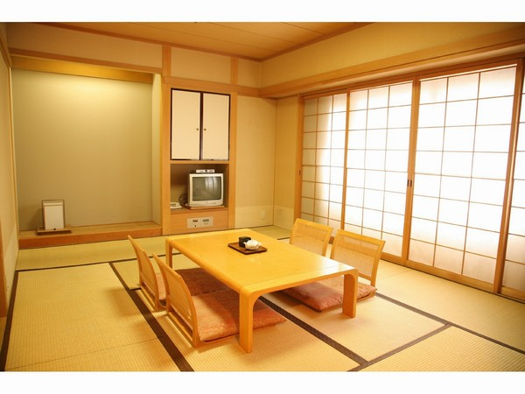
わしつ

Slide 20
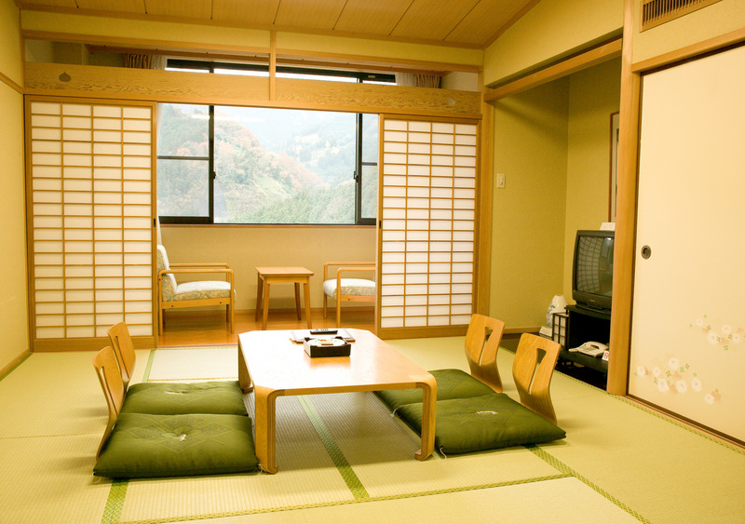
わしつ

