Slide 1
OBON festival in Japan

Slide 2
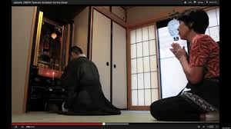
お盆
Obon (Bon) is a Buddhist ritual where families honour the spirit of the dead. It is a holiday during which people return to their family’s ancestral place.It is usually celebrated during 3 days around and 15th of August .

Slide 3
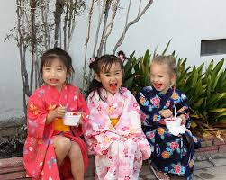
As it is the middle of summer, many people wear Yukata, （ゆかた） or cotton kimonos.

Slide 4
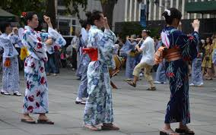
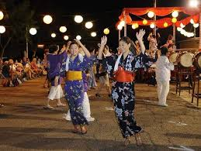
Some dances involve lining up or dancing in a circle, other use props such as fans or cotton towels called Tenugui (てぬぐい）
Dances called Bon Odori (ぼんおどり）are performed . Each town or area has its own typical dance and the music is also very local.

Slide 5
Fireworks or花火（はなび）are part of the Obon festivities.

Slide 6
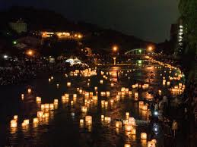
Can you read this Kanji?
It is a fire lit on the mountain in Kyoto with the symbol “DAI” (big) and called Daimonji .
(大文字)
It is lit on August 16 at the end of the 3 days of Obon, when the spirits of the dead are believed to return to the spirit world.
The spirit of the visiting dead are also guided back to the spirit world by floating lanterns from the rivers to the sea. This is
called Tourou nagashi

