Slide 1
J A P A N E S E : N I H O N G O
An Introduction

Slide 2
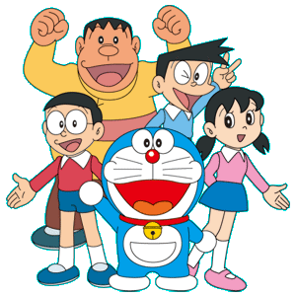
Why study Japanese?
Ask yourself questions about learning an additional language.
What are some of the benefits of learning Japanese – for your education, your career, your social life?
Think/Pair/Share
Popcorn Whiteboard

Slide 3
What do you already know about Japan?
People
Industries
Food
History
Culture

Slide 4

Let’s Test Your Knowledge!
Choose from one of two possible answers.
Follow the teacher as to where to stand to answer the question.
Keep a score of how many questions you answer correctly.

Slide 5

What is the major language spoken in Japan?
A> Cantonese
B> Japanese

Slide 6
True or False?
More people live in Australia than Japan.
A> False
B> True

Slide 7
Which food/meal is from Japan?
A> Sashimi
B> Pizza

Slide 8
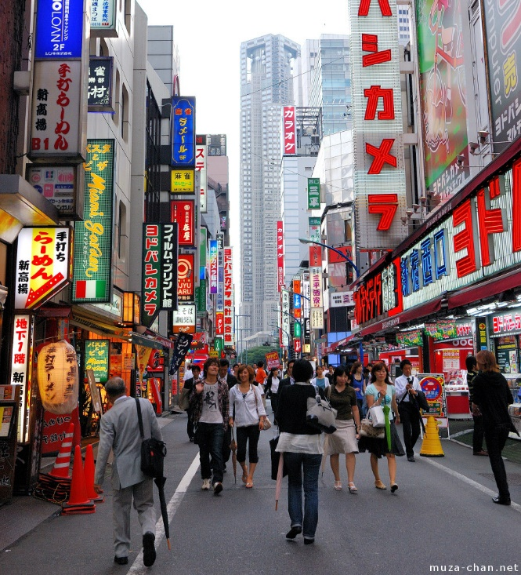
What is the capital of Japan?
A> Tokyo
B> Osaka

Slide 9
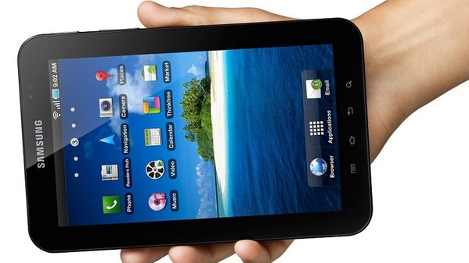
Which is NOT a Japanese company?
A> Sony
B> Samsung

Slide 10
Which celebrity is NOT Japanese?
A> Yoko Ono
B> Katy Perry

Slide 11
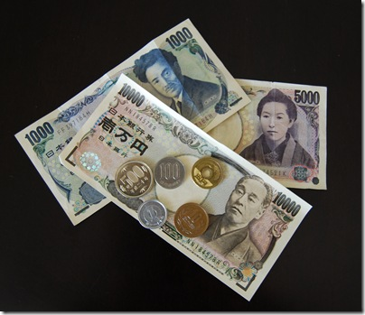
True or False? Japan’s currency is called Yen.
A> False
B> True

Slide 12
Congratulations.
Are you an expert on Japan?

