Slide 1
Quiz: Japanese Things

Slide 2
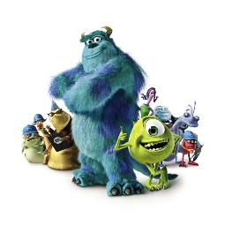
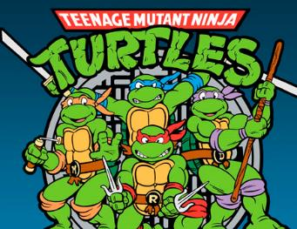
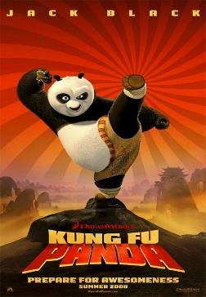
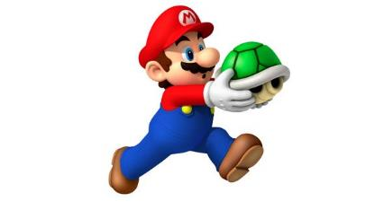
Which is from Japan?
[a] Monsters Ink
[b] Ninja Turtles
[c] Kang Fu Panda
[d] Super Mario

Slide 3
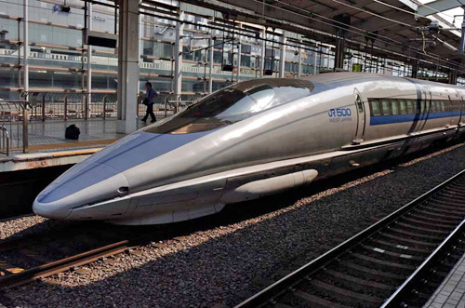
How fast is Bullet Train?
(a) 150km/h
(b) 200km/h
(c) 300km/h
(d)350km/h

Slide 4
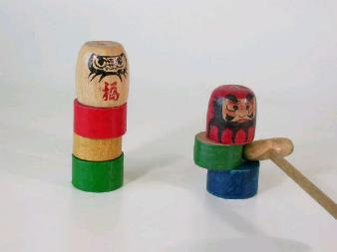
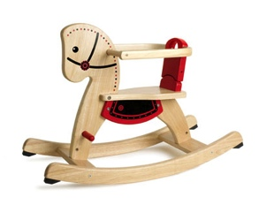
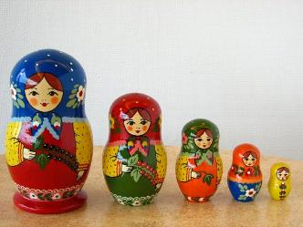
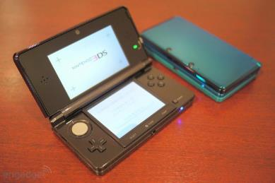
Which is Japanese traditional toy?
(a)
(c)
(b)
(d)

Slide 5
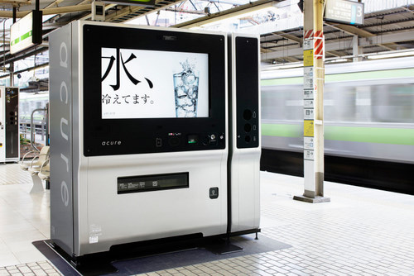
What‘s this?
(a) A Ticket Vending Machine
(b) A Public TV
(c) An Information Board
(d)A Drink Vending Machine

Slide 6
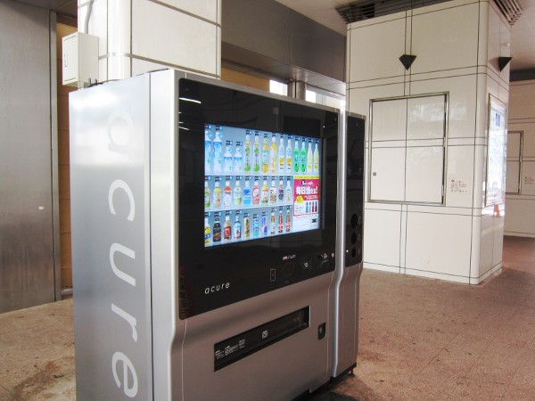
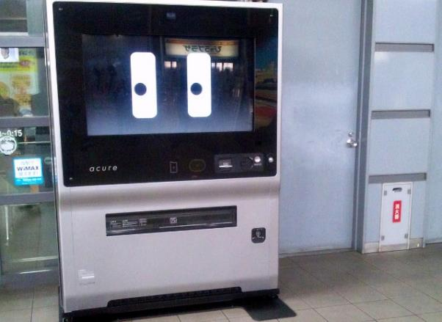
New Vending machine!

Slide 7
What is this building?
A Department Store (b) An Apartment
(c)A School (d) A Company

Slide 8
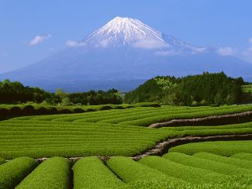
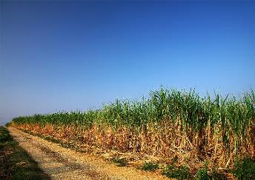
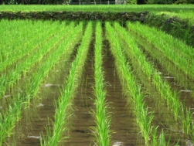
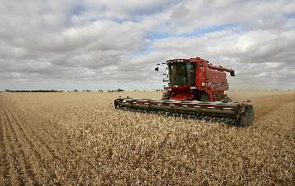
Which is the rice field?
(a)
(c)
(b)
(d)

Slide 9
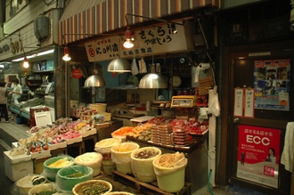
What do they sell?
(a)Japanese Pickles (b)Fish
(c)Onigiri (d)Water bombs

Slide 10
Japanese Pickles

Slide 11
When earthquake happens, you have to
(a) go to the beach because there is no building.
(b) stay as close to the wall as possible to protect yourself
(c) hide under the table to protect yourself

Slide 12
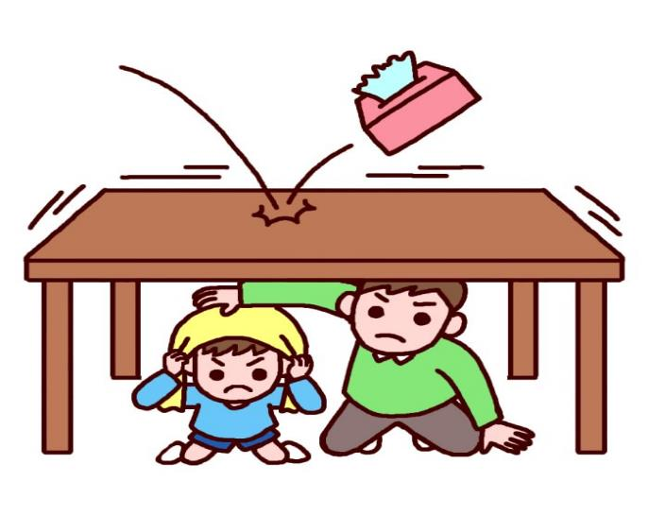
tables can protect you from things falling on you.

