Slide 1
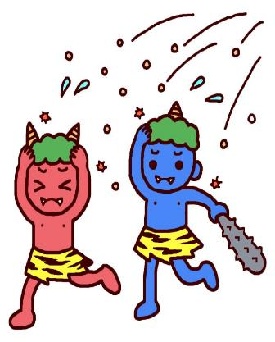
SETSUBUN
せつぶん

Slide 2
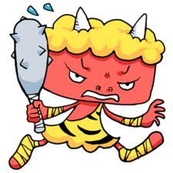
All About Setsubun
Setsubun is a festival held every year in Japan on the 3rd of February.
Setsubun marks the changing of the seasons and signifies the bringing of good fortune and good luck to families all over Japan

Slide 3
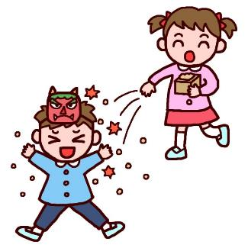
All About Setsubun
On the night of Setsubun, families all over Japan do a ‘mame-maki’ which is literally a bean throwing festival

Slide 4
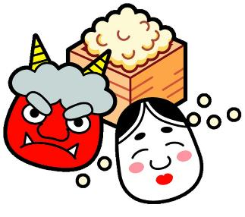
All About Setsubun
A wooden measuring cup is filled with roasted soybeans and the beans are thrown either out the door or at a family member wearing an oni (demon) mask

Slide 5
All About Setsubun
As people throw the beans they yell:
‘おにはそと、ふくはうち’
This means ‘out with the demons, in with the (good) fortune’
Japanese people sometimes attend a bean throwing ceremony at their local temple or shrine too

Slide 6
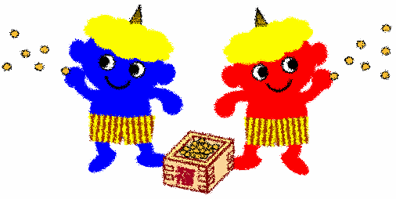
All About Setsubun
The Setsubun festival hopes to drive out the demons, bad spirits and misfortunes of the families and community
Setsubun hopes to bring good luck, good fortune and happiness to people all over Japan

Slide 7
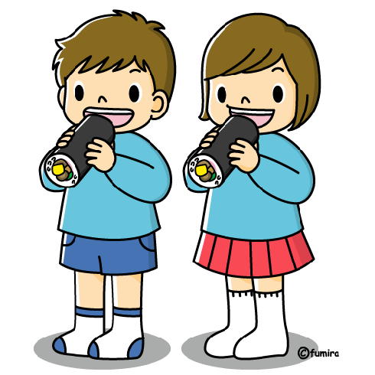
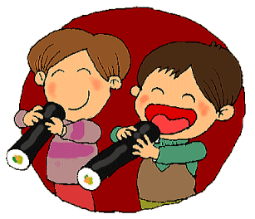
All About Setsubun
There is also a special type of sushi that is eaten at Setsubun. It sushi is long and uncut and is called
‘えほうまき’

Slide 8
All About Setsubun
It must contain seven ingredients, because seven is a lucky number.
It must not be cut, because it might cut (off) your luck.
You have to eat it while facing the lucky direction, which changes every year!
You must eat the whole roll in total silence.

Slide 9
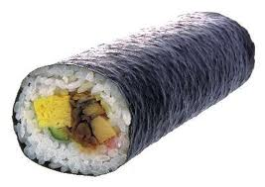
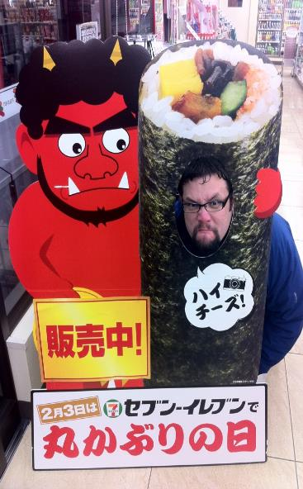
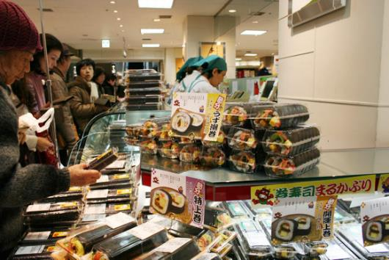

Slide 10
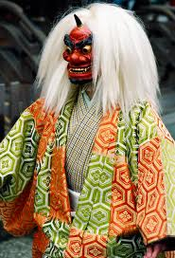
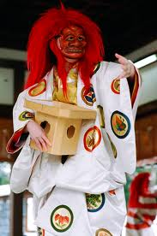
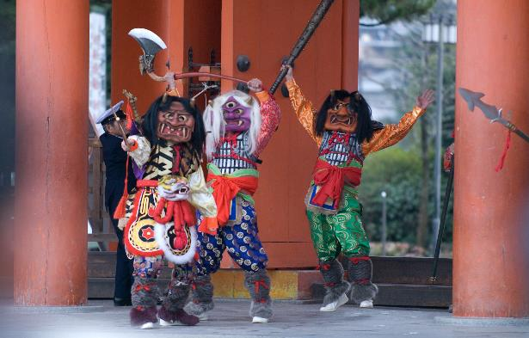

Slide 11
