Slide 1
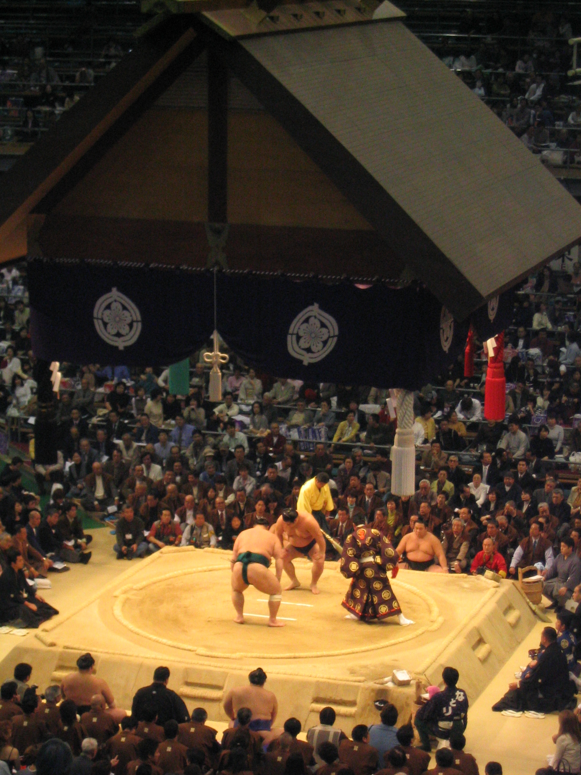
Sumo

Slide 2
Sumo Calendar
January Tournament in Tokyo
March Tournament in Osaka
May Tournament in Tokyo
July Tournament in Nagoya
September Tournament in Tokyo
November Tournament in Fukuoka

Slide 3
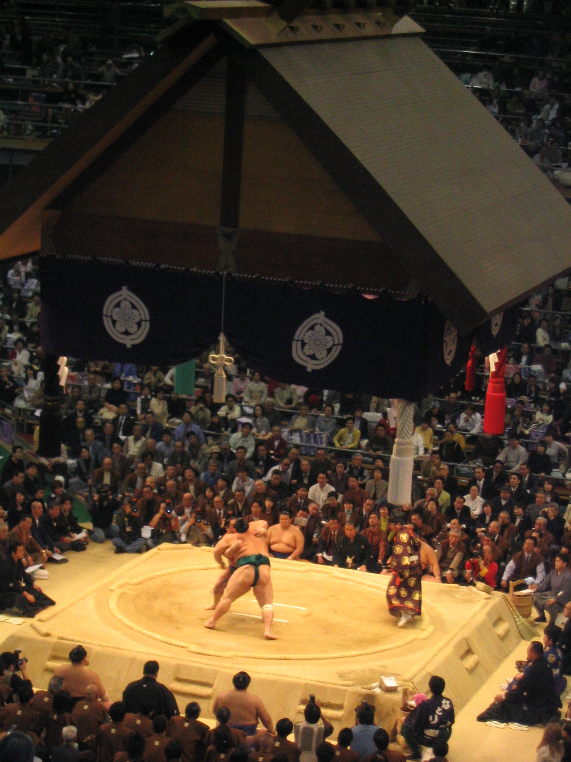

Slide 4
Makuuchi Division
5th Rank Maegashira
4th Rank Komusubi
3rd Rank Sekiwake
2nd Rank Ozeki
Top Rank Yokozuna

Slide 5
Income within the Makuuchi Division
Rank Monthly Tournament
Income Bonus (11/15 days)
5 $10 990 $ 250
4 $14 210 $ 500
3 $14 210 $ 500
2 $19 710 $1 500
Top $23 690 $2 000

Slide 6
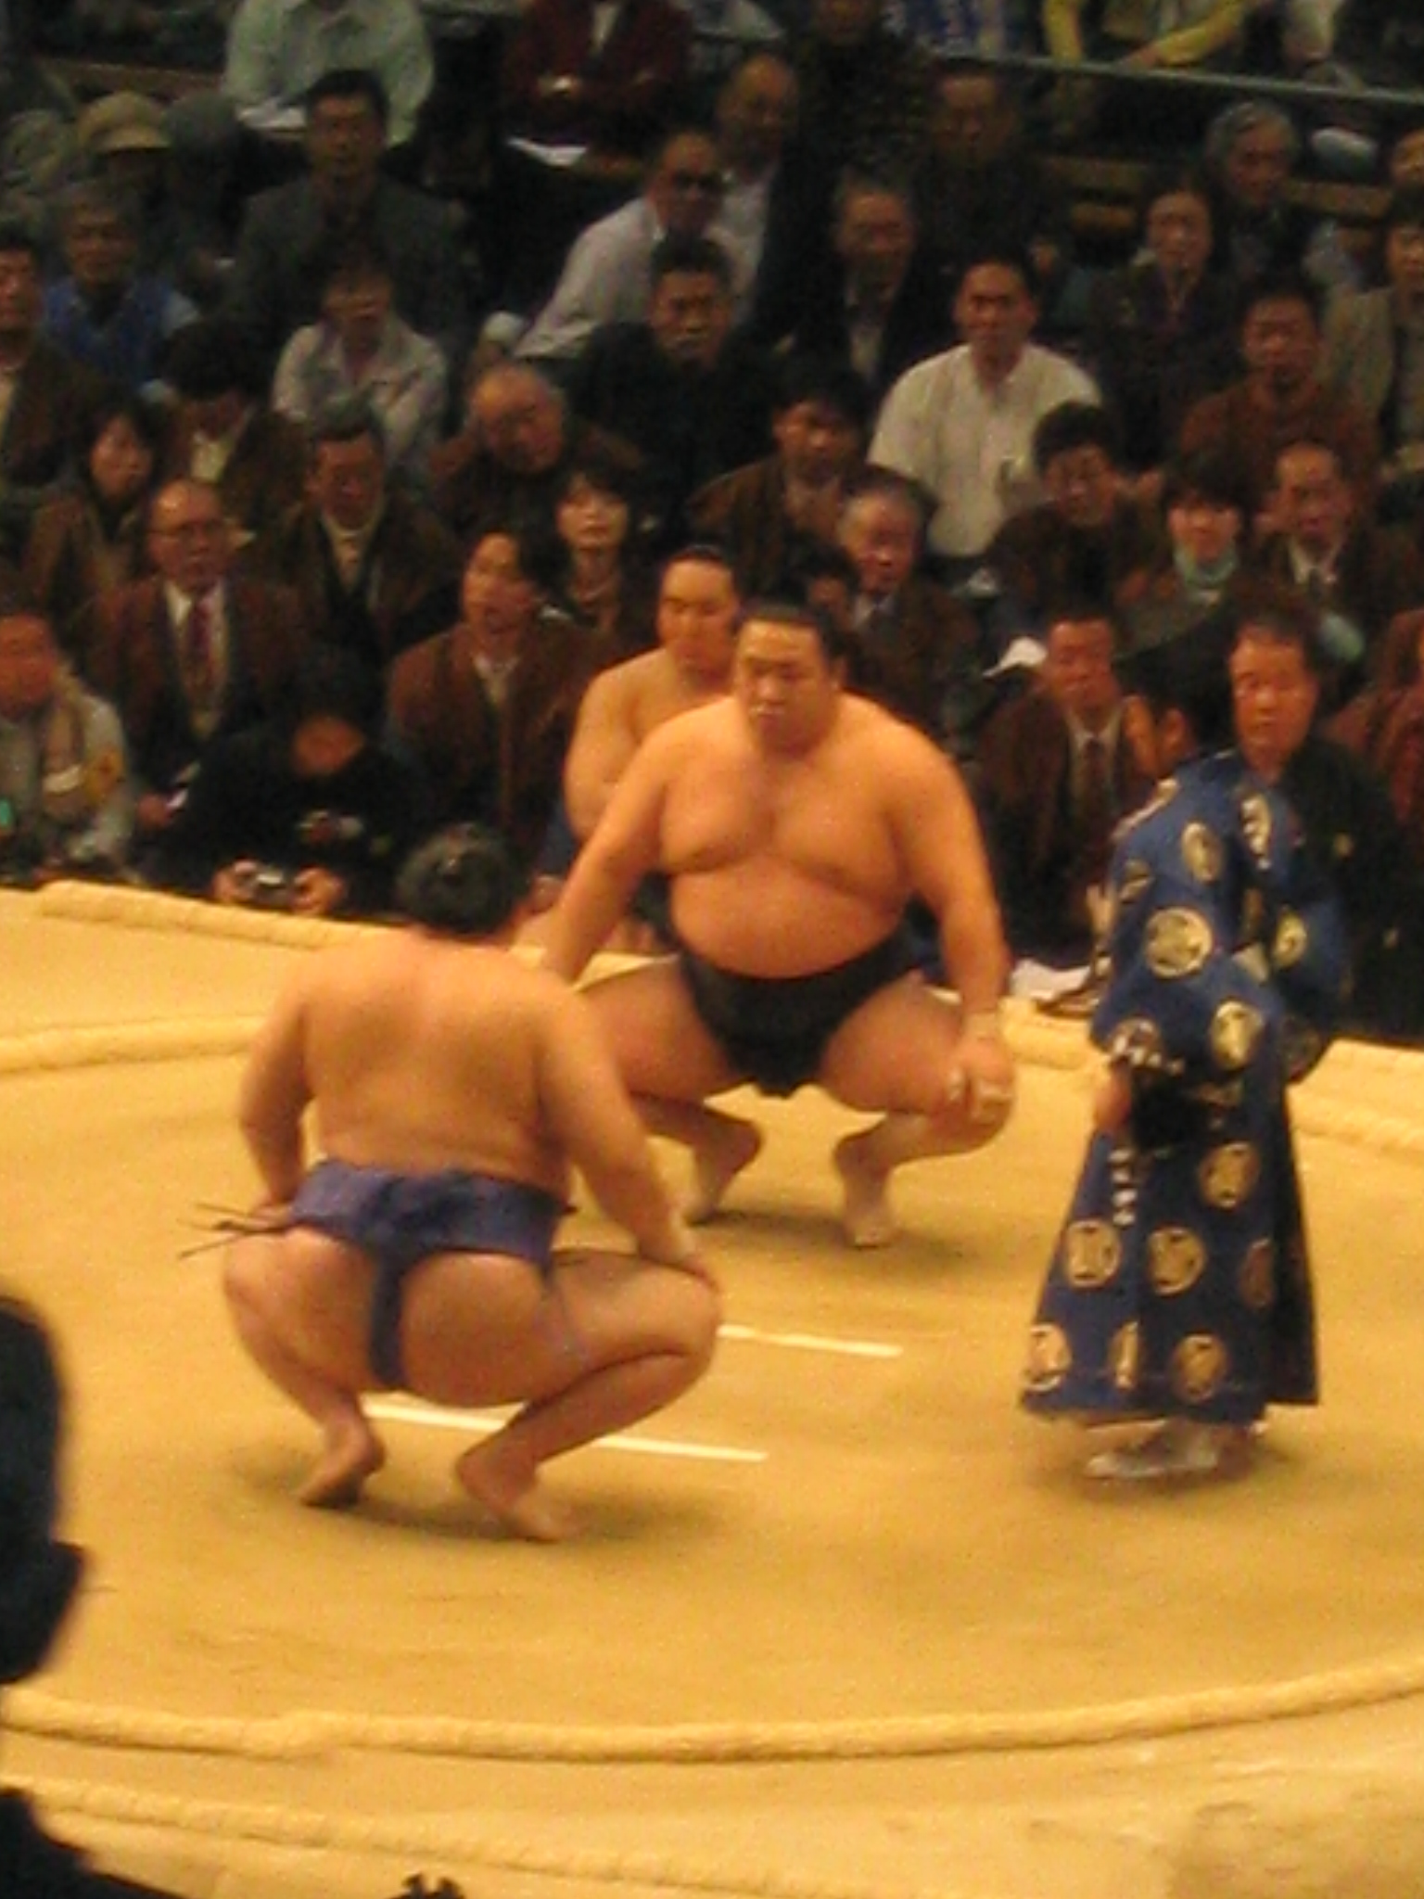

Slide 7
Pre Bout Rituals
Clap then 2 shiko stomps (1 with each leg)
Rinse with chikara mizu (power water)
Throw salt and enter the ring
Both arms down then clap
Extend arms out horizontally
Return to corner & throw salt again
Clap then two shiko stomps (1 with each leg)

Slide 8
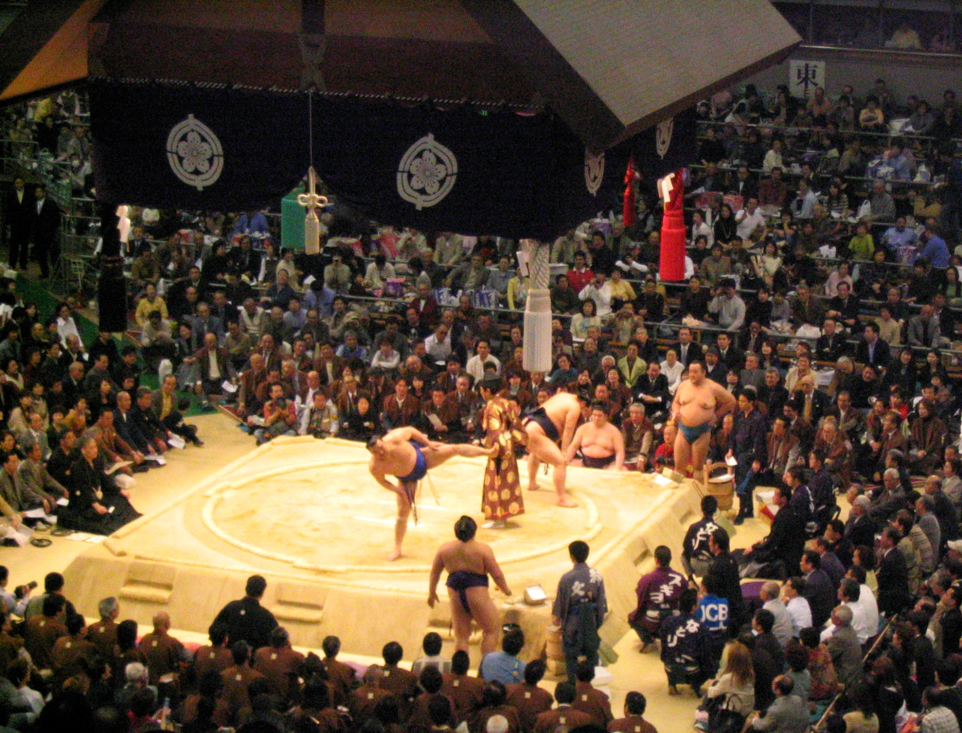

Slide 9
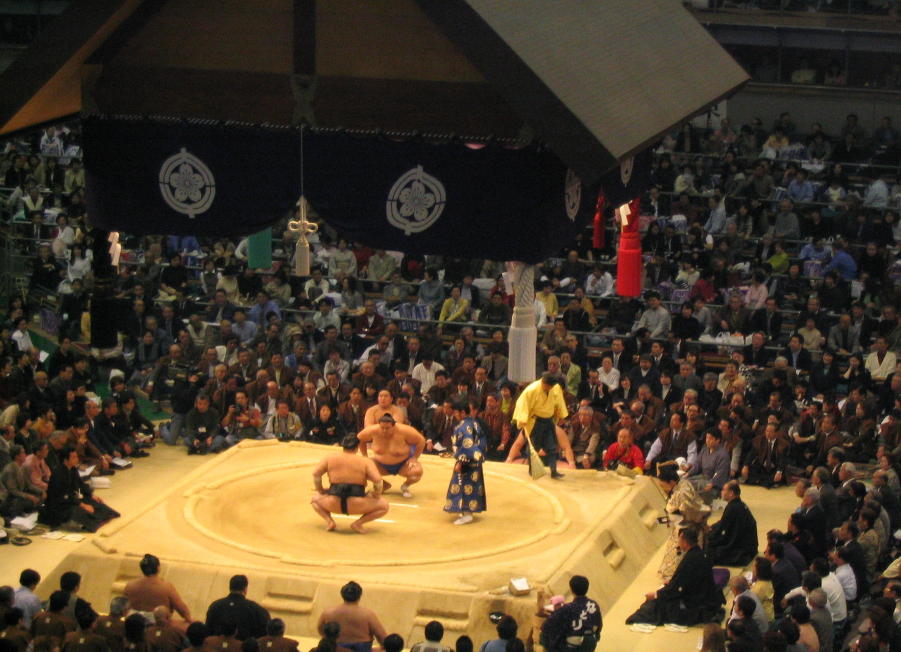

Slide 10
How to win a fight (bout)
Officially there are 70 ways of winning, but only 48 are commonly seen. Many are thrusting or pushing techniques, arm throws or leg trips.
The loser of the bout is the person who steps or falls out of the ring
The loser of the bout is the person who touches the ground with anything but the soles of their feet.
The loser of a bout is the person who uses an illegal technique.

Slide 11
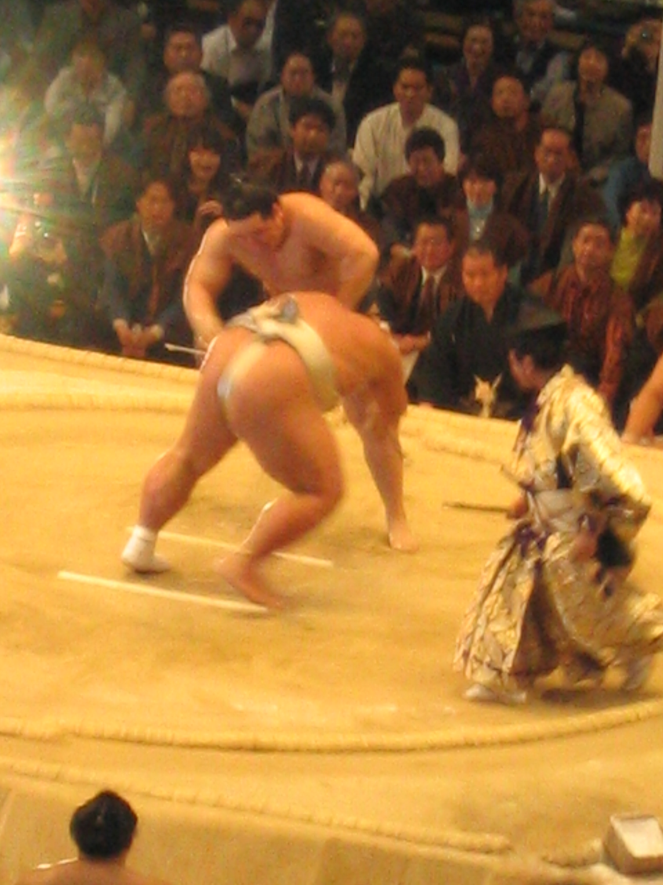

Slide 12
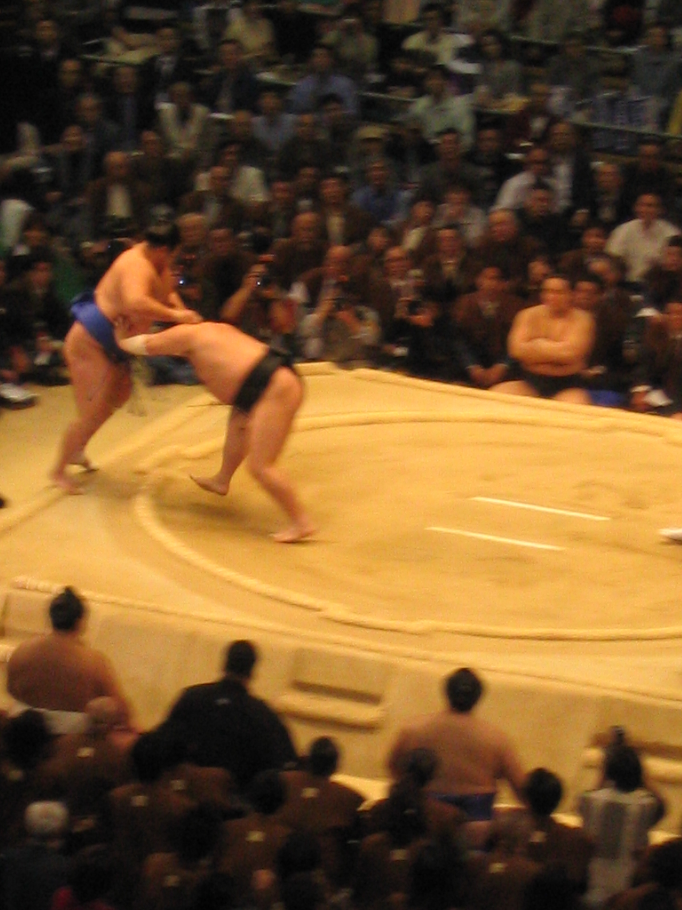

Slide 13
Big is not always better
The secret to sumo, even more important than weight, speed, and strength is:
GOOD technique and BALANCE.
* A large wrestler may be strong and able to push his opponent out of the ring, but if he loses his balance and falls first, he loses the bout.

Slide 14
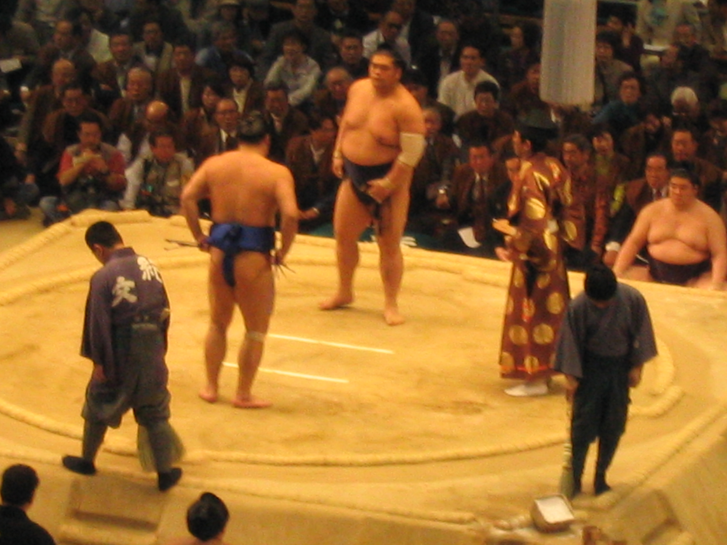

Slide 15
The Physique of a Sumo Wrestler
Although even the smaller wrestlers are fairly big, don’t mistake them for being fat!
Wrestlers do need a layer of fat to absorb the
impact of falling, but underneath the soft
tissue lies rock hard muscles.
* Most wrestlers have solid muscular arms & legs.
* They are extremely strong & agile athletes.
Some sumo wrestlers actually have a lower body fat percentage than the average businessman.

Slide 17
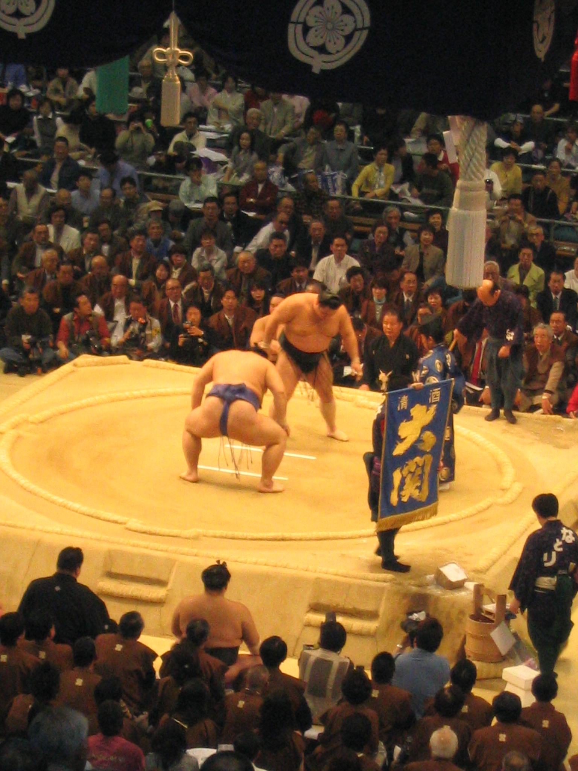

Slide 18
Encouragement money
Before some bouts, people walk around the ring (dohyo) holding tall banners.
Sponsors offer extra prize money for the winner of bouts when popular wrestlers or wrestlers of a very high rank are competing.
Each banner is worth approximately $300
Sometimes between 20-30 banners from various sponsors are walked around the ring.

Slide 19
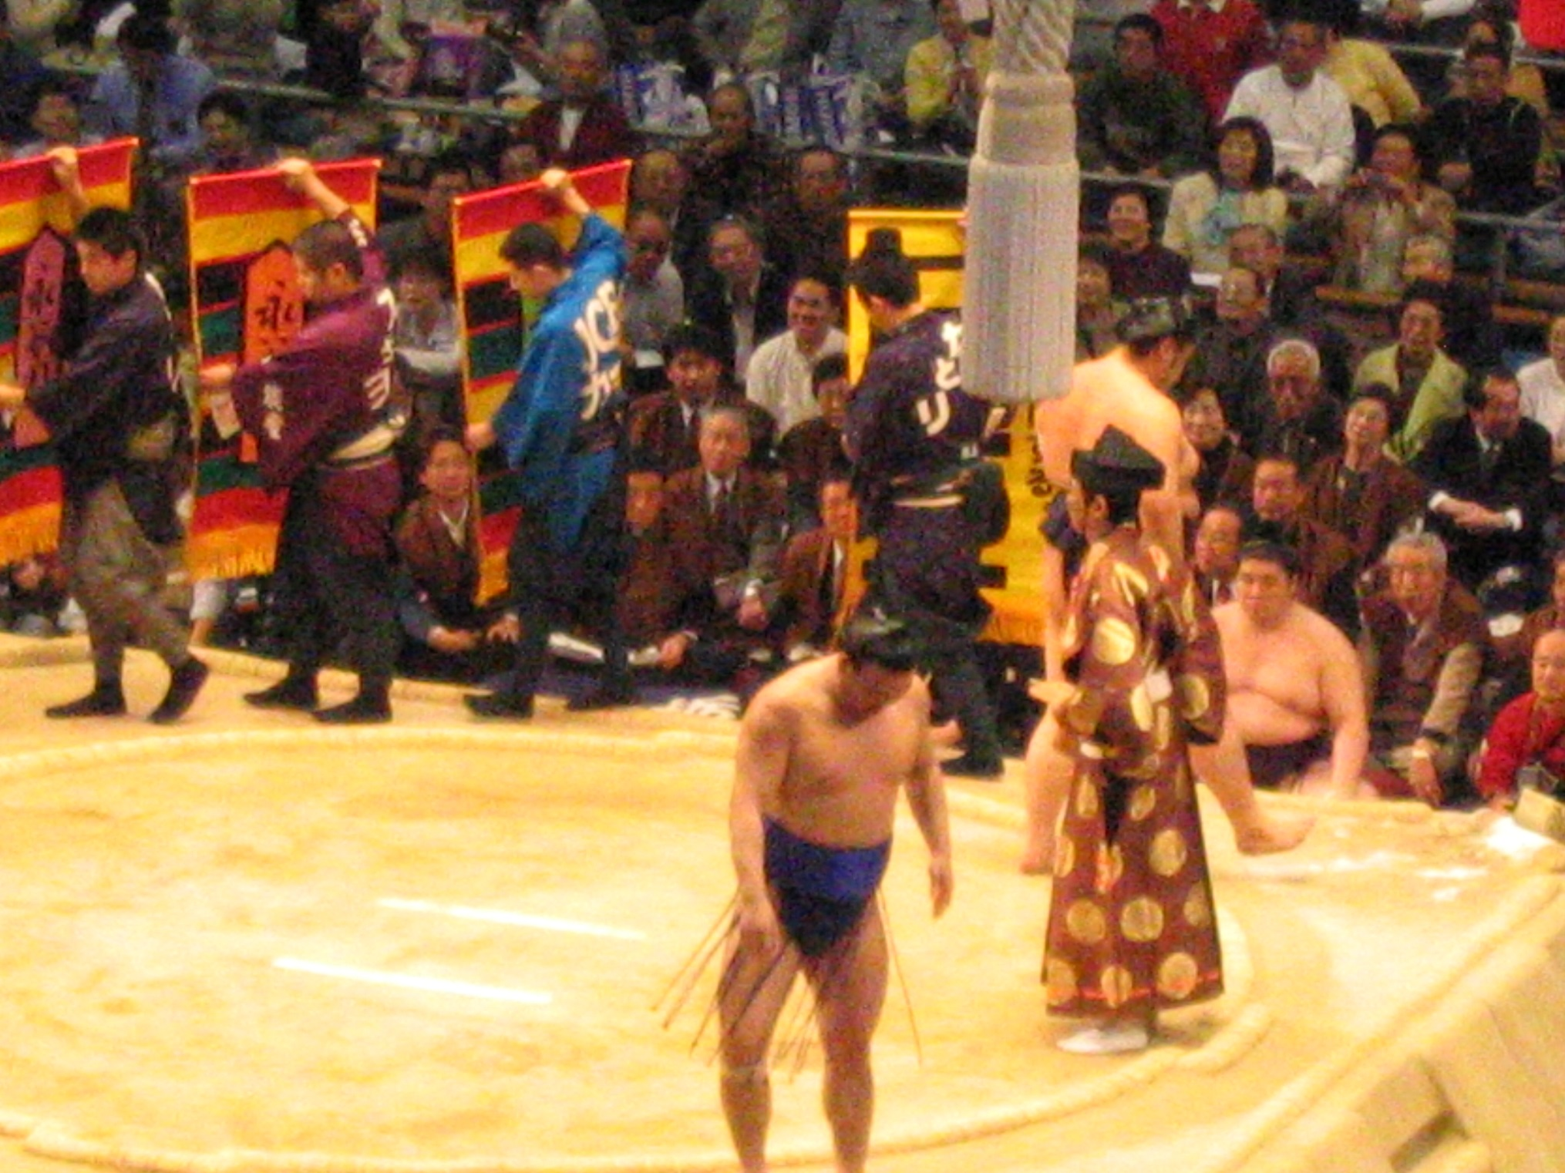

Slide 20
Tournament Prize Money
Fighting Spirit Award $20 000
Technique Award $20 000
Outstanding Performance Award $20 000
The winner of the tournament gets $100 000

Slide 21
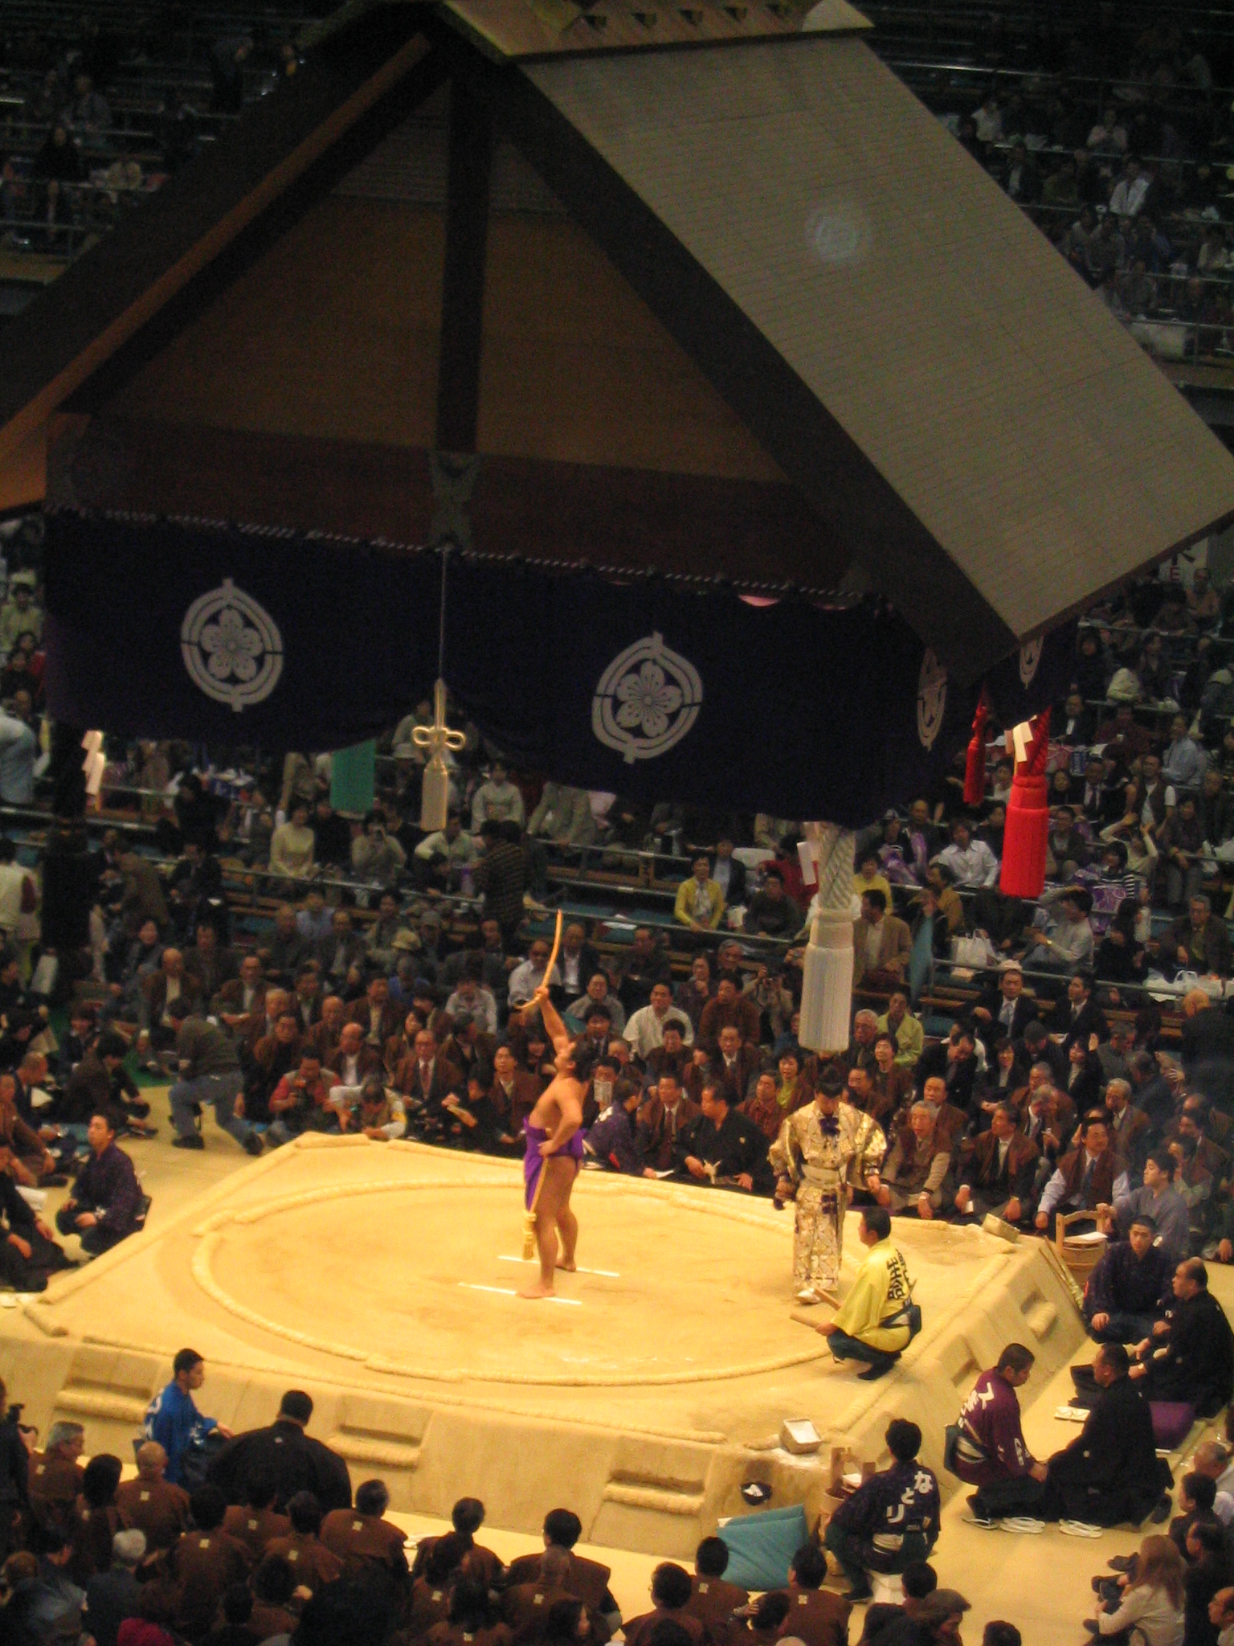

Slide 22
The Bow Twirling Ceremony
This ceremony is performed at tournaments after the last bout of the makuuchi division.
This ceremony is considered a gesture of appreciation on behalf of the victorious wrestlers of the day.
The performer of this ceremony (yumitori shiki) is generally a wrestler from the same stable as a yokozuna.

Slide 23
