Slide 1
Ten & Maru Sound Changes は ば ぱ

Slide 2
は ば ぱ
Ten ten (two lines)
Maru (small circle)
change the sounds of regular hiragana and katakana to make more sounds.
Use the following rhyme to help you remember how to change the sounds.

Slide 3
1.Kind Grandma

Slide 4
Kind Grandma
K + ゛→ G
かきくけこ がぎぐげご
Ka ki ku ke ko ga gi gu ge go

Slide 5
は ば ぱRules
1st Rule: Kind Grandma

Slide 6
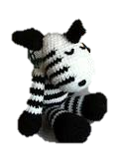
Sleepy Zebra

Slide 7
Sleepy Zebra
S + ゛→ Z
さしすせそ ざじずぜぞ
sa shi su se so za zi(ji) zu ze zo

Slide 8
は ば ぱRules
1st Rule Kind Grandma
2nd Rule Sleepy Zebra

Slide 9
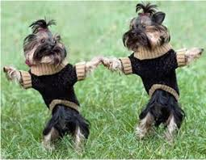
Tapping dogs

Slide 10
Tapping dogs
T + ゛→ D
たちつてと だぢづでど
ta ti(chi) tsu te to da di(ji) zu de do

Slide 11
は ば ぱRules
1st Rule Kind Grandma
2nd Rule Sleepy Zebra
3rd Rule Tapping Dogs

Slide 12
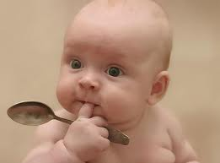
Hungry Baby

Slide 13
Hungry Baby
H + ゛→ B
はひふへほ ばびぶべぼ
ha hi hu he ho ba bi bu be bo

Slide 14
は ば ぱRules
1st Rule Kind Grandma
2nd Rule Sleepy Zebra
3rd Rule Tapping Dogs
4th Rule Hungry Baby

Slide 15
Happy puppy

Slide 16
Happy puppy
H + ゜→ P
はひふへほ ぱぴぷぺぽ
ha hi hu he ho pa pi pu pe po

Slide 17
1st Rule Kind Grandma
2nd Rule Sleepy Zebra
3rd Rule Tapping Dogs
4th Rule Hungry Baby
5th Rule Happy Puppy

