Slide 1
Teru Teru bozu
Learning Criteria: I have learned the particular belief that Japanese people or students have in winter or in rainy season.
Success Criteria: I can use my language and kinaesthetic skills to learn about Japanese culture.

Slide 2
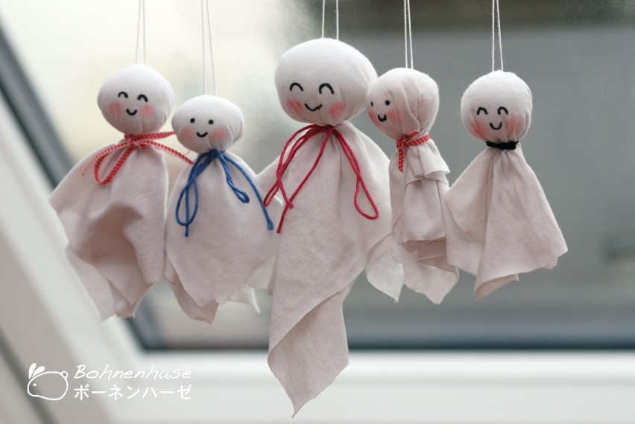
てるてるぼうず
It is a traditional handmade doll made out of White tissue paper that Japanese farmers began hanging outside of their window by a string.
It is a shape of ghost dolls. This talisman is supposed to have magical powers to bring good weather and to stop or prevent a rainy day.
Teru means sunshine. Bozu is a Buddhist monk.
Notes:
20 mins to note this down and show a littler anime to see how Japanese students view it these days.

Slide 3
Teru Teru bozu song
This is a song they sing as they hang their dolls in the window. Listen and now let’s sing together.
Play it once and sing it together, verse by verse.
https://www.youtube.com/watch?v=pnxMcNPE3Z4

Slide 4
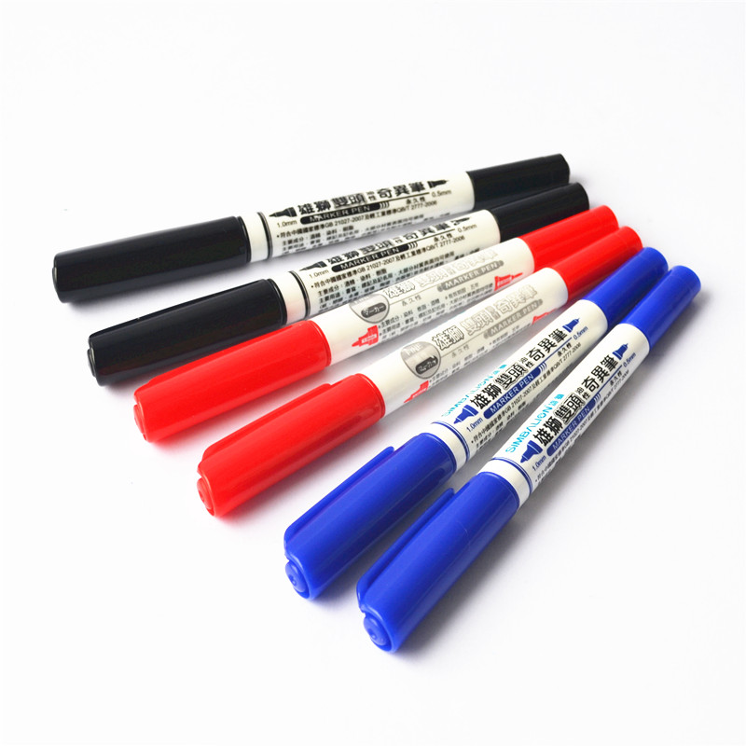
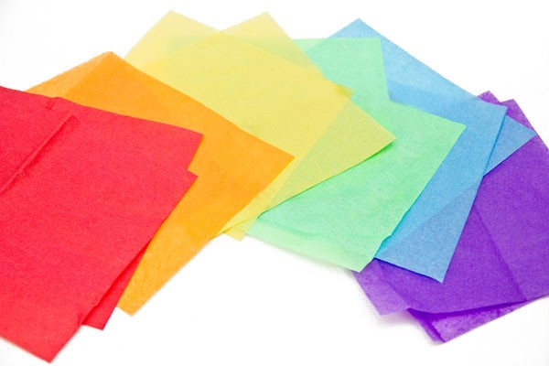
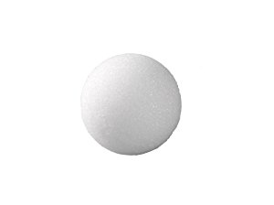
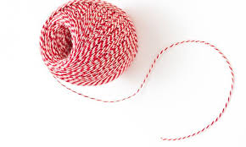
What do you Need?
Stereo foam ball, Tissue paper, String or a ribbon, marker
Notes:
Each students come up in a line and get it for their pair. They need to come in pairs.

Slide 5
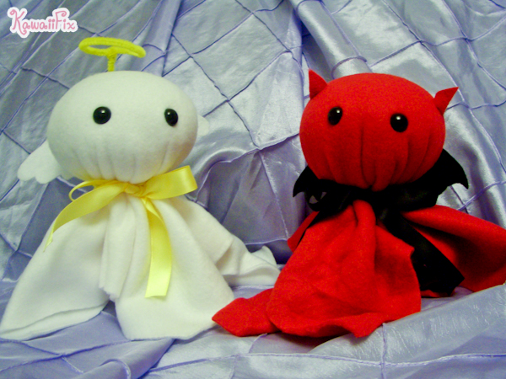
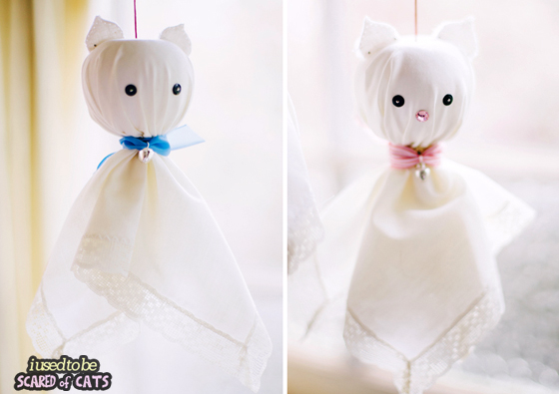
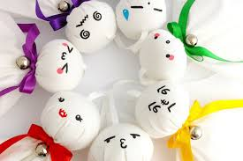
How to make teru teru bozu
Place a stereo foam ball in the centre of a square of white tissue paper.
Pull the material tight around the ball and secure with wool/string. Leave an overlap of string as this how you will hang up your doll.
Draw a face and hang up! Your teru teru bozu is now ready to deter the rain!
Notes:
20 mins

