Slide 1
運動会
うんどうかい
undookai

Slide 2
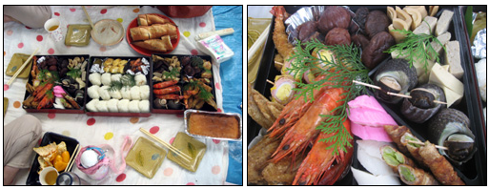
Undookai (うんどうかい) - fun sports day
held for more than 100 years
held nationally since 1964 Tokyo
Olympics
usually held in October (date of
opening ceremony of Tokyo Olympics )
weather in usually good in October
held on weekend - families can attend
picnic mat and lunches

Slide 3
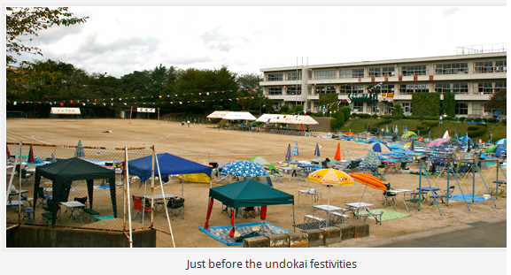

Slide 4
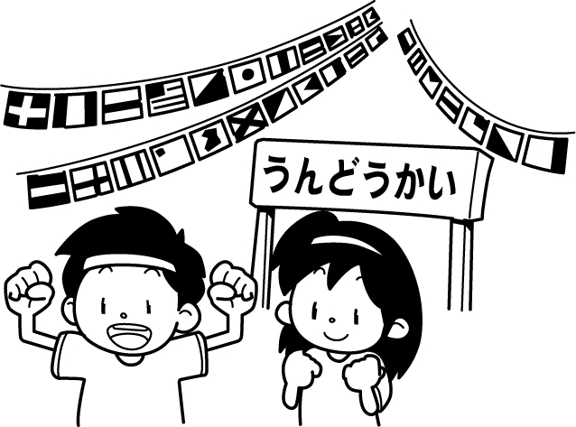
Athletic Events: individual and team

Slide 5
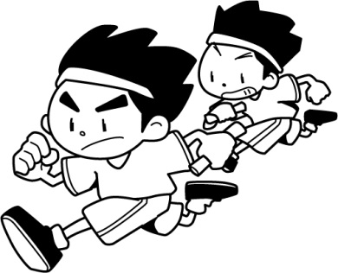
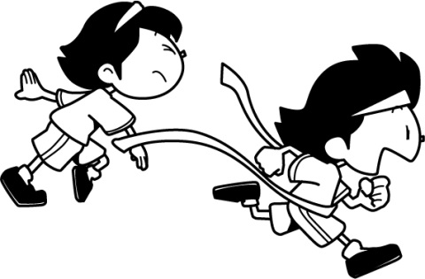
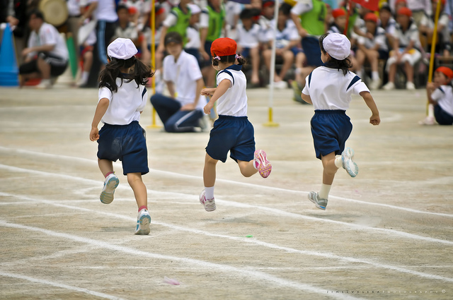
Running:
Compete against similar size and height, not always age

Slide 6
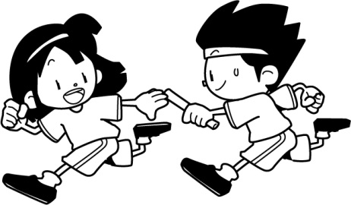
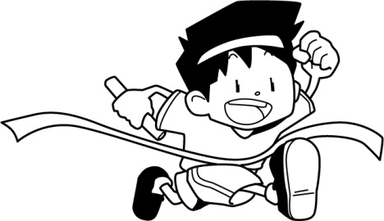
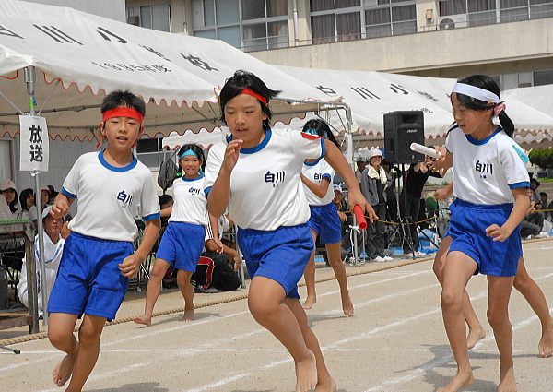
Relays:
can be each year level in the team – Year 1 – Year 6

Slide 7
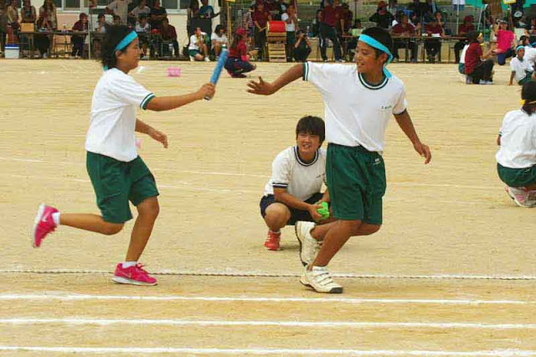

Slide 8
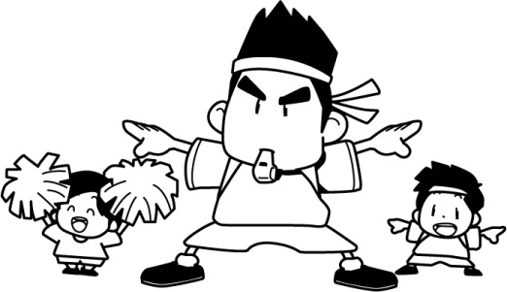
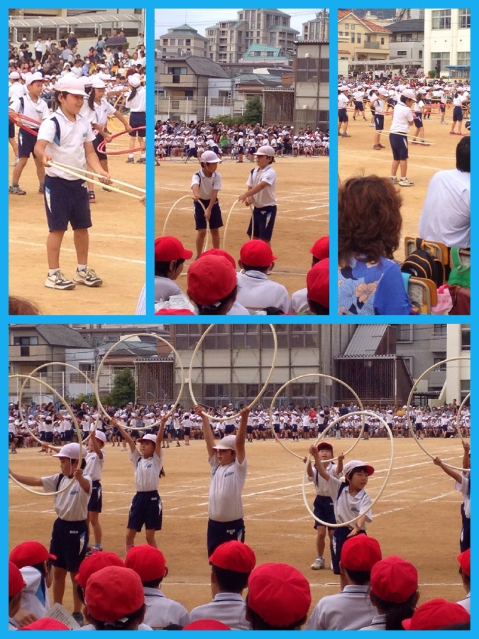
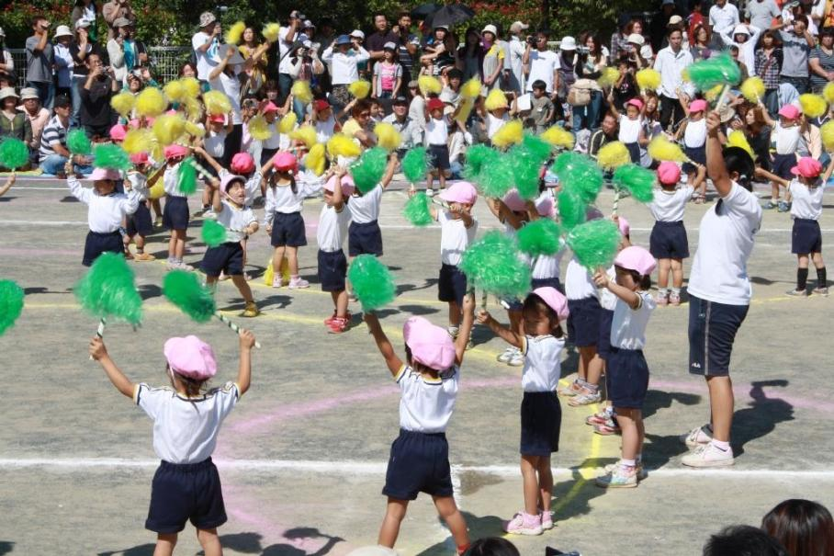
Displays:
Varies from school to school and from year to year – folk dances, cheer leading, gymnastic displays

Slide 9
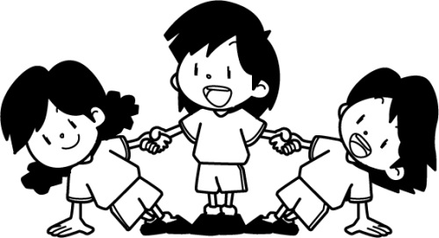
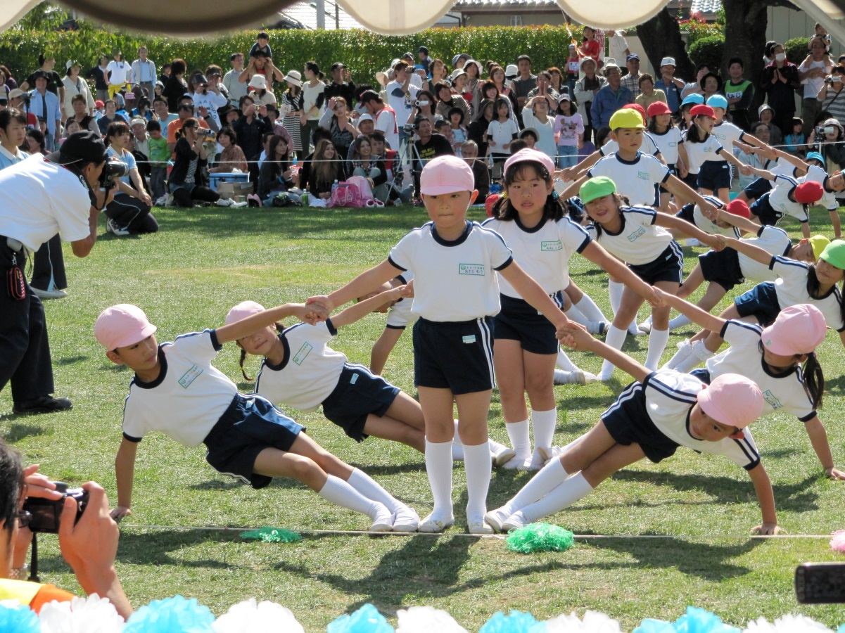

Slide 10
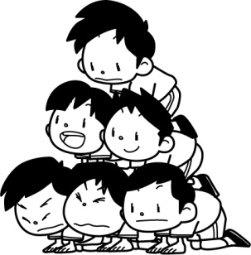
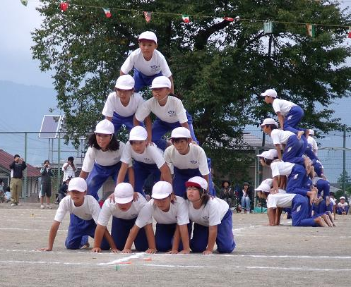
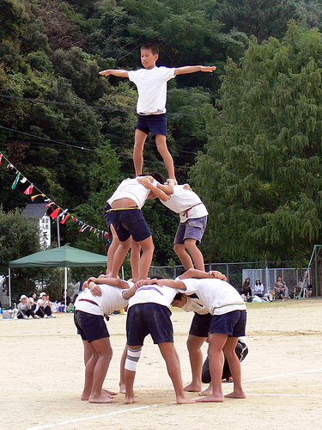
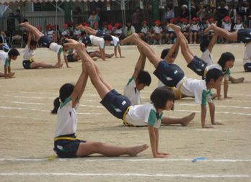
kumitaisoo:
くみたいそう
Group Gymnastics

Slide 11
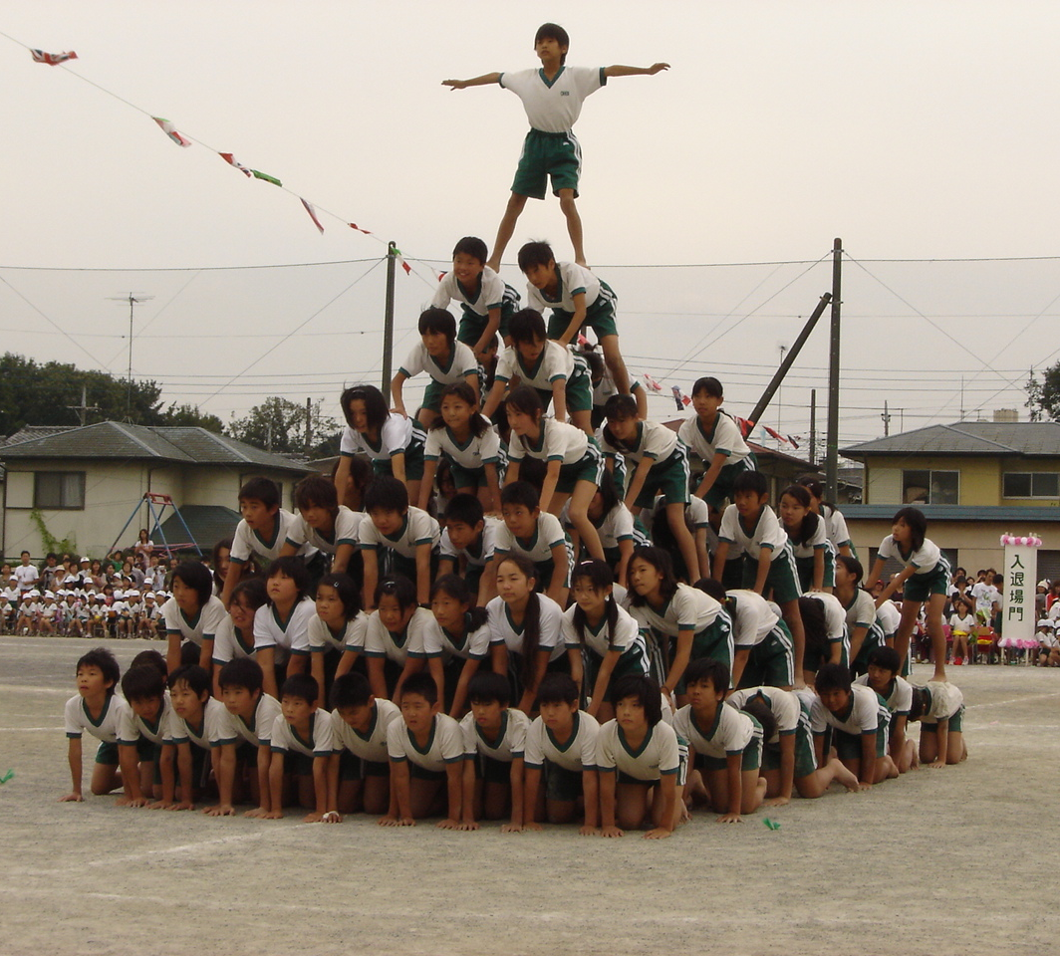

Slide 12
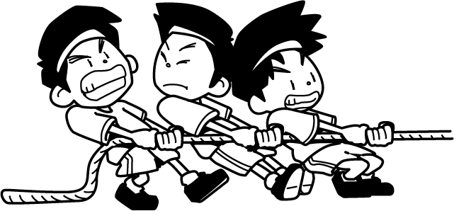
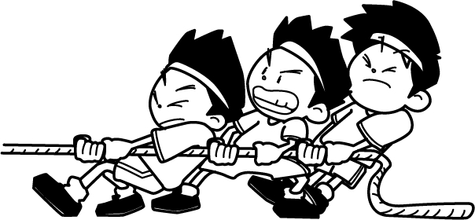
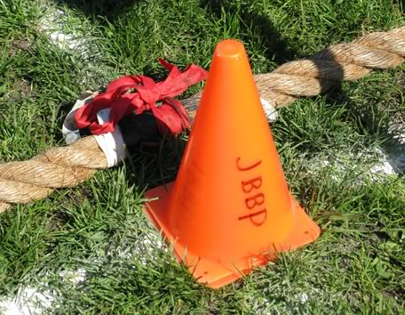
Novelty Events:
1. tsunahiki つなひき:
Tug of War

Slide 13
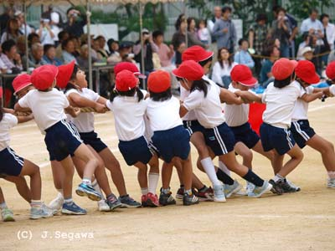
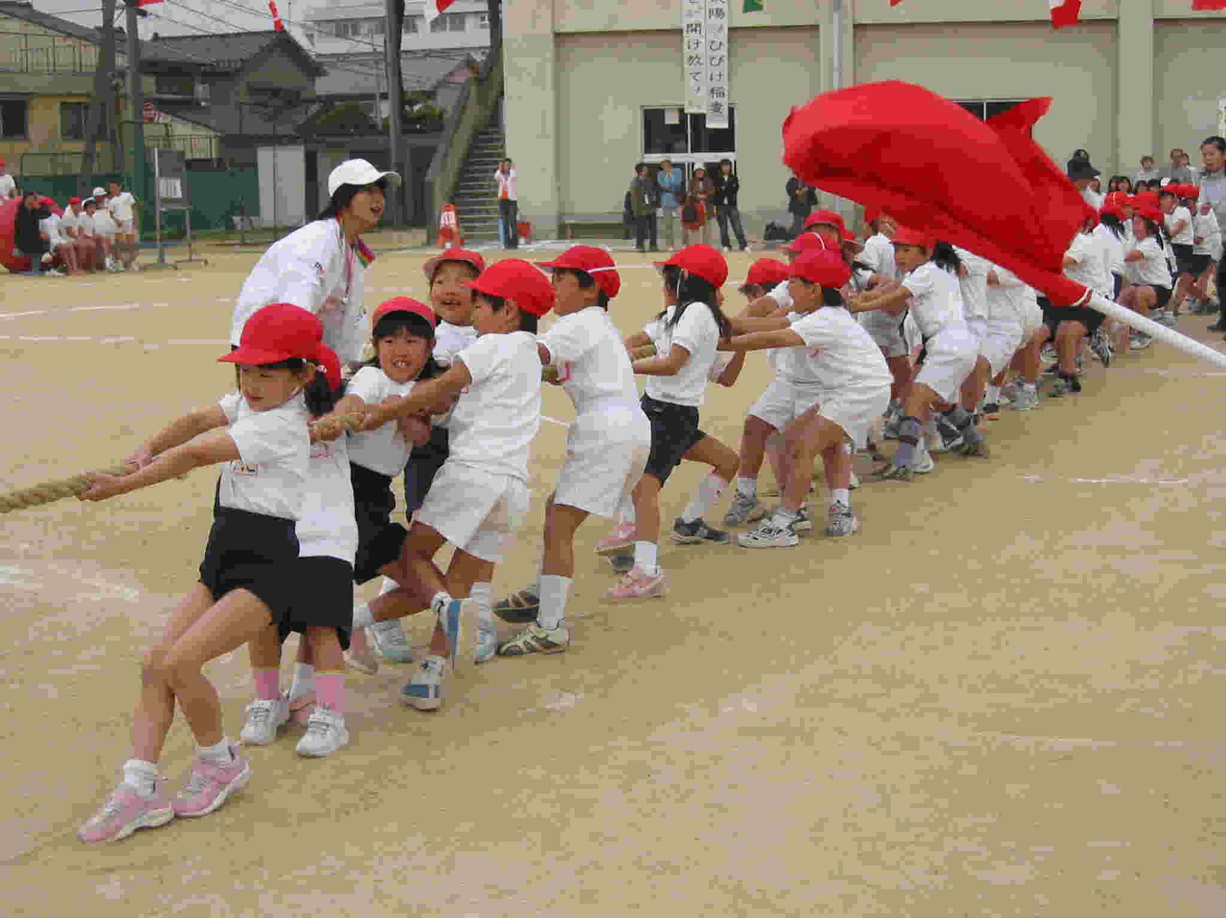
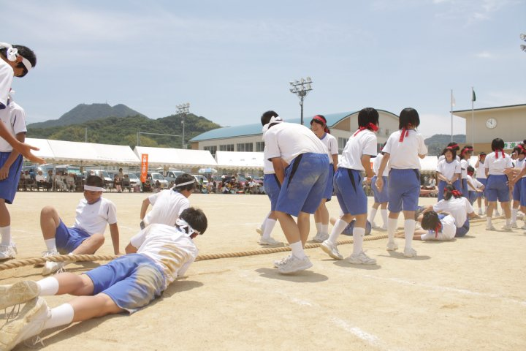

Slide 14
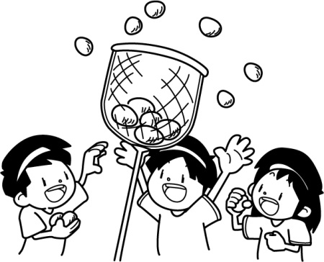
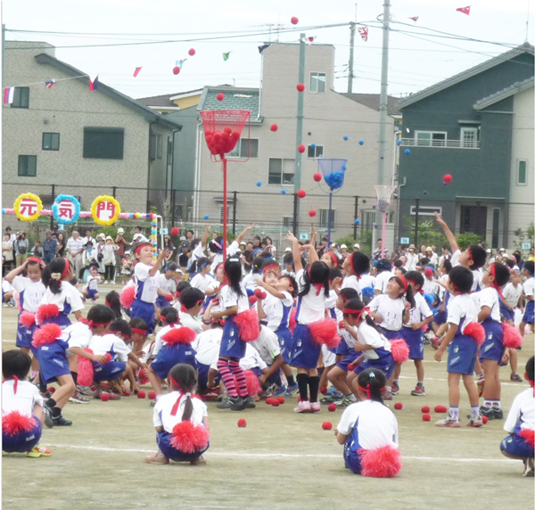
2. tamaire たまいれ:
Balls in the Basket
teams throw balls into baskets on the top of poles
at end of time limit, announcer counts as teams take a ball from the basket and throw it in the air
last team to still be throwing balls up is the winner

Slide 15
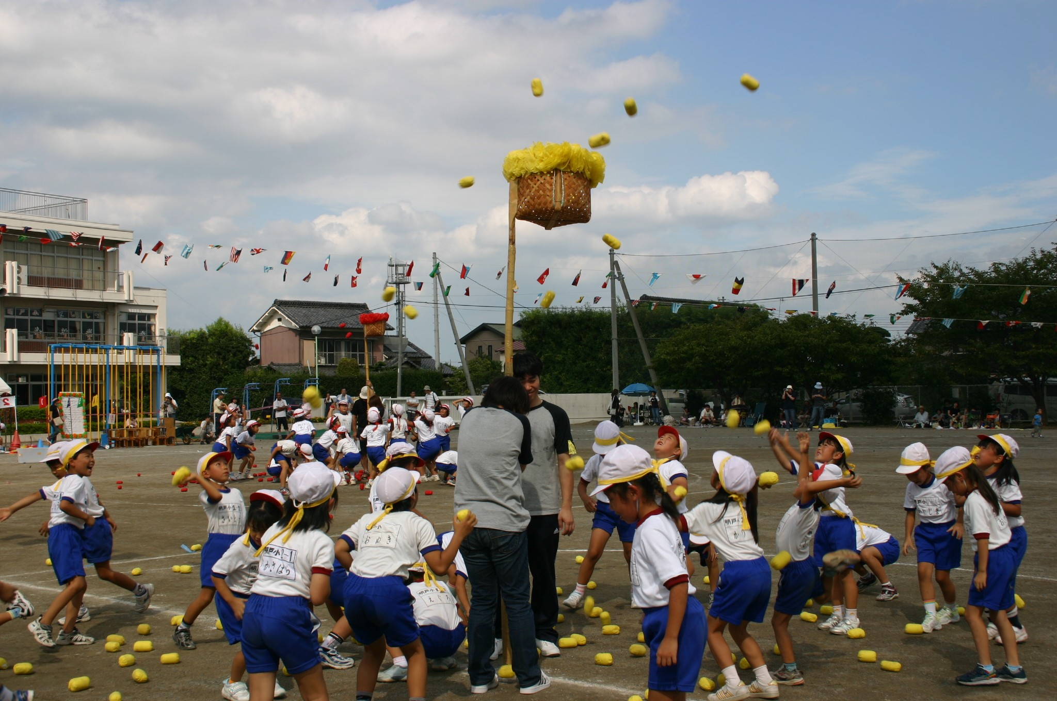

Slide 16
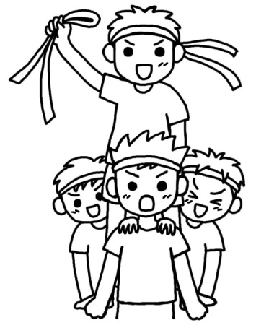
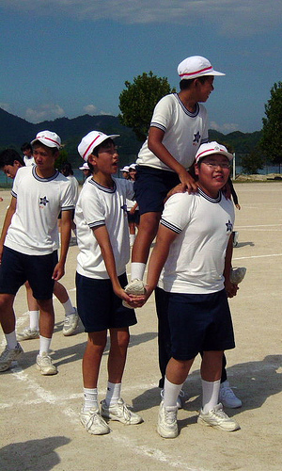
3. kibasen きばせん:
Cavalry Battle
teams have four member
three people form the horse
fourth person is the jockey
the jockey wears a hat or hachimaki
each team stands behind a designated line
on the referee’s whistle they enter the ring
the aim is to take the hat or hachimaki off an opposition jockey without losing his or her own

Slide 17
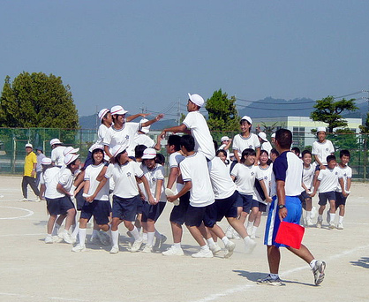

Slide 18
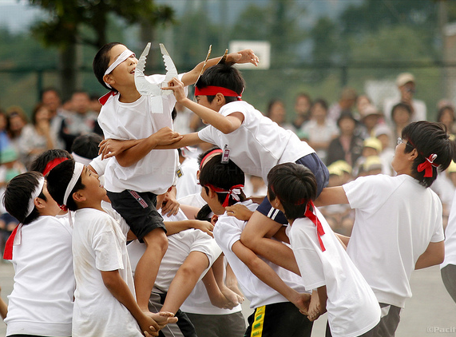

Slide 19
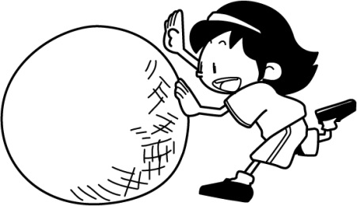
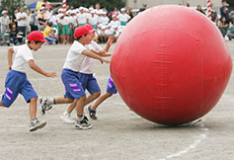
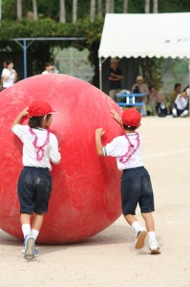
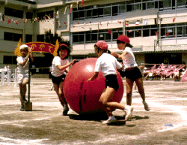
4. Ootama korogashi おおたま ころがし:
Roll the Ball
played as relay or individual race
generally rolled, but variations becoming more popular

Slide 20
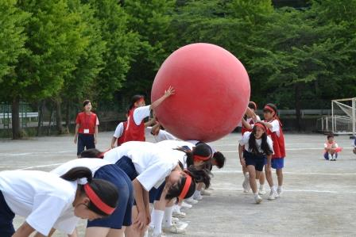

Slide 21
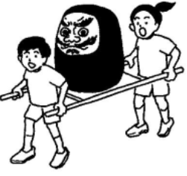
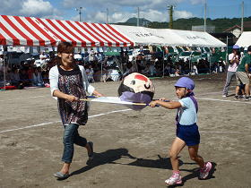
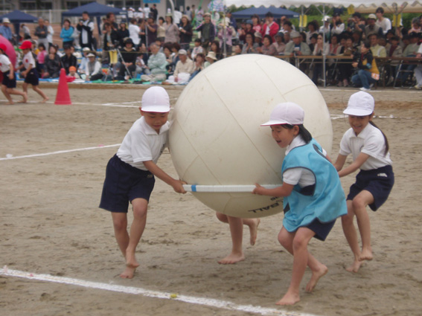
5. daruma hakobi だるま はこび:
Carry the Daruma
teams of two or more must carry a daruma or a stuffed toy on a litter or with large chopsticks
if the daruma falls off, the litter must be put on the ground and the daruma replaced before continuing

Slide 22
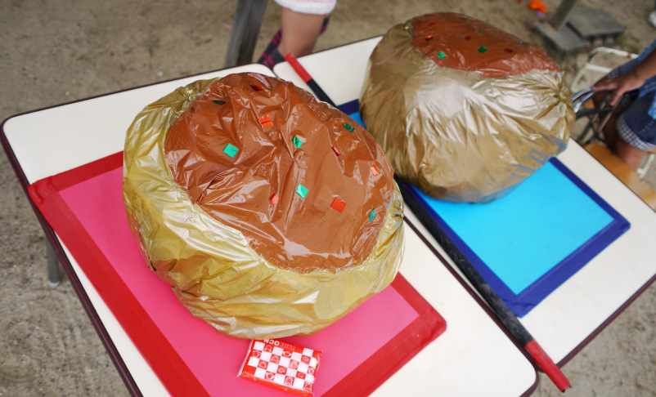
pretend takoyaki ready to be carried with chopsticks

Slide 23
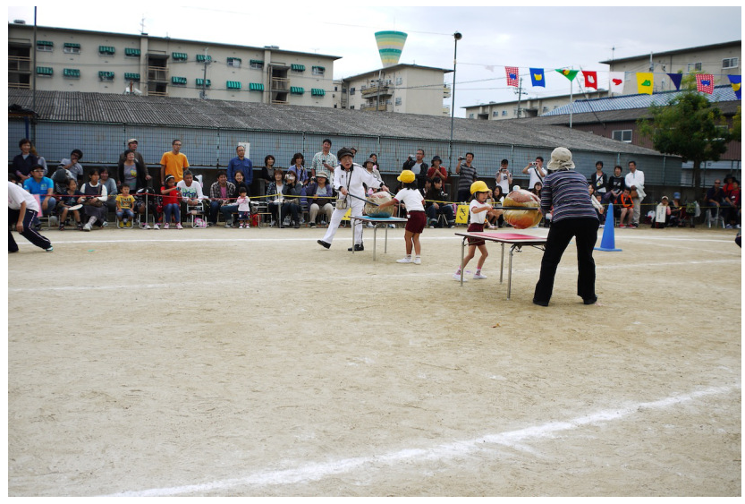
Pick it up and race!

Slide 24
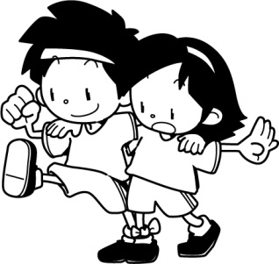
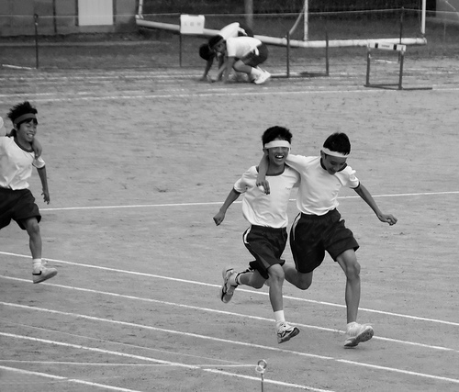
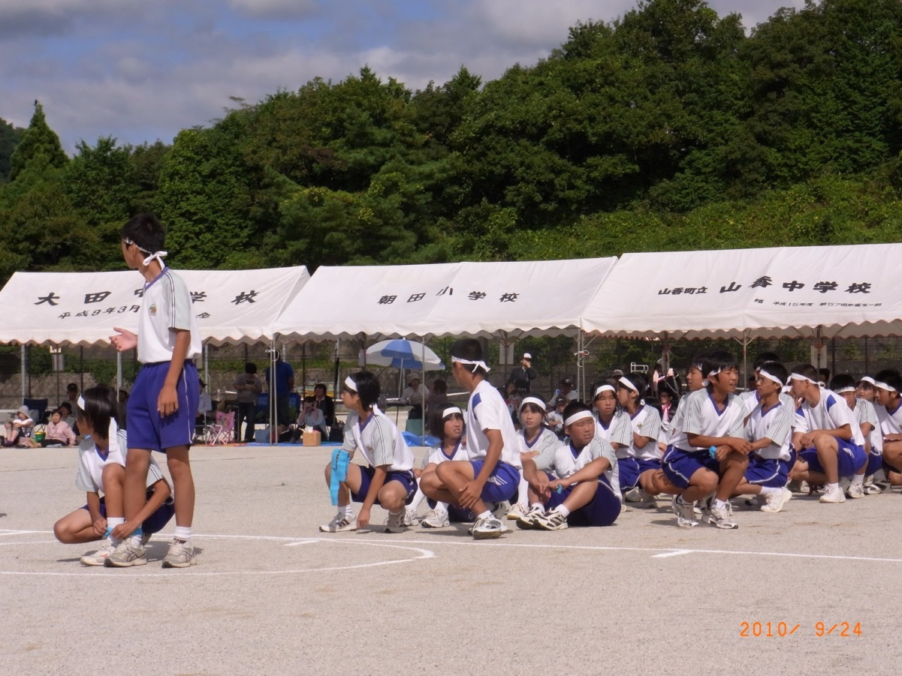
6. ninin sankyaku 二人 さんきゃく:
Three-legged Race
relay race
individual race

Slide 25
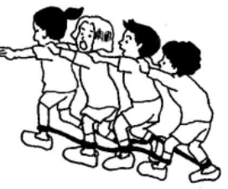
7. mukade kyoosoo むかで きょうそう:
Centipede Race
teams of three, five or more
each members right foot is tied together
then each members left foot is tied together
usually put hands on the shoulders of the person in front
also run as a relay

Slide 26
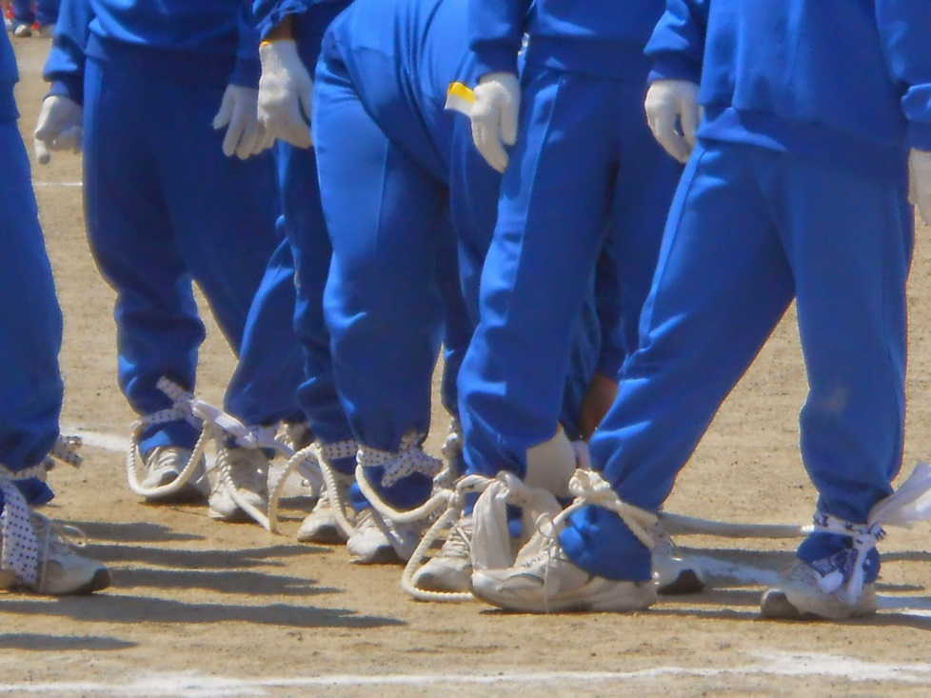
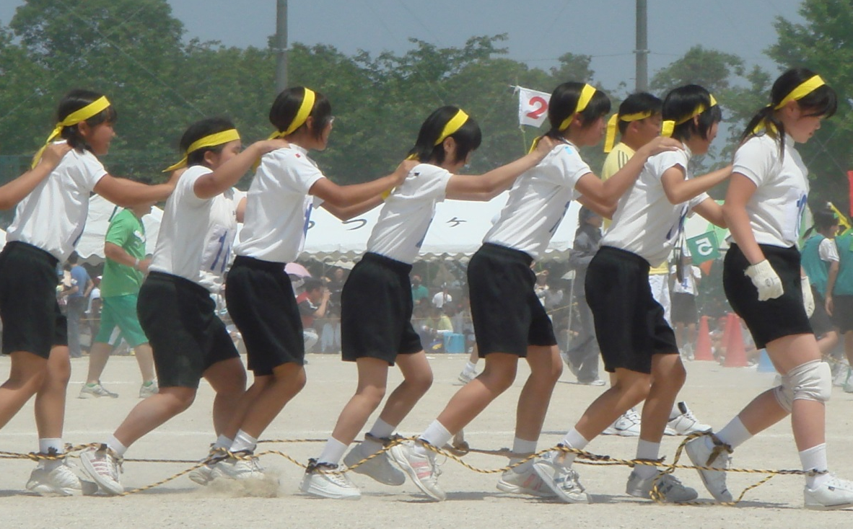
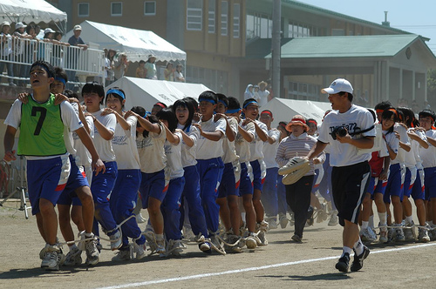

Slide 27
relay event

Slide 28
getting ready
7. takeuma たけうま:
Stilts
off and running
little ones too

Slide 29
Novelty Events:
family members (including grandparents) participate – helping the small children as well as their own special races

Slide 30
ばんざい! banzai!

Slide 31
BIBLIOGRAPHY:
Ideas Book 5 by Hiroko Nishibayashi Liston
Japanese Culture Resources and Activities by Karan Chandler
http://web-japan.org/kidsweb/explore/schools/q8.html
http://www.toss-mio.com/tsujino/undokai.htmhttp://www.kobun.co.jp/feature/aki/01.html
http://www.thejapanguy.com/my-first-elementary-school-undokai/
http://www.japanvisitor.com/japan-travel/japan-residents/undokai
http://stufflikemikans.blogspot.com.au/2009/09/undokai-sports-day.html
http://kansai-inochi.com/2013/01/18/undokai-sports-festival/
http://web-japan.org/kidsweb/manga/0710/index.html
http://blog.mikesryukyugallery.com/2012/09/scenes-from-junior-high-undokai.html
http://www.kobun.co.jp/feature/aki/01.html

