Slide 1
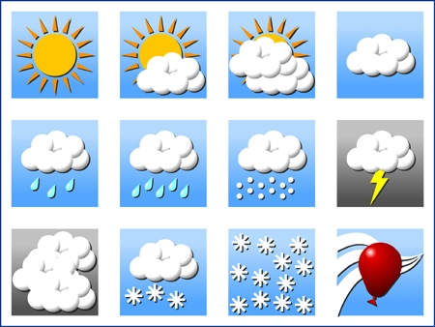
Tenki てんき weather

Slide 2
When you want to ask somebody what the weather is like, you use the following expression:
How is the weather?
てんき は どう です か？
Tenki wa dou desu ka?
topic particle is question marker
weather how

Slide 3
To answer that question is simple:
( weather or adjectives ) + desu.
Learn the following vocabulary about weather which will enable you to talk about weather in Japanese

Slide 4
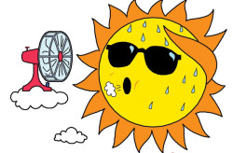
Atsui あつい hot

Slide 5
Atatakai あたたかい warm

Slide 6
Hare はれ sunny

Slide 7
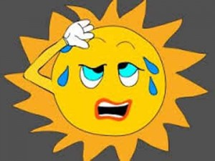
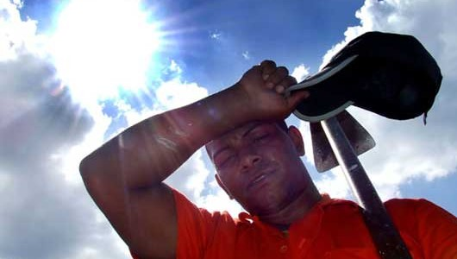
mushiatsui むしあつい muggy; hot and humid

Slide 8
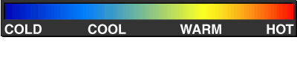
suzushii すずしい

Slide 9
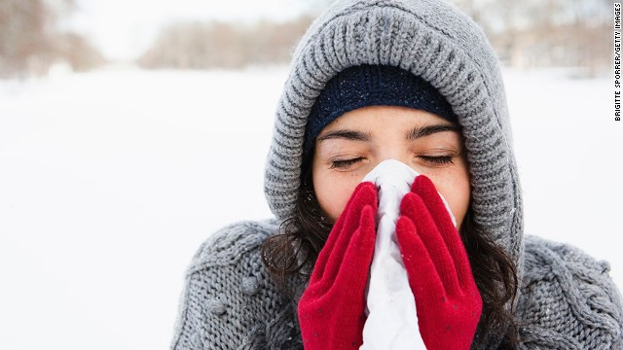
samui さむい cold

Slide 10
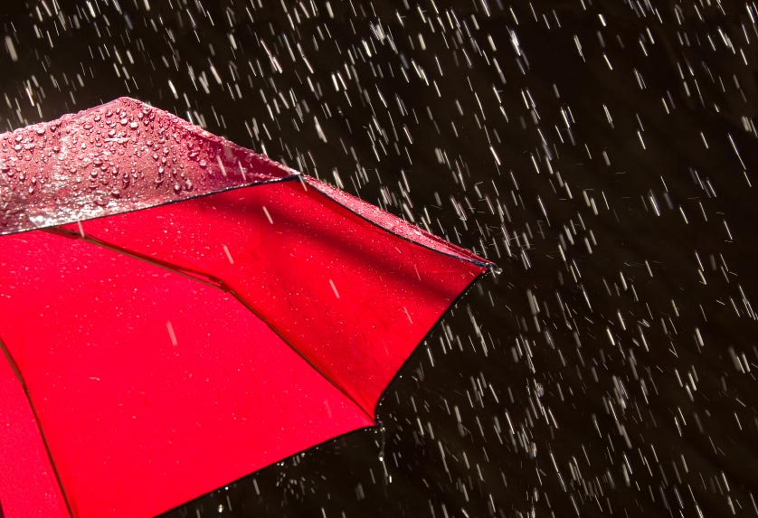
ame あめ rain

Slide 11
kumori くもり cloudy

Slide 12
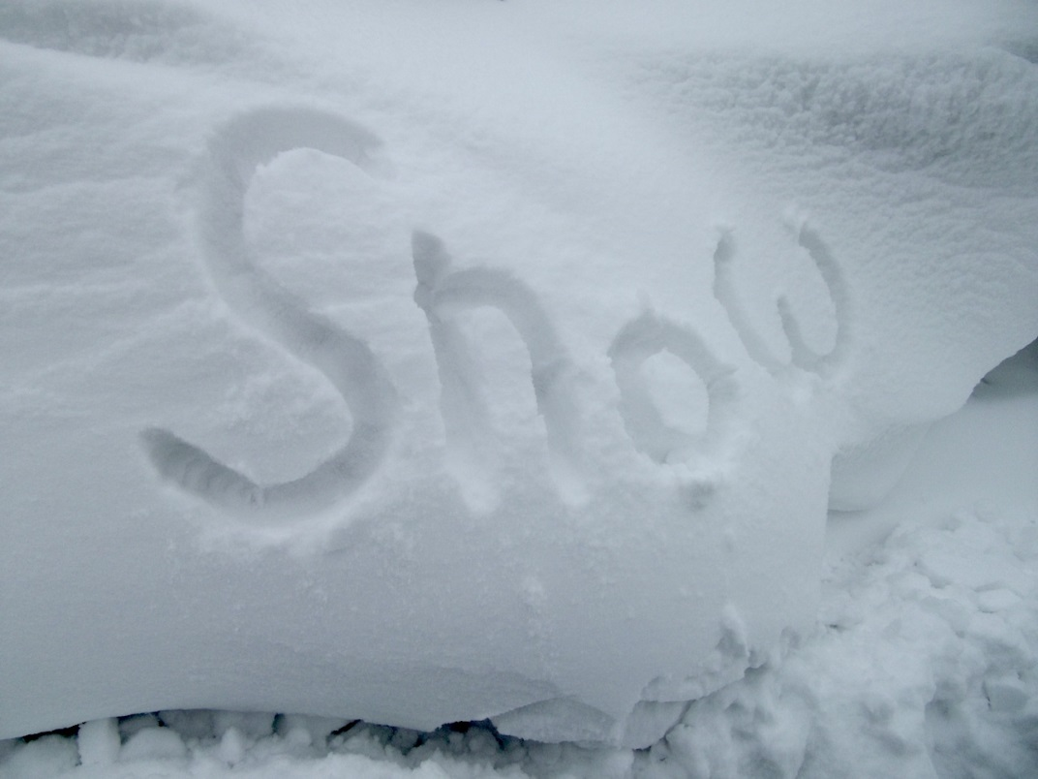
Yuki ゆき snow

