Slide 1
Manga 漫画

Slide 2
What is Manga?
Manga 漫画 is a Japanese word.
- man 漫 = fanciful; with strange ideas
- ga 画 = pictures
Manga are like comics that tell stories in pictures and words.
In Manga anything can happen.
There is manga for children and manga for adults.

Slide 3
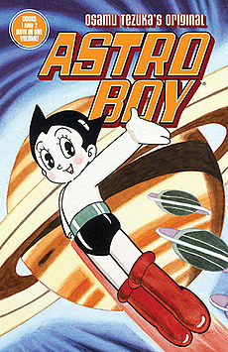
Do you know any manga artists 漫画家or manga 漫画?
TEZUKA Osamu 手塚治虫 is Japan’s most famous manga artist.
His manga include:
鉄腕アトム
Tetsuwan Atomu (Astro Boy)
ジャングル大帝
Janguru Taitei
(Jungle Emperor or
Kimba the White Lion)

Slide 4
Other well known manga漫画 are:
Naruto ナルトー
Written and illustrated by
KISHIMOTO Masashi
岸本斉史
Sailor Moon
美少女戦士セーラームーン(Bishoojo senshi Seeraamuun)
by TAKEUCHI Naoko
武内直子

Slide 5
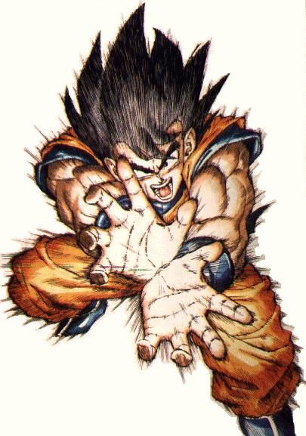
ドラゴンボール Dragon Ball by TORIYAMA Akira 鳥山明

Slide 6
How do you read Manga?
Like reading Japanese, you read manga from right to left.

Slide 7
There are close up scenes for special dramatic effects

Slide 8
Patterns, lines and shapes in the background help make a mood

Slide 9
Speed lines in the background put action into the picture and tell us something is moving

Slide 10
Impact pages with just one picture shout an idea

Slide 11
The shape of speech and thought bubbles help reflect a mood

Slide 12
Views & Expressions

Slide 13
Speech Bubbles

